Slide 1

Is there Evidence that
Jesus’ Resurrection actually took place?
Big Questions?

Slide 2



Slide 3


Slide 4
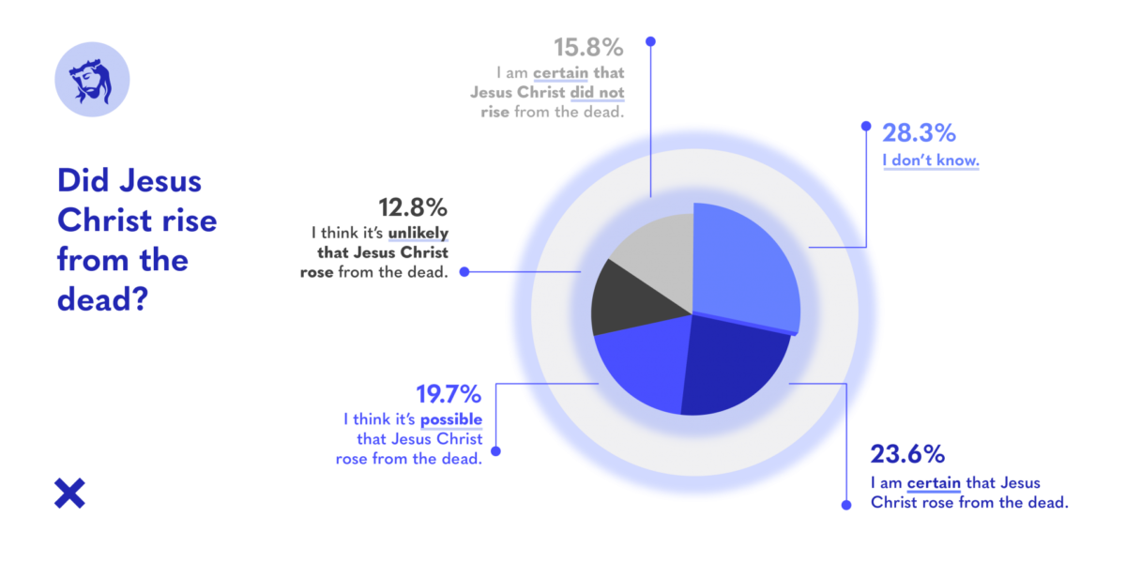

Slide 5
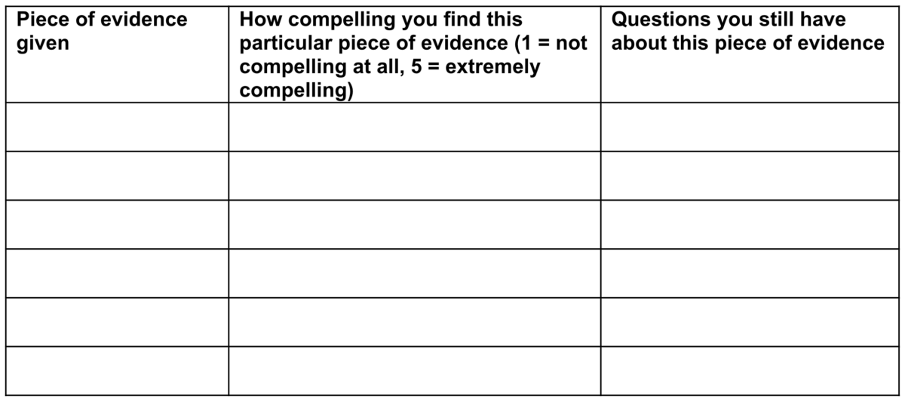

Slide 6
³ For what I received I passed on to you as of first importance: that Christ died for our sins according to the Scriptures, ⁴ that he was buried, that he was raised on the third day according to the Scriptures, ⁵ and that he appeared to Cephas, and then to the Twelve. ⁶ After that, he appeared to more than five hundred of the brothers and sisters at the same time, most of whom are still living, though some have fallen asleep. ⁷ Then he appeared to James, then to all the apostles, ⁸ and last of all he appeared to me also, as to one abnormally born.
1 Corinthians 15.3-8 (NIV)

Slide 7
¹⁴ And if Christ has not been raised, our preaching is useless and so is your faith. ¹⁵ More than that, we are then found to be false witnesses about God, for we have testified about God that he raised Christ from the dead. But he did not raise him if in fact the dead are not raised. ¹⁶ For if the dead are not raised, then Christ has not been raised either. ¹⁷ And if Christ has not been raised, your faith is futile; you are still in your sins. ¹⁸ Then those also who have fallen asleep in Christ are lost. ¹⁹ If only for this life we have hope in Christ, we are of all people most to be pitied.
²⁰ But Christ has indeed been raised from the dead, the firstfruits of those who have fallen asleep.
1 Corinthians 15.14-20 (NIV)

Slide 8



