Slide 1

Lesson 1: The Foundation of ‘Human Dignity’
Human Dignity

Slide 2
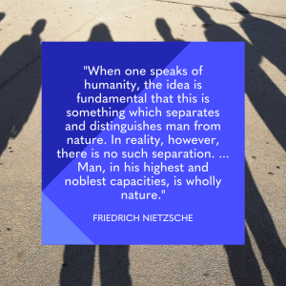


Slide 3
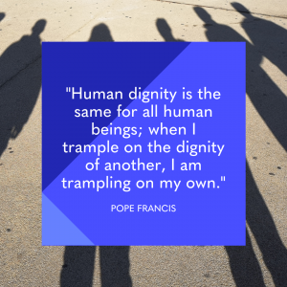

Slide 4
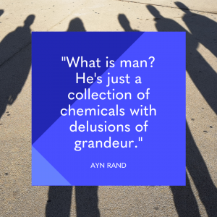

Slide 5
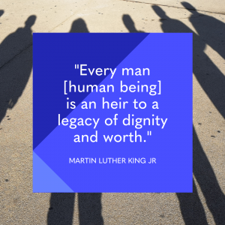

Slide 6
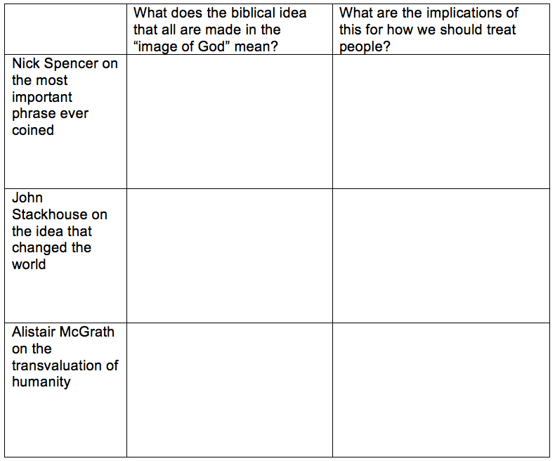

Slide 7
There is neither Jew nor Greek,
there is neither slave nor free,
there is no male and female,
for you are all one in Christ Jesus.
Galatians 3.28 (ESV)

