Slide 1

Lesson 3: The Dream of Racial Equality
Human Dignity

Slide 2


Slide 3


Slide 4


Slide 5
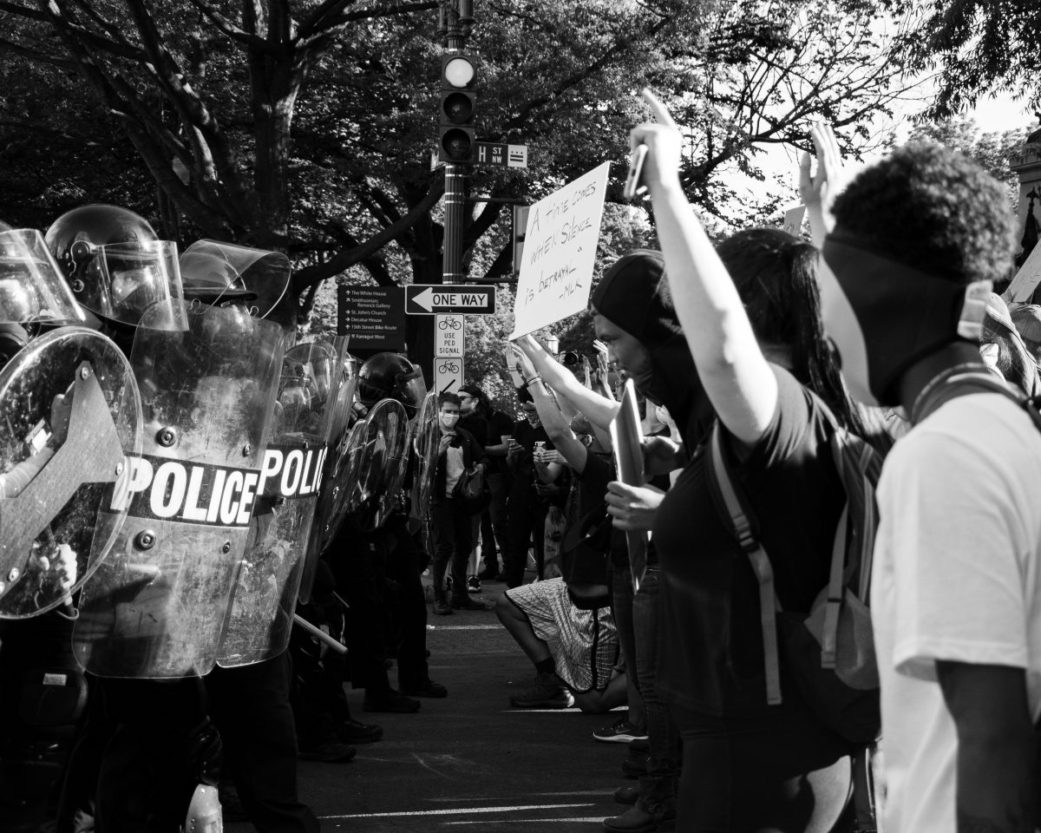

Slide 6
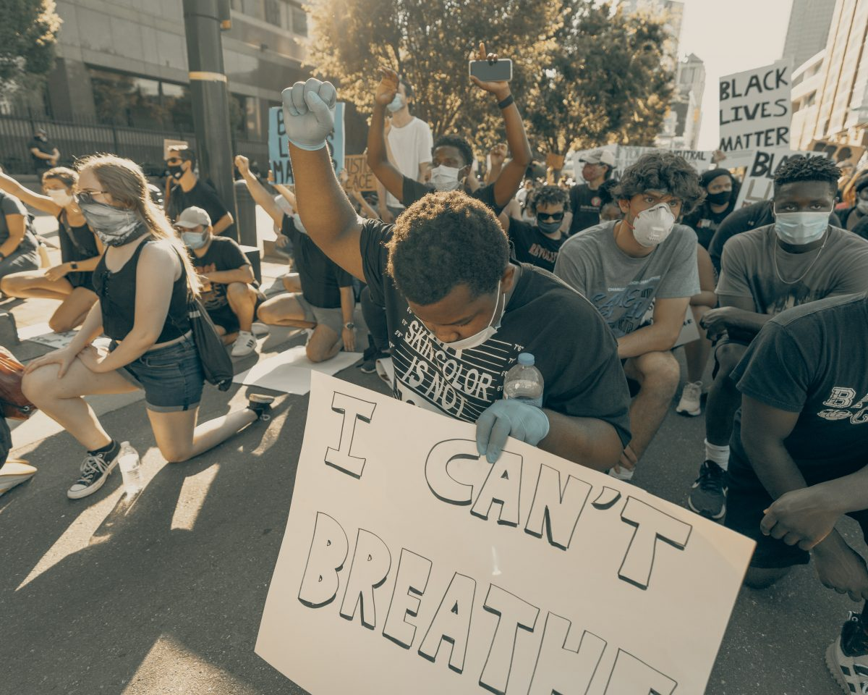

Slide 7


Sandra Liebenberg

