Slide 1

Lesson 4:
Dignity for the Marginalised
Human Dignity

Slide 2
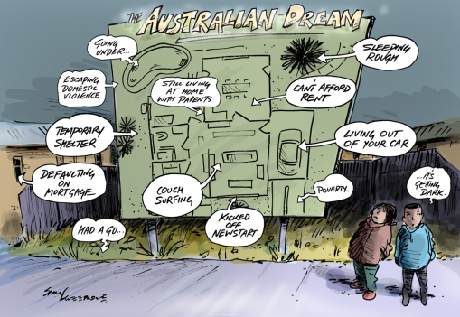

Slide 3
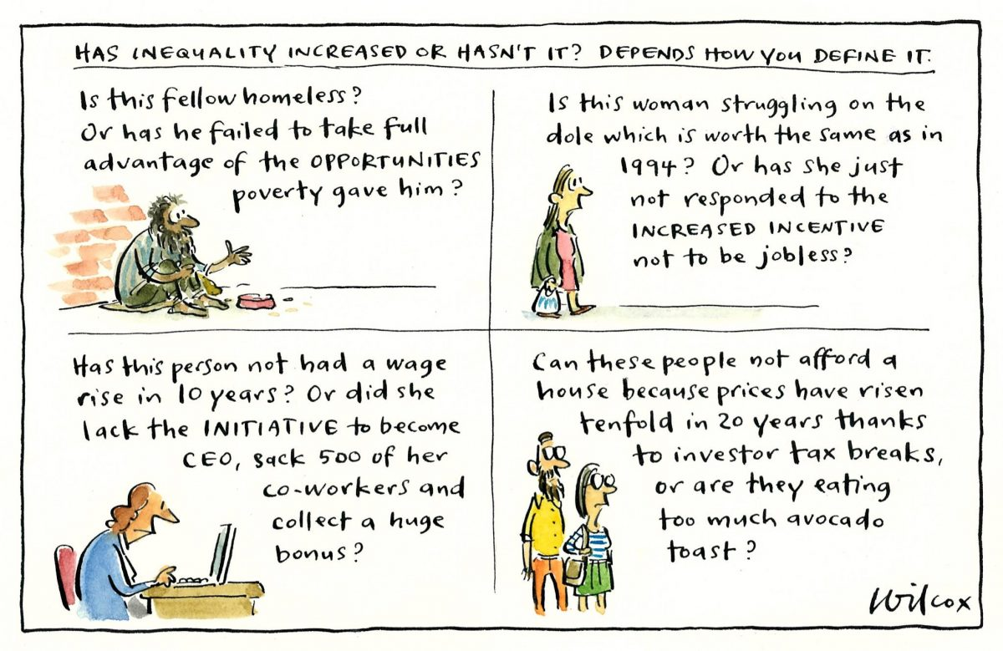

Slide 4
