Slide 1
Lesson 7: The Beginning of Life
Human Dignity

Slide 3
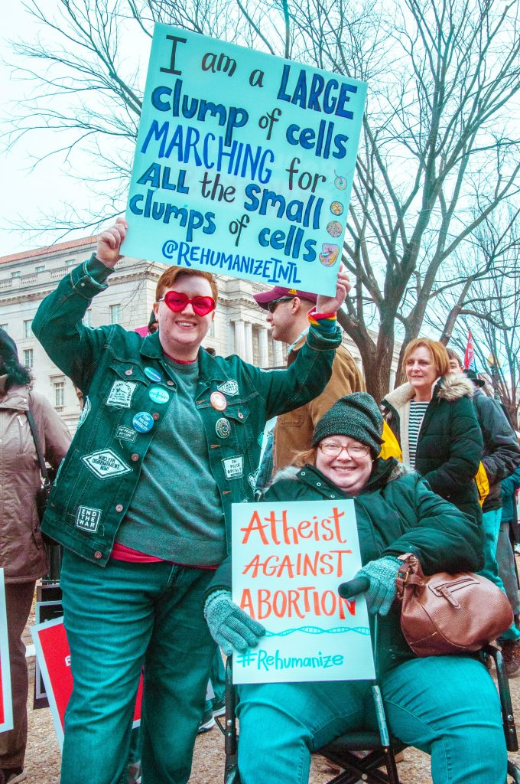

Slide 4
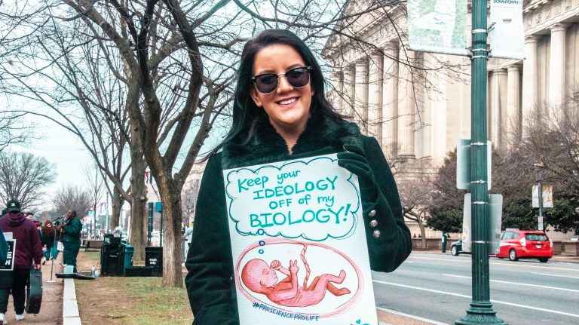

Slide 5
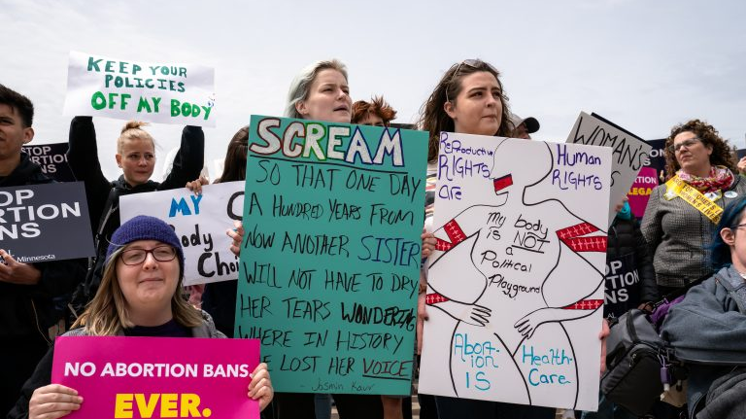

Slide 6
I think life starts…
at conception
at birth
sometime in between conception and birth
I don’t know

