Slide 1

HOLY WAR
For the Love of God
‘The Crusades’
Notes:
Title with Subtitle

Slide 2

Pineapple should never be found on Pizza
Bible verse goes here. Make the type smaller so it fits in this box.
Agree
Disagree
Notes:
Human Barometer Activity intro slide – delete the slides you don’t want

Slide 3
You can’t call chess
a sport
Bible verse goes here. Make the type smaller so it fits in this box.
Agree
Disagree
Notes:
Human Barometer Activity intro slide – delete the slides you don’t want

Slide 4
The moon landing never really happened
Bible verse goes here. Make the type smaller so it fits in this box.
Agree
Disagree
Notes:
Human Barometer Activity intro slide – delete the slides you don’t want

Slide 5
Marvel movies are an insult to our intelligence.
Bible verse goes here. Make the type smaller so it fits in this box.
Agree
Disagree
Notes:
Human Barometer Activity intro slide – delete the slides you don’t want

Slide 6
War is a necessary evil
Bible verse goes here. Make the type smaller so it fits in this box.
Agree
Disagree
Notes:
Human Barometer Activity – delete the slides you don’t want

Slide 7
Religion is responsible for most/all wars
Bible verse goes here. Make the type smaller so it fits in this box.
Agree
Disagree
Notes:
Human Barometer Activity – delete the slides you don’t want

Slide 8
Christians should never be pro-war
Bible verse goes here. Make the type smaller so it fits in this box.
Agree
Disagree
Notes:
Human Barometer Activity – delete the slides you don’t want

Slide 9
Caring for the needy is a responsibility that comes with wealth
Bible verse goes here. Make the type smaller so it fits in this box.
Agree
Disagree

Slide 10
A healthy society will always offer genuine care for the poor and needy
Bible verse goes here. Make the type smaller so it fits in this box.
Agree
Disagree

Slide 11
Jesus’ most significant teaching was that we should love and care for the needy
Bible verse goes here. Make the type smaller so it fits in this box.
Agree
Disagree

Slide 12
Religious people should spend more time helping people and less time talking about their religion
Bible verse goes here. Make the type smaller so it fits in this box.
Agree
Disagree

Slide 13
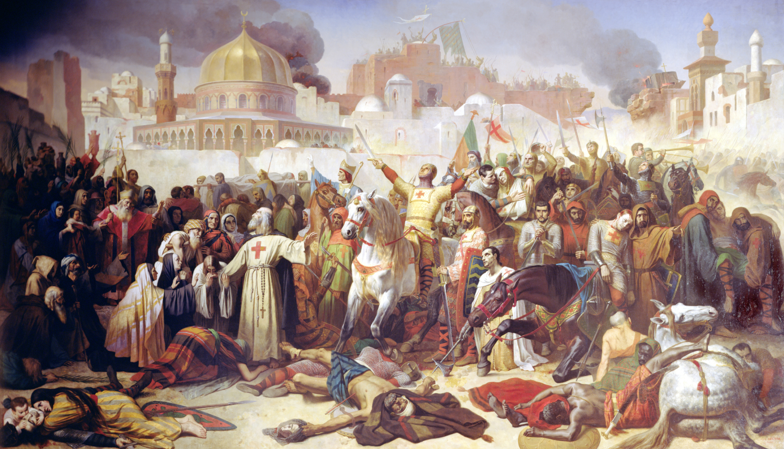
Émile Signol (1847) Taking of Jerusalem by the Crusaders, 15th July 1099
Notes:
Image for activity

Slide 14
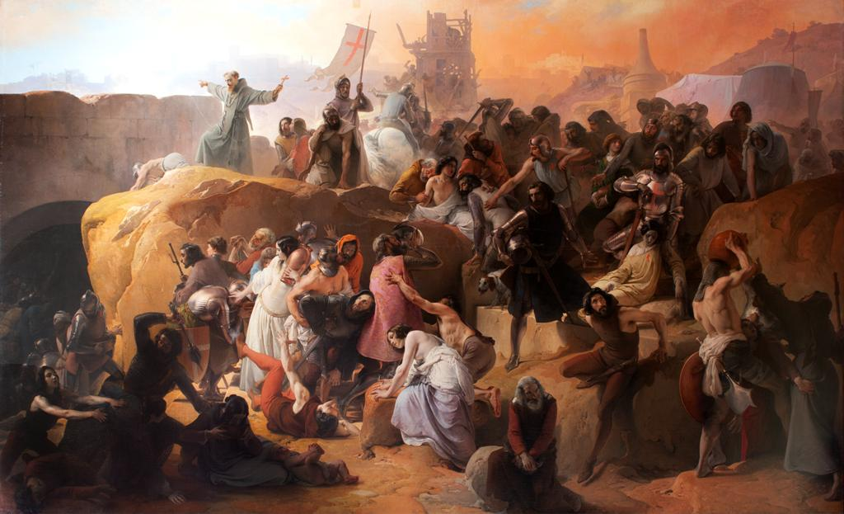
Francesco Hayez (1837) The thirst of the crusaders at Jerusalem

Slide 15
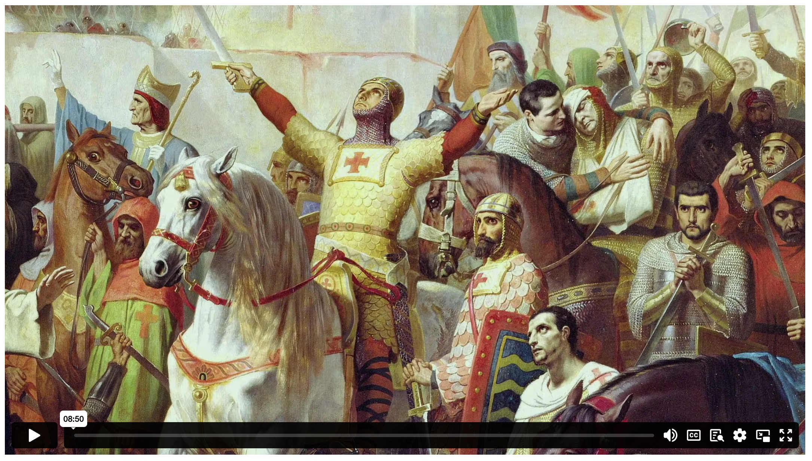
HOLY WAR: THE CRUSADES
Notes:
Holding/Final slide

Slide 16
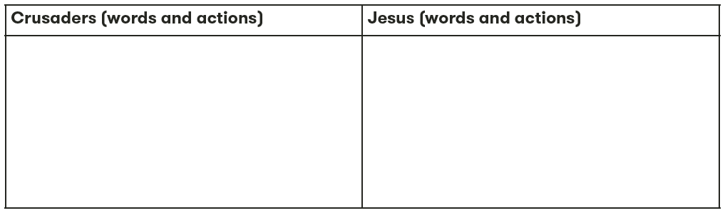

Slide 17
‘Were the Crusaders truly followers of Jesus?’

Slide 18
²⁷ ‘But to you who are listening I say: love your enemies, do good to those who hate you, ²⁸ bless those who curse you, pray for those who ill-treat you. ²⁹ If someone slaps you on one cheek, turn to them the other also. If someone takes your coat, do not withhold your shirt from them. ³⁰ Give to everyone who asks you, and if anyone takes what belongs to you, do not demand it back. ³¹ Do to others as you would have them do to you.
³² ‘If you love those who love you, what credit is that to you? Even sinners love those who love them. ³³ And if you do good to those who are good to you, what credit is that to you? Even sinners do that. ³⁴ And if you lend to those from whom you expect repayment, what credit is that to you? Even sinners lend to sinners, expecting to be repaid in full. ³⁵ But love your enemies, do good to them, and lend to them without expecting to get anything back. Then your reward will be great, and you will be children of the Most High, because he is kind to the ungrateful and wicked. ³⁶ Be merciful, just as your Father is merciful.
LUKE 6 (NIV)

Slide 19
“Do to others as you would have them do to you.”
LUKE 6.31 (NIV)

Slide 20
  DISCUSSION QUESTIONS:
  Do we have the right to judge the church today for historical events such as the Crusades?

Slide 21
  DISCUSSION QUESTIONS:
  Do we have the right to judge the church today for historical events such as the Crusades?
  The church at the time of the Crusades was influenced by warrior culture. Are there ways in which you think the church today might be affected by cultural factors that pull it away from Jesus’ original teachings?

Slide 22
  DISCUSSION QUESTIONS:
  Do we have the right to judge the church today for historical events such as the Crusades?
  The church at the time of the Crusades was influenced by warrior culture. Are there ways in which you think the church today might be affected by cultural factors that pull it away from Jesus’ original teachings?
  Is loving your enemies something that you personally try to practice? What does that look like for you?

Slide 23
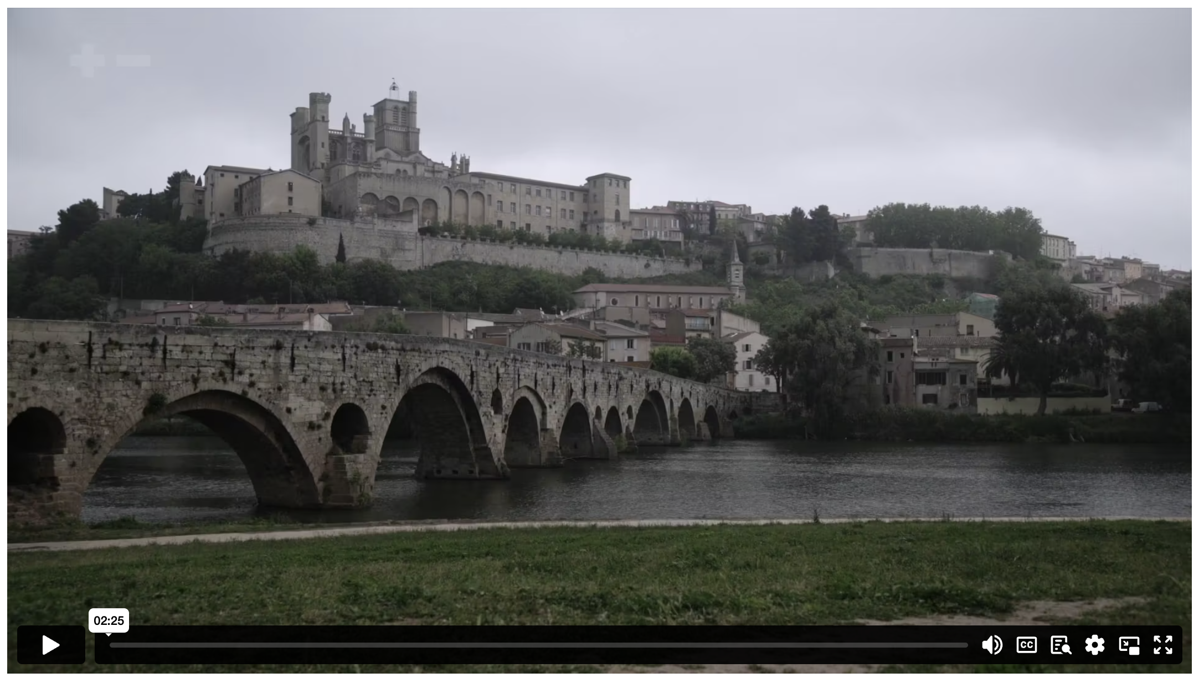
KILL THEM ALL: THE ALBIGENSIAN CRUSADE
Notes:
Holding/Final slide

Slide 24
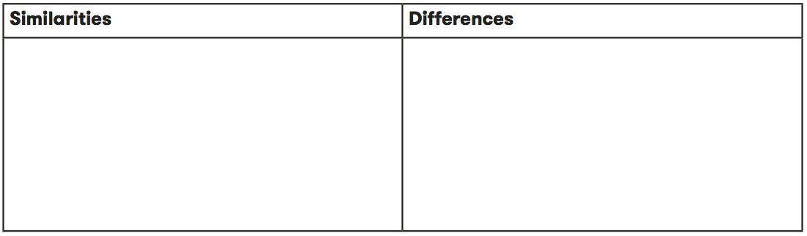
  EXTENSION

Slide 25
Notes:
Holding/Final slide

Slide 26
Notes:
Holding/Final slide

