Slide 1

ABOLITION
For the Love of God
William Wilberforce & The Slave Trade
Notes:
Title with Subtitle

Slide 2

  DISCUSSION QUESTIONS:
  Have you ever worn a wristband, ribbon, or something similar in support of a particular cause? Why did you choose to do it?
Notes:
Large discussion questions

Slide 3
  DISCUSSION QUESTIONS:
  Have you ever worn a wristband, ribbon, or something similar in support of a particular cause? Why did you choose to do it?
  Do you have any causes that you are passionate about? Why?
Notes:
Large discussion questions

Slide 4
  DISCUSSION QUESTIONS:
  Have you ever worn a wristband, ribbon, or something similar in support of a particular cause? Why did you choose to do it?
  Do you have any causes that you are passionate about? Why?
  What does “freedom” mean to you?
Notes:
Large discussion questions

Slide 5
  DISCUSSION QUESTIONS:
  Have you ever worn a wristband, ribbon, or something similar in support of a particular cause? Why did you choose to do it?
  Do you have any causes that you are passionate about? Why?
  What does “freedom” mean to you?
  Do you think the Christian Church is concerned about freedom for the oppressed?
Notes:
Large discussion questions

Slide 6
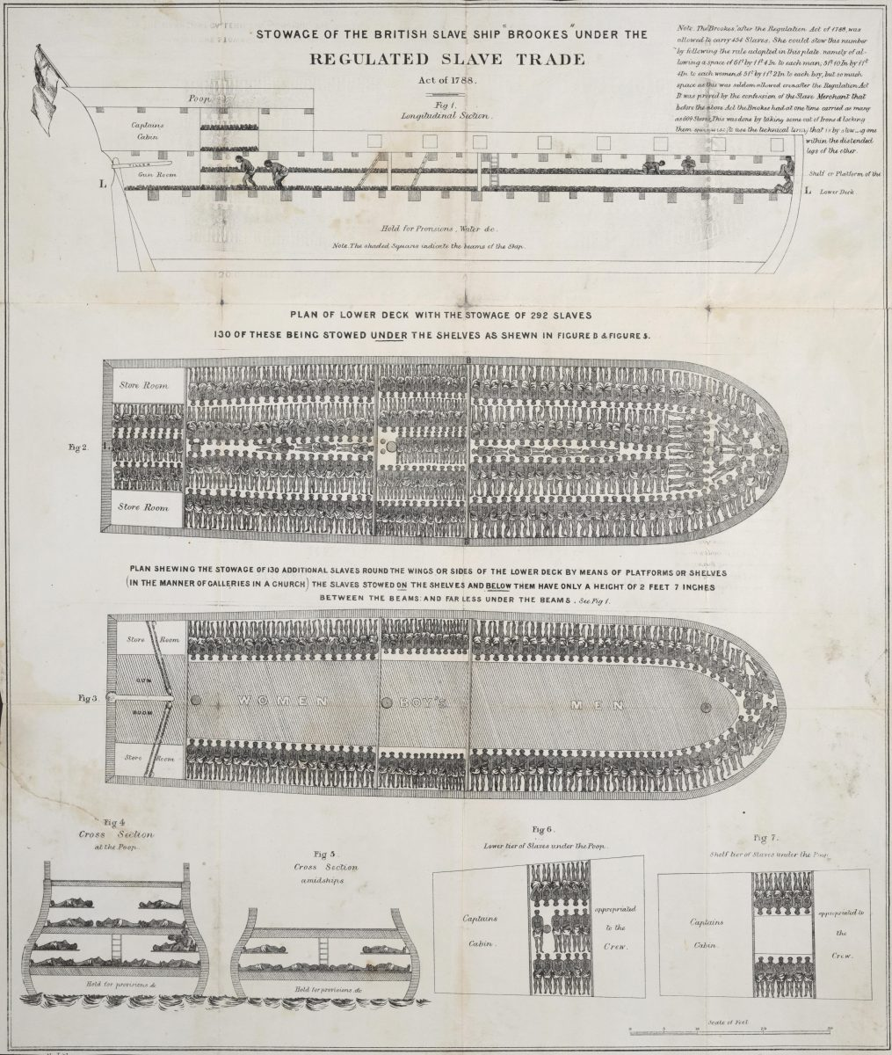
Notes:
Image for activity

Slide 7
Notes:
Image for activity

Slide 8
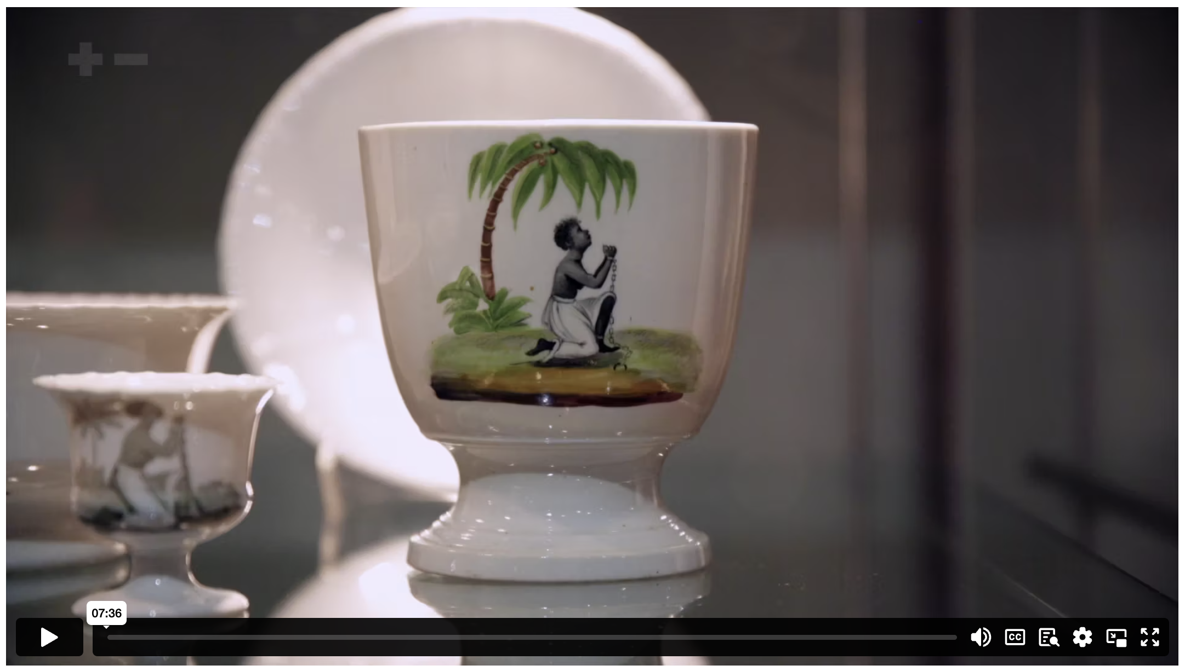
AM I NOT A MAN AND A BROTHER? THE ABOLITION OF THE SLAVE TRADE
Notes:
Content Clip for this lesson

Slide 9


Wilberforce’s new-found faith came [with] a passionate commitment to action on behalf of others.
SIMON SMART
Notes:
Discuss how Wilberforce’s faith motivated his level of activism – how the convictions of his faith shaped his values and choices.

Slide 10
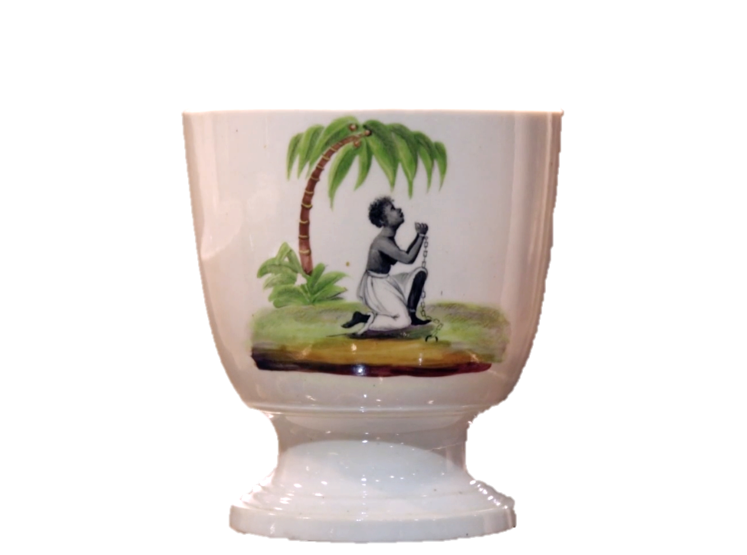
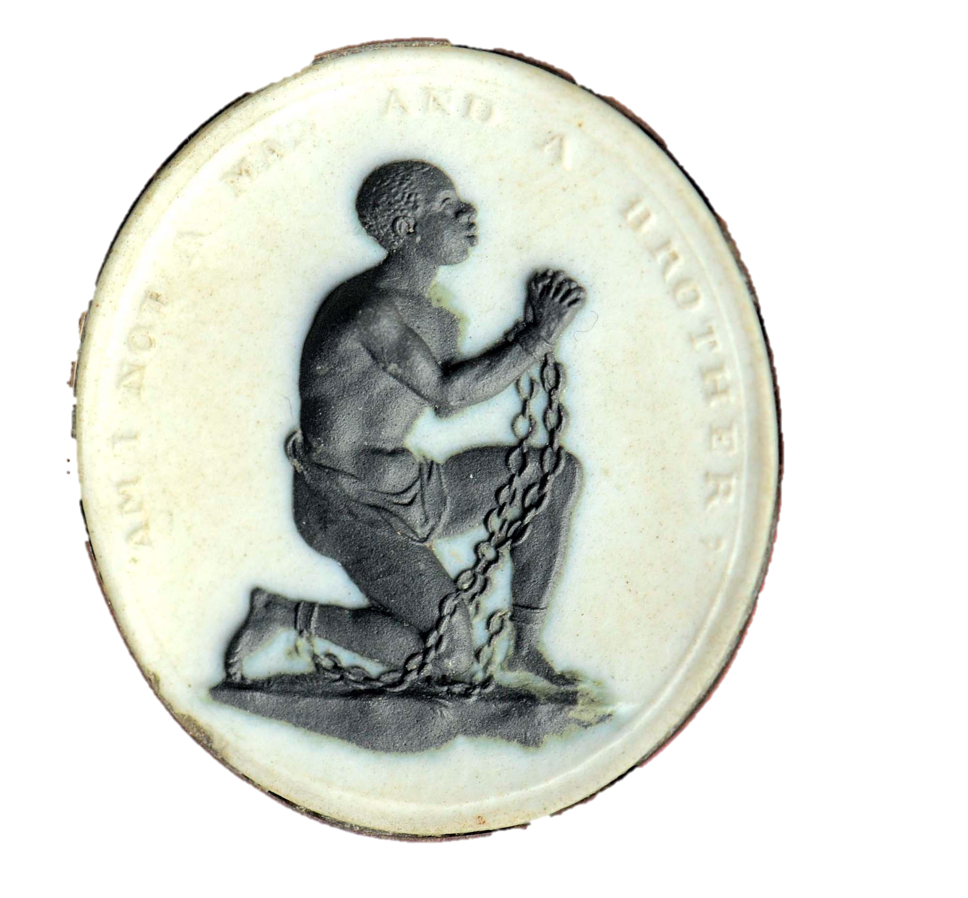
WEDGWOOD
Notes:
Students explain how this became a powerful tool in the Abolition movement, and specifically the role that women played.

Slide 11
¹⁴Jesus returned to Galilee in the power of the Spirit, and news about him spread through the whole countryside. ¹⁵He was teaching in their synagogues, and everyone praised him.
¹⁶ He went to Nazareth, where he had been brought up, and on the Sabbath day he went into the synagogue, as was his custom. He stood up to read, ¹⁷ and the scroll of the prophet Isaiah was handed to him. Unrolling it, he found the place where it is written:
¹⁸ “The Spirit of the Lord is on me,
because he has anointed me to proclaim good news to the poor.
He has sent me to proclaim freedom for the prisoners
and recovery of sight for the blind,
to set the oppressed free, ¹⁹ to proclaim the year of the Lord’s favour.”
²⁰ Then he rolled up the scroll, gave it back to the attendant and sat down. The eyes of everyone in the synagogue were fastened on him. ²¹ He began by saying to them, “Today this scripture is fulfilled in your hearing.”
LUKE 4 (NIV)
Notes:
Large Bible passage

Slide 12
So let’s not allow ourselves to get fatigued doing good. At the right time we will harvest a good crop if we don’t give up, or quit.
GALTIANS 6.9 (MSG)
Notes:
Emphasis bible verse

Slide 13
Notes:
Holding/Final slide

Slide 14
Scripture quotations marked (CEV) are from the Contemporary English Version Copyright © 1991, 1992, 1995 by American Bible Society. Used by Permission.
Scripture quotations marked (ESV) are from the ESV® Bible (The Holy Bible, English Standard Version®), © 2001 by Crossway, a publishing ministry of Good News Publishers. Used by permission. All rights reserved.
Scripture quotations marked (MSG) are taken from The Message, copyright © 1993, 2002, 2018 by Eugene H. Peterson. Used by permission of NavPress. All rights reserved. Represented by Tyndale House Publishers.
Scripture quotations marked (NIV) are taken from the Holy Bible, New International Version®, NIV®. Copyright © 1973, 1978, 1984, 2011 by Biblica, Inc.™ Used by permission of Zondervan. All rights reserved worldwide.
Scripture quotations marked (NIVUK) are taken from the Holy Bible, New International Version® Anglicized, NIV® Copyright © 1979, 1984, 2011 by Biblica, Inc.® Used by permission of Zondervan. All rights reserved worldwide.
Scripture quotations marked (NLT) are taken from the Holy Bible, New Living Translation, copyright ©1996, 2004, 2015 by Tyndale House Foundation. Used by permission of Tyndale House Publishers, Carol Stream, Illinois 60188. All rights reserved.
Notes:
Bible Translation Copyright Credits

