Slide 1
CATHOLIC v PROTESTANT
For the Love of God
“The Troubles” in Northern Ireland
Notes:
Title with Subtitle

Slide 2
‘Religion is a powerful motivator for violence’
Notes:
Students respond and offer reasons for when and why this may or may not be true.

Slide 3
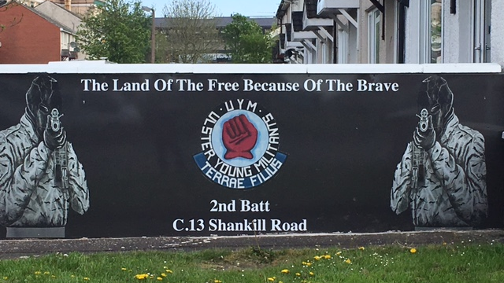
Notes:
Image for activity

Slide 4
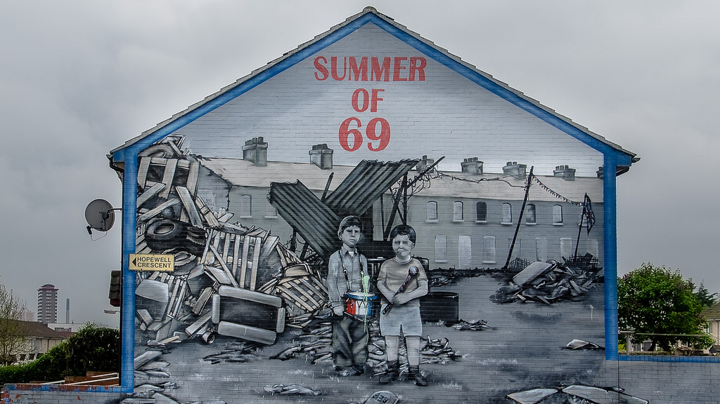
Notes:
Image for activity

Slide 5
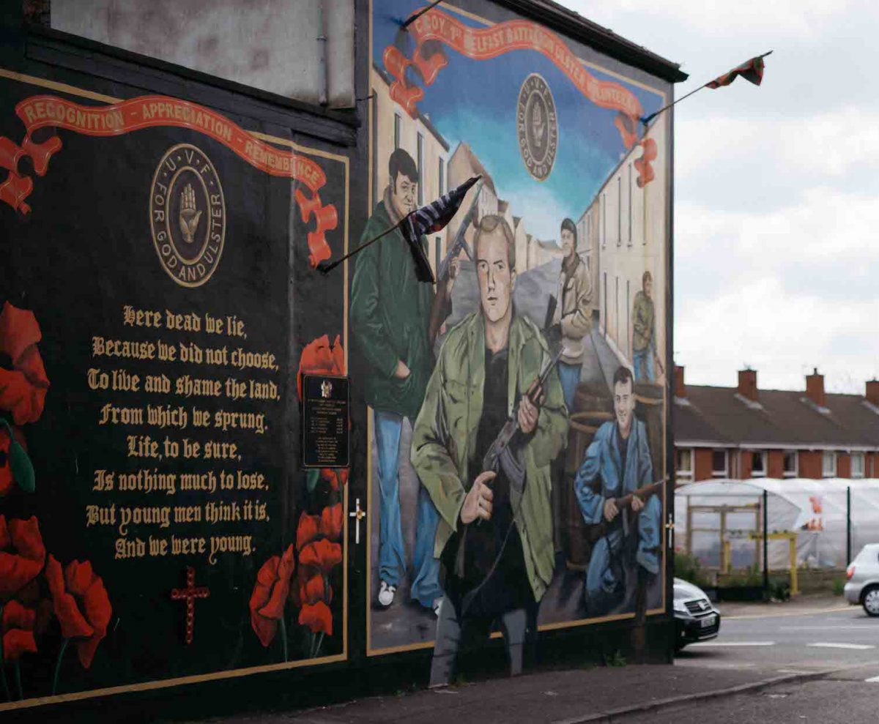
Summer of 69 mural’ by Udri available at https://www.flickr.com/photos/udri/14277608973 under a Creative Commons BY-NC-SA 2.0 Licence. Full terms at https://creativecommons.org/licenses/by-nc-sa/2.0

Slide 6
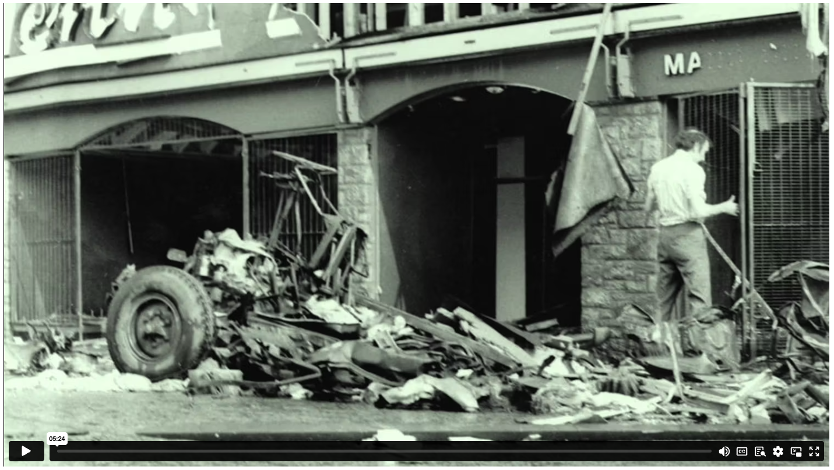
CATHOLIC vs PROTESTANT
Notes:
Content Clip for this lesson

Slide 7
Notes:
Table Template

Slide 8
Notes:
John Lennox Quote

Slide 9
⁸ Finally, all of you, be like-minded, be sympathetic, love one another, be compassionate and humble. ⁹ Do not repay evil with evil or insult with insult. On the contrary, repay evil with blessing, because to this you were called so that you may inherit a blessing. ¹⁰ For,
‘Whoever would love life and see good days must keep their tongue from evil and their lips from deceitful speech. ¹¹ They must turn from evil and do good; they must seek peace and pursue it. ¹² For the eyes of the Lord are on the righteous and his ears are attentive to their prayer, but the face of the Lord is against those who do evil.’
1 PETER 3 (NIVUK)
Notes:
Large Bible passage

Slide 10
Were ‘the Troubles’ in Northern Ireland religiously motivated?
Notes:
Mini-debate stimulus statement.

Slide 11
Notes:
Holding/Final slide

Slide 12
Scripture quotations marked (CEV) are from the Contemporary English Version Copyright © 1991, 1992, 1995 by American Bible Society. Used by Permission.
Scripture quotations marked (ESV) are from the ESV® Bible (The Holy Bible, English Standard Version®), © 2001 by Crossway, a publishing ministry of Good News Publishers. Used by permission. All rights reserved.
Scripture quotations marked (MSG) are taken from The Message, copyright © 1993, 2002, 2018 by Eugene H. Peterson. Used by permission of NavPress. All rights reserved. Represented by Tyndale House Publishers.
Scripture quotations marked (NIV) are taken from the Holy Bible, New International Version®, NIV®. Copyright © 1973, 1978, 1984, 2011 by Biblica, Inc.™ Used by permission of Zondervan. All rights reserved worldwide.
Scripture quotations marked (NIVUK) are taken from the Holy Bible, New International Version® Anglicized, NIV® Copyright © 1979, 1984, 2011 by Biblica, Inc.® Used by permission of Zondervan. All rights reserved worldwide.
Scripture quotations marked (NLT) are taken from the Holy Bible, New Living Translation, copyright ©1996, 2004, 2015 by Tyndale House Foundation. Used by permission of Tyndale House Publishers, Carol Stream, Illinois 60188. All rights reserved.
Notes:
Bible Translation Copyright Credits

