Slide 1

‘CHRISTIAN IMPERIALISM’
For the Love of God
The Empire Converts Under Constantine

Slide 2
How much do you think the church is an organisation with a ‘fixation on power’?
Notes:
Discussion Question

Slide 3
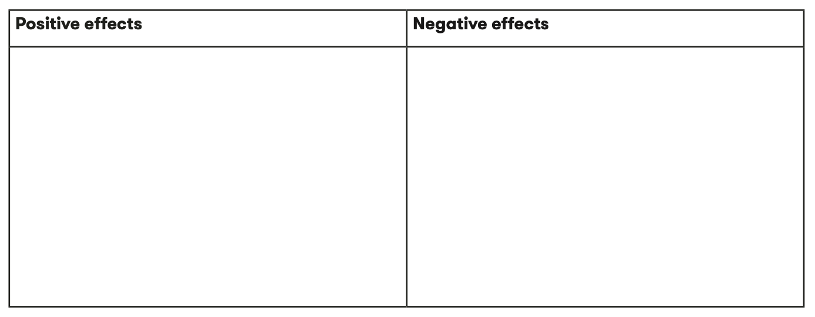

Notes:
As a class brainstorm some of the ways in which having power can have both positive and negative effects.

Slide 4

Notes:
Quote images

Slide 5


Notes:
Quote images

Slide 6


Notes:
Quote images

Slide 7


Notes:
Quote images

Slide 8
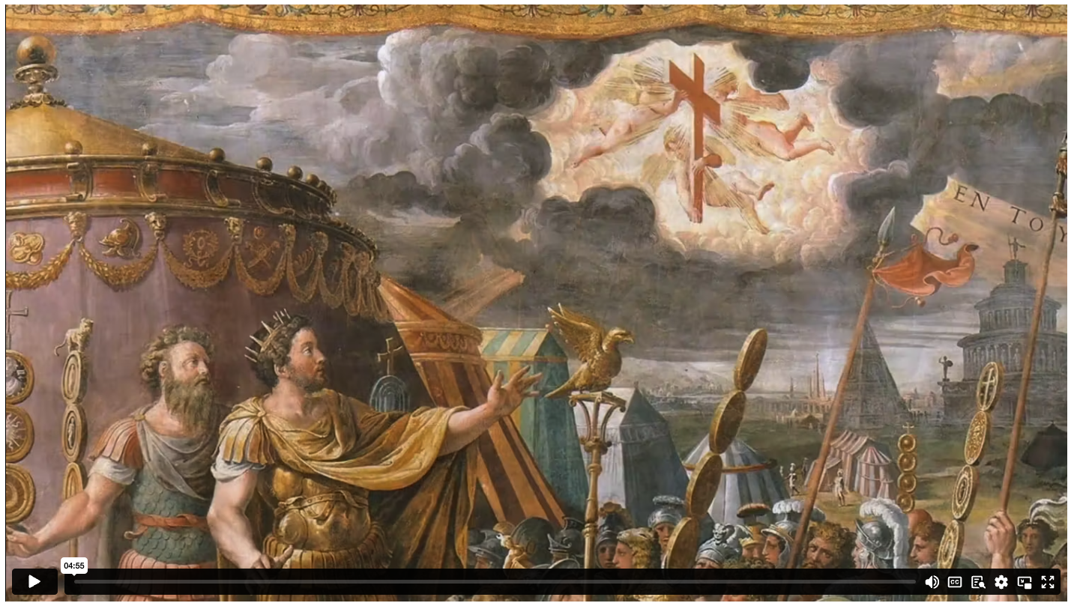
THE EMPIRE CONVERTS
Notes:
Content Clip for this lesson

Slide 9

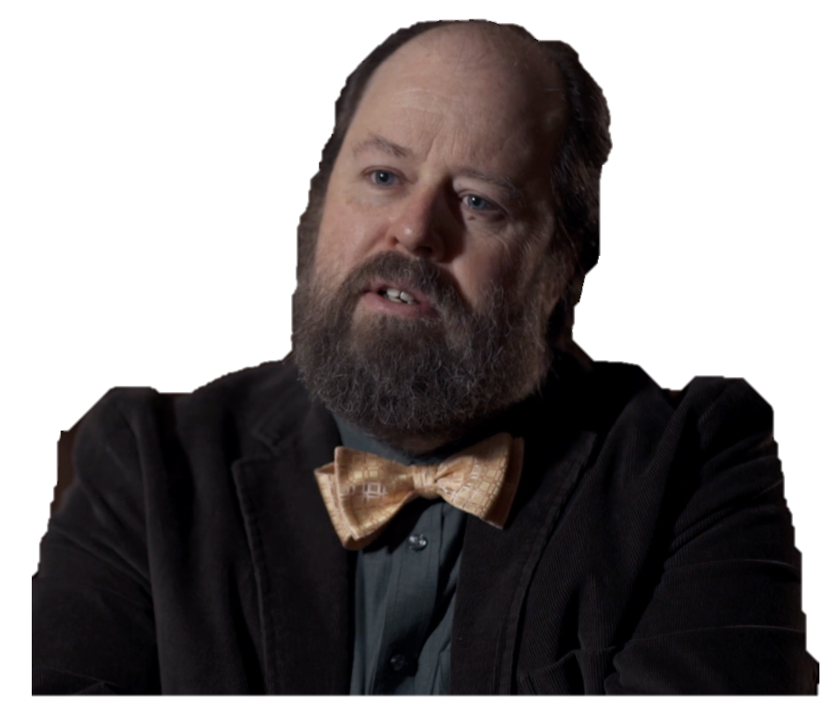
I think it’s fair to say that the greatest historical triumph of Christianity as a cultural force, its conversion to the empire, was in many ways also its greatest defeat.
DAVID BENTLEY HART

Slide 10
⁷ A church leader* is a manager of God’s household, so he must live a blameless life. He must not be arrogant or quick-tempered; he must not be a heavy drinker, violent, or dishonest with money.
*overseer or bishop
TITUS 1 (NLT)

Slide 11
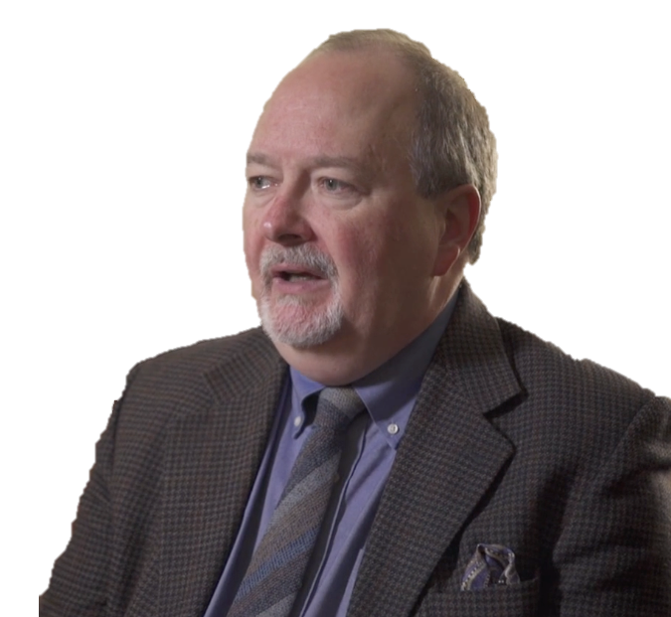
Christian history is littered with instances of Christians behaving badly when they have a chance to pull the levers of power.
JOHN G. STACKHOUSE JR.

Slide 12
^{3.33-34 (NIVUK)}
The Lord’s curse is on the house of the wicked,
but he blesses the home of the righteous.
He mocks proud mockers
but shows favour to the humble and oppressed.
^{11.2 (ESV)}
When pride comes, then comes disgrace,
but with the humble is wisdom.
PROVERBS

Slide 13
¹To the elders among you, I appeal as a fellow elder and a witness of Christ’s sufferings who also will share in the glory to be revealed: ² be shepherds of God’s flock that is under your care, watching over them – not because you must, but because you are willing, as God wants you to be; not pursuing dishonest gain, but eager to serve; ³ not lording it over those entrusted to you, but being examples to the flock. ⁴ And when the Chief Shepherd appears, you will receive the crown of glory that will never fade away.
⁵ In the same way, you who are younger, submit yourselves to your elders. All of you, clothe yourselves with humility towards one another, because,
‘God opposes the proud
but shows favour to the humble.’
⁶ Humble yourselves, therefore, under God’s mighty hand, that he may lift you up in due time.
1 PETER 5 (NIVUK)

Slide 14
JULIUS: But now, open the door, I tell you.
PETER: And I won't do a thing, I tell you, unless you give me a full account of your merits.
JULIUS: What merits?
PETER: Let me explain the idea. Did you distinguish yourself in theology?
JULIUS: Not at all. I had no time for it, being continually engaged in warfare. Besides, there are plenty of priests to do that sort of work.
PETER: Then by the holiness of your life you gained many souls for Christ?
GENIUS: Many more for hell, I'd say.
PETER: You performed miracles?
JULIUS: You're talking old-fashioned nonsense.
PETER: You prayed earnestly and constantly?
‘JULIUS EXCLUDED FROM HEAVEN’
Notes:
Source: Desiderius Erasmus, The Praise of Folly and Other Writings, trans. Robert M. Adams (New York and London: Norton Critical Edition:, 1989)

Slide 15
JULIUS: This is pure foolishness.
PETER: You subdued the lusts of the flesh with fasts and long vigils?
GENIUS: Enough of this, please; with this line of questioning, you're just wasting your time.
PETER: I never heard of any other gifts that an outstanding pope was supposed to possess. If he has some more apostolic talents, let him tell me about them himself.
JULIUS: Though it's a disgraceful thing for Julius who never lowered his crest before anyone else to yield to Peter-who was, to say nothing worse, a lowly fisherman and almost a beggar-still, just to let you know what sort of prince you're slighting in this way, now hear this. In the first place, I am from Liguria, not a Jew like you; but I'm afraid that like you I was once a boatman.
‘JULIUS EXCLUDED FROM HEAVEN’
Notes:
Source: Desiderius Erasmus, The Praise of Folly and Other Writings, trans. Robert M. Adams (New York and London: Norton Critical Edition:, 1989)

Slide 17
Scripture quotations marked (CEV) are from the Contemporary English Version Copyright © 1991, 1992, 1995 by American Bible Society. Used by Permission.
Scripture quotations marked (ESV) are from the ESV® Bible (The Holy Bible, English Standard Version®), © 2001 by Crossway, a publishing ministry of Good News Publishers. Used by permission. All rights reserved.
Scripture quotations marked (MSG) are taken from The Message, copyright © 1993, 2002, 2018 by Eugene H. Peterson. Used by permission of NavPress. All rights reserved. Represented by Tyndale House Publishers.
Scripture quotations marked (NIV) are taken from the Holy Bible, New International Version®, NIV®. Copyright © 1973, 1978, 1984, 2011 by Biblica, Inc.™ Used by permission of Zondervan. All rights reserved worldwide.
Scripture quotations marked (NIVUK) are taken from the Holy Bible, New International Version® Anglicized, NIV® Copyright © 1979, 1984, 2011 by Biblica, Inc.® Used by permission of Zondervan. All rights reserved worldwide.
Scripture quotations marked (NLT) are taken from the Holy Bible, New Living Translation, copyright ©1996, 2004, 2015 by Tyndale House Foundation. Used by permission of Tyndale House Publishers, Carol Stream, Illinois 60188. All rights reserved.
Notes:
Bible Translation Copyright Credits

