Slide 1

CHRISTIANITY & COLONIALISM
For the Love of God
& The Impact on Indigenous Australians

Slide 2
How good is the ‘Church’ at accepting and embracing diversity?
DISABILITY
POLITICS
GENDER
AGE
RACE
WEALTH
HEALTH
CULTURE
Notes:
Statement or Discussion Question

Slide 3
“One in five young Australians would move if a person of Aboriginal or Torres Strait Islander descent sat next to them, a survey has found. And the same percentage would keep an eye on an indigenous person if they were shopping.
More than one in three young Australians also believe that indigenous people are lazy and have been given an unfair advantage by the government.”
Sydney Morning Herald – 30.7.2014
Notes:
Retrieved from https://www.smh.com.au/national/these-six-charts-show-the-state-of-discrimination-towards-indigenous-australians-20140729-zy6fa.html 20.1.2024

Slide 4
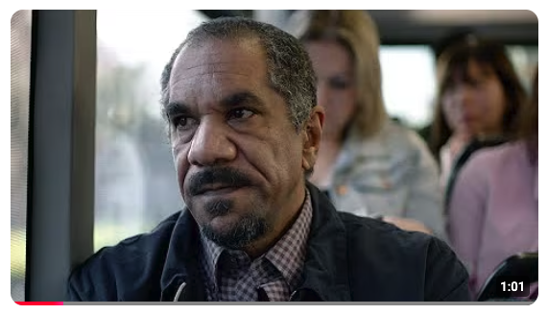
BEYOND BLUE: THE INVISIBLE DISCRIMINATOR
Notes:
Content Clip for this lesson

Slide 5
Have you ever witnessed or experienced racial discrimination?
Notes:
Statement or Discussion Question

Slide 6
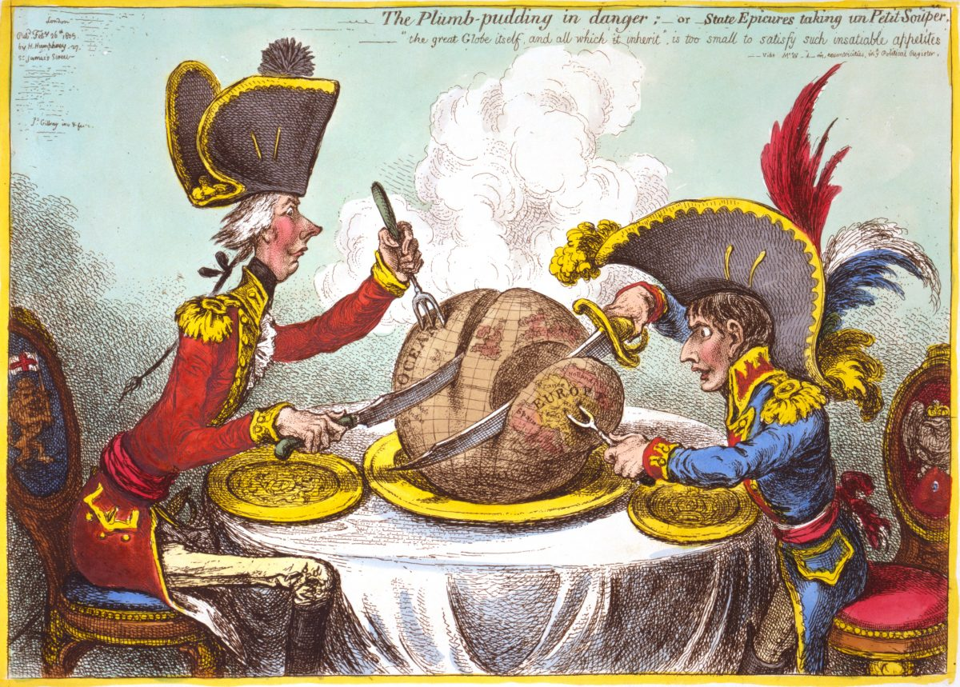

Slide 7
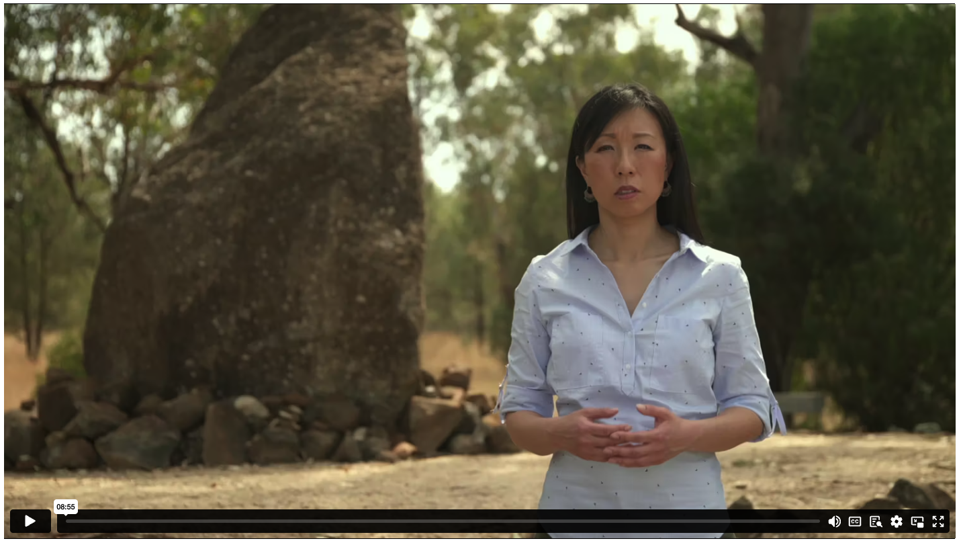
THE COLONIAL PROJECT
Notes:
Content Clip for this lesson

Slide 8
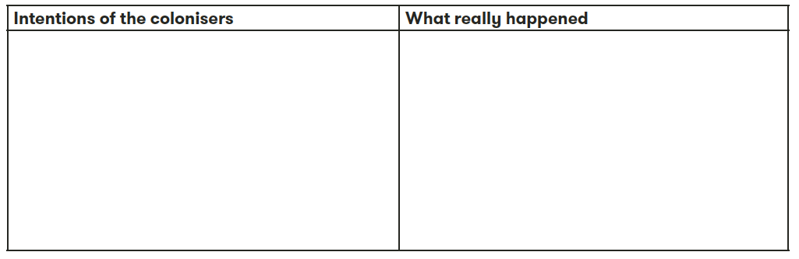


Slide 9
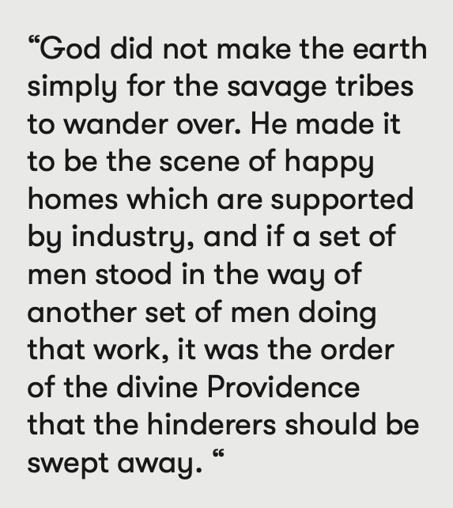
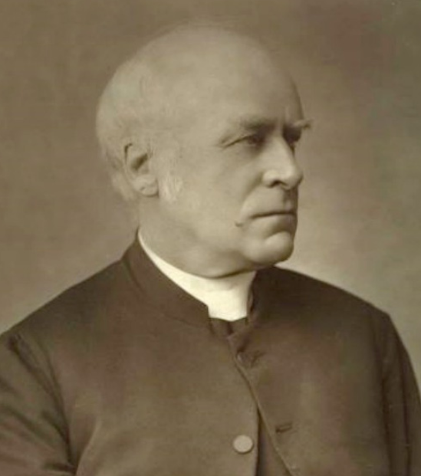
BISHOP JAMES MOORHOUSE
Bishop of Melbourne 1877-1886

Slide 10
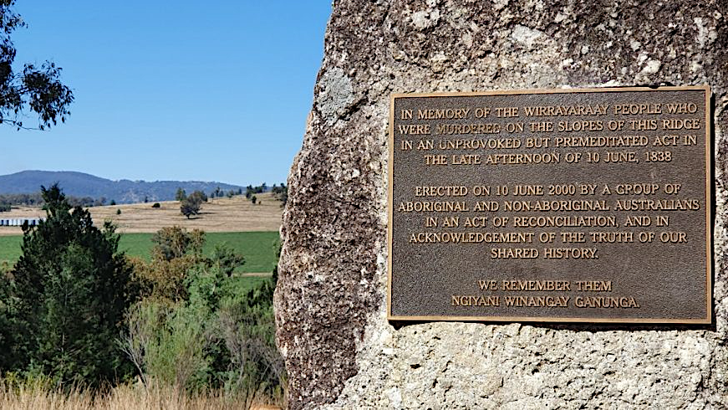
Notes:
Myall Creek Massacre Memorial Plaque

Slide 11
“I knew well they were guilty of the murder, but I for one would never see a white man suffer for shooting a black.”
“I would never consent to hang a white man for a black one.”
“I see the blacks as a set of monkeys. The sooner they are exterminated from the face of the earth, the better.”
Notes:
Juror comments explaining their reasons for the acquittal.

Slide 12
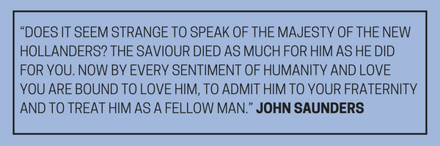

Slide 13
[God] hath made of one blood all nations of men for to dwell on all the face of the earth.
ACTS 17.26 (KJV)
Notes:
Students rewrite this old translation in their own words.

Slide 14
²⁴ ‘The God who made the world and everything in it is the Lord of heaven and earth and does not live in temples built by human hands. ²⁵ And he is not served by human hands, as if he needed anything. Rather, he himself gives everyone life and breath and everything else. ²⁶ From one man he made all the nations, that they should inhabit the whole earth; and he marked out their appointed times in history and the boundaries of their lands. ²⁷ God did this so that they would seek him and perhaps reach out for him and find him, though he is not far from any one of us. ²⁸ “For in him we live and move and have our being.” As some of your own poets have said, “We are his offspring.”
ACTS 17 (NIVUK)
Notes:
Paul speaking at the Areopagus in Athens.

Slide 15
“After this I saw a vast crowd, too great to count, from every nation and tribe and people and language, standing in front of the throne and before the Lamb. They were clothed in white robes and held palm branches in their hands.”
REVELATION 7.9 (NLT)
Notes:
Part of John’s vision of heaven.

Slide 16
How is it possible that Christians (who should think of all people as made in God’s image) could be involved in the mistreatment of Indigenous Australians?
  WRITTEN REFLECTION:
Notes:
Students write a reflection paragraph in response.

Slide 17
  DISCUSSION QUESTIONS:
  What might someone in the future think about how Indigenous Australians are being treated today?

Slide 18
  DISCUSSION QUESTIONS:
  What might someone in the future think about how Indigenous Australians are being treated today?
  Churches can be very culturally diverse places. Does this sort of community appeal to you? Why or why not?

Slide 19
  DISCUSSION QUESTIONS:
  What might someone in the future think about how Indigenous Australians are being treated today?
  Churches can be very culturally diverse places. Does this sort of community appeal to you? Why or why not?
  How important is it to think of all people as being “of one blood”?

Slide 21
Scripture quotations marked (CEV) are from the Contemporary English Version Copyright © 1991, 1992, 1995 by American Bible Society. Used by Permission.
Scripture quotations marked (ESV) are from the ESV® Bible (The Holy Bible, English Standard Version®), © 2001 by Crossway, a publishing ministry of Good News Publishers. Used by permission. All rights reserved.
Scripture quotations marked (MSG) are taken from The Message, copyright © 1993, 2002, 2018 by Eugene H. Peterson. Used by permission of NavPress. All rights reserved. Represented by Tyndale House Publishers.
Scripture quotations marked (NIV) are taken from the Holy Bible, New International Version®, NIV®. Copyright © 1973, 1978, 1984, 2011 by Biblica, Inc.™ Used by permission of Zondervan. All rights reserved worldwide.
Scripture quotations marked (NIVUK) are taken from the Holy Bible, New International Version® Anglicized, NIV® Copyright © 1979, 1984, 2011 by Biblica, Inc.® Used by permission of Zondervan. All rights reserved worldwide.
Scripture quotations marked (NLT) are taken from the Holy Bible, New Living Translation, copyright ©1996, 2004, 2015 by Tyndale House Foundation. Used by permission of Tyndale House Publishers, Carol Stream, Illinois 60188. All rights reserved.
Notes:
Bible Translation Copyright Credits

