Slide 1

CHRISTIANITY & WOMEN
For the Love of God
Oppressive or Liberating?

Slide 2

Pineapple should never be found on Pizza
Agree
Disagree
Notes:
Human Barometer Activity intro slide – delete the slides you don’t want

Slide 3
You can’t call chess
a sport
Agree
Disagree
Notes:
Human Barometer Activity intro slide – delete the slides you don’t want

Slide 4
The moon landing never really happened
Agree
Disagree
Notes:
Human Barometer Activity intro slide – delete the slides you don’t want

Slide 5
Marvel movies are an insult to our intelligence.
Agree
Disagree
Notes:
Human Barometer Activity intro slide – delete the slides you don’t want

Slide 6
Gender inequality is a significant problem in today’s world
Agree
Disagree

Slide 7
Gender inequality is still a significant problem in Australia today
Agree
Disagree

Slide 8
Christianity values
men and women equally
Agree
Disagree

Slide 9
Christianity is
good news for women
Agree
Disagree

Slide 10
  DISCUSSION QUESTIONS:
  What do you think would be challenging about being a woman
  …in Afghanistan today?

Slide 11
  DISCUSSION QUESTIONS:
  What do you think would be challenging about being a woman
  …in Afghanistan today?
  …in England in the 1880’s?

Slide 12
  DISCUSSION QUESTIONS:
  What do you think would be challenging about being a woman
  …in Afghanistan today?
  …in England in the 1880’s?
  …in Jerusalem when Jesus was teaching and ministering?

Slide 13
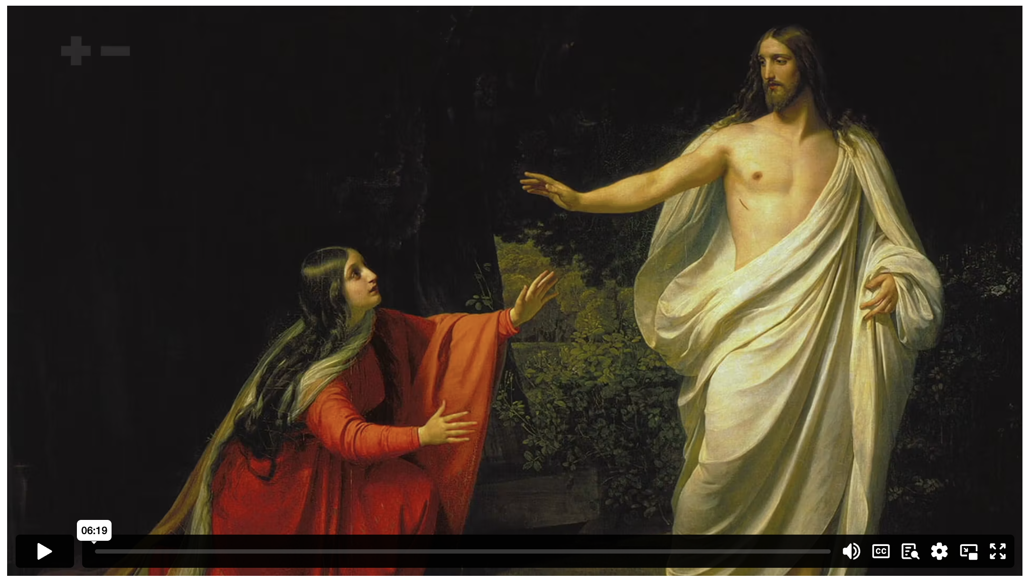
OPPRESSIVE OR LIBERATING?: CHRISTIANITY & WOMEN
Notes:
Discuss how Jesus responded to the women that he met?

Slide 14
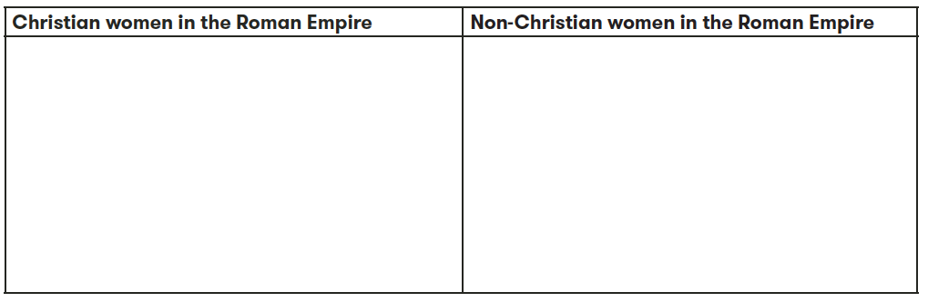

Slide 15
²⁵ A woman in the crowd had suffered for twelve years with constant bleeding. ²⁶ She had suffered a great deal from many doctors, and over the years she had spent everything she had to pay them, but she had gotten no better. In fact, she had gotten worse. ²⁷ She had heard about Jesus, so she came up behind him through the crowd and touched his robe. ²⁸ For she thought to herself, “If I can just touch his robe, I will be healed.” ²⁹ Immediately the bleeding stopped, and she could feel in her body that she had been healed of her terrible condition.
MARK 5 (NIVUK)

Slide 16
³⁰ Jesus realized at once that healing power had gone out from him, so he turned around in the crowd and asked, “Who touched my robe?”
³¹ His disciples said to him, “Look at this crowd pressing around you. How can you ask, ‘Who touched me?’”
³² But he kept on looking around to see who had done it. ³³ Then the frightened woman, trembling at the realization of what had happened to her, came and fell to her knees in front of him and told him what she had done. ³⁴ And he said to her, “Daughter, your faith has made you well. Go in peace. Your suffering is over.”
MARK 5 (NLT)

Slide 17
²⁵ “If a woman has a flow of blood for many days that is unrelated to her menstrual period, or if the blood continues beyond the normal period, she is ceremonially unclean. As during her menstrual period, the woman will be unclean as long as the discharge continues. ²⁶ Any bed she lies on and any object she sits on during that time will be unclean, just as during her normal menstrual period. ²⁷ If any of you touch these things, you will be ceremonially unclean. You must wash your clothes and bathe yourself in water, and you will remain unclean until evening…
³¹ “This is how you will guard the people of Israel from ceremonial uncleanness. Otherwise they would die, for their impurity would defile my Tabernacle that stands among them.
LEVITICUS 15 (NLT)

Slide 18
  DISCUSSION QUESTIONS:
  What do you think would be challenging about being a woman
  …in Afghanistan today?

Slide 19
²³ Before the way of faith in Christ was available to us, we were placed under guard by the law. We were kept in protective custody, so to speak, until the way of faith was revealed.
²⁴ Let me put it another way. The law was our guardian until Christ came; it protected us until we could be made right with God through faith. ²⁵ And now that the way of faith has come, we no longer need the law as our guardian.
²⁶ For you are all children of God through faith in Christ Jesus. ²⁷ And all who have been united with Christ in baptism have put on Christ, like putting on new clothes. ²⁸ There is no longer Jew or Gentile, slave or free, male and female. For you are all one in Christ Jesus.
GALATIANS 3 (NLT)

Slide 21
Scripture quotations marked (CEV) are from the Contemporary English Version Copyright © 1991, 1992, 1995 by American Bible Society. Used by Permission.
Scripture quotations marked (ESV) are from the ESV® Bible (The Holy Bible, English Standard Version®), © 2001 by Crossway, a publishing ministry of Good News Publishers. Used by permission. All rights reserved.
Scripture quotations marked (MSG) are taken from The Message, copyright © 1993, 2002, 2018 by Eugene H. Peterson. Used by permission of NavPress. All rights reserved. Represented by Tyndale House Publishers.
Scripture quotations marked (NIV) are taken from the Holy Bible, New International Version®, NIV®. Copyright © 1973, 1978, 1984, 2011 by Biblica, Inc.™ Used by permission of Zondervan. All rights reserved worldwide.
Scripture quotations marked (NIVUK) are taken from the Holy Bible, New International Version® Anglicized, NIV® Copyright © 1979, 1984, 2011 by Biblica, Inc.® Used by permission of Zondervan. All rights reserved worldwide.
Scripture quotations marked (NLT) are taken from the Holy Bible, New Living Translation, copyright ©1996, 2004, 2015 by Tyndale House Foundation. Used by permission of Tyndale House Publishers, Carol Stream, Illinois 60188. All rights reserved.
Notes:
Bible Translation Copyright Credits

