Slide 1
CHRISTIANS WHO CARE
For the Love of God
The Christian Origins of Western Healthcare

Slide 2
How responsible are we for the wellbeing of others?
Notes:
Statement for discussion.

Slide 3
Describe an experience where you or a family member were sick enough to need healthcare.
(PAIR & SHARE)

Slide 4
Which disease would you eradicate from the world if you could?
Notes:
Discussion question.

Slide 5
2014 EBOLA OUTBREAK IN SIERRA LEONNE
Notes:
CONTENT WARING: Some students may find the content in this clip distressing.

Slide 6
How important is it for a society to provide affordable, quality healthcare?
Notes:
Discussion question.

Slide 7
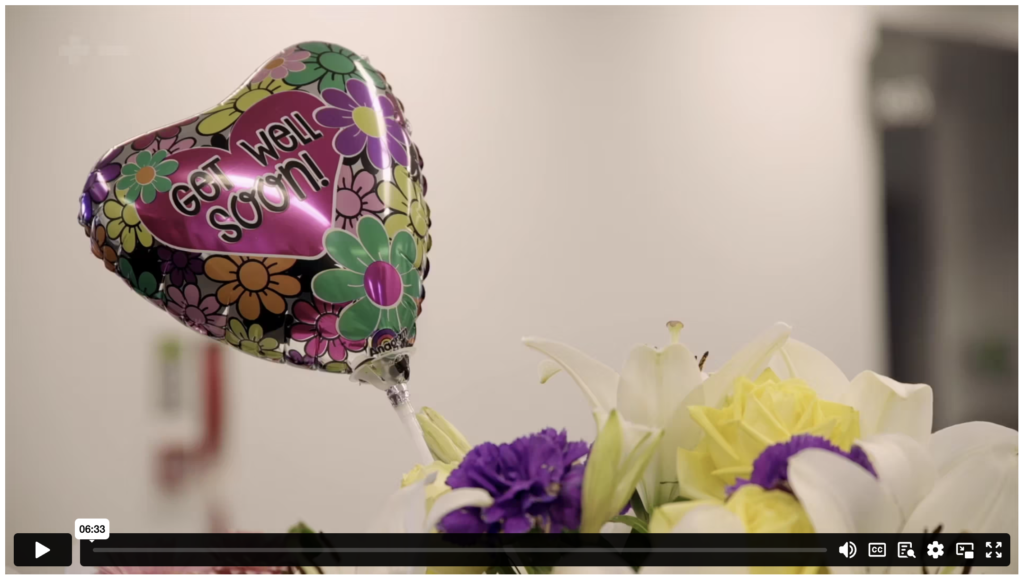
THE ORIGINS OF WESTERN HEALTHCARE
Notes:
Content Clip for this lesson

Slide 8
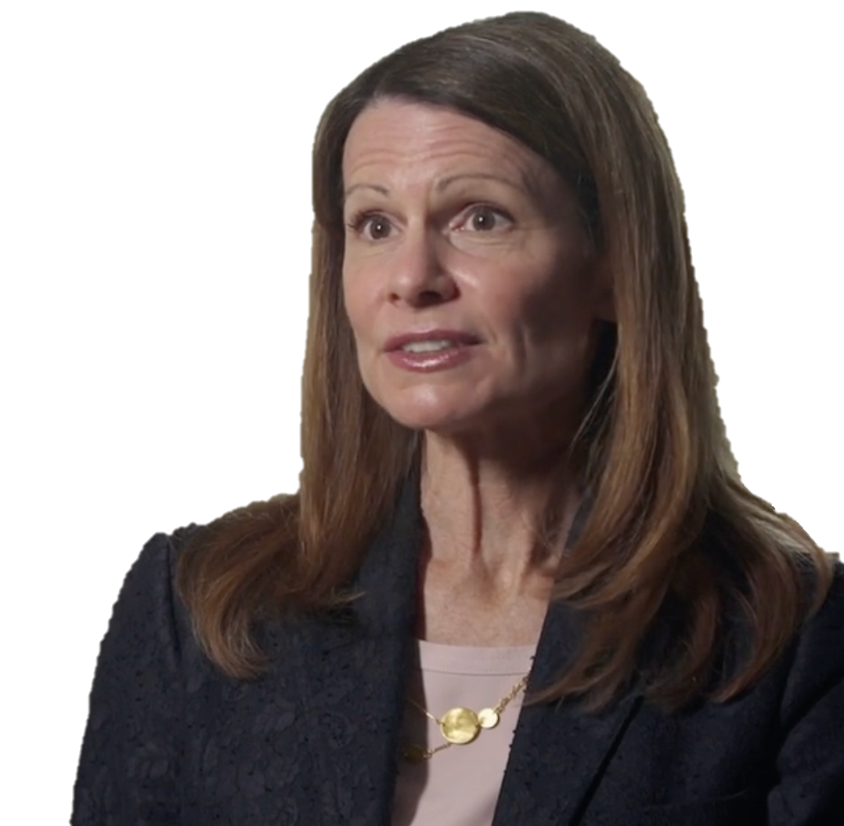
Christians believe that each person is made in the image of God, and thus each person should be cared for, even if they are very ill.
DR LYNN COHICK

Slide 9
She founded an infirmary and gathered into it sufferers from the streets, giving a nurse’s care to poor bodies worn with sickness and hunger – maimed noses, lost eyes, scorched feet, leprous arms, swollen bellies. How often she carried on her own shoulders poor filthy wretches tortured by epilepsy! How often did she wash away the purulent matters from wounds which others could not even endure to look at! She gave food with her own hands, and even when a man was but a breathing corpse, she would moisten his lips with drops of water. Rome was not large enough for her kindness.
JEROME’s description of FABIOLA

Slide 10
This Jesus of Nazareth, the incarnate gospel of love, this “Redeemer” bringing salvation and victory to the poor, the sick, the sinners – was he not really temptation in its most sinister and irresistible form?
Preventing the sick from making the healthy sick – this ought to be our supreme object in the world. But for this it is above all essential that the healthy remain separated from the sick, that they should even guard themselves from the look of the sick, that they not even associate with the sick…The higher must not degrade itself by becoming the tool of the lower.
FRIEDRICH NIETSECHE

Slide 11
Nature intended the strong to thrive and the weak to disappear.
(Mini-Debate)

Slide 12
[Jesus] left the meeting place and went to Simon’s house. Simon’s mother-in-law was running a high fever and they asked him to do something for her. He stood over her, told the fever to leave – and it left. Before they knew it, she was up getting dinner for them.
When the sun went down, everyone who had anyone sick with some ailment or other brought them to him. One by one he placed his hands on them and healed them. Demons left in droves, screaming, “Son of God! You’re the Son of God!” But he shut them up, refusing to let them speak because they knew too much, they knew him to be the Messiah.
LUKE 4.38-41 (MSG)

Slide 13
²⁸ One of the teachers of religious law was standing there listening to the debate. He realized that Jesus had answered well, so he asked, “Of all the commandments, which is the most important?”
²⁹ Jesus replied, “The most important commandment is this: ‘Listen, O Israel! The Lord our God is the one and only Lord. ³⁰ And you must love the Lord your God with all your heart, all your soul, all your mind, and all your strength.’ ³¹ The second is equally important: ‘Love your neighbour as yourself.’ No other commandment is greater than these.”
MARK (NLT)

Slide 14
RESPOND:
Who is Jesus talking about when he says “your neighbour”?
Describe a scenario that demonstrates what loving another person as yourself would look like.
Explain how the early Christians interpreted this teaching.

Slide 16
Scripture quotations marked (CEV) are from the Contemporary English Version Copyright © 1991, 1992, 1995 by American Bible Society. Used by Permission.
Scripture quotations marked (ESV) are from the ESV® Bible (The Holy Bible, English Standard Version®), © 2001 by Crossway, a publishing ministry of Good News Publishers. Used by permission. All rights reserved.
Scripture quotations marked (MSG) are taken from The Message, copyright © 1993, 2002, 2018 by Eugene H. Peterson. Used by permission of NavPress. All rights reserved. Represented by Tyndale House Publishers.
Scripture quotations marked (NIV) are taken from the Holy Bible, New International Version®, NIV®. Copyright © 1973, 1978, 1984, 2011 by Biblica, Inc.™ Used by permission of Zondervan. All rights reserved worldwide.
Scripture quotations marked (NIVUK) are taken from the Holy Bible, New International Version® Anglicized, NIV® Copyright © 1979, 1984, 2011 by Biblica, Inc.® Used by permission of Zondervan. All rights reserved worldwide.
Scripture quotations marked (NLT) are taken from the Holy Bible, New Living Translation, copyright ©1996, 2004, 2015 by Tyndale House Foundation. Used by permission of Tyndale House Publishers, Carol Stream, Illinois 60188. All rights reserved.
Notes:
Bible Translation Copyright Credits

