Slide 1

DOES RELIGION CAUSE WARS?
For the Love of God
How much is Christianity to Blame?

Slide 2

Pineapple should never be found on Pizza
Agree
Disagree
Notes:
Human Barometer Activity intro slide – delete the slides you don’t want

Slide 3
You can’t call chess
a sport
Agree
Disagree
Notes:
Human Barometer Activity intro slide – delete the slides you don’t want

Slide 4
The moon landing never really happened
Agree
Disagree
Notes:
Human Barometer Activity intro slide – delete the slides you don’t want

Slide 5
Marvel movies are an insult to our intelligence.
Agree
Disagree
Notes:
Human Barometer Activity intro slide – delete the slides you don’t want

Slide 6
Religion should never be
used to justify war
Agree
Disagree

Slide 7
Christianity is a peaceful
belief system
Agree
Disagree

Slide 8
Jesus was a pacifist
Agree
Disagree

Slide 9
Religion is the cause of
most of the wars in history
Agree
Disagree

Slide 10

DOES RELIGION CAUSE ALL WARS?
Notes:
Content Clip for this lesson

Slide 11

“Those who make you believe absurdities, can make you commit atrocities.”
Voltaire (1694-1778) – French Philosopher
Notes:
Students rewrite the quote in their own words.

Slide 12
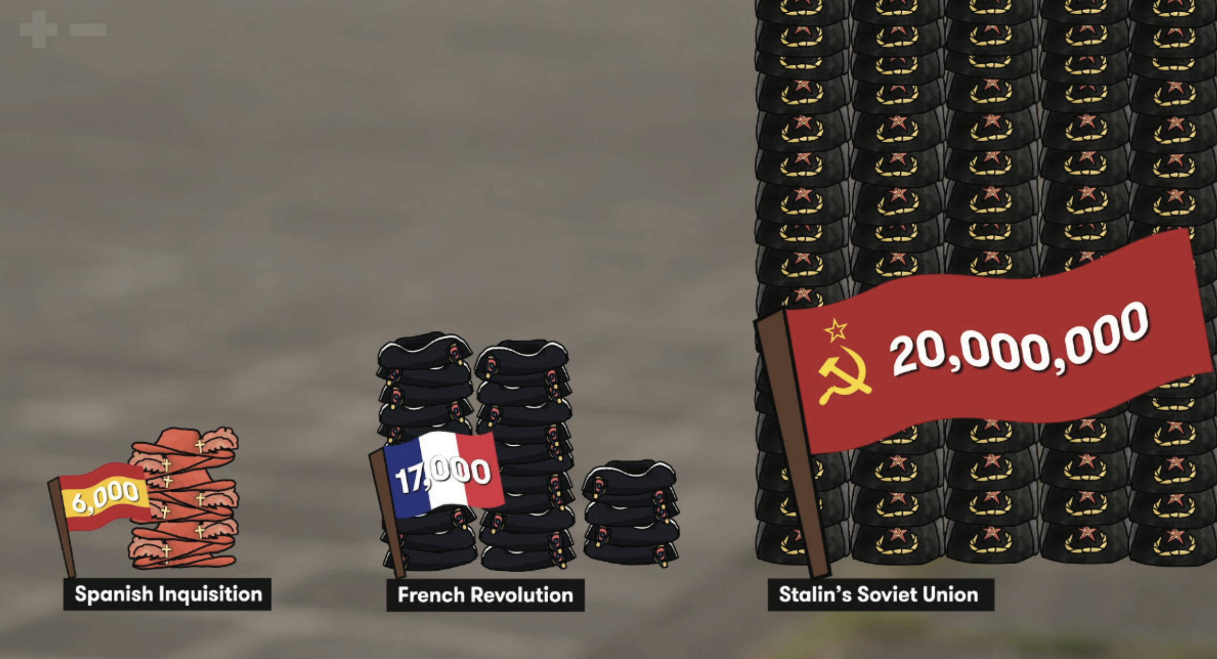
Notes:
Invite students to offer observations and questions that arise.

Slide 13
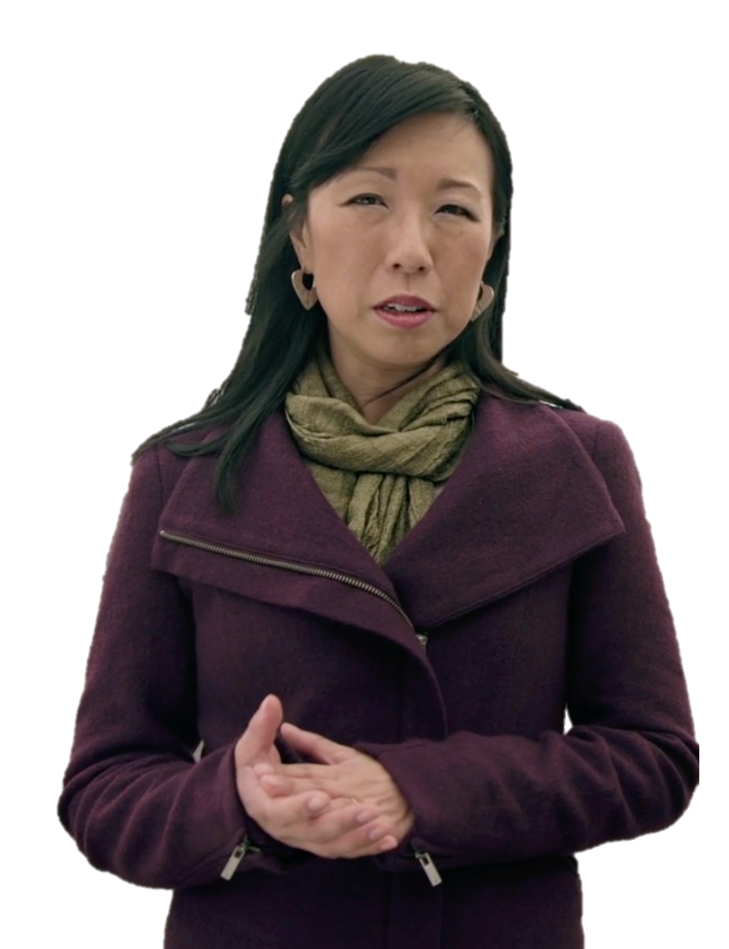
The human capacity for brutality is vast.
JUSTINE TOH

Slide 14
²The Lord looks down from heaven on the entire human race;
he looks to see if anyone is truly wise, if anyone seeks God.
³ But no, all have turned away; all have become corrupt.
No one does good, not a single one!
Psalm 14 (NLT)
⁸ If we claim we have no sin, we are only fooling ourselves and not living in the truth. 9 But if we confess our sins to him, he is faithful and just to forgive us our sins and to cleanse us from all wickedness.
1 John 1 (NLT)

Slide 15

Religion has caused innumerable people not just to conduct themselves no better than others, but to award themselves permission to behave in ways that would make a brothel-keeper or an ethnic cleanser raise an eyebrow…
As I write these words, and as you read them, people of faith are in their different ways planning your and my destruction, and the destruction of all the hard-won human attainments that I have touched upon.
Religion poisons everything.”

Slide 16

If only it were so simple! If only there were evil people somewhere insidiously committing evil deeds, and it were necessary only to separate them from the rest of us and destroy them. But the line dividing good and evil cuts through the heart of every human being. And who is willing to destroy a piece of his own heart?
Notes:
Discuss how the quote supports the conclusion of the clip, and the degree to which the class agrees with the quote. Does it match their experience of life, and how they imagine the world to be?

Slide 18
Scripture quotations marked (CEV) are from the Contemporary English Version Copyright © 1991, 1992, 1995 by American Bible Society. Used by Permission.
Scripture quotations marked (ESV) are from the ESV® Bible (The Holy Bible, English Standard Version®), © 2001 by Crossway, a publishing ministry of Good News Publishers. Used by permission. All rights reserved.
Scripture quotations marked (MSG) are taken from The Message, copyright © 1993, 2002, 2018 by Eugene H. Peterson. Used by permission of NavPress. All rights reserved. Represented by Tyndale House Publishers.
Scripture quotations marked (NIV) are taken from the Holy Bible, New International Version®, NIV®. Copyright © 1973, 1978, 1984, 2011 by Biblica, Inc.™ Used by permission of Zondervan. All rights reserved worldwide.
Scripture quotations marked (NIVUK) are taken from the Holy Bible, New International Version® Anglicized, NIV® Copyright © 1979, 1984, 2011 by Biblica, Inc.® Used by permission of Zondervan. All rights reserved worldwide.
Scripture quotations marked (NLT) are taken from the Holy Bible, New Living Translation, copyright ©1996, 2004, 2015 by Tyndale House Foundation. Used by permission of Tyndale House Publishers, Carol Stream, Illinois 60188. All rights reserved.
Notes:
Bible Translation Copyright Credits

