Slide 1

THE LEPER PRIEST
For the Love of God
Father Damian of Molokai

Slide 2

  DISCUSSION QUESTIONS:
  What attitude do you think Jesus had to wealth and power?

Slide 3
  DISCUSSION QUESTIONS:
  What attitude do you think Jesus had to wealth and power?
  Who do you think Christians should be known more for associating with – the needy or the successful?

Slide 4
  DISCUSSION QUESTIONS:
  What attitude do you think Jesus had to wealth and power?
  Who do you think Christians should be known more for associating with – the needy or the successful?
  Have you ever taken a risk to help someone in need?

Slide 5
  DISCUSSION QUESTIONS:
  What attitude do you think Jesus had to wealth and power?
  Who do you think Christians should be known more for associating with – the needy or the successful?
  Have you ever taken a risk to help someone in need?
  Have you ever felt completely alone?

Slide 6
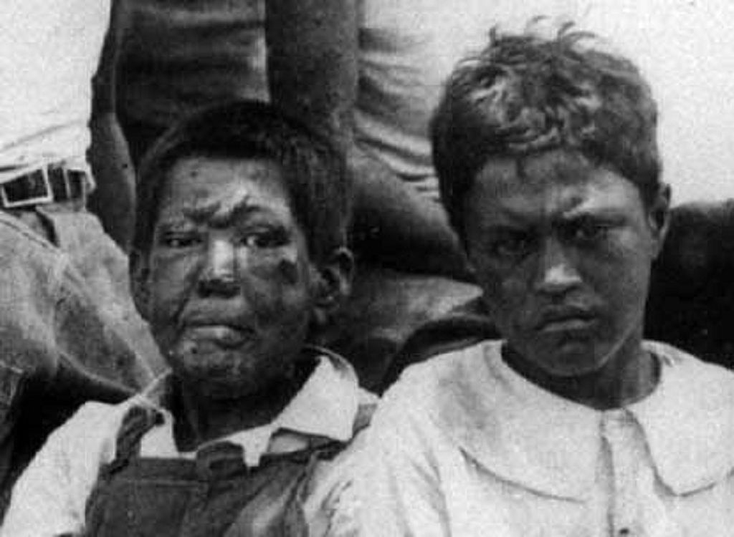
Leprosy is a chronic bacterial infection that damages nerves in the legs, arms and skin, and causes serious skin sores that disfigure the body. It is most common in tropical and sub-tropical areas. Until the 1940s there was no effective treatment for the disease, and it was thought to be highly contagious. For this reason, victims of leprosy were often isolated in an attempt to stop the spread of the disease. Today, leprosy still occurs (up to 250,000 cases a year being reported to WHO) but it is completely curable with antibiotics.
Notes:
Image from 1900 of two children with leprosy in Hawaii
Retrieved from https://commons.wikimedia.org/wiki/File:Hawaiian_Boys_with_Leprosy.jpg 22-1-25.

Slide 7
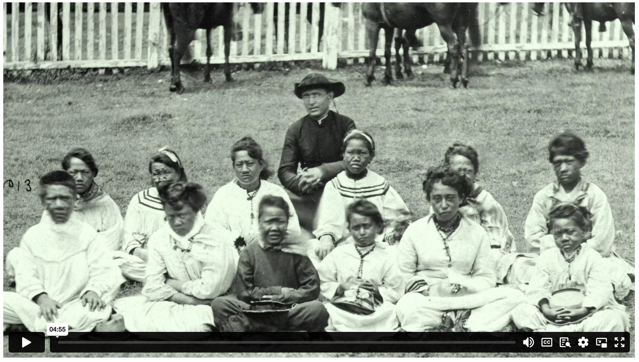
THE LEPER PRIEST
Notes:
Content Clip for this lesson

Slide 8

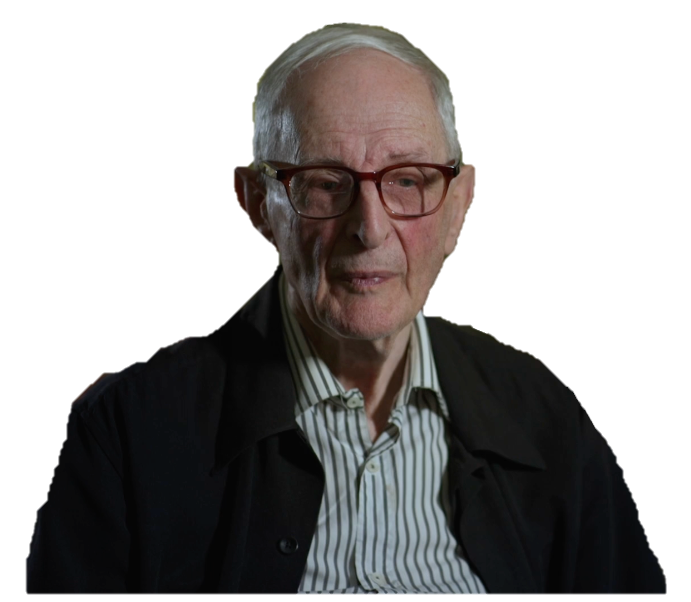
Compassion is, at the heart, the principal of caring.
You care enough to suffer with the other person.
PROF. EDWIN JUDGE
Notes:
Students reflect on the degree to which Father Damien displayed this kind of compassion on Molokai, and how he might respond to someone who said that he wasted his life.

Slide 9
⁴⁰ A man with leprosy came and knelt in front of Jesus, begging to be healed. “If you are willing, you can heal me and make me clean,” he said.
⁴¹ Moved with compassion, Jesus reached out and touched him. “I am willing,” he said. “Be healed!” ⁴² Instantly the leprosy disappeared, and the man was healed.
MARK 1 (NLT)

Slide 10
JOHN 13.1-15
Notes:
Statement or Discussion Question

Slide 11
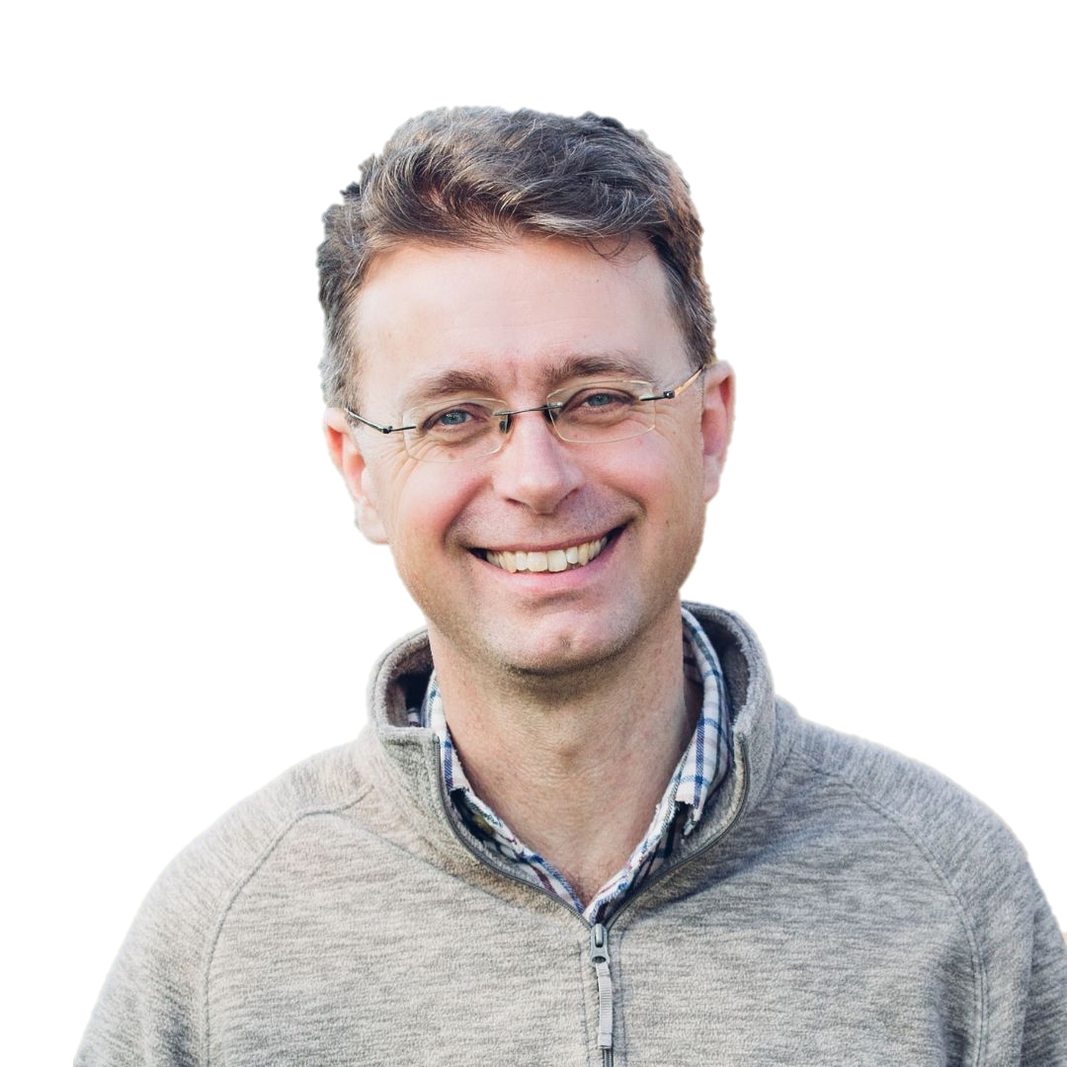
Christians as a rule are quite good at not following through the really radical, really challenging teachings of Jesus Christ. It’s easy to criticise Christians like that, but I think it’s justifiable.
NICK SPENCER
Notes:
Discuss how true this is. (Why or why not?)

Slide 13
Scripture quotations marked (CEV) are from the Contemporary English Version Copyright © 1991, 1992, 1995 by American Bible Society. Used by Permission.
Scripture quotations marked (ESV) are from the ESV® Bible (The Holy Bible, English Standard Version®), © 2001 by Crossway, a publishing ministry of Good News Publishers. Used by permission. All rights reserved.
Scripture quotations marked (MSG) are taken from The Message, copyright © 1993, 2002, 2018 by Eugene H. Peterson. Used by permission of NavPress. All rights reserved. Represented by Tyndale House Publishers.
Scripture quotations marked (NIV) are taken from the Holy Bible, New International Version®, NIV®. Copyright © 1973, 1978, 1984, 2011 by Biblica, Inc.™ Used by permission of Zondervan. All rights reserved worldwide.
Scripture quotations marked (NIVUK) are taken from the Holy Bible, New International Version® Anglicized, NIV® Copyright © 1979, 1984, 2011 by Biblica, Inc.® Used by permission of Zondervan. All rights reserved worldwide.
Scripture quotations marked (NLT) are taken from the Holy Bible, New Living Translation, copyright ©1996, 2004, 2015 by Tyndale House Foundation. Used by permission of Tyndale House Publishers, Carol Stream, Illinois 60188. All rights reserved.
Notes:
Bible Translation Copyright Credits

