Slide 1

HUMAN RIGHTS – THE GENESIS
For the Love of God
Behind the Universal Declaration of Human Rights

Slide 2
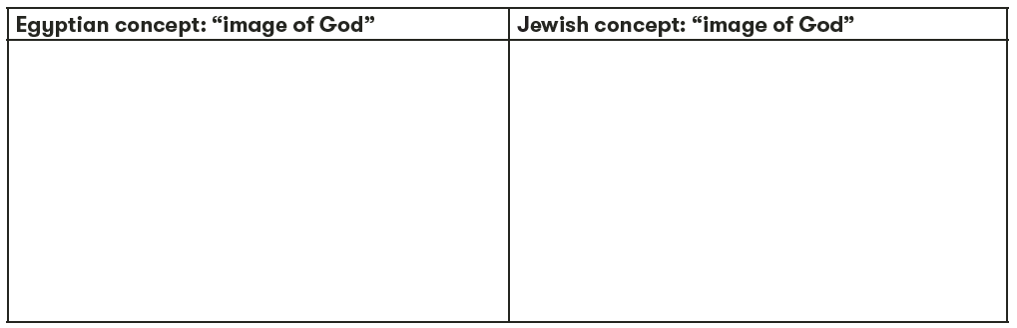

  COMPARE & CONTRAST

Slide 3

  Christianity & Human Rights
Notes:
Students indicate where they think Christianity should be placed on a spectrum between restricting and promoting human rights for all.

Slide 4

On 3 May 2011, an international online design competition to create a universal logo for human rights was launched. From the more than 15,300 suggestions from over 190 countries, the winning logo was selected. It was designed by Predrag Stakić from Serbia.
What do you think it is trying to
represent and why do you think it won the competition?

Slide 5
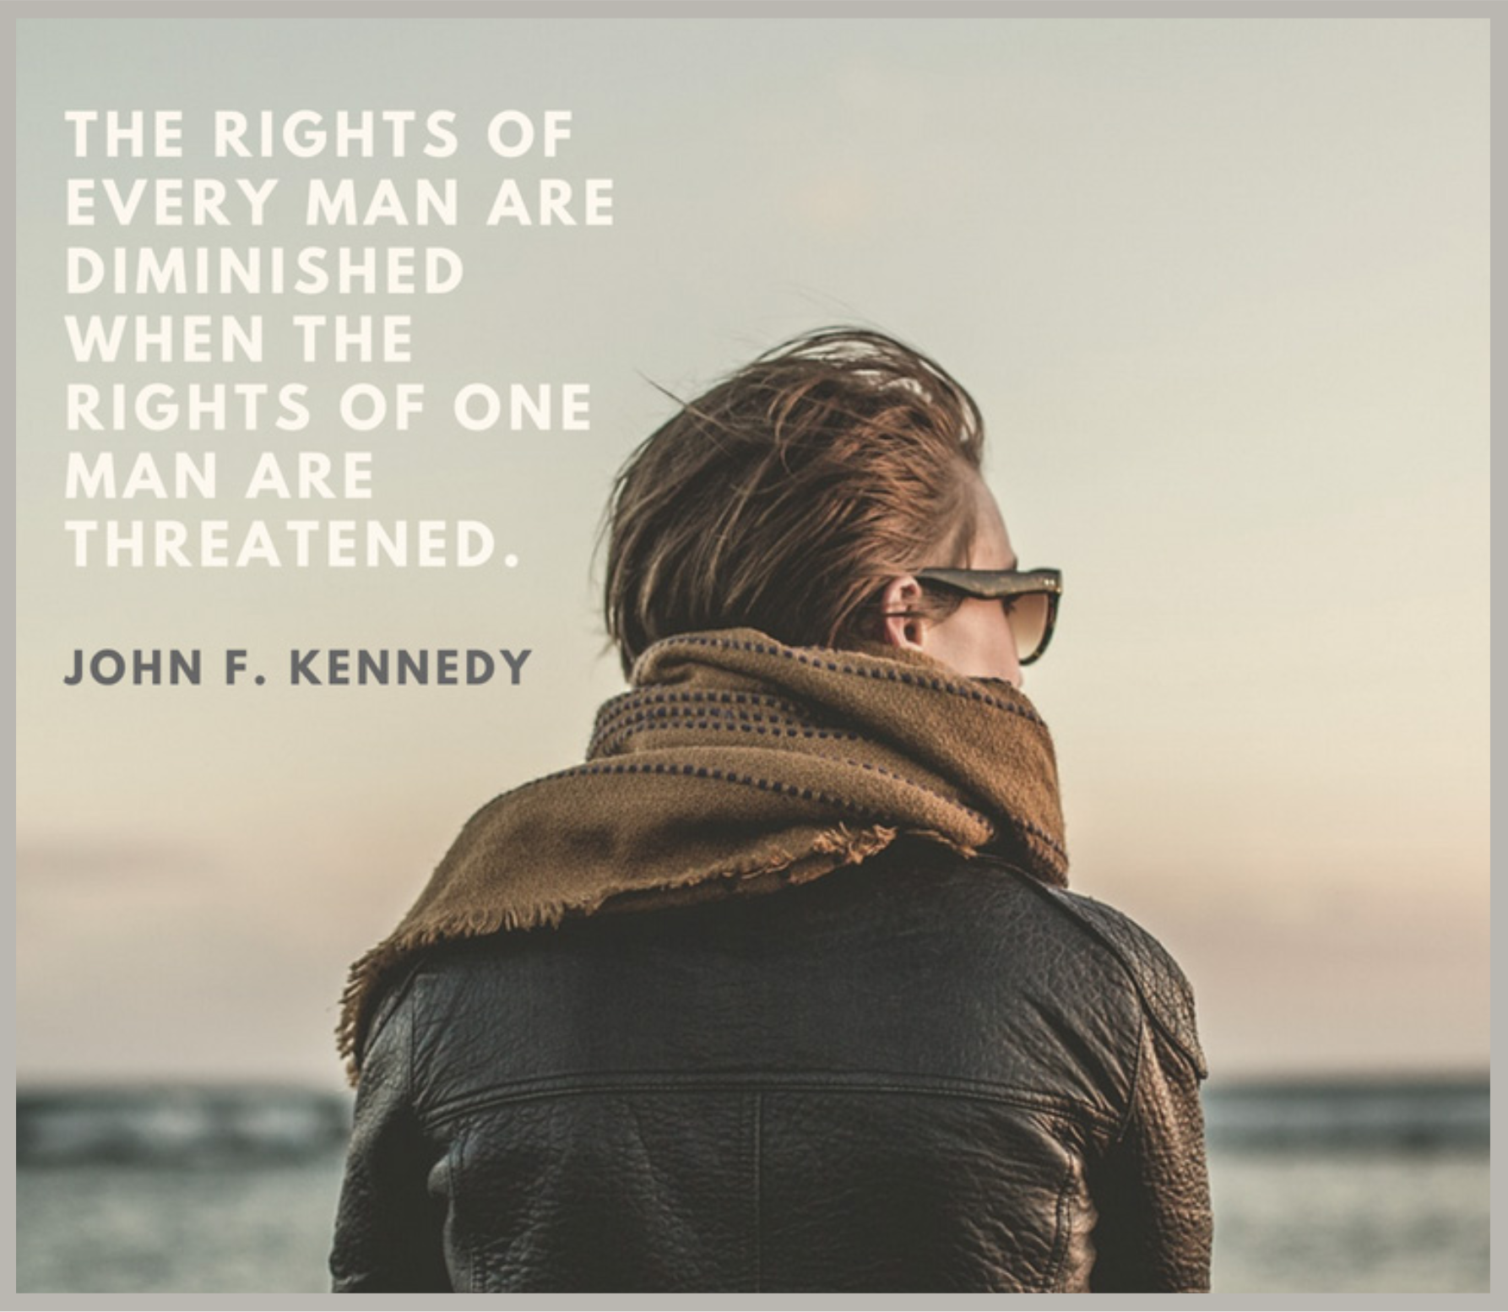


Slide 6
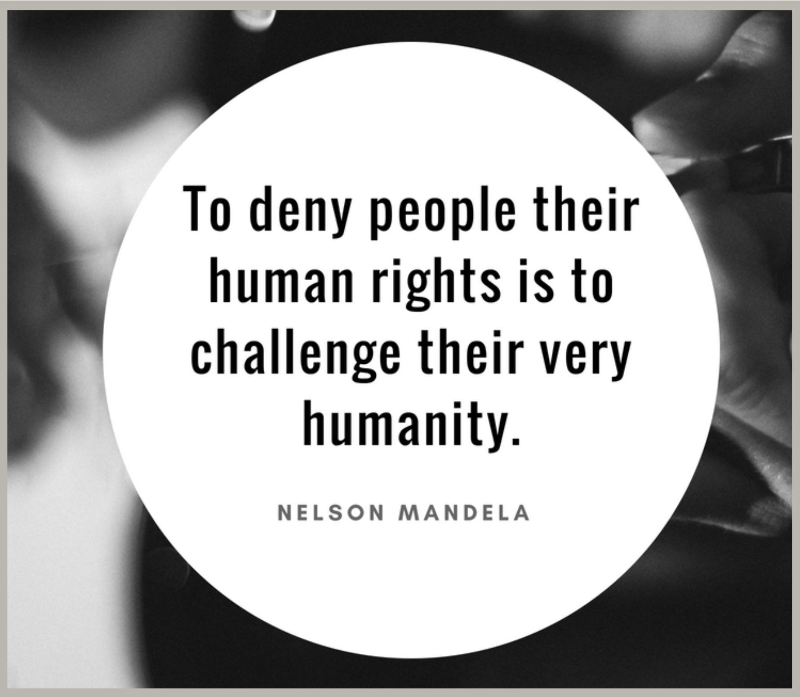
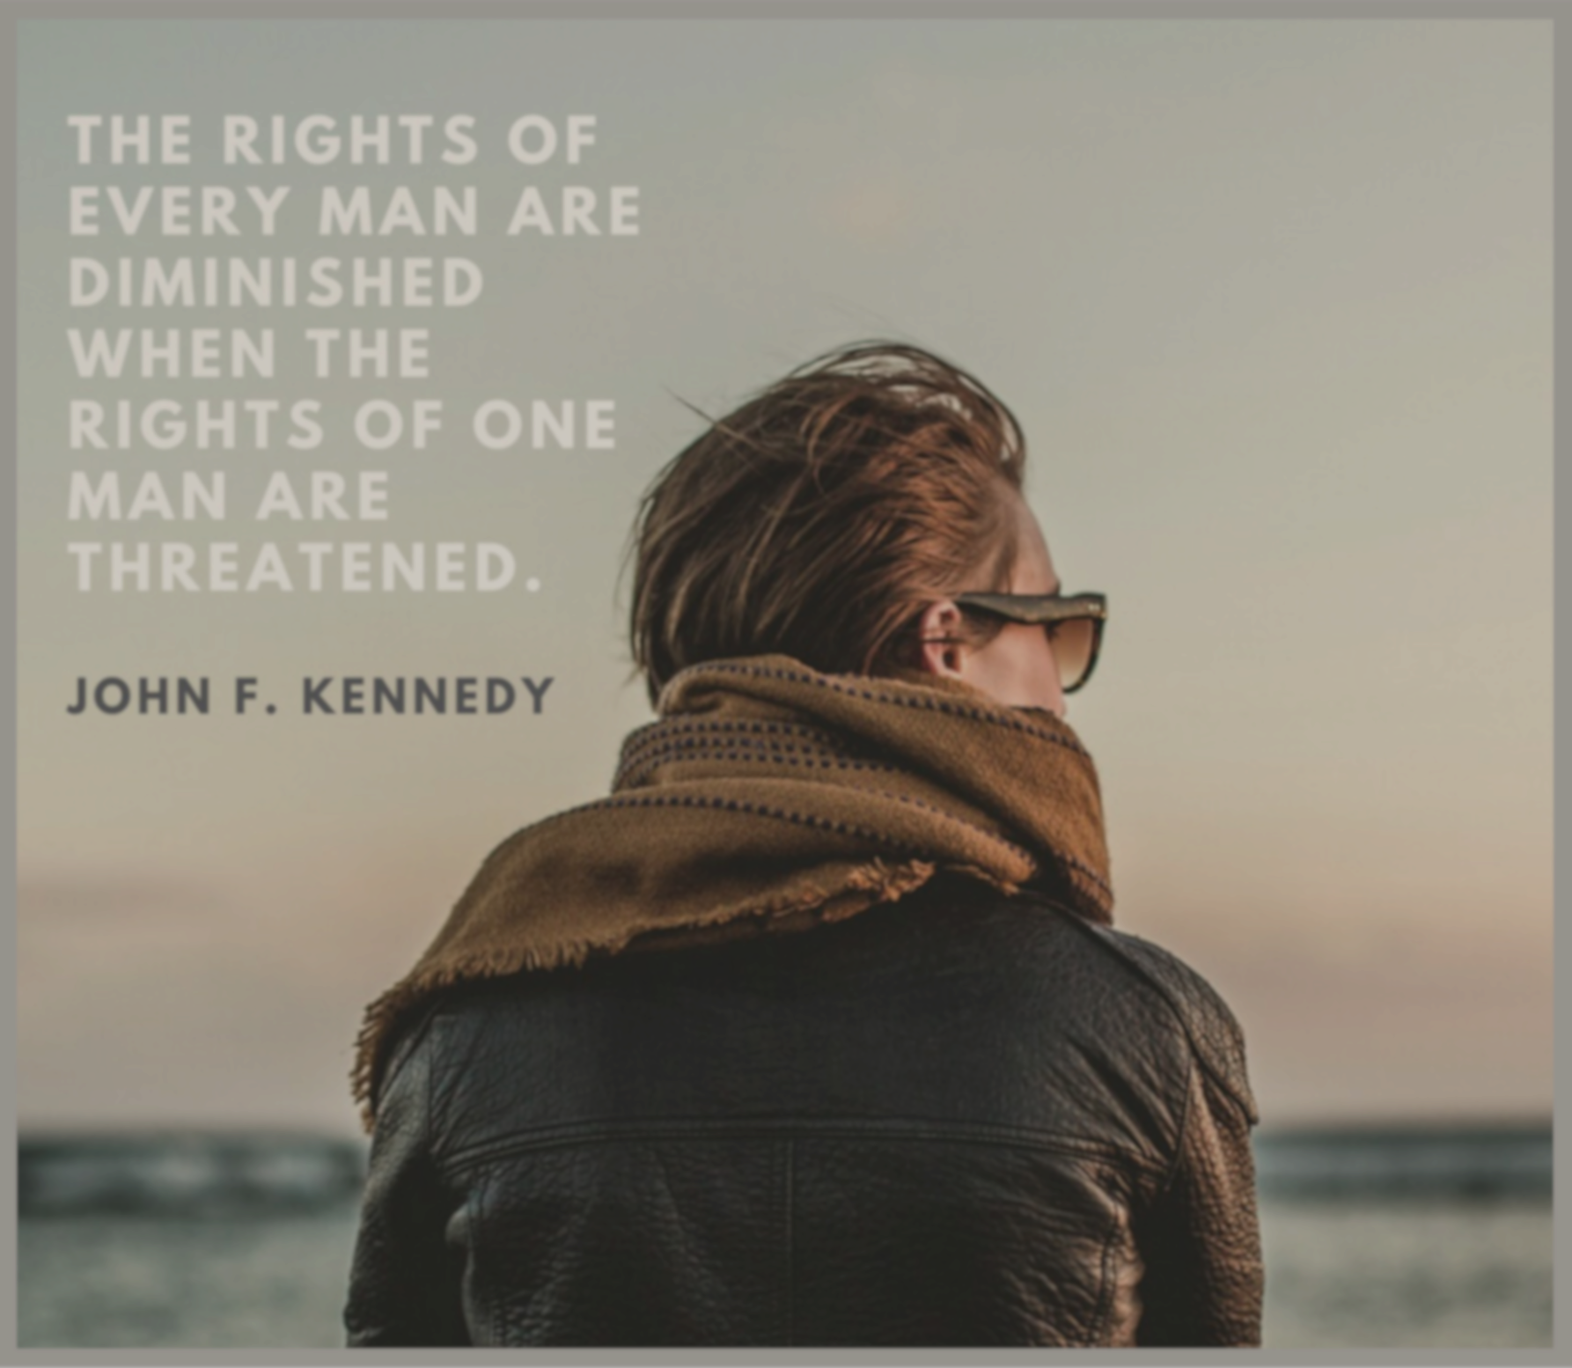

Slide 7
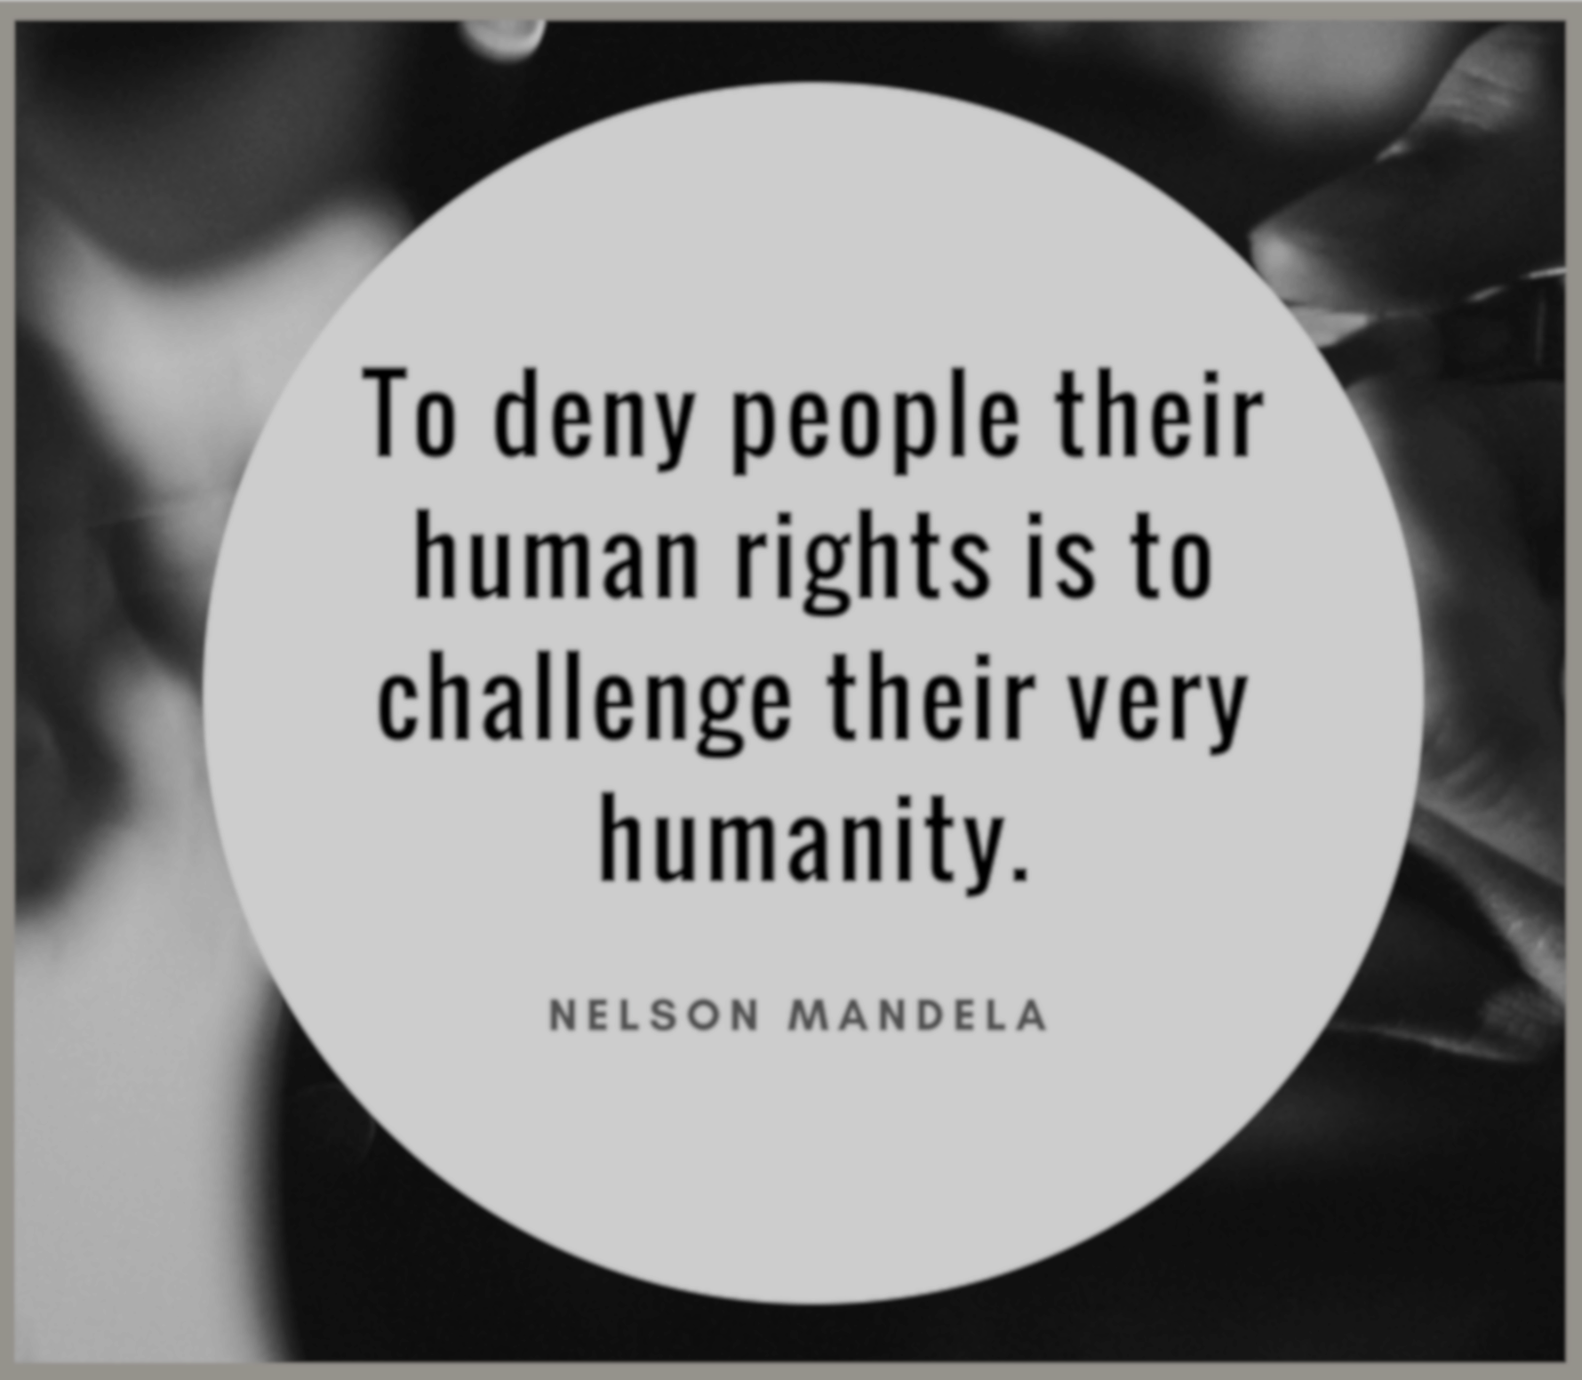
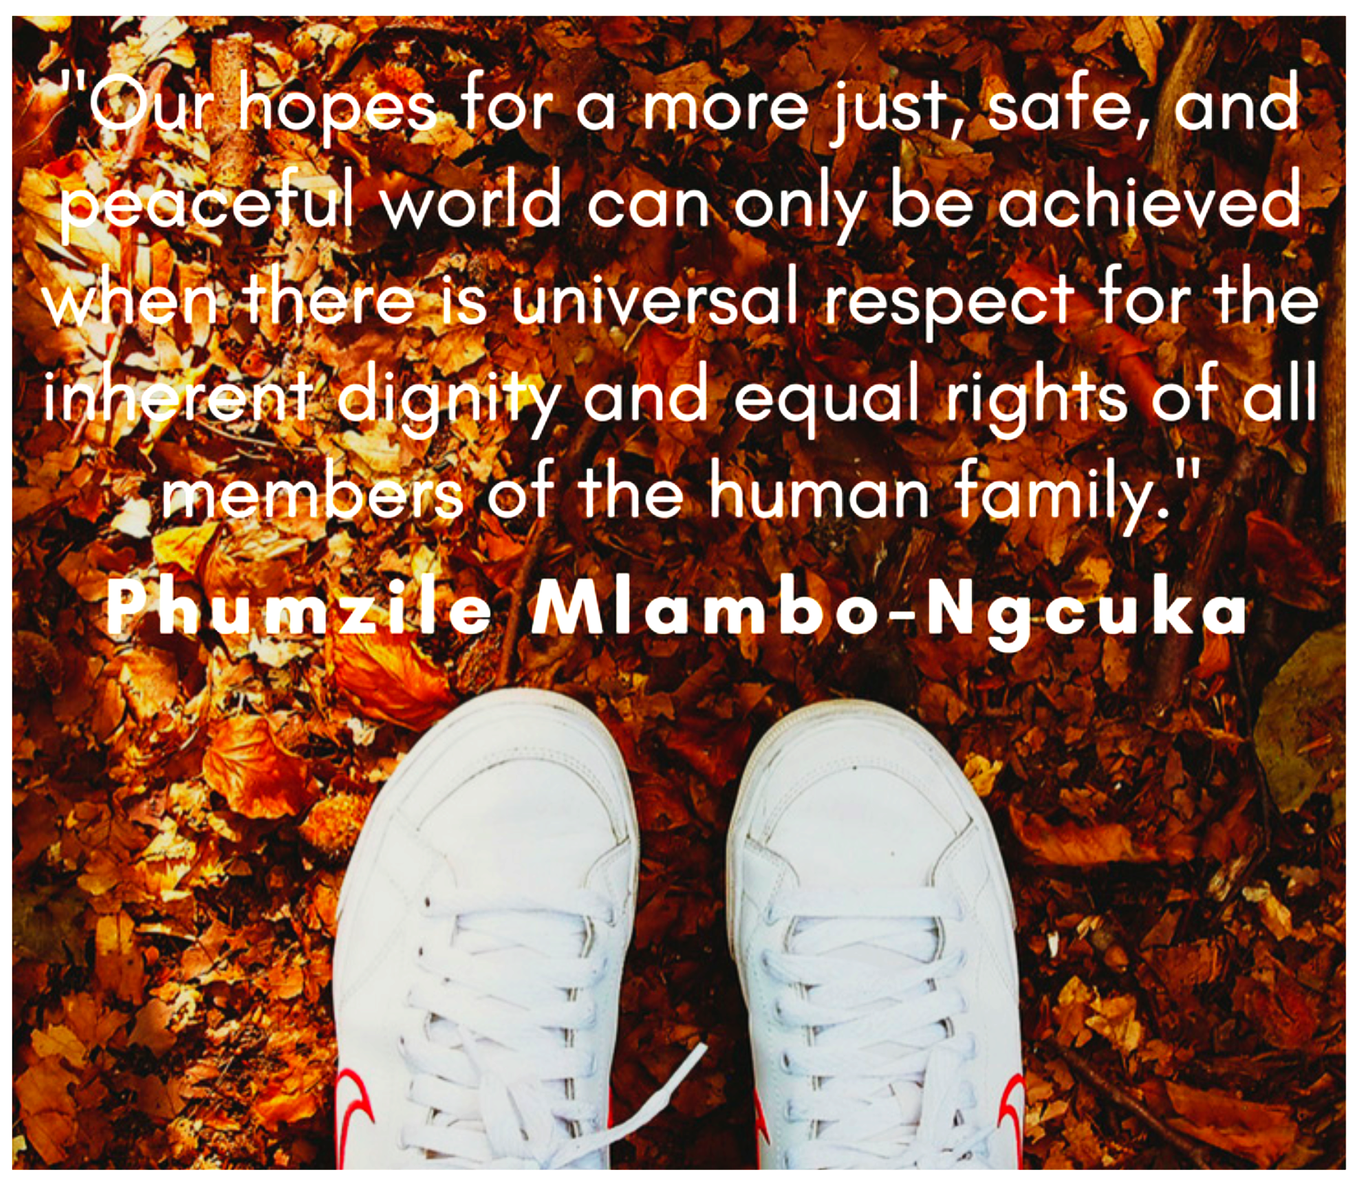

Slide 8
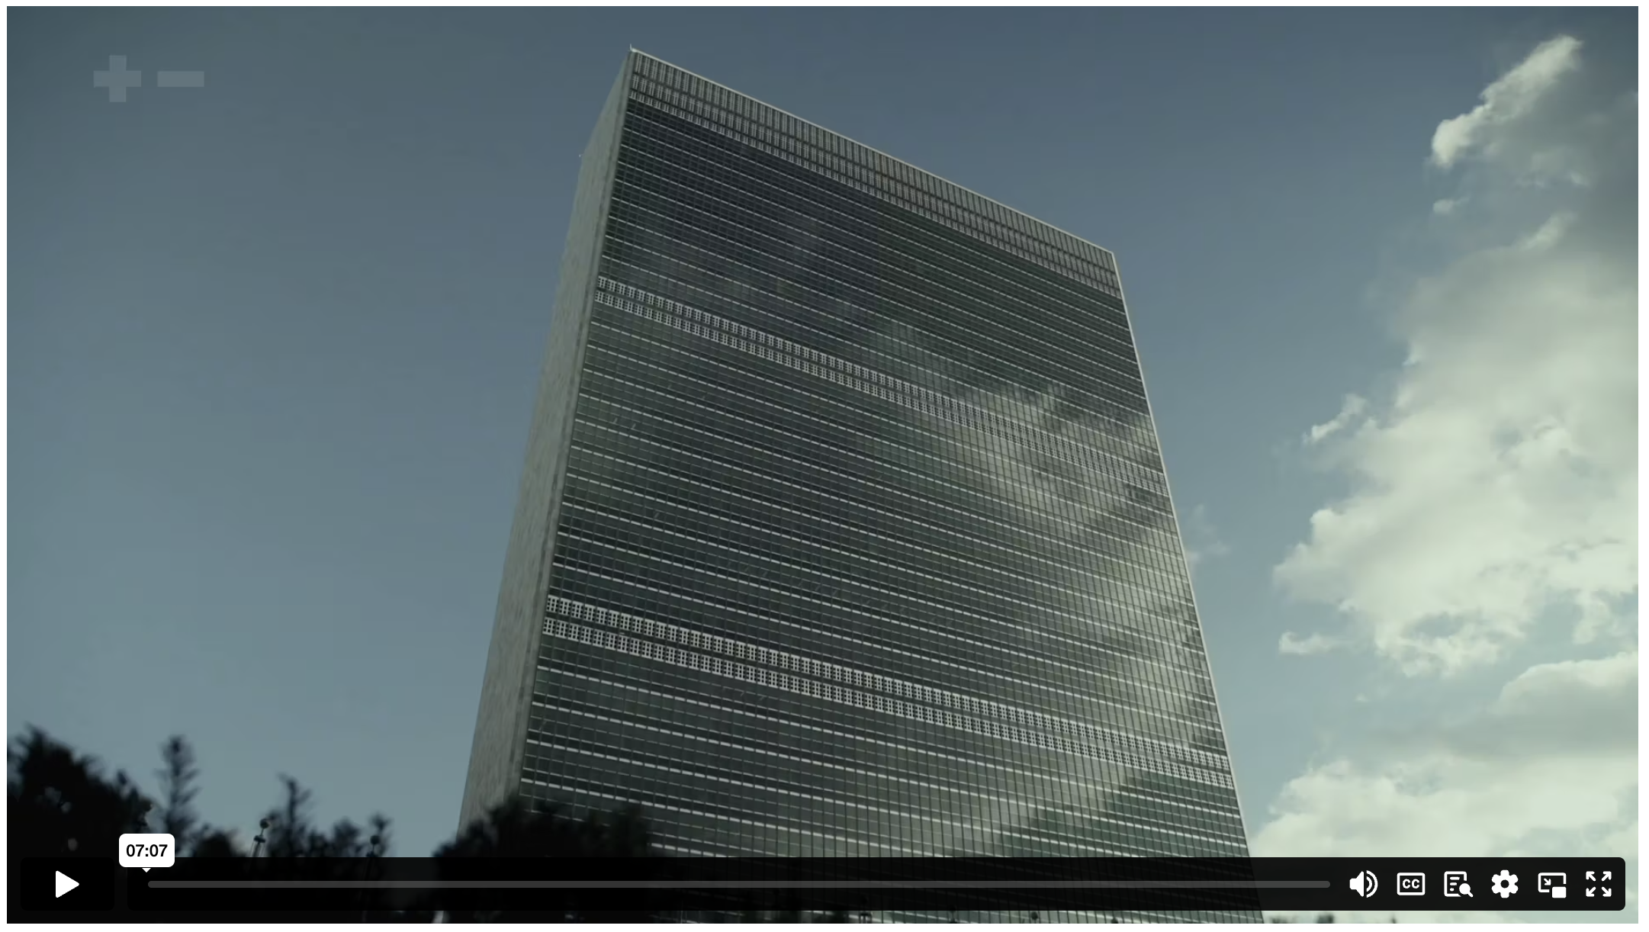
THE GENESIS OF HUMAN RIGHTS
Notes:
Content Clip for this lesson

Slide 9
The UNIVERSAL DECLARATION OF HUMAN RIGHTS
All human beings are born free and equal in dignity and rights.
Everyone has the right to life, liberty and security of person.
No one shall be held in slavery or servitude.
Everyone has the right to freedom of thought, conscience and religion.
Everyone has the right to freedom of opinion and expression.
Notes:
Students find or create an image to represent each article.

Slide 10
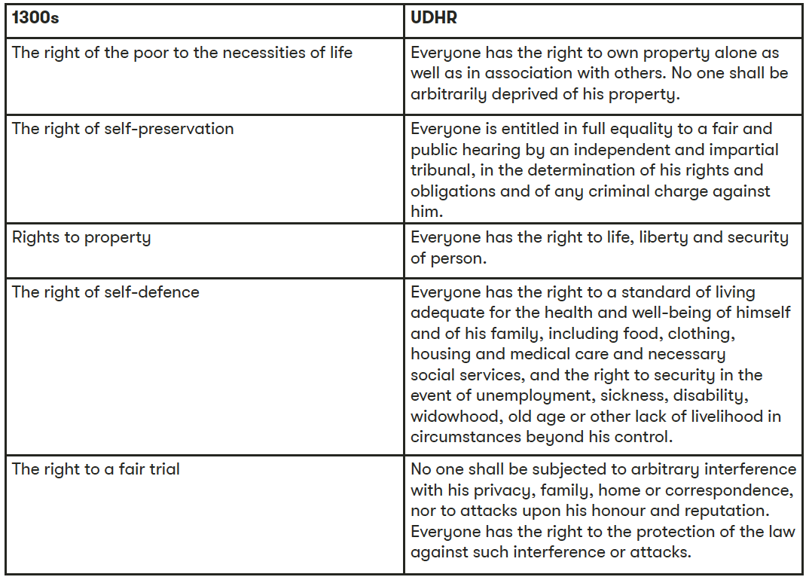
Notes:
Comparing the 1300’s rights with the Universal Declaration of Human Rights

Slide 11

I don’t doubt that Jesus Christ in particular brought about a revolution in thinking of people as equal in the sight of God...
Later, this idea of moral equality became an ideal of political equality, and there’s no doubt that that’s caused the world to change drastically.
SAMUEL MOYN
Notes:
Students offer specific examples of Christianity influencing the development of human rights.

Slide 12
⁸ Speak up for those who cannot speak for themselves;
ensure justice for those being crushed.
⁹ Yes, speak up for the poor and helpless,
and see that they get justice.
PROVERBS 31 (NLT)

Slide 13
²⁶ So in Christ Jesus you are all children of God through faith, ²⁷ for all of you who were baptised into Christ have clothed yourselves with Christ. ²⁸ There is neither Jew nor Gentile, neither slave nor free, nor is there male and female, for you are all one in Christ Jesus.
GALATIANS 3 (NLT)

Slide 14
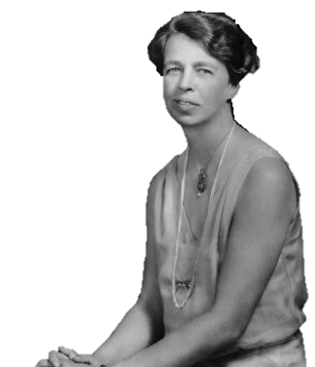
Where, after all, do universal human rights begin? In small places, close to home – so close and so small that they cannot be seen on any maps of the world…
Unless these rights have meaning there, they have little meaning anywhere. Without concerned citizen action to uphold them close to home, we shall look in vain for progress in the larger world.
ELEANOR ROOSEVELT
Notes:
In what ways can your local community or Australia as a whole make improvements in the way we uphold universal human rights?

Slide 16
Scripture quotations marked (CEV) are from the Contemporary English Version Copyright © 1991, 1992, 1995 by American Bible Society. Used by Permission.
Scripture quotations marked (ESV) are from the ESV® Bible (The Holy Bible, English Standard Version®), © 2001 by Crossway, a publishing ministry of Good News Publishers. Used by permission. All rights reserved.
Scripture quotations marked (MSG) are taken from The Message, copyright © 1993, 2002, 2018 by Eugene H. Peterson. Used by permission of NavPress. All rights reserved. Represented by Tyndale House Publishers.
Scripture quotations marked (NIV) are taken from the Holy Bible, New International Version®, NIV®. Copyright © 1973, 1978, 1984, 2011 by Biblica, Inc.™ Used by permission of Zondervan. All rights reserved worldwide.
Scripture quotations marked (NIVUK) are taken from the Holy Bible, New International Version® Anglicized, NIV® Copyright © 1979, 1984, 2011 by Biblica, Inc.® Used by permission of Zondervan. All rights reserved worldwide.
Scripture quotations marked (NLT) are taken from the Holy Bible, New Living Translation, copyright ©1996, 2004, 2015 by Tyndale House Foundation. Used by permission of Tyndale House Publishers, Carol Stream, Illinois 60188. All rights reserved.
Notes:
Bible Translation Copyright Credits

