Slide 1
IMAGE OF GOD (II)
For the Love of God
The Future of Human Dignity

Slide 2
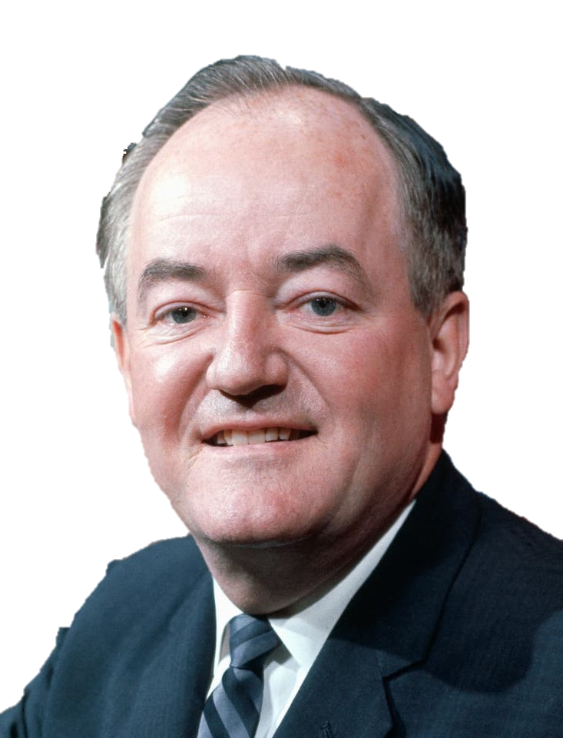
The moral test of government is how that government treats those who are in the dawn of life, the children; those who are in the twilight of life, the elderly; and those who are in the shadows of life, the sick, the needy, and the handicapped.
HUBERT H. HUMPHREY
Notes:
US Vice President 1965-1969
Discuss how important this idea is, and how much it should shape society.

Slide 3
THE IMAGE OF GOD: THE FUTURE
Notes:
Content Clip for this lesson

Slide 4
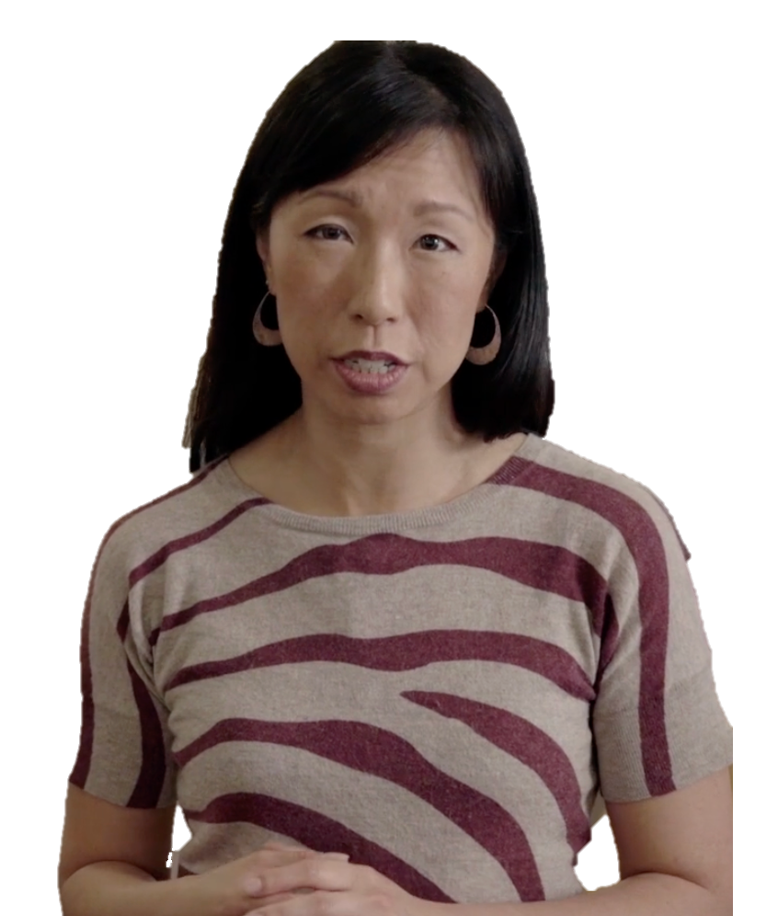
For a long time, the worth of those on the margins – the child with a disability, the person with dementia – has been safeguarded by this notion that there’s something divine about even the most broken or powerless person.
JUTSINE TOH
Notes:
Discuss what might be “beautiful” about showing care and respect to someone who isn’t successful or powerful by the world’s standards?

Slide 5
Summarise what it means to ‘Be made in the Image of God.’

Slide 6
Christianity has taken the side of everything weak, base, ill-constituted… Christianity is called the religion of compassion… One loses force when one has compassion... Compassion on the whole thwarts the law of evolution, which is the law of selection. It preserves what is ripe for destruction, it defends life’s disinherited and condemned… in every noble morality it counts as weakness… Nothing in our unhealthy modernity is more unhealthy than Christian compassion.
FRIEDRICH NIETZSCHE on ‘Compassion’

Slide 7
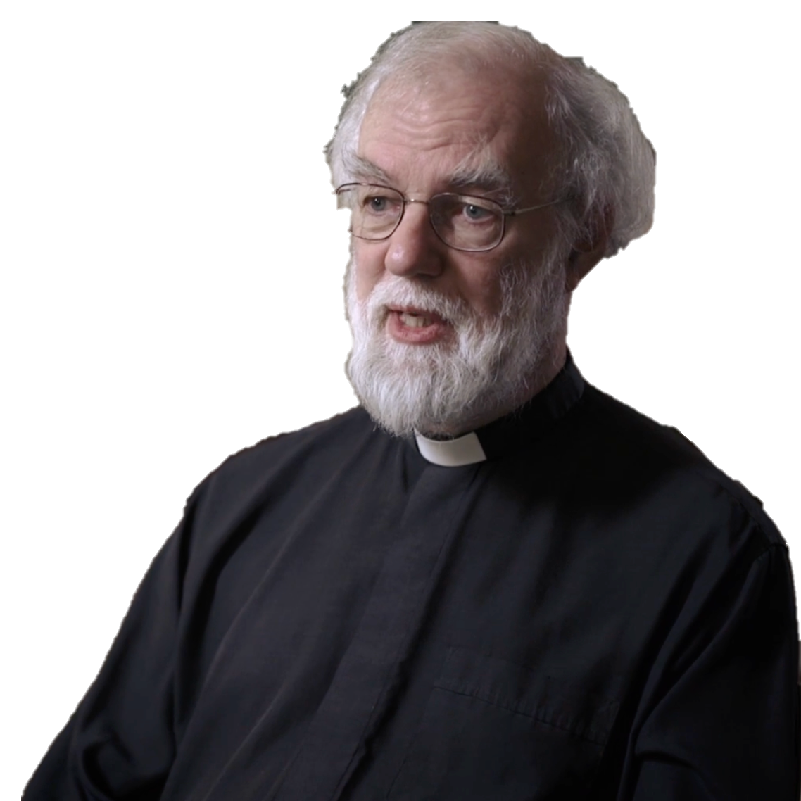
[Being made in the image of God is] …a very, very robust anchorage for human rights…
I do believe personally it’s quite difficult to sustain the kind of absolute doctrine of human rights in the long run without that…
ROWAN WILLIAMS

Slide 8
³¹ “But when the Son of Man comes in his glory, and all the angels with him, then he will sit upon his glorious throne. ³² All the nations will be gathered in his presence, and he will separate the people as a shepherd separates the sheep from the goats. ³³ He will place the sheep at his right hand and the goats at his left.
³⁴ “Then the King will say to those on his right, ‘Come, you who are blessed by my Father, inherit the Kingdom prepared for you from the creation of the world. ³⁵ For I was hungry, and you fed me. I was thirsty, and you gave me a drink. I was a stranger, and you invited me into your home. ³⁶ I was naked, and you gave me clothing. I was sick, and you cared for me. I was in prison, and you visited me.’
MATTHEW 25 (NLT)

Slide 9
³⁷ “Then these righteous ones will reply, ‘Lord, when did we ever see you hungry and feed you? Or thirsty and give you something to drink? ³⁸ Or a stranger and show you hospitality? Or naked and give you clothing? ³⁹ When did we ever see you sick or in prison and visit you?’
⁴⁰ “And the King will say, ‘I tell you the truth, when you did it to one of the least of these my brothers and sisters, you were doing it to me!’
MATTHEW 25 (NLT)

Slide 10
⁹ Sometimes [the tongue] praises our Lord and Father, and sometimes it curses those who have been made in the image of God. ¹⁰ And so blessing and cursing come pouring out of the same mouth. Surely, my brothers and sisters, this is not right!
JAMES 3 (NLT)

Slide 11
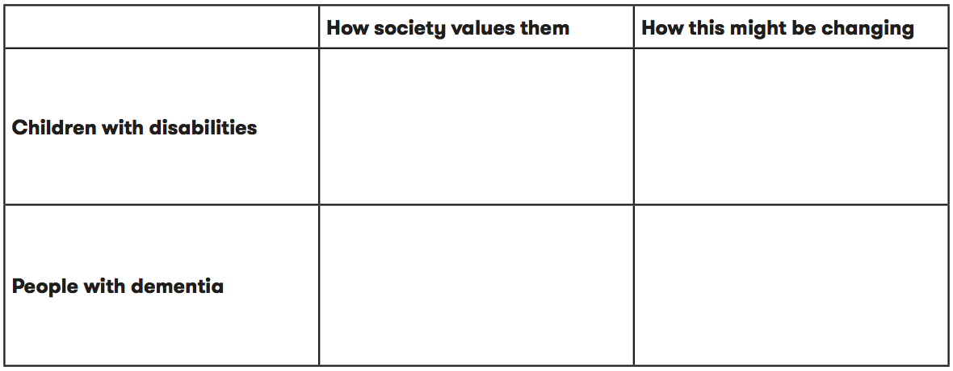
ANALYSE

Slide 13
Scripture quotations marked (CEV) are from the Contemporary English Version Copyright © 1991, 1992, 1995 by American Bible Society. Used by Permission.
Scripture quotations marked (ESV) are from the ESV® Bible (The Holy Bible, English Standard Version®), © 2001 by Crossway, a publishing ministry of Good News Publishers. Used by permission. All rights reserved.
Scripture quotations marked (MSG) are taken from The Message, copyright © 1993, 2002, 2018 by Eugene H. Peterson. Used by permission of NavPress. All rights reserved. Represented by Tyndale House Publishers.
Scripture quotations marked (NIV) are taken from the Holy Bible, New International Version®, NIV®. Copyright © 1973, 1978, 1984, 2011 by Biblica, Inc.™ Used by permission of Zondervan. All rights reserved worldwide.
Scripture quotations marked (NIVUK) are taken from the Holy Bible, New International Version® Anglicized, NIV® Copyright © 1979, 1984, 2011 by Biblica, Inc.® Used by permission of Zondervan. All rights reserved worldwide.
Scripture quotations marked (NLT) are taken from the Holy Bible, New Living Translation, copyright ©1996, 2004, 2015 by Tyndale House Foundation. Used by permission of Tyndale House Publishers, Carol Stream, Illinois 60188. All rights reserved.
Notes:
Bible Translation Copyright Credits

