Slide 1

CURBING VIOLENCE
For the Love of God
Just War and the Peace of God

Slide 2
Jesus taught his followers to “love their enemies”. So, should Christians join the military?
Notes:
Discussion question.

Slide 3

Notes:
What is the purpose of having clear rules for sport?
Why is having clear rules in sport a good thing?
Photo by Fancy Crave on Unsplash

Slide 4
‘Just War’
Notes:
Students find or create an image that represents the phrase “Just War”.
Students describe and define the term “Just War”.

Slide 5
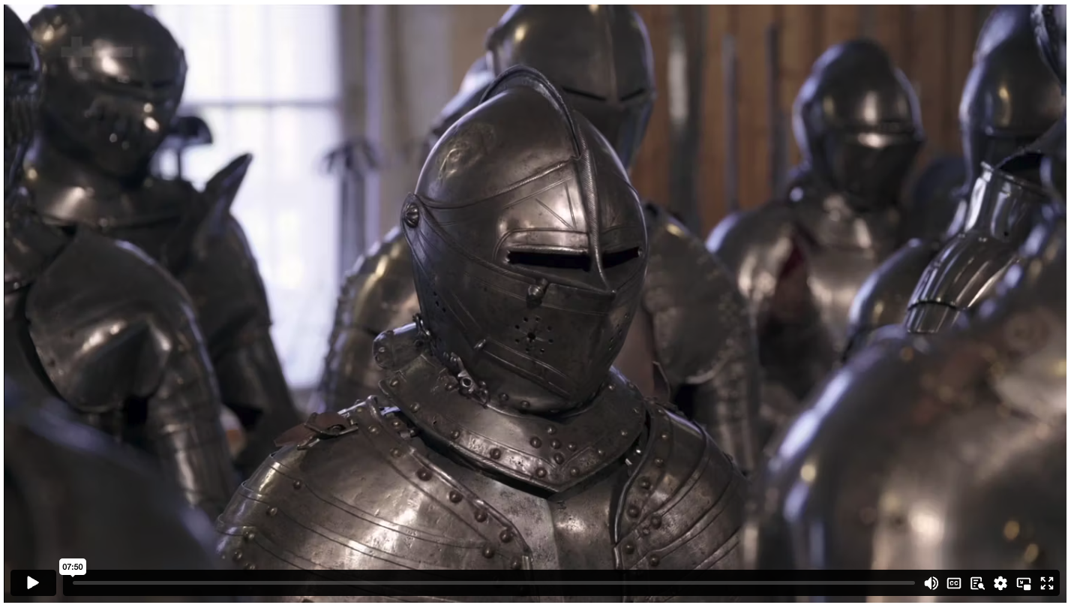
CURBING VIOLENCE
Notes:
Content Clip for this lesson

Slide 6

Christians have always been part of wars.
(TRUE or FALSE)
Notes:
False

Slide 7
Just war theory assumes that going to war is a good option.
(TRUE or FALSE)
Notes:
False

Slide 8
Many early Christians
died for their beliefs.
(TRUE or FALSE)
Notes:
True

Slide 9
Most of the Roman
emperors were Christians.
(TRUE or FALSE)
Notes:
False

Slide 10
Augustine was very pro-war.
(TRUE or FALSE)
Notes:
False

Slide 11
¹⁷ Never pay back evil with more evil. Do things in such a way that everyone can see you are honourable. ¹⁸ Do all that you can to live in peace with everyone.
¹⁹ Dear friends, never take revenge. Leave that to the righteous anger of God. For the Scriptures say,
“I will take revenge; I will pay them back,”^{[a]} says the Lord.
²⁰ Instead, “If your enemies are hungry, feed them.
If they are thirsty, give them something to drink.
In doing this, you will heap burning coals of shame on their heads.”^{[b]}
²¹ Don’t let evil conquer you, but conquer evil by doing good.
  ROMANS 12 (NLT)
Notes:
a – Deuteronomy 32.35
b – Proverbs 25.21-22

Slide 12
¹ This is a vision that Isaiah son of Amoz saw concerning Judah and Jerusalem:
² In the last days, the mountain of the Lord’s house
will be the highest of all – the most important place on earth.
It will be raised above the other hills,
and people from all over the world will stream there to worship.
³ People from many nations will come and say,
“Come, let us go up to the mountain of the Lord, to the house of Jacob’s God.
There he will teach us his ways, and we will walk in his paths.”
For the Lord’s teaching will go out from Zion; his word will go out from Jerusalem.
⁴ The Lord will mediate between nations and will settle international disputes.
They will hammer their swords into ploughshares and their spears into pruning hooks.
Nation will no longer fight against nation, nor train for war anymore.
⁵ Come, descendants of Jacob, let us walk in the light of the Lord!
  ISAIAH 2 (NLT)
Notes:
Context: This passage is written by the Old Testament prophet Isaiah, and through poetic, metaphorical language, gives a picture of what God’s future kingdom will look like.

Slide 13
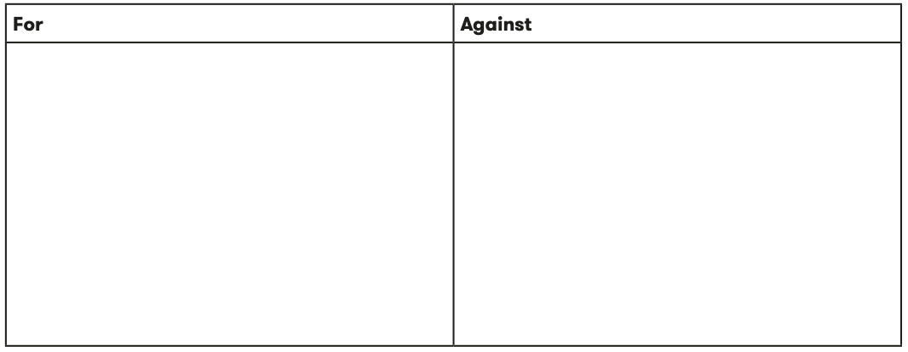
  “Just War Theory is a positive contribution
  Christianity has had on the world.”

Slide 14
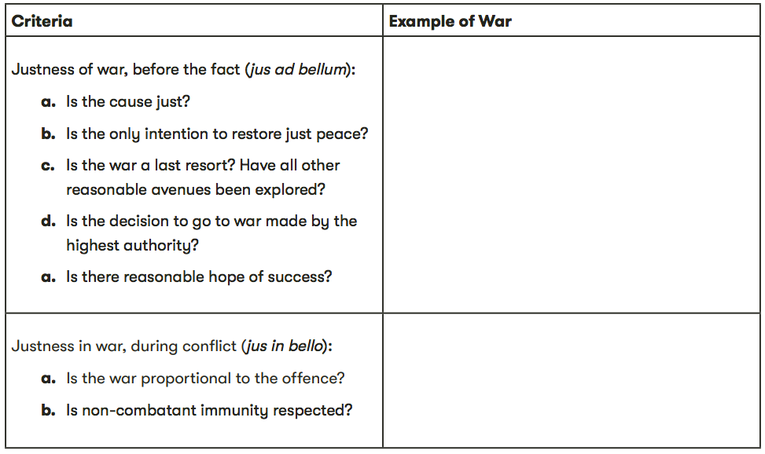
  JUST WAR CRITERIA

Slide 16
Scripture quotations marked (CEV) are from the Contemporary English Version Copyright © 1991, 1992, 1995 by American Bible Society. Used by Permission.
Scripture quotations marked (ESV) are from the ESV® Bible (The Holy Bible, English Standard Version®), © 2001 by Crossway, a publishing ministry of Good News Publishers. Used by permission. All rights reserved.
Scripture quotations marked (MSG) are taken from The Message, copyright © 1993, 2002, 2018 by Eugene H. Peterson. Used by permission of NavPress. All rights reserved. Represented by Tyndale House Publishers.
Scripture quotations marked (NIV) are taken from the Holy Bible, New International Version®, NIV®. Copyright © 1973, 1978, 1984, 2011 by Biblica, Inc.™ Used by permission of Zondervan. All rights reserved worldwide.
Scripture quotations marked (NIVUK) are taken from the Holy Bible, New International Version® Anglicized, NIV® Copyright © 1979, 1984, 2011 by Biblica, Inc.® Used by permission of Zondervan. All rights reserved worldwide.
Scripture quotations marked (NLT) are taken from the Holy Bible, New Living Translation, copyright ©1996, 2004, 2015 by Tyndale House Foundation. Used by permission of Tyndale House Publishers, Carol Stream, Illinois 60188. All rights reserved.
Notes:
Bible Translation Copyright Credits

