Slide 1

‘LOVE YOUR ENEMIES’
For the Love of God
What Jesus had to say about Violence

Slide 2
Jesus’ attitude to violence.
Find & share an image that describes:

Slide 3
²³…a life for a life, ²⁴ an eye for an eye, a tooth for a tooth, a hand for a hand, a foot for a foot, ²⁵ a burn for a burn, a wound for a wound, a bruise for a bruise.
EXODUS 21 (NLT)
Notes:
Discuss whether or not the statement “an eye for an eye and a tooth for a tooth” is justifiable and when it might be helpful.

Slide 4

“… Mahatma Gandhi, the most influential person in India … had close contacts with evangelical Christians in England, South Africa, and India, and his knowledge of Christian doctrine was considerable. His concept of nonviolence (satyagraha), which he used so effectively against the British Raj, he got from the Sermon on the Mount, not the Bhagavad Gita.”
Notes:
Evangelical: Adherents to Christianity who give the authority of the Bible the highest weight
Sermon on the Mount: A long passage of Jesus’ teaching, recorded in Matthew 5-7
Bhagavad Gita: A key sacred text of Hinduism

Slide 5
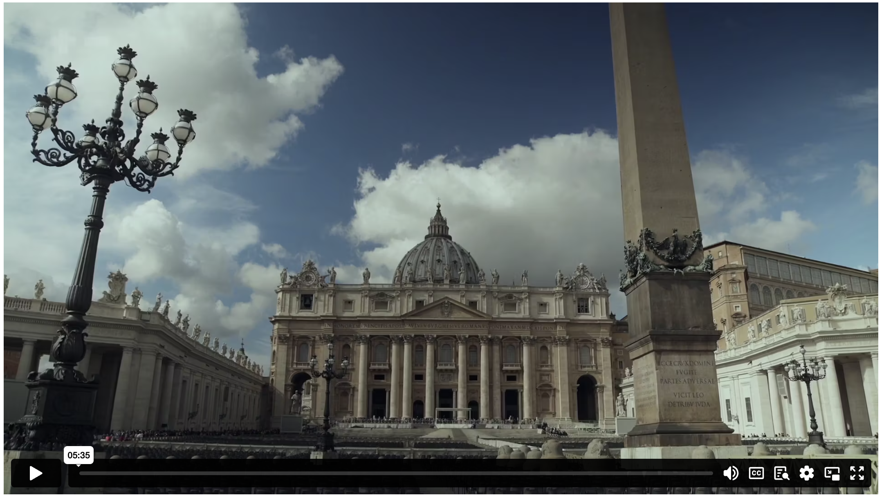
LOVE YOUR ENEMIES
Notes:
Content Clip for this lesson

Slide 6

In response to their anger, be gentle; in response to their boasts, be humble; in response to their cruelty, be civilised.
Do not be eager to imitate them. Let us show by our gracious forbearance that we are their brothers and sisters. Let us be eager to be imitators of the Lord.
IGNATIUS: LETTER TO THE EPHESIANS
Notes:
Ignatius was a first century Christian leader.
Martyred during Emperor Trajan’s persecution.
Students explain how these behaviours would have been counter-cultural in the Roman Empire.

Slide 7
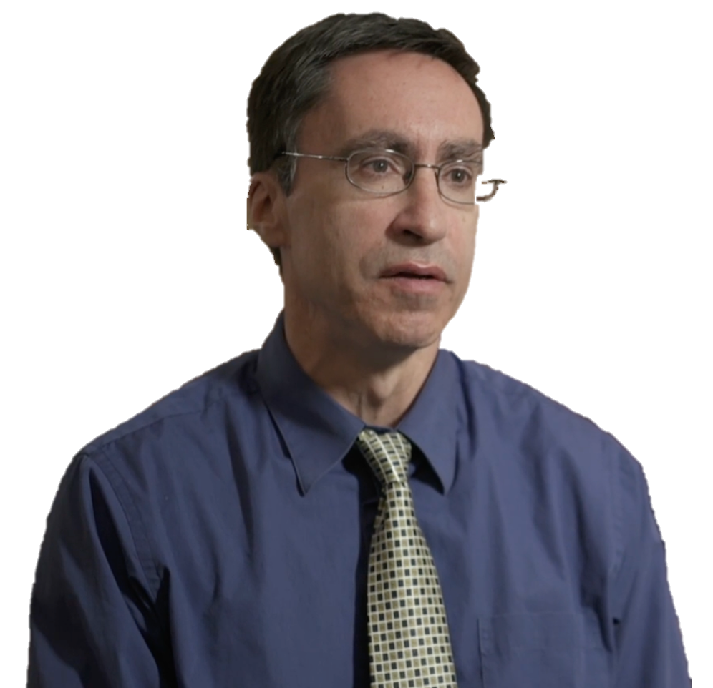
The early Christians… would prefer to go to [their] death rather than shed blood, and so the early Christian church is full of martyrs.
WILLIAM CAVANAUGH
Notes:
Discuss what was so attractive about Jesus’ message of non-violence for these early Christians, and how the class feels about this idea.

Slide 8
Jesus:
^{“9} Blessed are the peacemakers,
for they will be called children of God.
¹⁰ Blessed are those who are persecuted because of righteousness,
for theirs is the kingdom of heaven.”
MATTHEW 5 (NIVUK)

Slide 9
Jesus:
^{“38} ‘You have heard that it was said, “Eye for eye, and tooth for tooth.” ³⁹ But I tell you, do not resist an evil person. If anyone slaps you on the right cheek, turn to them the other cheek also. ⁴⁰ And if anyone wants to sue you and take your shirt, hand over your coat as well. ⁴¹ If anyone forces you to go one mile, go with them two miles. ⁴² Give to the one who asks you, and do not turn away from the one who wants to borrow from you.
MATTHEW 5 (NIVUK)

Slide 10
⁴³ ‘You have heard that it was said, “Love your neighbour and hate your enemy.” ⁴⁴ But I tell you, love your enemies and pray for those who persecute you, ⁴⁵ that you may be children of your Father in heaven. He causes his sun to rise on the evil and the good, and sends rain on the righteous and the unrighteous. ⁴⁶ If you love those who love you, what reward will you get? Are not even the tax collectors doing that? ⁴⁷ And if you greet only your own people, what are you doing more than others? Do not even pagans do that? ⁴⁸ Be perfect, therefore, as your heavenly Father is perfect.”
MATTHEW 5 (NIVUK)

Slide 11
⁶ You see, at just the right time, when we were still powerless, Christ died for the ungodly. ⁷ Very rarely will anyone die for a righteous person, though for a good person someone might possibly dare to die. ⁸ But God demonstrates his own love for us in this: while we were still sinners, Christ died for us.
⁹ Since we have now been justified by his blood, how much more shall we be saved from God’s wrath through him! ¹⁰ For if, while we were God’s enemies, we were reconciled to him through the death of his Son, how much more, having been reconciled, shall we be saved through his life!
ROMANS 5 (NIVUK)

Slide 12
In response to their anger, be gentle; in response to their boasts, be humble; in response to their cruelty, be civilised.
Do not be eager to imitate them. Let us show by our gracious forbearance that we are their brothers and sisters. Let us be eager to be imitators of the Lord.
IGNATIUS: LETTER TO THE EPHESIANS
Notes:
Ignatius was a first century Christian leader.
Martyred during Emperor Trajan’s persecution.
Students explain how these behaviours would have been counter-cultural in the Roman Empire.

Slide 13

Pineapple should never be found on Pizza
Agree
Disagree
Notes:
Human Barometer Activity intro slide – delete the slides you don’t want

Slide 14
You can’t call chess
a sport
Agree
Disagree
Notes:
Human Barometer Activity intro slide – delete the slides you don’t want

Slide 15
The moon landing never really happened
Agree
Disagree
Notes:
Human Barometer Activity intro slide – delete the slides you don’t want

Slide 16
Marvel movies are an insult to our intelligence.
Agree
Disagree
Notes:
Human Barometer Activity intro slide – delete the slides you don’t want

Slide 17
People should be able to
‘Love their enemy’
Agree
Disagree

Slide 18
’Turning the other cheek’
is a recipe for abuse
Agree
Disagree

Slide 19
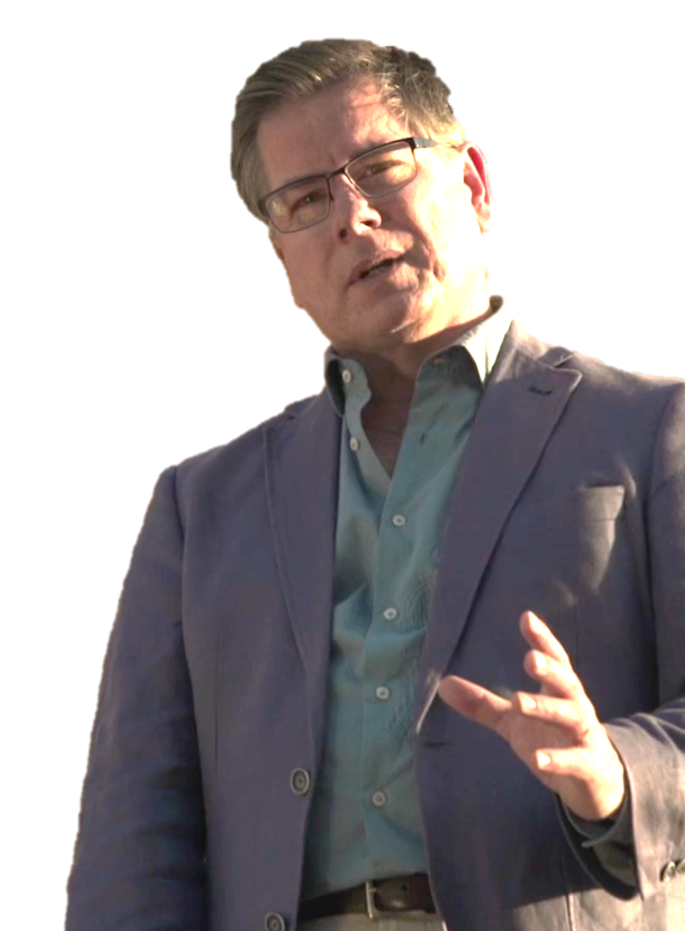
Anyone can tell you that when Christians are violent and imperialistic they are not obeying Jesus but defying him who said “love your enemy and do good to those who hate you.” At best, the criticisms launched by Hitchens, Dawkins and Coulter only prove that Christians haven’t been Christian enough. Believers confess that daily, and look to Christ for mercy and guidance.
JOHN DICKSON
Notes:
J. Dickson – https://publicchristianity.org/article/does-religion-cause-violence/
Discuss why you think Christians sometimes fail to follow Jesus’ teaching on violence.

Slide 21
Scripture quotations marked (CEV) are from the Contemporary English Version Copyright © 1991, 1992, 1995 by American Bible Society. Used by Permission.
Scripture quotations marked (ESV) are from the ESV® Bible (The Holy Bible, English Standard Version®), © 2001 by Crossway, a publishing ministry of Good News Publishers. Used by permission. All rights reserved.
Scripture quotations marked (MSG) are taken from The Message, copyright © 1993, 2002, 2018 by Eugene H. Peterson. Used by permission of NavPress. All rights reserved. Represented by Tyndale House Publishers.
Scripture quotations marked (NIV) are taken from the Holy Bible, New International Version®, NIV®. Copyright © 1973, 1978, 1984, 2011 by Biblica, Inc.™ Used by permission of Zondervan. All rights reserved worldwide.
Scripture quotations marked (NIVUK) are taken from the Holy Bible, New International Version® Anglicized, NIV® Copyright © 1979, 1984, 2011 by Biblica, Inc.® Used by permission of Zondervan. All rights reserved worldwide.
Scripture quotations marked (NLT) are taken from the Holy Bible, New Living Translation, copyright ©1996, 2004, 2015 by Tyndale House Foundation. Used by permission of Tyndale House Publishers, Carol Stream, Illinois 60188. All rights reserved.
Notes:
Bible Translation Copyright Credits

