Slide 1

POVERTY IN THE ANCIENT WORLD
For the Love of God
Early Christian Attitudes to the Poor

Slide 2
Describe a time in your life when you were confronted by the reality of poverty and/or inequality.
(PAIR & SHARE)
Notes:
Perhaps while travelling, or something they or a friend have experienced.

Slide 3
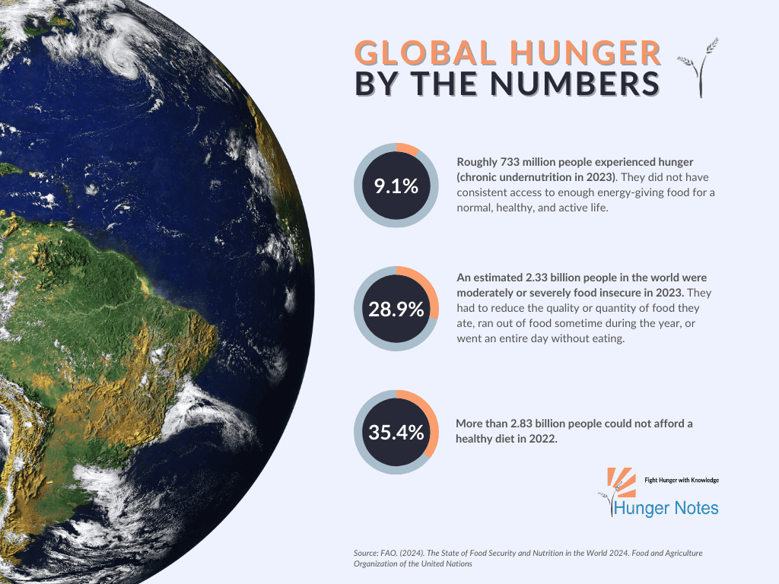

Slide 4
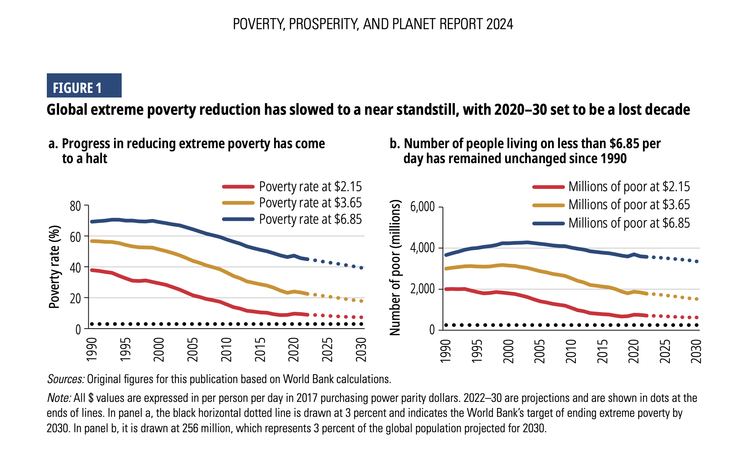

POVERTY, PROSPERITY AND PLANET REPORT 2024

Slide 5
POVERTY, PROSPERITY AND PLANET REPORT 2024

Slide 6
Pineapple should never be found on Pizza
Agree
Disagree
Notes:
Human Barometer Activity intro slide – delete the slides you don’t want

Slide 7
You can’t call chess
a sport
Agree
Disagree
Notes:
Human Barometer Activity intro slide – delete the slides you don’t want

Slide 8
The moon landing never really happened
Agree
Disagree
Notes:
Human Barometer Activity intro slide – delete the slides you don’t want

Slide 9
Marvel movies are an insult to our intelligence.
Agree
Disagree
Notes:
Human Barometer Activity intro slide – delete the slides you don’t want

Slide 10
Poor people deserve
to be poor
Agree
Disagree

Slide 11
Those who are wealthy have a responsibility to help the poor
Agree
Disagree

Slide 12
Giving to the poor is mostly about getting something back in the process
Agree
Disagree

Slide 13
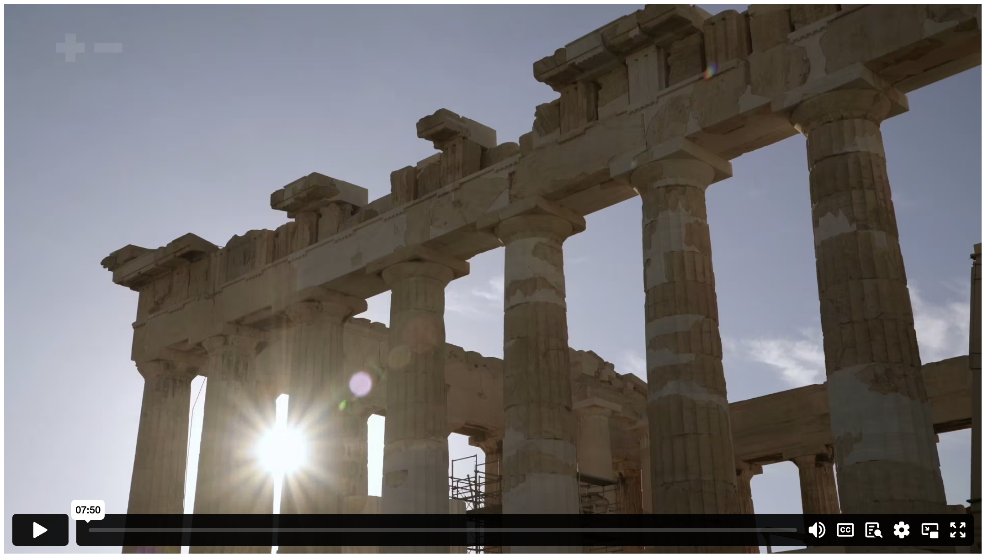
BEING POOR IN THE ANCIENT WORLD
Notes:
Content Clip for this lesson

Slide 14
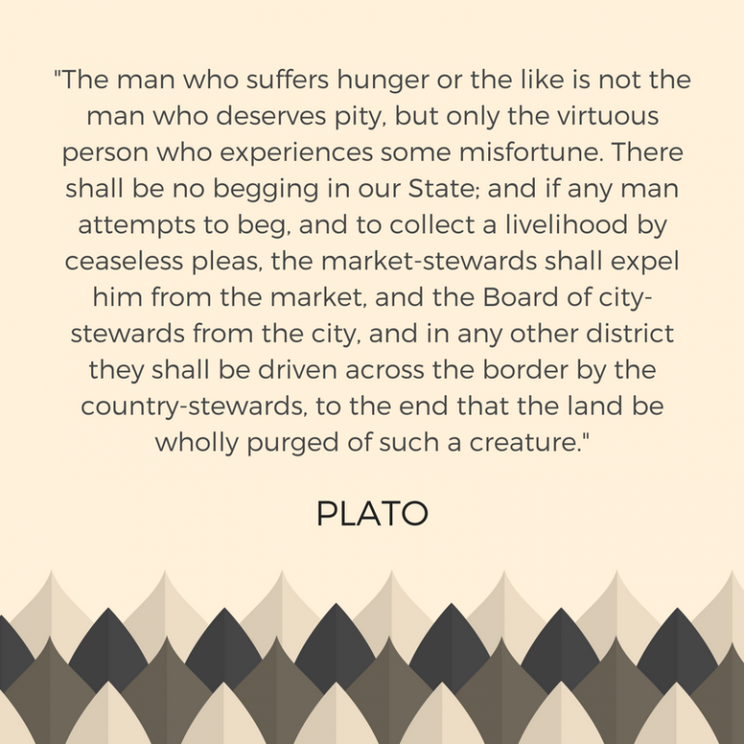


Slide 15
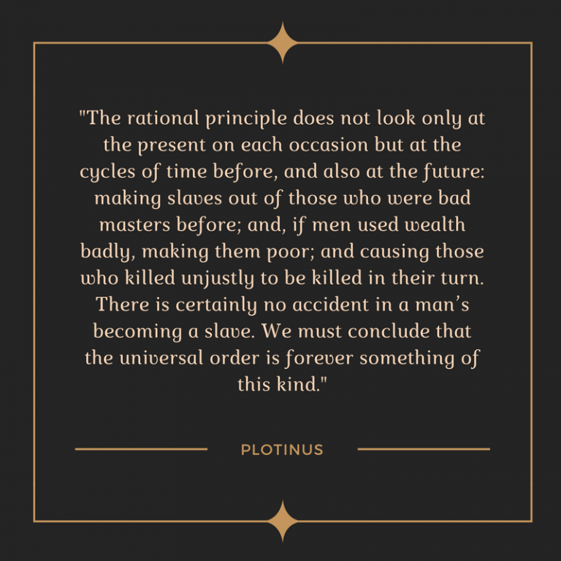

Slide 16
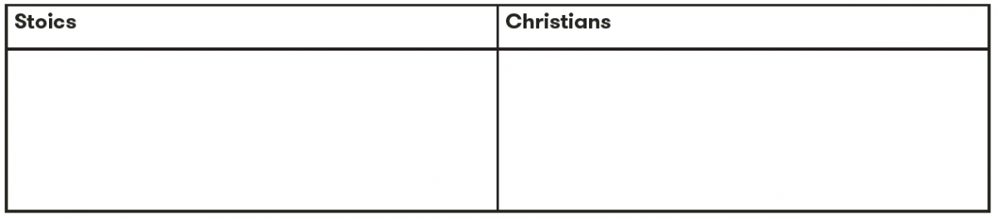
  COMPARE & CONTRAST
Notes:
Students fill out the table looking at what we know about the attitude of the Stoics and the Christians to the poor.

Slide 17
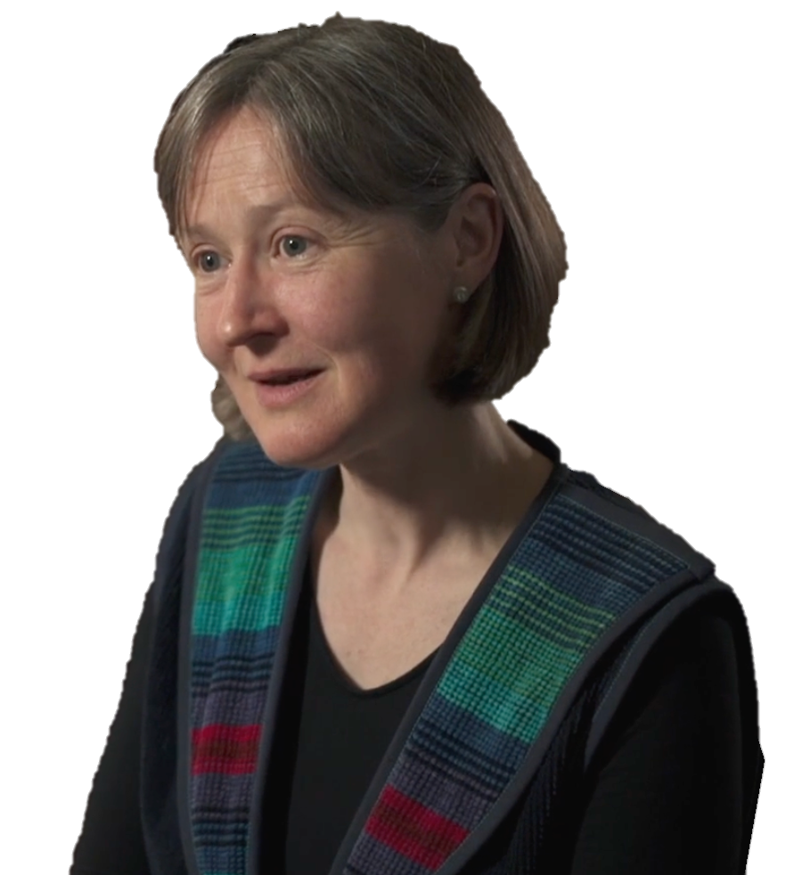
The Christian insistence that if those things are good they are good for everybody and they are always good – I think that was transformational for the Roman world and then for the Christian world and is perhaps the single greatest contribution of Christianity to public life.
TERESA MORGAN

Slide 18
^{14:31} Those who oppress the poor insult their Maker,
but helping the poor honours him.
^{19:17} If you help the poor, you are lending to the Lord – and he will repay you!
^{21:13} Those who shut their ears to the cries of the poor
will be ignored in their own time of need.
^{29:7} The godly care about the rights of the poor;
the wicked don’t care at all.
PROVERBS (NLT)

Slide 19
¹⁶ We know what real love is because Jesus gave up his life for us. So we also ought to give up our lives for our brothers and sisters. ¹⁷ If someone has enough money to live well and sees a brother or sister in need but shows no compassion – how can God’s love be in that person?
1 JOHN 3 (NLT)

Slide 20
^{14:31} Those who oppress the poor insult their Maker,
but helping the poor honours him.
^{19:17} If you help the poor, you are lending to the Lord – and he will repay you!
^{21:13} Those who shut their ears to the cries of the poor
will be ignored in their own time of need.
^{29:7} The godly care about the rights of the poor;
the wicked don’t care at all.
PROVERBS (NLT)

Slide 22
Scripture quotations marked (CEV) are from the Contemporary English Version Copyright © 1991, 1992, 1995 by American Bible Society. Used by Permission.
Scripture quotations marked (ESV) are from the ESV® Bible (The Holy Bible, English Standard Version®), © 2001 by Crossway, a publishing ministry of Good News Publishers. Used by permission. All rights reserved.
Scripture quotations marked (MSG) are taken from The Message, copyright © 1993, 2002, 2018 by Eugene H. Peterson. Used by permission of NavPress. All rights reserved. Represented by Tyndale House Publishers.
Scripture quotations marked (NIV) are taken from the Holy Bible, New International Version®, NIV®. Copyright © 1973, 1978, 1984, 2011 by Biblica, Inc.™ Used by permission of Zondervan. All rights reserved worldwide.
Scripture quotations marked (NIVUK) are taken from the Holy Bible, New International Version® Anglicized, NIV® Copyright © 1979, 1984, 2011 by Biblica, Inc.® Used by permission of Zondervan. All rights reserved worldwide.
Scripture quotations marked (NLT) are taken from the Holy Bible, New Living Translation, copyright ©1996, 2004, 2015 by Tyndale House Foundation. Used by permission of Tyndale House Publishers, Carol Stream, Illinois 60188. All rights reserved.
Notes:
Bible Translation Copyright Credits

