Slide 1
POWER TO THE PEOPLE
For the Love of God
Luther, Tyndale, and the Road to Democracy

Slide 2
Why do you think education is recognised as a universal human right?
Article 26 of the Universal Declaration of Human Rights states that: “Everyone has the right to education.”
Notes:
Statement or Discussion Question

Slide 3
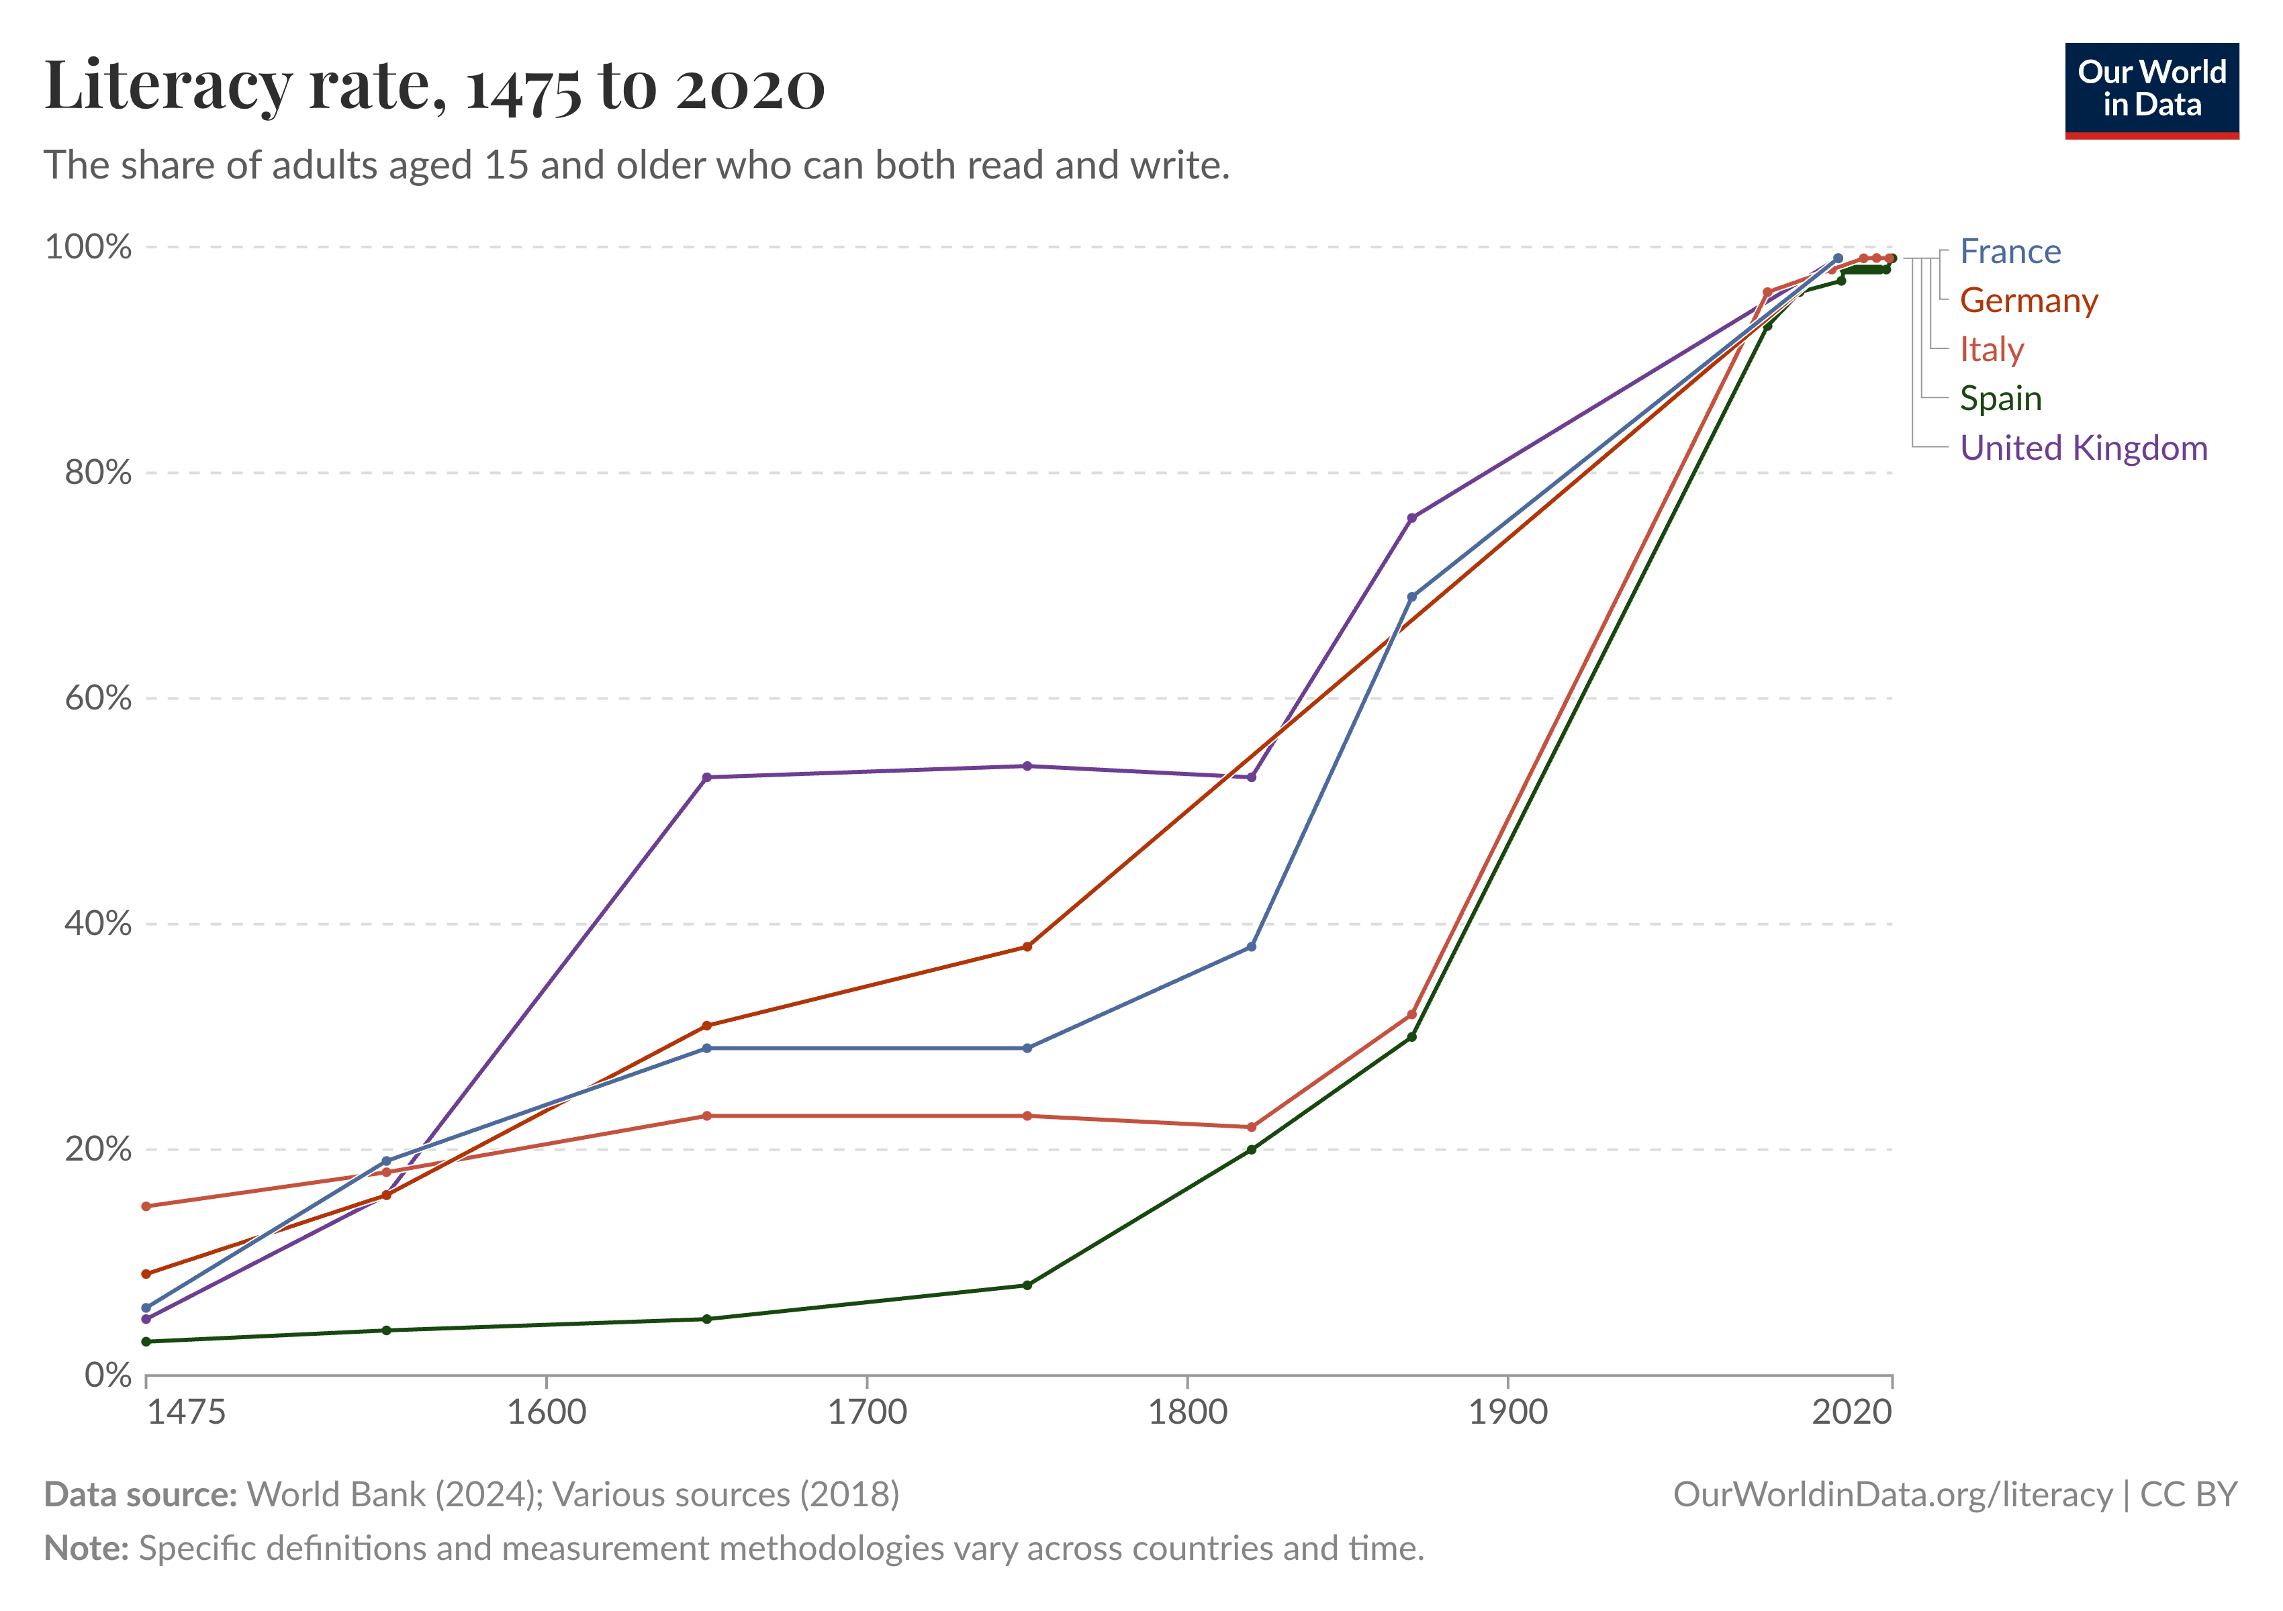
Notes:
Discuss the observable changes and how students imagine these have changed the history of the world.

Slide 4
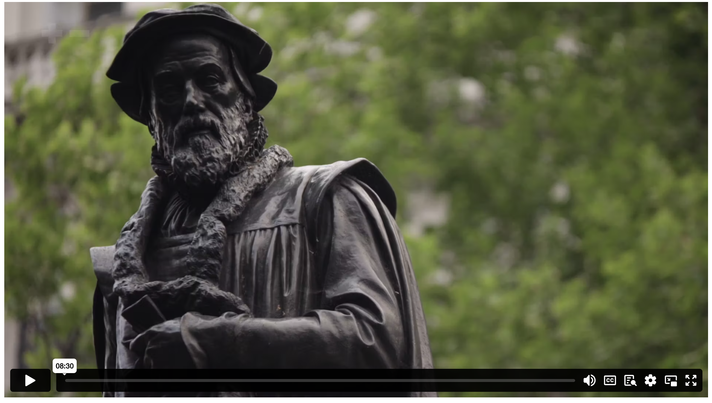
POWER TO THE PEOPLE
Notes:
Content Clip for this lesson

Slide 5
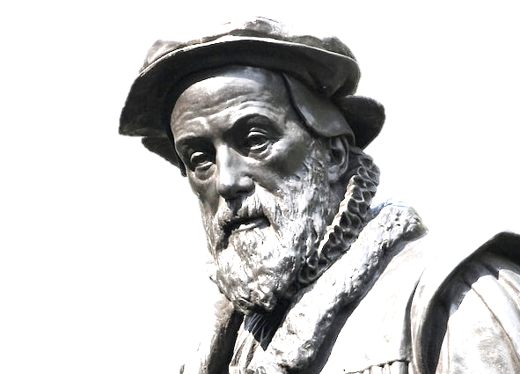
If God allows me to live long enough, I will cause the boy who drives the plough to know more of the scriptures than you!
WILLIAM TYNDALE
Notes:
Statement or Discussion Question

Slide 6
⁹⁷ Oh, how I love your instructions! I think about them all day long. ⁹⁸ Your commands make me wiser than my enemies, for they are my constant guide. ⁹⁹ Yes, I have more insight than my teachers, for I am always thinking of your laws. ¹⁰⁰ I am even wiser than my elders, for I have kept your commandments. ¹⁰¹ I have refused to walk on any evil path, so that I may remain obedient to your word. ¹⁰² I haven’t turned away from your regulations, for you have taught me well. ¹⁰³ How sweet your words taste to me; they are sweeter than honey. ¹⁰⁴ Your commandments give me understanding; no wonder I hate every false way of life.
PSALM 119 (NLT)

Slide 7
¹⁴ But you must remain faithful to the things you have been taught. You know they are true, for you know you can trust those who taught you. ¹⁵ You have been taught the holy Scriptures from childhood, and they have given you the wisdom to receive the salvation that comes by trusting in Christ Jesus. ¹⁶ All Scripture is inspired by God and is useful to teach us what is true and to make us realize what is wrong in our lives. It corrects us when we are wrong and teaches us to do what is right. ¹⁷ God uses it to prepare and equip his people to do every good work.
2 TIMOTHY 3 (NLT)

Slide 8
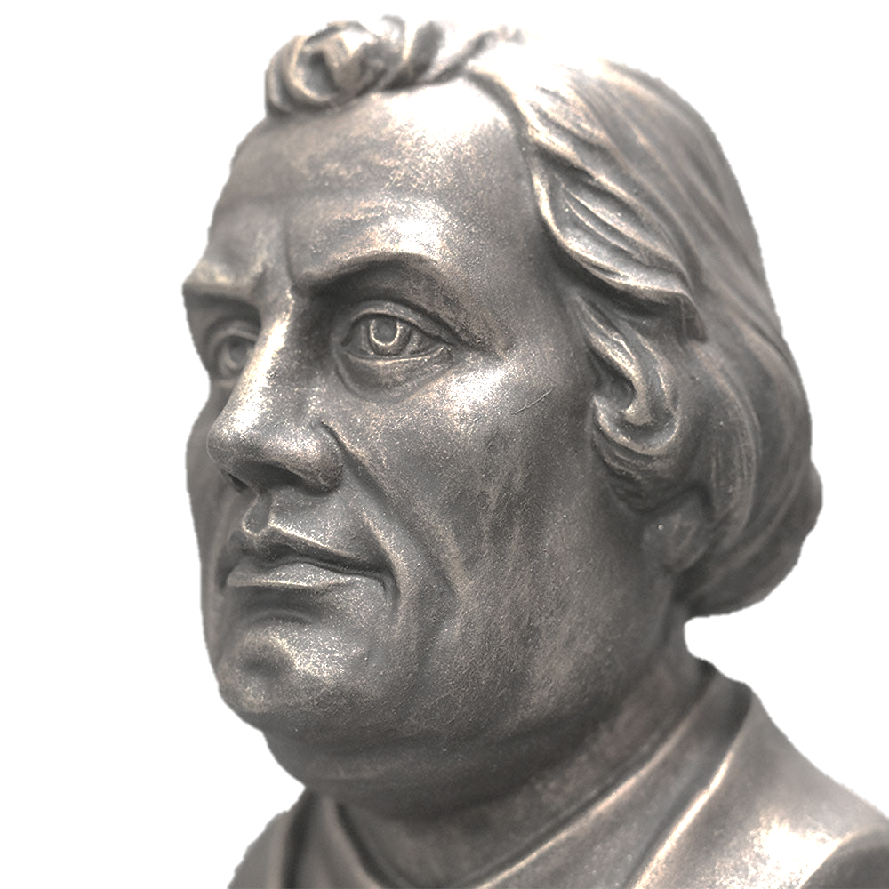
For some years now, I have read through the Bible twice a year. If you picture the Bible to be a mighty tree and every word a little branch, I have shaken everyone of these branches because I wanted to know what it was and what it meant.
MARTIN LUTHER
Notes:
Statement or Discussion Question

Slide 10
Scripture quotations marked (CEV) are from the Contemporary English Version Copyright © 1991, 1992, 1995 by American Bible Society. Used by Permission.
Scripture quotations marked (ESV) are from the ESV® Bible (The Holy Bible, English Standard Version®), © 2001 by Crossway, a publishing ministry of Good News Publishers. Used by permission. All rights reserved.
Scripture quotations marked (MSG) are taken from The Message, copyright © 1993, 2002, 2018 by Eugene H. Peterson. Used by permission of NavPress. All rights reserved. Represented by Tyndale House Publishers.
Scripture quotations marked (NIV) are taken from the Holy Bible, New International Version®, NIV®. Copyright © 1973, 1978, 1984, 2011 by Biblica, Inc.™ Used by permission of Zondervan. All rights reserved worldwide.
Scripture quotations marked (NIVUK) are taken from the Holy Bible, New International Version® Anglicized, NIV® Copyright © 1979, 1984, 2011 by Biblica, Inc.® Used by permission of Zondervan. All rights reserved worldwide.
Scripture quotations marked (NLT) are taken from the Holy Bible, New Living Translation, copyright ©1996, 2004, 2015 by Tyndale House Foundation. Used by permission of Tyndale House Publishers, Carol Stream, Illinois 60188. All rights reserved.
Notes:
Bible Translation Copyright Credits

