Slide 1

‘A HEART FOR THE POOR’
For the Love of God
The 7th Earl of Shaftsbury: Anthony Ashley-Cooper

Slide 2

Pineapple should never be found on Pizza
Agree
Disagree
Notes:
Human Barometer Activity intro slide – delete the slides you don’t want

Slide 3
You can’t call chess
a sport
Agree
Disagree
Notes:
Human Barometer Activity intro slide – delete the slides you don’t want

Slide 4
The moon landing never really happened
Agree
Disagree
Notes:
Human Barometer Activity intro slide – delete the slides you don’t want

Slide 5
Marvel movies are an insult to our intelligence.
Agree
Disagree
Notes:
Human Barometer Activity intro slide – delete the slides you don’t want

Slide 6
Poverty is something we should be able to get rid of
Agree
Disagree

Slide 7
A healthy society protects those who are poor
Agree
Disagree

Slide 8
Caring for the poor should be a priority for the government
Agree
Disagree

Slide 9
  DISCUSSION QUESTIONS:
  Are you aware of any current news stories which are essentially about the treatment of the poor in Australia?

Slide 10
  DISCUSSION QUESTIONS:
  Are you aware of any current news stories which are essentially about the treatment of the poor in Australia?
  If you were a politician what piece of legislation caring for the poor would you want to pass?

Slide 11
  DISCUSSION QUESTIONS:
  Are you aware of any current news stories which are essentially about the treatment of the poor in Australia?
  If you were a politician what piece of legislation caring for the poor would you want to pass?
  Should an elected politician be influenced by their faith? Why? Why not? How much?

Slide 12
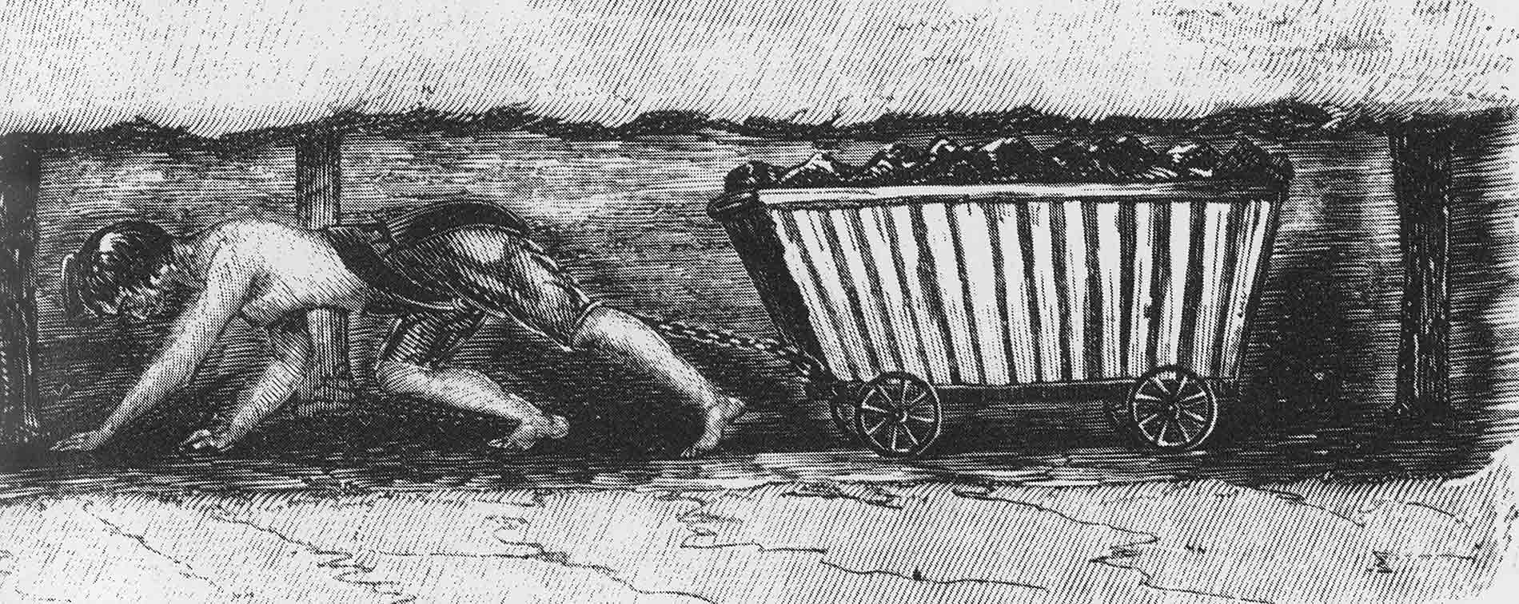
Image from the First Report of the Children’s Employment Commission (1842)

Slide 13
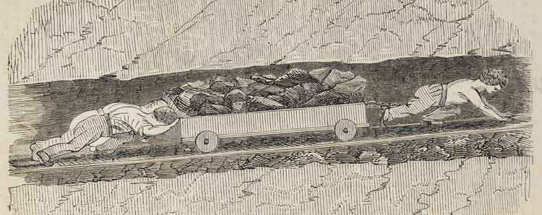
Image from the First Report of the Children’s Employment Commission (1842)

Slide 14
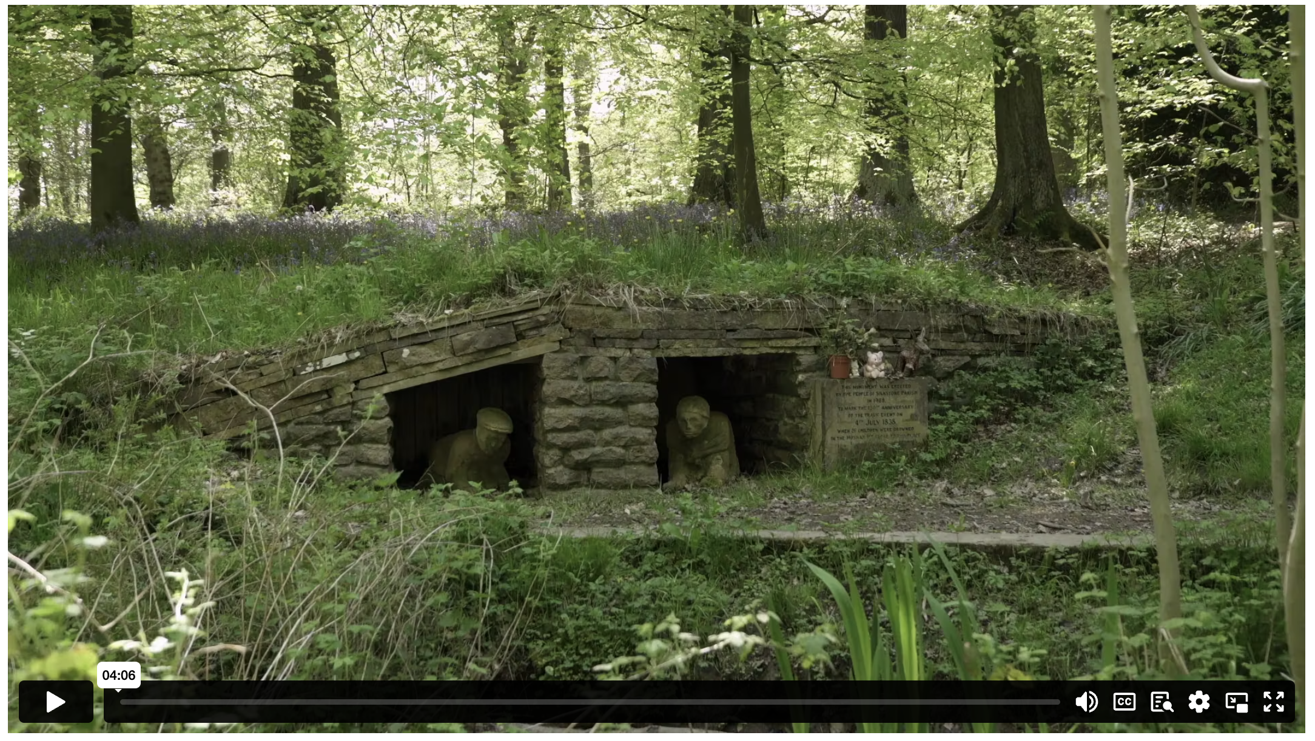
A HEART FOR THE POOR
Notes:
Content Clip for this lesson

Slide 15
  DISCUSSION QUESTIONS:
  What was Lord Ashley’s response to the Huskar mining accident? What did he achieve?

Slide 16
  DISCUSSION QUESTIONS:
  What was Lord Ashley’s response to the Huskar mining accident? What did he achieve?
  What do we learn about Shaftesbury from his campaigning and the 197 organisations he was involved with?

Slide 17

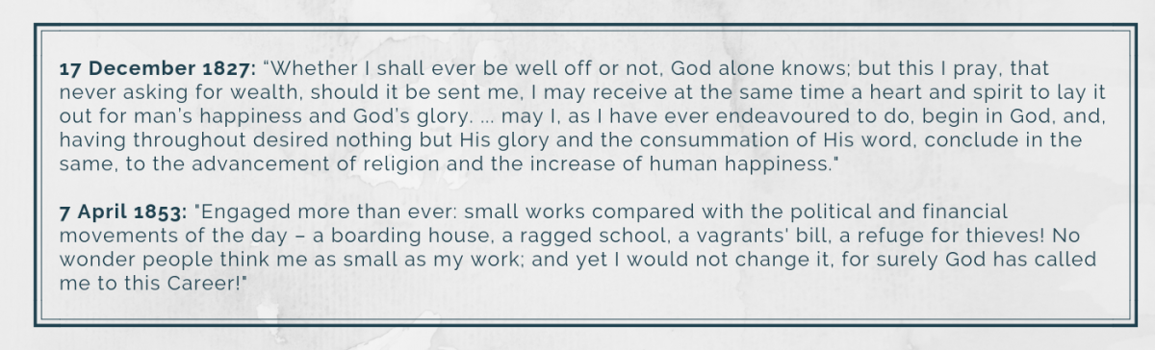

Slide 18
  DISCUSSION QUESTIONS:
  What was Lord Ashley’s response to the Huskar mining accident? What did he achieve?
  What do we learn about Shaftesbury from his campaigning and the 197 organisations he was involved with?
  What do these diary excerpts reveal about Shaftesbury’s faith?

Slide 19
  DISCUSSION QUESTIONS:
  What was Lord Ashley’s response to the Huskar mining accident? What did he achieve?
  What do we learn about Shaftesbury from his campaigning and the 197 organisations he was involved with?
  What do these diary excerpts reveal about Shaftesbury’s faith?
  What is your reaction to this description of Shaftesbury: “No man has ever done more to lessen the extent of human misery or to add to the sum total of human happiness”?

Slide 20
^{15 “}But a beautiful cedar palace does not make a great king!
Your father, Josiah, also had plenty to eat and drink.
But he was just and right in all his dealings.
That is why God blessed him.
¹⁶ He gave justice and help to the poor and needy,
and everything went well for him.
Isn’t that what it means to know me?”
says the Lord.
JEREMIAH 22 (NLT)
Notes:
In these verses, God is speaking against Shallum, a wicked king whose father Josiah was one of the greatest reformer kings of Israel.

Slide 21
  BIBLE QUESTIONS:
  What do these verses tell us about what priorities a follower of God should have?
  What is your reaction to the question, “Is that not what it means to know me?”

Slide 22
¹⁷ Teach those who are rich in this world not to be proud and not to trust in their money, which is so unreliable. Their trust should be in God, who richly gives us all we need for our enjoyment. ¹⁸ Tell them to use their money to do good. They should be rich in good works and generous to those in need, always being ready to share with others. ¹⁹ By doing this they will be storing up their treasure as a good foundation for the future so that they may experience true life.
1 TIMOTHY 6 (NLT)
Notes:
In these verses, God is speaking against Shallum, a wicked king whose father Josiah was one of the greatest reformer kings of Israel.

Slide 23
  BIBLE QUESTIONS:
  What do these verses tell us about what priorities a follower of God should have?
  What is your reaction to the question, “Is that not what it means to know me?”
  What command is given to those who are rich?
  Why do these verses say not to put your hope in wealth?
  What do you think Paul means when he talks about the “life that is truly life”?

Slide 24
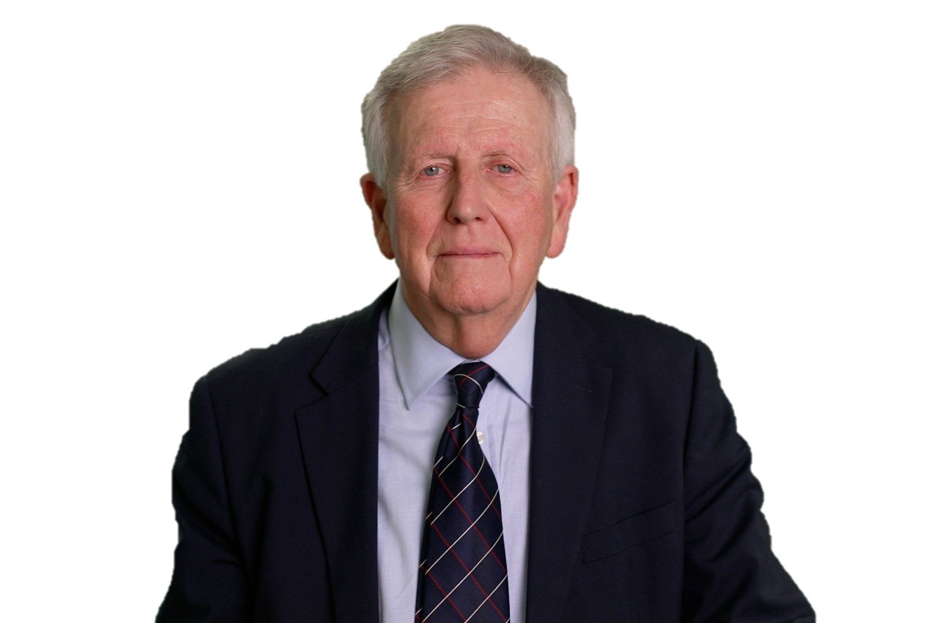
If you think about an overall assessment of the man, you have to say that perhaps the most significant thing about him is that he made Christianity credible in the general population, because he stood so strongly for his Christian faith. And when the general population thought about Christianity they thought about Wilberforce and then they thought about Shaftesbury, and they thought, “This is real, this something worth having in society, this is something we want.”
DR MICHAEL SCHLUTER
Notes:
Discuss whether this is the attitude the general public has towards Christianity today? Why or why not?
Dr. Michael Schluter CBE is a British social entrepreneur known for his work in advocating for the importance of relationships in society, founding Relationships Foundation to promote social and economic change through stronger relationships, and pioneering the development of relationship-centered approaches in various sectors, including education, family life, and economic policy.

Slide 26
Scripture quotations marked (CEV) are from the Contemporary English Version Copyright © 1991, 1992, 1995 by American Bible Society. Used by Permission.
Scripture quotations marked (ESV) are from the ESV® Bible (The Holy Bible, English Standard Version®), © 2001 by Crossway, a publishing ministry of Good News Publishers. Used by permission. All rights reserved.
Scripture quotations marked (MSG) are taken from The Message, copyright © 1993, 2002, 2018 by Eugene H. Peterson. Used by permission of NavPress. All rights reserved. Represented by Tyndale House Publishers.
Scripture quotations marked (NIV) are taken from the Holy Bible, New International Version®, NIV®. Copyright © 1973, 1978, 1984, 2011 by Biblica, Inc.™ Used by permission of Zondervan. All rights reserved worldwide.
Scripture quotations marked (NIVUK) are taken from the Holy Bible, New International Version® Anglicized, NIV® Copyright © 1979, 1984, 2011 by Biblica, Inc.® Used by permission of Zondervan. All rights reserved worldwide.
Scripture quotations marked (NLT) are taken from the Holy Bible, New Living Translation, copyright ©1996, 2004, 2015 by Tyndale House Foundation. Used by permission of Tyndale House Publishers, Carol Stream, Illinois 60188. All rights reserved.
Notes:
Bible Translation Copyright Credits

