Slide 1
THE HUMILITY REVOLUTION
For the Love of God

Slide 5
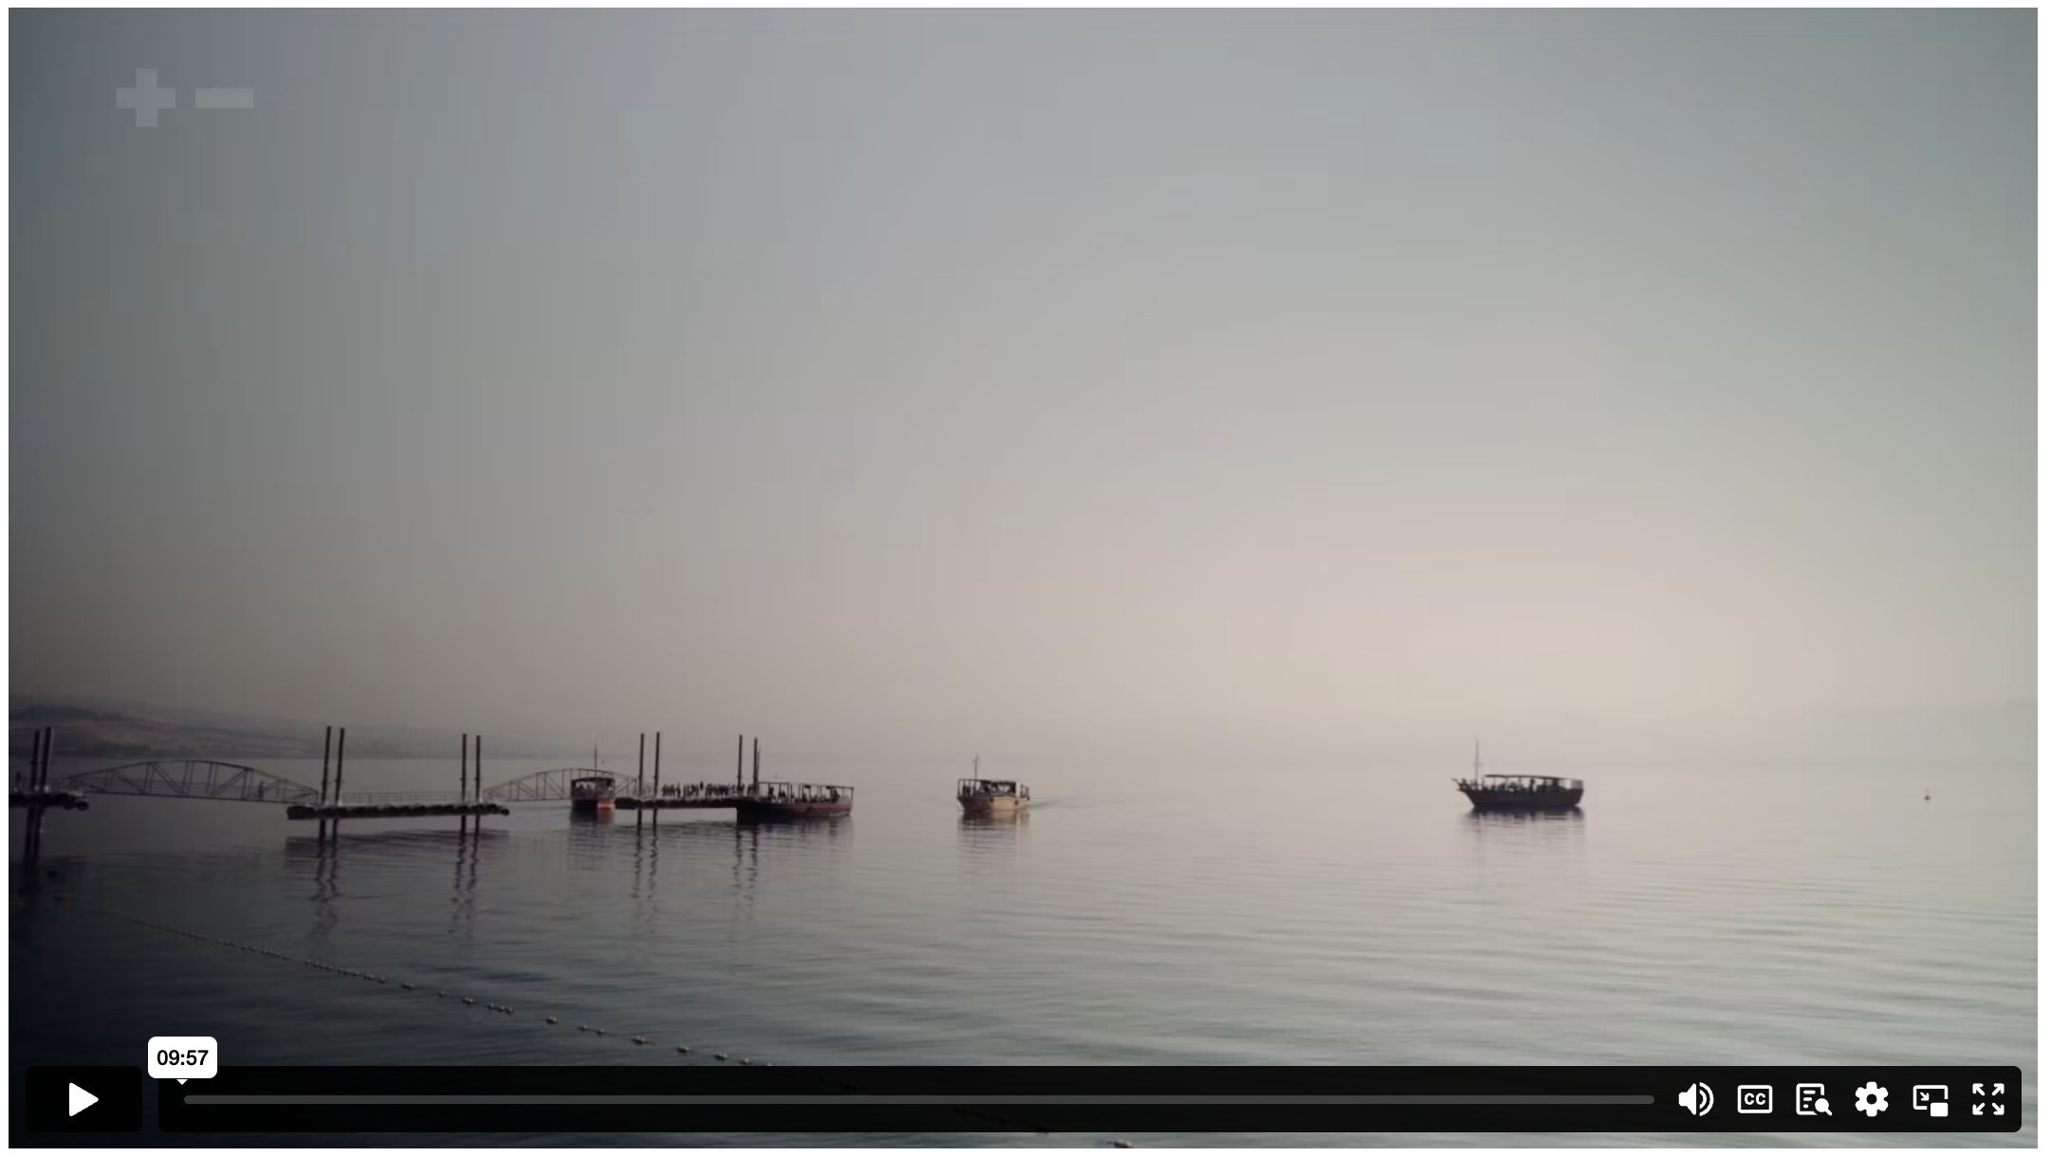
THE HUMILITY REVOLUTION
Notes:
Content Clip for this lesson

Slide 6
³⁵ Then James and John, the sons of Zebedee, came to him. ‘Teacher,’ they said, ‘we want you to do for us whatever we ask.’
³⁶ ‘What do you want me to do for you?’ he asked.
³⁷ They replied, ‘Let one of us sit at your right and the other at your left in your glory.’
³⁸ ‘You don’t know what you are asking,’ Jesus said. ‘Can you drink the cup I drink or be baptised with the baptism I am baptised with?’
³⁹ ‘We can,’ they answered.
MARK 10 (NIVUK)

Slide 7
Jesus said to them, ‘You will drink the cup I drink and be baptised with the baptism I am baptised with, ⁴⁰ but to sit at my right or left is not for me to grant. These places belong to those for whom they have been prepared.’
⁴¹ When the ten heard about this, they became indignant with James and John. ⁴² Jesus called them together and said, ‘You know that those who are regarded as rulers of the Gentiles lord it over them, and their high officials exercise authority over them. ⁴³ Not so with you. Instead, whoever wants to become great among you must be your servant, ⁴⁴ and whoever wants to be first must be slave of all. ⁴⁵ For even the Son of Man did not come to be served, but to serve, and to give his life as a ransom for many.’
MARK 10 (NIVUK)

Slide 8
COMPARE & CONTRAST

Slide 9
¹ Is there any encouragement from belonging to Christ? Any comfort from his love? Any fellowship together in the Spirit? Are your hearts tender and compassionate? ² Then make me truly happy by agreeing wholeheartedly with each other, loving one another, and working together with one mind and purpose.
³ Don’t be selfish; don’t try to impress others. Be humble, thinking of others as better than yourselves. ⁴ Don’t look out only for your own interests, but take an interest in others, too.
⁵ You must have the same attitude that Christ Jesus had.
PHILIPPIANS 2 (NLT)

Slide 10
¹ Is there any encouragement from belonging to Christ? Any comfort from his love? Any fellowship together in the Spirit? Are your hearts tender and compassionate? ² Then make me truly happy by agreeing wholeheartedly with each other, loving one another, and working together with one mind and purpose.
³ Don’t be selfish; don’t try to impress others. Be humble, thinking of others as better than yourselves. ⁴ Don’t look out only for your own interests, but take an interest in others, too.
⁵ You must have the same attitude that Christ Jesus had.
⁶ Though he was God, he did not think of equality with God as something to cling to. ⁷ Instead, he gave up his divine privileges;
PHILIPPIANS 2 (NLT)

Slide 11
⁵ You must have the same attitude that Christ Jesus had.
⁶ Though he was God, he did not think of equality with God as something to cling to. ⁷ Instead, he gave up his divine privileges; he took the humble position of a slave and was born as a human being. When he appeared in human form, ⁸ he humbled himself in obedience to God and died a criminal’s death on a cross.
⁹ Therefore, God elevated him to the place of highest honor and gave him the name above all other names, ¹⁰ that at the name of Jesus every knee should bow, in heaven and on earth and under the earth, ¹¹ and every tongue declare that Jesus Christ is Lord, to the glory of God the Father.
PHILIPPIANS 2 (NLT)

Slide 12
The shameful death of Jesus posed a difficult question for his first followers. Was he not as great as they thought, given the nature of his execution? Or does greatness itself have to be redefined to include a willingness to lower yourself for the sake of others?
JOHN DICKSON

Slide 13
In what ways should leaders who are Christian be different from those who are not?
Notes:
Statement or Discussion Question

Slide 15
Scripture quotations marked (CEV) are from the Contemporary English Version Copyright © 1991, 1992, 1995 by American Bible Society. Used by Permission.
Scripture quotations marked (ESV) are from the ESV® Bible (The Holy Bible, English Standard Version®), © 2001 by Crossway, a publishing ministry of Good News Publishers. Used by permission. All rights reserved.
Scripture quotations marked (MSG) are taken from The Message, copyright © 1993, 2002, 2018 by Eugene H. Peterson. Used by permission of NavPress. All rights reserved. Represented by Tyndale House Publishers.
Scripture quotations marked (NIV) are taken from the Holy Bible, New International Version®, NIV®. Copyright © 1973, 1978, 1984, 2011 by Biblica, Inc.™ Used by permission of Zondervan. All rights reserved worldwide.
Scripture quotations marked (NIVUK) are taken from the Holy Bible, New International Version® Anglicized, NIV® Copyright © 1979, 1984, 2011 by Biblica, Inc.® Used by permission of Zondervan. All rights reserved worldwide.
Scripture quotations marked (NLT) are taken from the Holy Bible, New Living Translation, copyright ©1996, 2004, 2015 by Tyndale House Foundation. Used by permission of Tyndale House Publishers, Carol Stream, Illinois 60188. All rights reserved.
Notes:
Bible Translation Copyright Credits

