Slide 1

THE INVENTION OF CHARITY
For the Love of God
How Jesus Reshaped Attitudes to the Vulnerable

Slide 2
Define ‘Generosity’

Slide 3

  THINK / PAIR / SHARE
  Describe a time when you’ve been generous to another person or group of people.
  Describe a time when someone has been really generous to you.
  Write down a range of good and bad reasons why people might be generous.

Slide 4
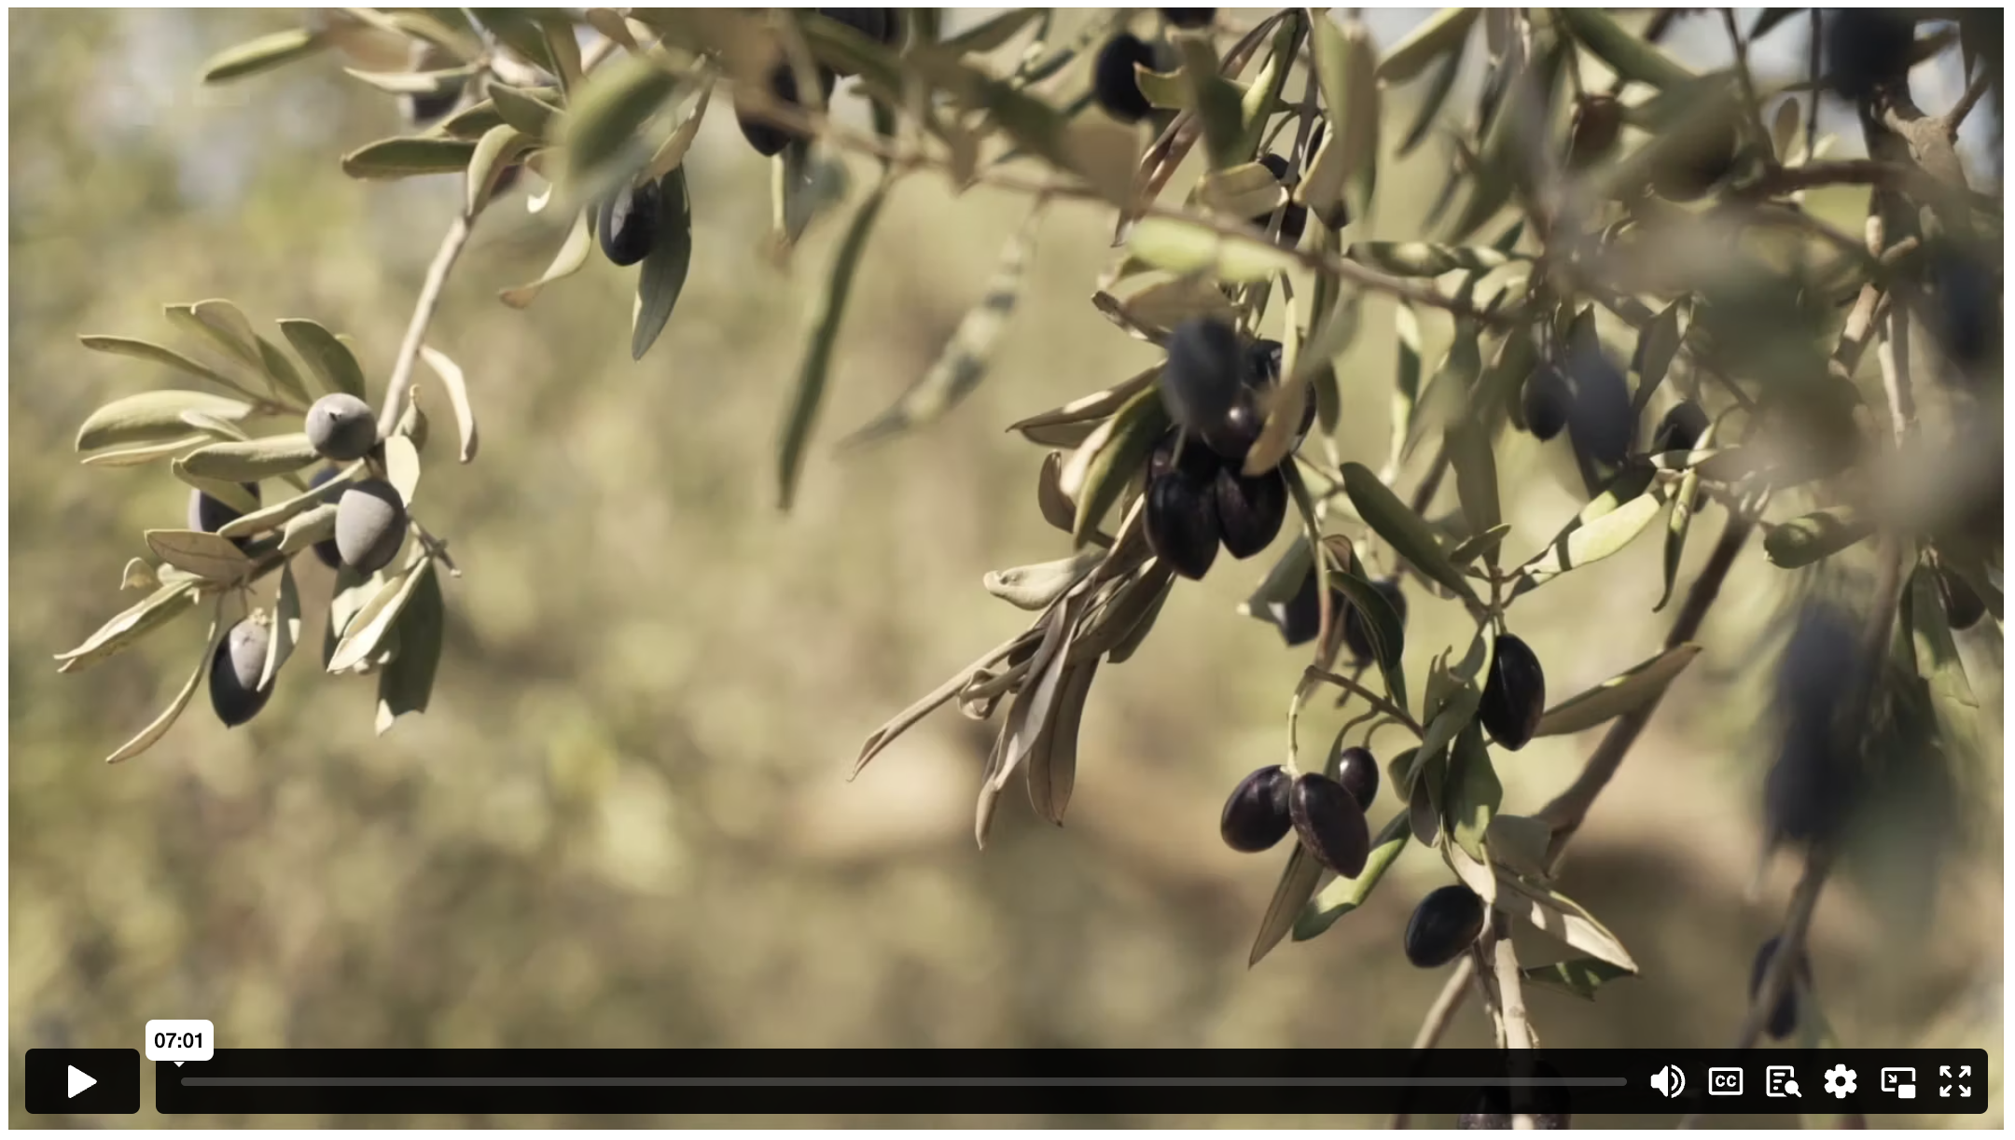
THE INVENTION OF CHARITY
Notes:
Content Clip for this lesson

Slide 5
  CLIP ANALYSIS QUESTIONS:
  What were the “older foundations” that the Christian commitment to charity was based on?
  What is your reaction to the Old Testament idea that “the surplus of the rich belongs to the poor”?
  What does this show us about the character of God?
  How did the early Christians expand the Jewish idea of caring for the poor?
  Evaluate how the values of community care and generosity may have contributed to the growth of Christianity.
  Why did Emperor Julian panic? What did this cause him to do?
  What was ironic about Julian’s response to the Christians’ welfare program?

Slide 6

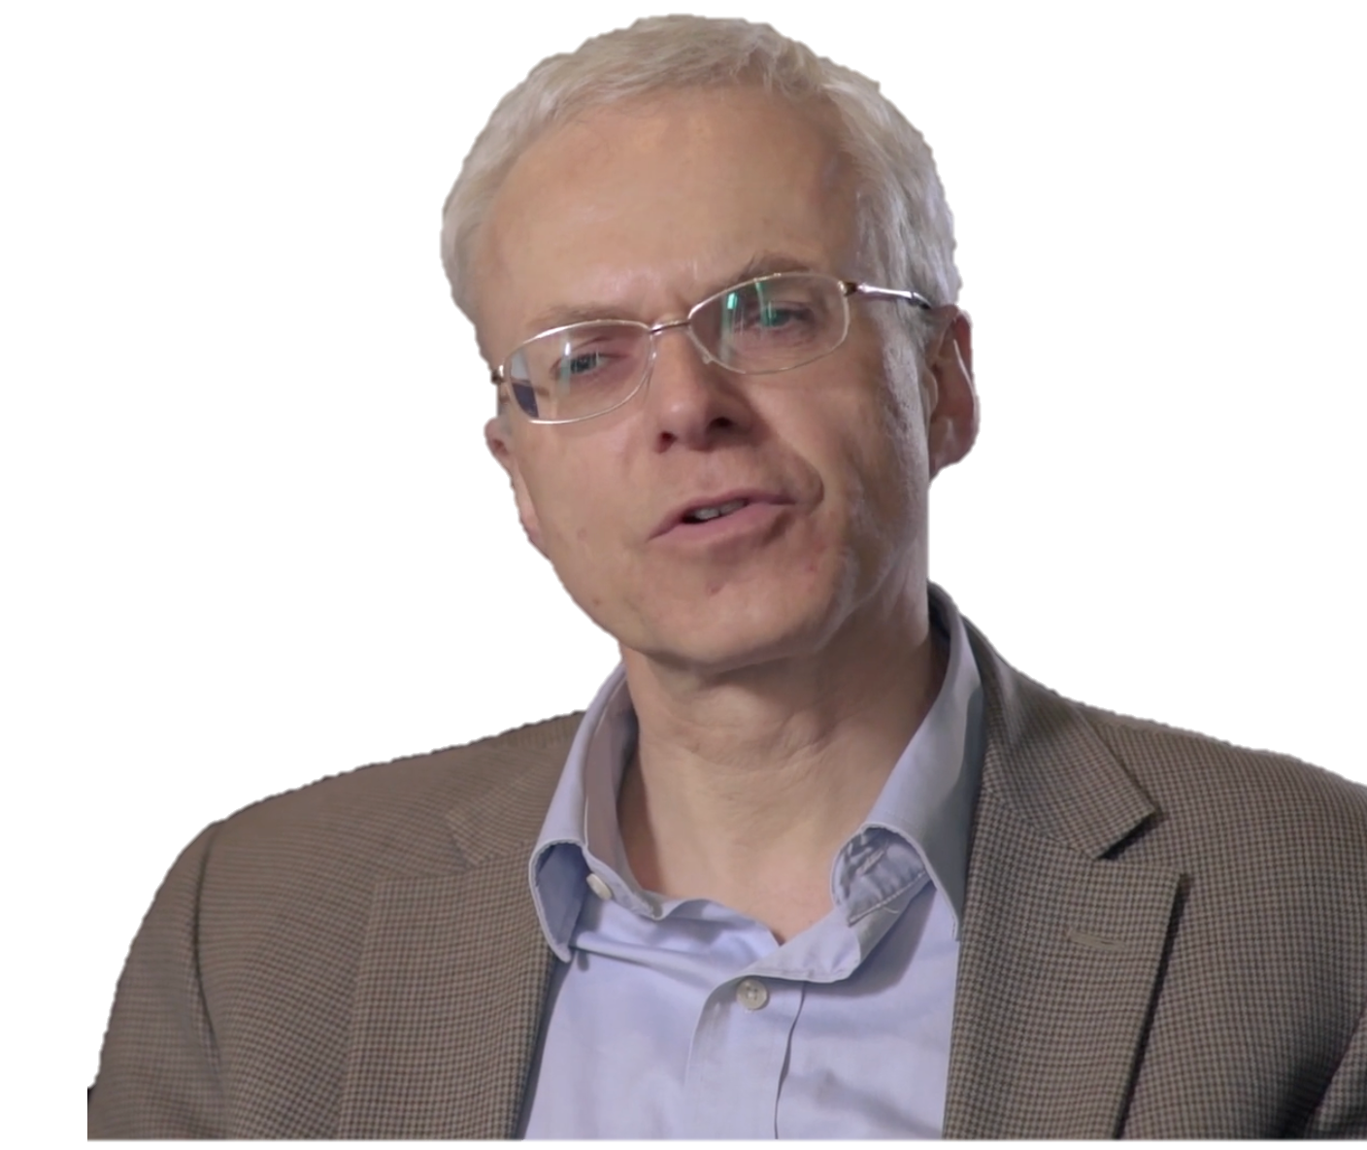
Many of these values – the values of welfare, of care for widows and orphans, of the support of those who are weak – are…in a sense a response to God’s grace and a response to God’s reaching out to humanity.
MARCUS BOCKMUEHL
Notes:
Discuss what ‘God’s grace’ is and what ‘God’s reaching out to humanity’ means.

Slide 7
  CLIP ANALYSIS QUESTIONS:
  In what ways could the actions of these early Christians be seen to be motivated by the belief in God’s grace and the belief in the value of every human person?
  How might these values have shaped the way modern society cares for the poor?

Slide 8
¹⁹ “When you are harvesting your crops and forget to bring in a bundle of grain from your field, don’t go back to get it. Leave it for the foreigners, orphans, and widows. Then the Lord your God will bless you in all you do. ²⁰ When you beat the olives from your olive trees, don’t go over the boughs twice. Leave the remaining olives for the foreigners, orphans, and widows. ²¹ When you gather the grapes in your vineyard, don’t glean the vines after they are picked. Leave the remaining grapes for the foreigners, orphans, and widows.
DEUTERONOMY 24 (NLT)

Slide 9
  BIBLE QUESTIONS:
  What does God command the Israelites to do in these verses?
  What would have been challenging about this?

Slide 10
³² “So don’t be afraid, little flock. For it gives your Father great happiness to give you the Kingdom.
³³ “Sell your possessions and give to those in need. This will store up treasure for you in heaven! And the purses of heaven never get old or develop holes. Your treasure will be safe; no thief can steal it and no moth can destroy it. ³⁴ Wherever your treasure is, there the desires of your heart will also be.
LUKE 12 (NLT)

Slide 11
  BIBLE QUESTIONS:
  What does God command the Israelites to do in these verses?
  What would have been challenging about this?
  How could someone sell all their possessions and give to the poor, and not be afraid of the future?
  What do you think Jesus means when he says, “For where your treasure is, there your heart will be also”?

Slide 12
⁴² All the believers devoted themselves to the apostles’ teaching, and to fellowship, and to sharing in meals (including the Lord’s Supper), and to prayer.
⁴³ A deep sense of awe came over them all, and the apostles performed many miraculous signs and wonders. ⁴⁴ And all the believers met together in one place and shared everything they had. ⁴⁵ They sold their property and possessions and shared the money with those in need. ⁴⁶ They worshiped together at the Temple each day, met in homes for the Lord’s Supper, and shared their meals with great joy and generosity — ⁴⁷ all the while praising God and enjoying the goodwill of all the people. And each day the Lord added to their fellowship those who were being saved.
ACTS 2 (NLT)

Slide 13
  BIBLE QUESTIONS:
  What does God command the Israelites to do in these verses?
  What would have been challenging about this?
  How could someone sell all their possessions and give to the poor, and not be afraid of the future?
  What do you think Jesus means when he says, “For where your treasure is, there your heart will be also”?
  Create an image to reflect the description of the early church in this passage, explaining your design to a partner.

Slide 14
¹⁹ “When you are harvesting your crops and forget to bring in a bundle of grain from your field, don’t go back to get it. Leave it for the foreigners, orphans, and widows. Then the Lord your God will bless you in all you do. ²⁰ When you beat the olives from your olive trees, don’t go over the boughs twice. Leave the remaining olives for the foreigners, orphans, and widows. ²¹ When you gather the grapes in your vineyard, don’t glean the vines after they are picked. Leave the remaining grapes for the foreigners, orphans, and widows.
DEUTERONOMY 24 (NLT)
Notes:
How could we apply these principles to today’s society? Invite students to share any modern examples that they are aware of?

Slide 16
Scripture quotations marked (CEV) are from the Contemporary English Version Copyright © 1991, 1992, 1995 by American Bible Society. Used by Permission.
Scripture quotations marked (ESV) are from the ESV® Bible (The Holy Bible, English Standard Version®), © 2001 by Crossway, a publishing ministry of Good News Publishers. Used by permission. All rights reserved.
Scripture quotations marked (MSG) are taken from The Message, copyright © 1993, 2002, 2018 by Eugene H. Peterson. Used by permission of NavPress. All rights reserved. Represented by Tyndale House Publishers.
Scripture quotations marked (NIV) are taken from the Holy Bible, New International Version®, NIV®. Copyright © 1973, 1978, 1984, 2011 by Biblica, Inc.™ Used by permission of Zondervan. All rights reserved worldwide.
Scripture quotations marked (NIVUK) are taken from the Holy Bible, New International Version® Anglicized, NIV® Copyright © 1979, 1984, 2011 by Biblica, Inc.® Used by permission of Zondervan. All rights reserved worldwide.
Scripture quotations marked (NLT) are taken from the Holy Bible, New Living Translation, copyright ©1996, 2004, 2015 by Tyndale House Foundation. Used by permission of Tyndale House Publishers, Carol Stream, Illinois 60188. All rights reserved.
Notes:
Bible Translation Copyright Credits

