Slide 1
THE MARCH FOR VOTES
For the Love of God
Martin Luther King Jnr – Selma to Montgomery

Slide 2
Christianity is more violent than peaceful Christianity is equally violent and peaceful Christianity is more peaceful than violent
Notes:
Students discuss which most reflects their personal opinion.

Slide 3
DISCUSSION QUESTIONS:
Can you think of a cause that is important enough to you that you would march for it?

Slide 4
DISCUSSION QUESTIONS:
Can you think of a cause that is important enough to you that you would march for it?
Why would you march for this cause?

Slide 5
DISCUSSION QUESTIONS:
Can you think of a cause that is important enough to you that you would march for it?
Why would you march for this cause?
Would you still march if there was a very real possibility of injury or death? Why or why not?

Slide 6
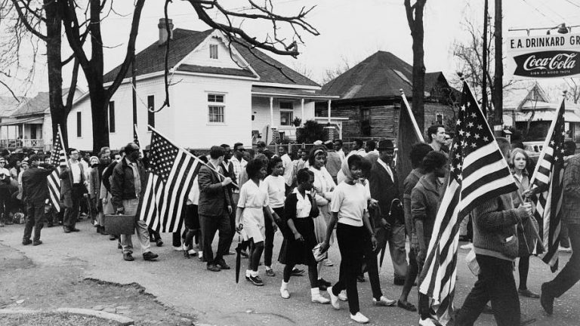
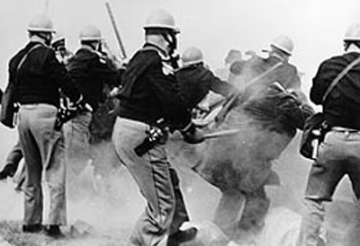

Slide 8
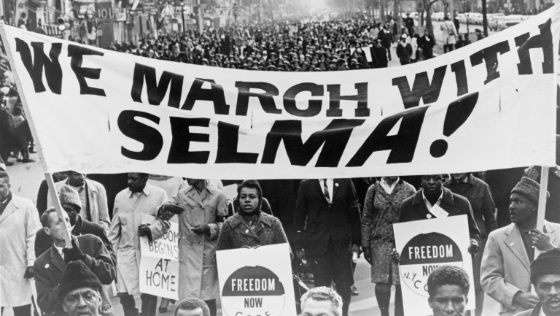

Slide 9
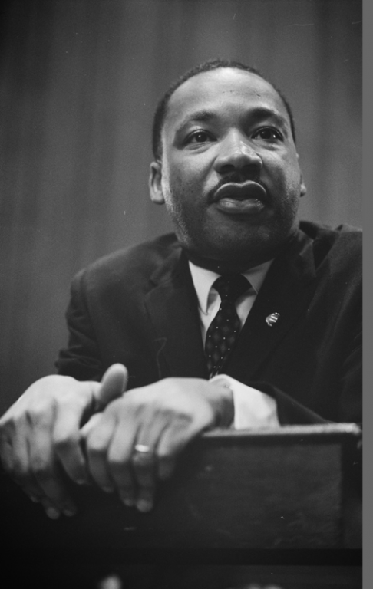
“Returning hate
for hate multiplies hate, adding
deeper darkness
to a night already devoid of stars.
Darkness cannot drive out darkness; only light can do that. Hate cannot drive out hate; only love can do that.”
Notes:
Invite students to respond to this Martin Luther King Jnr quote.

Slide 10
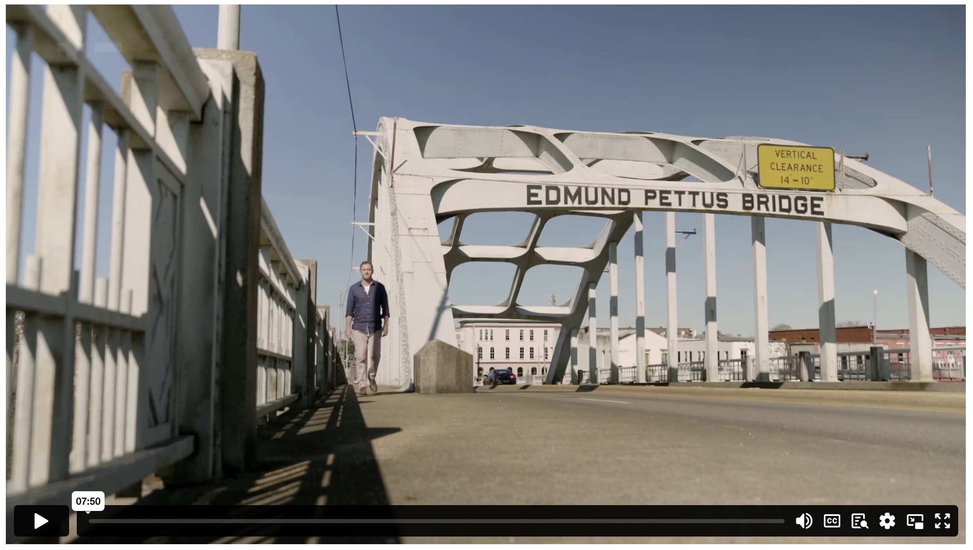
MARTIN LUTHER KING JNR: THE MARCH FOR VOTES
Notes:
Content Clip for this lesson

Slide 11
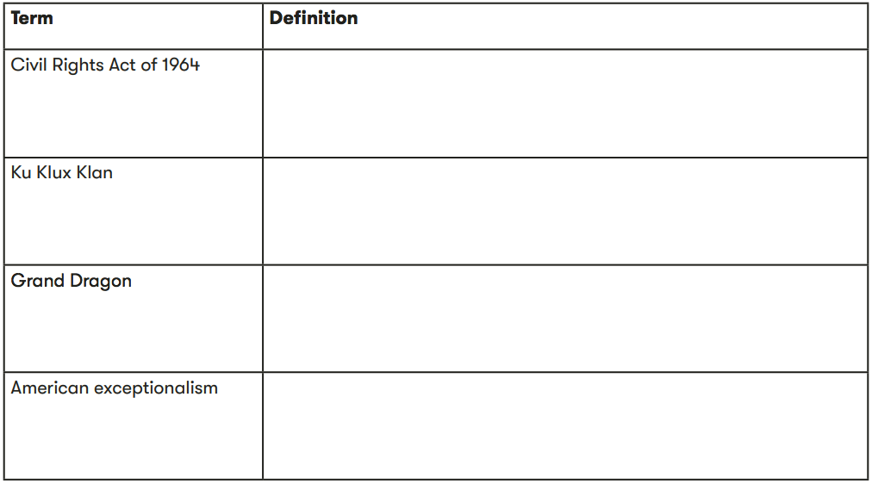

Slide 12
CLIP ANALYSIS QUESTIONS:
Why did Martin Luther King Jr and his followers choose Selma as the place to begin their march for voting rights?
What role did television play in creating an outcry against the brutality on the Edmund Pettus Bridge?
What is striking about the actions of the protestors in the face of extreme opposition?
Maria J. Stephan says that the “combination of the spiritual and the practical/strategic” resources enabled the protestors to maintain non-violent discipline. Explain what she means by this.

Slide 13
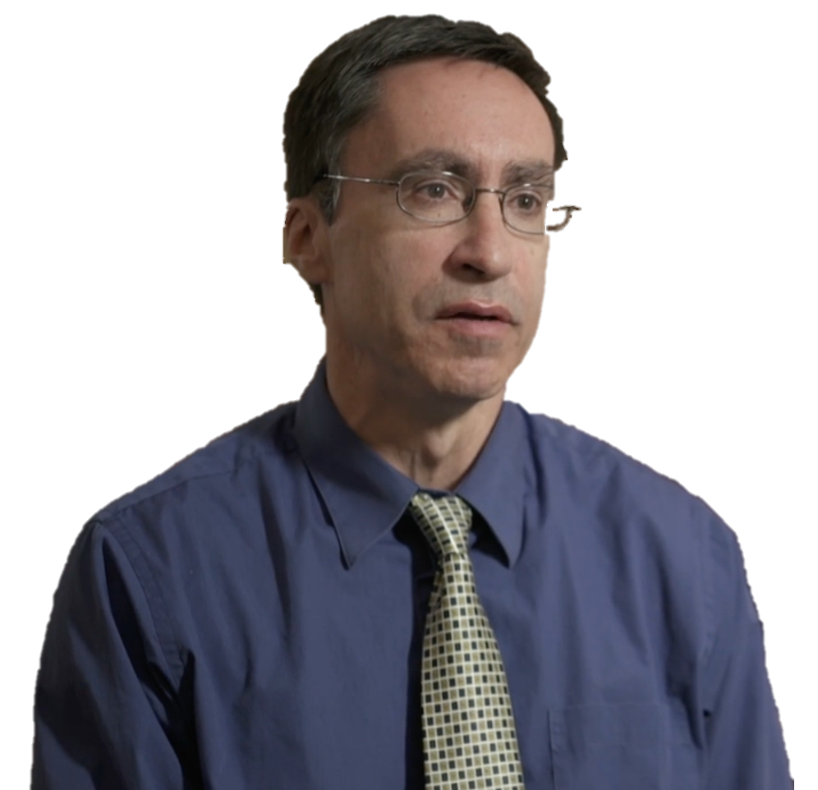
God identifies with the victim… …when they got clubbed it became obvious to see on whose side justice really was. And that, I think, is a kind of ‘enactment of the story of Christ’.
WILLIAM CAVANAUGH

Slide 14
REFLECT & COMPARE

Slide 15
CLIP ANALYSIS QUESTIONS (cont):
Describe what the march ultimately achieved?
What do you think motivated and sustained Martin Luther King Jr.

Slide 16
⁵¹ As the time drew near for him to ascend to heaven, Jesus resolutely set out for Jerusalem. ⁵² He sent messengers ahead to a Samaritan village to prepare for his arrival. ⁵³ But the people of the village did not welcome Jesus because he was on his way to Jerusalem. ⁵⁴ When James and John saw this, they said to Jesus, “Lord, should we call down fire from heaven to burn them up?” ⁵⁵ But Jesus turned and rebuked them. ⁵⁶ So they went on to another village.
LUKE 9 (NLT)

Slide 17
QUESTIONS:
How did people in the Samaritan village react to news that Jesus would be passing through?
How did James and John react to this?
How did Jesus respond to James and John’s question? What might this show us about Jesus’ attitude towards violence?

Slide 18
¹⁴ Then the Pharisees called a meeting to plot how to kill Jesus. ¹⁵ But Jesus knew what they were planning. So he left that area, and many people followed him. He healed all the sick among them, ¹⁶ but he warned them not to reveal who he was. ¹⁷ This fulfilled the prophecy of Isaiah concerning him:
¹⁸ “Look at my Servant, whom I have chosen. He is my Beloved, who pleases me. I will put my Spirit upon him, and he will proclaim justice to the nations. ¹⁹ He will not fight or shout or raise his voice in public. ²⁰ He will not crush the weakest reed or put out a flickering candle. Finally he will cause justice to be victorious. ²¹ And his name will be the hope of all the world.”
MATTHEW 12 (NLT)

Slide 19
QUESTIONS:
What did Jesus’ enemies want to do to him?
What overall picture do we get of Jesus from Isaiah’s prophecy?
What might this prophecy tell us about how Jesus would respond to violence (in particular v.19)?

Slide 21
Scripture quotations marked (CEV) are from the Contemporary English Version Copyright © 1991, 1992, 1995 by American Bible Society. Used by Permission.
Scripture quotations marked (ESV) are from the ESV® Bible (The Holy Bible, English Standard Version®), © 2001 by Crossway, a publishing ministry of Good News Publishers. Used by permission. All rights reserved.
Scripture quotations marked (MSG) are taken from The Message, copyright © 1993, 2002, 2018 by Eugene H. Peterson. Used by permission of NavPress. All rights reserved. Represented by Tyndale House Publishers.
Scripture quotations marked (NIV) are taken from the Holy Bible, New International Version®, NIV®. Copyright © 1973, 1978, 1984, 2011 by Biblica, Inc.™ Used by permission of Zondervan. All rights reserved worldwide.
Scripture quotations marked (NIVUK) are taken from the Holy Bible, New International Version® Anglicized, NIV® Copyright © 1979, 1984, 2011 by Biblica, Inc.® Used by permission of Zondervan. All rights reserved worldwide.
Scripture quotations marked (NLT) are taken from the Holy Bible, New Living Translation, copyright ©1996, 2004, 2015 by Tyndale House Foundation. Used by permission of Tyndale House Publishers, Carol Stream, Illinois 60188. All rights reserved.
Notes:
Bible Translation Copyright Credits

