Slide 1
THE SALEM WITCH TRIALS
For the Love of God
The European and American Witch Hunts

Slide 2
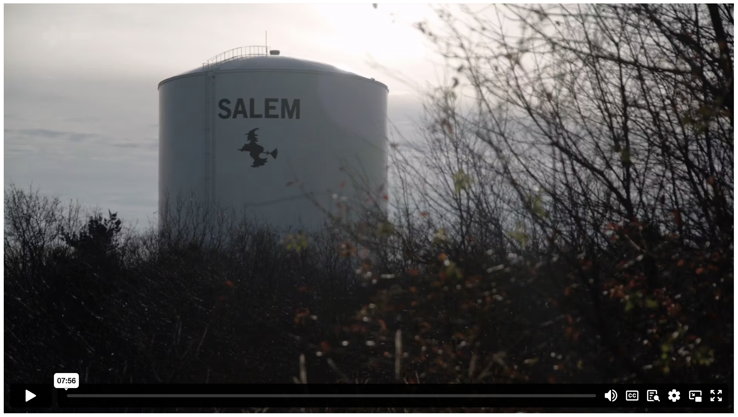
WITCH HUNTS IN EUROPE AND SALEM
Notes:
Content Clip for this lesson

Slide 3
ANALYSIS QUESTIONS:
How does the video segment contrast Walpurgisnacht today with the witch panics that swept across Europe in the 1600s?
Explain what happened to Rebecca Lemp. Why do you think she might have been accused?
Write another paragraph of Rebecca Lemp’s letter.
Write down as many things as you can remember from the video segment about what happened in Salem in February 1692.
Outline the possible contribution of each of these to the Salem Witch Hunts:
Misogyny
Economic Tensions
Factional & Personal Vendettas

Slide 4
²⁹ Don’t plot harm against your neighbour, for those who live nearby trust you. ³⁰ Don’t pick a fight without reason, when no one has done you harm.
³¹ Don’t envy violent people or copy their ways.
PROVERBS 3 (NLT)

Slide 5
²⁸ One of the teachers of religious law was standing there listening to the debate. He realized that Jesus had answered well, so he asked, “Of all the commandments, which is the most important?”
²⁹ Jesus replied, “The most important commandment is this: ‘Listen, O Israel! The Lord our God is the one and only Lord. ³⁰ And you must love the Lord your God with all your heart, all your soul, all your mind, and all your strength.’ ³¹ The second is equally important: ‘Love your neighbour as yourself.’ No other commandment is greater than these.”
MARK 12 (NLT)

Slide 7
Scripture quotations marked (CEV) are from the Contemporary English Version Copyright © 1991, 1992, 1995 by American Bible Society. Used by Permission.
Scripture quotations marked (ESV) are from the ESV® Bible (The Holy Bible, English Standard Version®), © 2001 by Crossway, a publishing ministry of Good News Publishers. Used by permission. All rights reserved.
Scripture quotations marked (MSG) are taken from The Message, copyright © 1993, 2002, 2018 by Eugene H. Peterson. Used by permission of NavPress. All rights reserved. Represented by Tyndale House Publishers.
Scripture quotations marked (NIV) are taken from the Holy Bible, New International Version®, NIV®. Copyright © 1973, 1978, 1984, 2011 by Biblica, Inc.™ Used by permission of Zondervan. All rights reserved worldwide.
Scripture quotations marked (NIVUK) are taken from the Holy Bible, New International Version® Anglicized, NIV® Copyright © 1979, 1984, 2011 by Biblica, Inc.® Used by permission of Zondervan. All rights reserved worldwide.
Scripture quotations marked (NLT) are taken from the Holy Bible, New Living Translation, copyright ©1996, 2004, 2015 by Tyndale House Foundation. Used by permission of Tyndale House Publishers, Carol Stream, Illinois 60188. All rights reserved.
Notes:
Bible Translation Copyright Credits

