Slide 1

THE SPANISH INQUISITION
For the Love of God
The Hunt for Heretics

Slide 2

Pineapple should never be found on Pizza
Agree
Disagree
Notes:
Human Barometer Activity intro slide – delete the slides you don’t want

Slide 3
You can’t call chess
a sport
Agree
Disagree
Notes:
Human Barometer Activity intro slide – delete the slides you don’t want

Slide 4
The moon landing never really happened
Agree
Disagree
Notes:
Human Barometer Activity intro slide – delete the slides you don’t want

Slide 5
Marvel movies are an insult to our intelligence.
Agree
Disagree
Notes:
Human Barometer Activity intro slide – delete the slides you don’t want

Slide 6
Christianity embraces diversity
Agree
Disagree

Slide 7
Christians tolerate and respect other people’s points of view
Agree
Disagree

Slide 8
Sharing harmful ideas should be banned in a civilised society
Agree
Disagree

Slide 9
  REFLECTION QUESTIONS:
  Have you ever been punished for something you didn’t do, or that you did but didn’t believe was wrong? How did you feel?

Slide 10
  REFLECTION QUESTIONS:
  Have you ever been punished for something you didn’t do, or that you did but didn’t believe was wrong? How did you feel?
  Have you ever argued with someone about their beliefs? What were you trying to achieve?

Slide 11
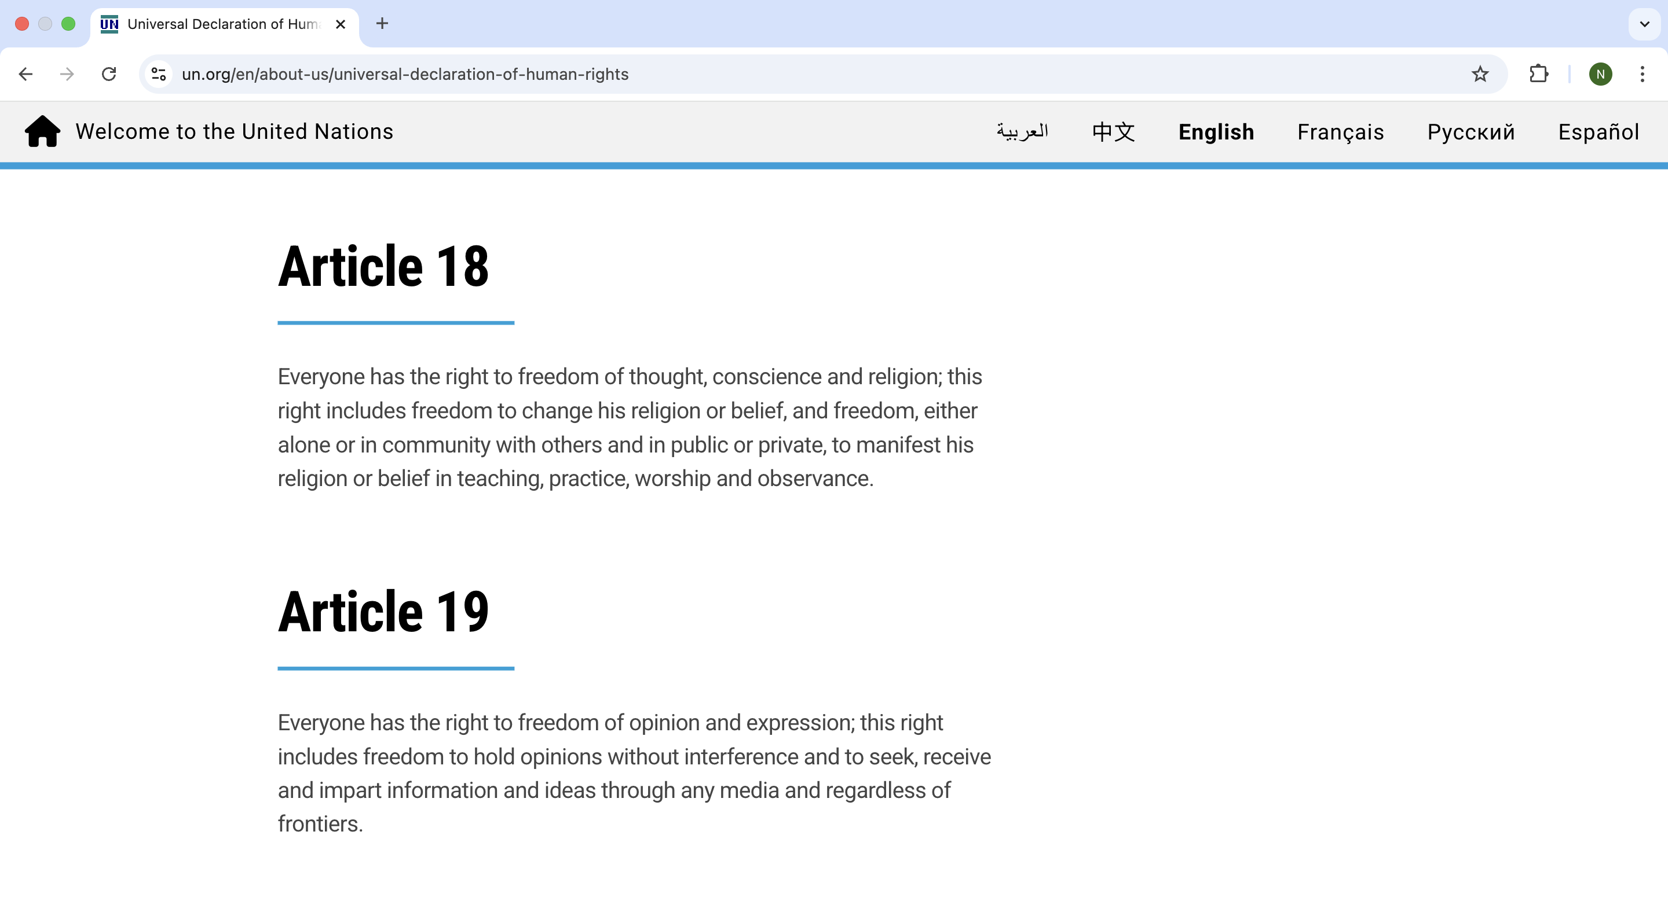

Slide 12
  ANSWER THE QUESTIONS:
  Why do you think these articles were included in the UDHR?
  How important do you think the rights to freedom of belief and expression are?
  Should there be any limits to these freedoms?
  Can you think of any modern examples that you have heard about where these rights have been denied?

Slide 13
  ANSWER THE QUESTIONS:
  Why do you think these articles were included in the UDHR?
  How important do you think the rights to freedom of belief and expression are?
  Should there be any limits to these freedoms?
  Can you think of any modern examples that you have heard about where these rights have been denied?
  Write a definition of the word “heresy” and explain why heresy might be a big deal to some religious groups.

Slide 14
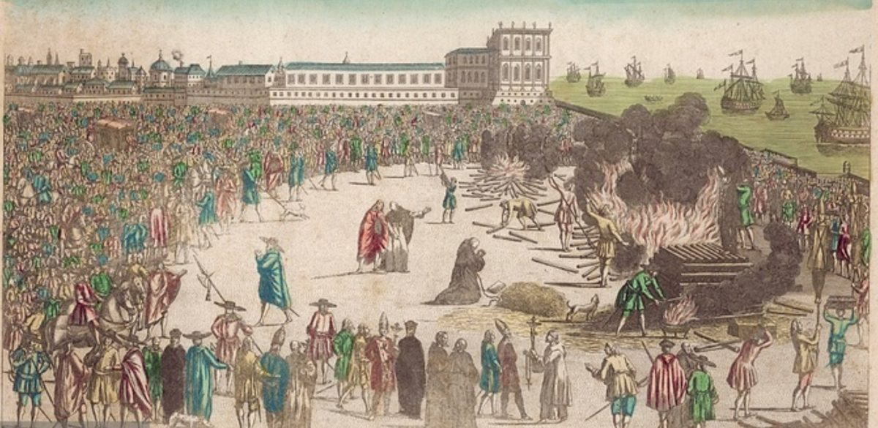
Notes:
Spanish Inquisition image 1

Slide 15
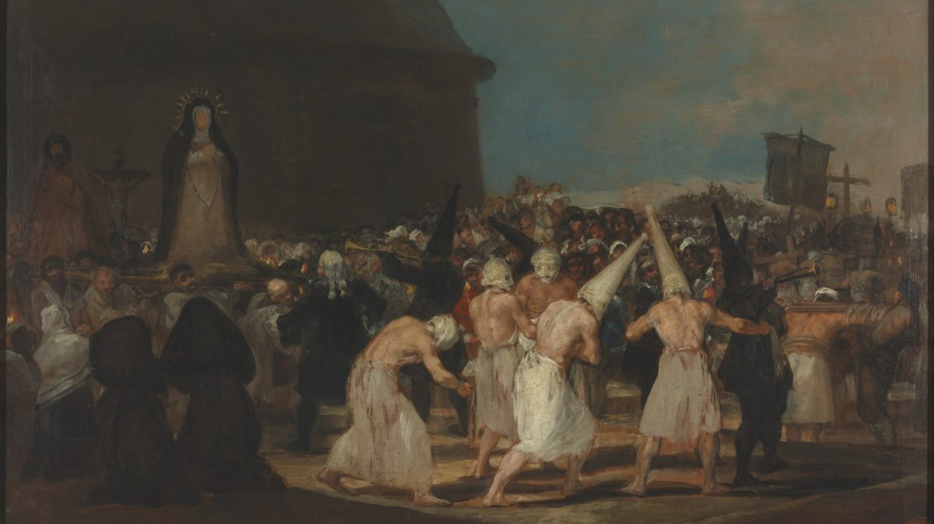
Notes:
Spanish Inquisition image 2

Slide 16
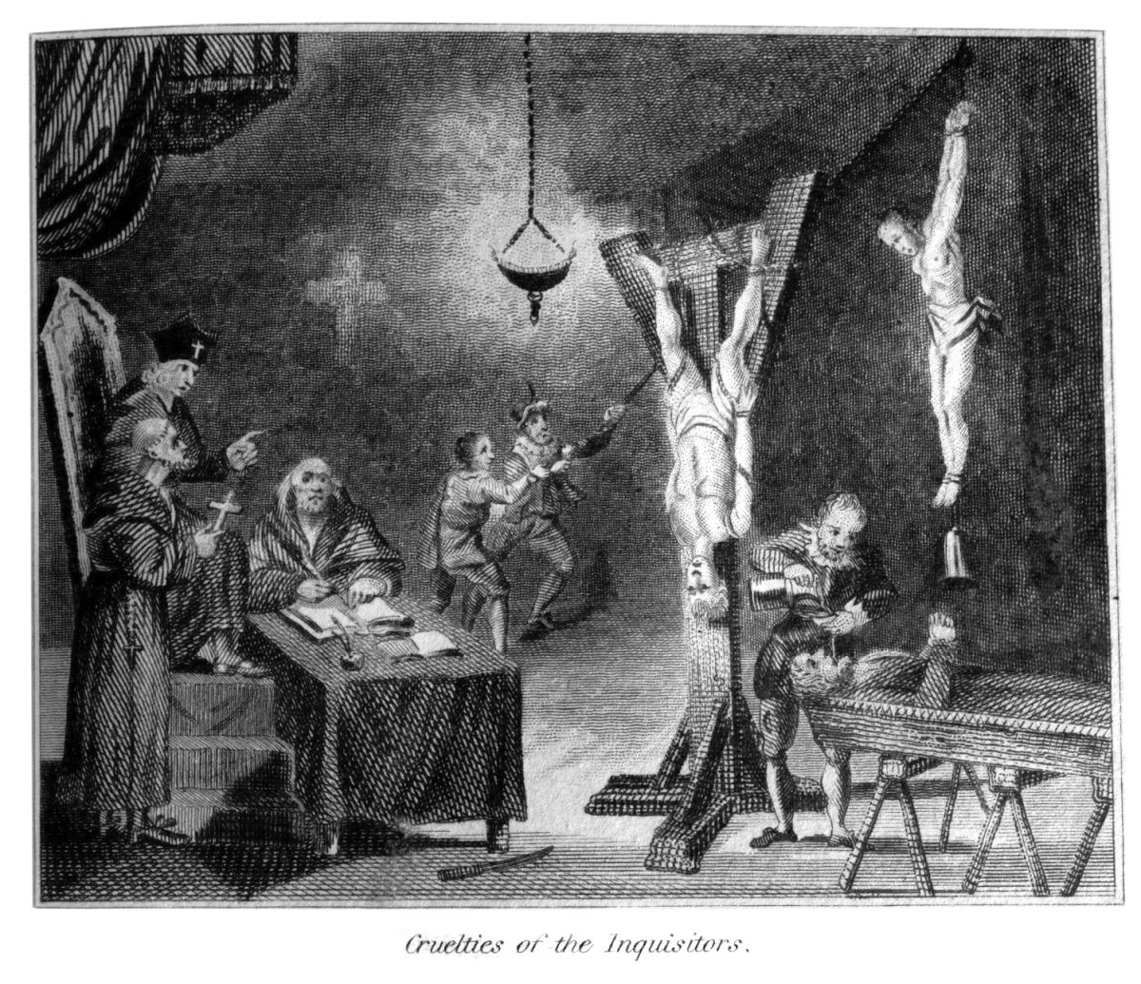
Notes:
Spanish Inquisition image 3

Slide 17
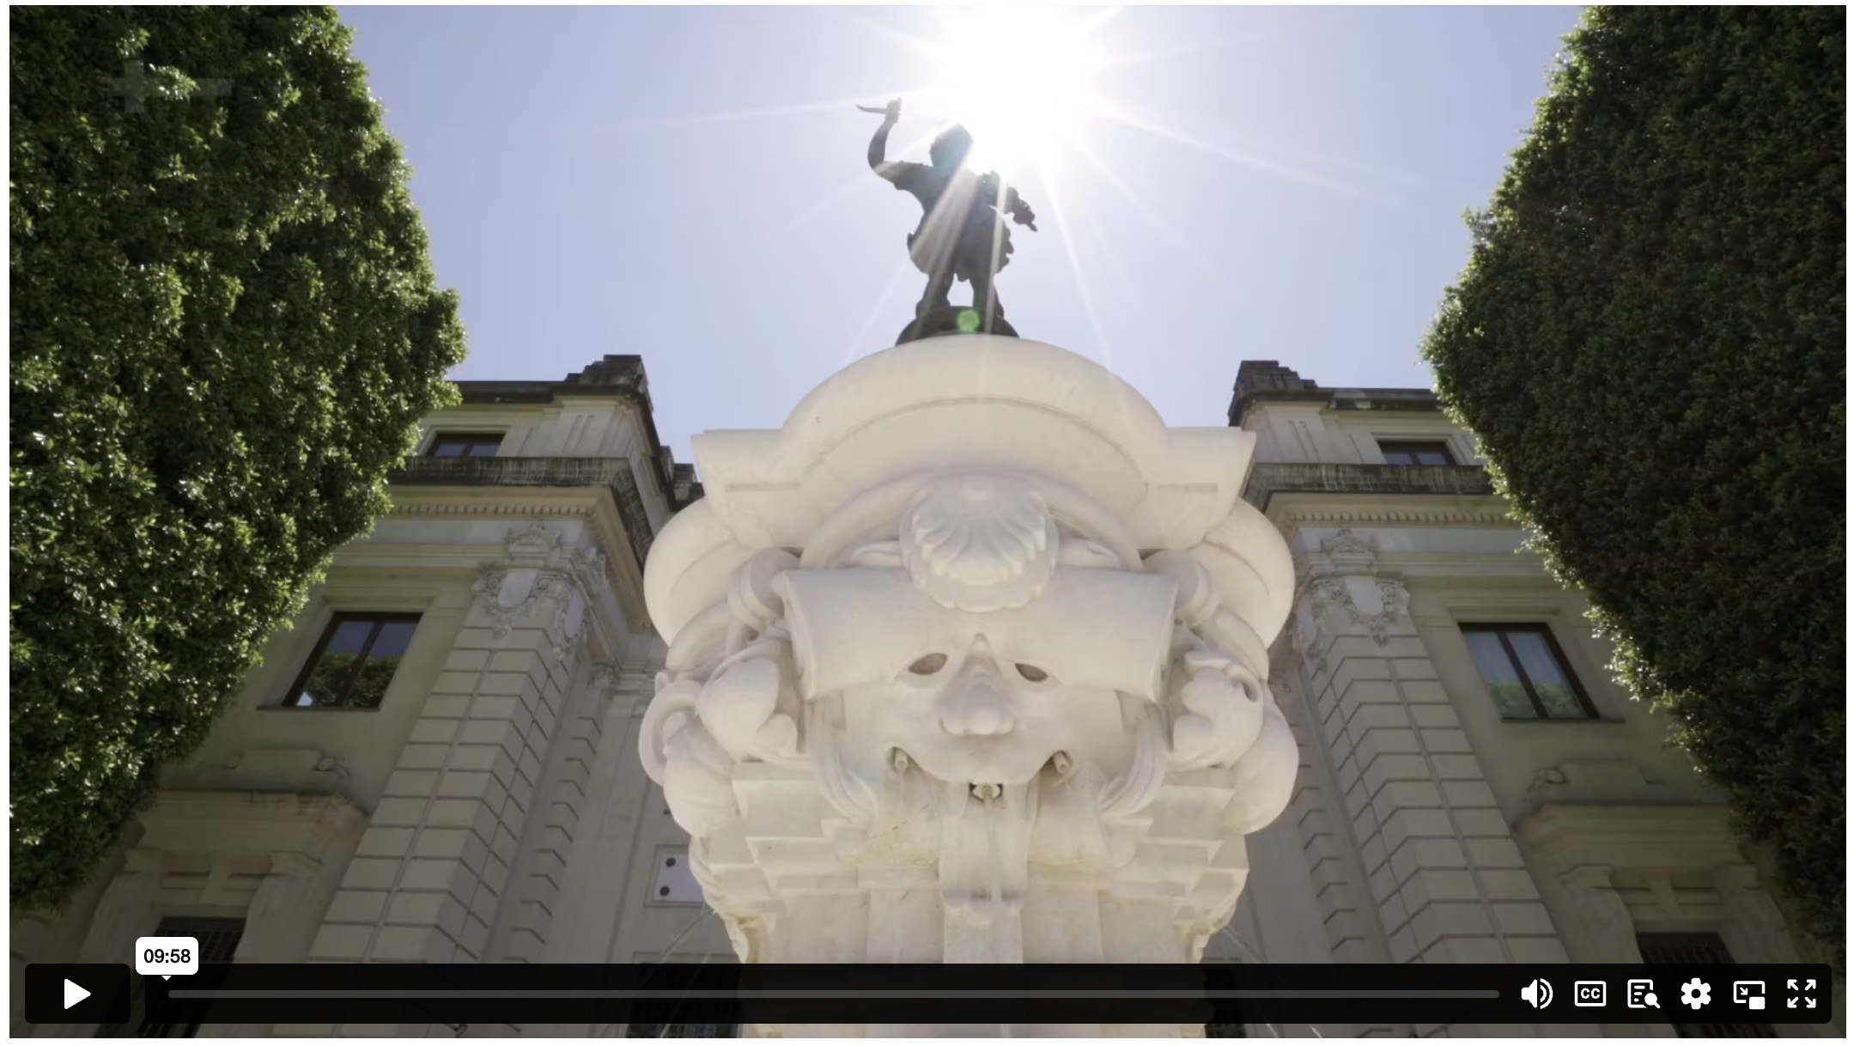
THE HUNT FOR HERETICS
Notes:
Content Clip for this lesson

Slide 18
  ANSWER THE QUESTIONS:
  Why were Conversos resented in Spain in the 1400s?
  How were charges brought against the Conversos? What kind of evidence was required?

Slide 19

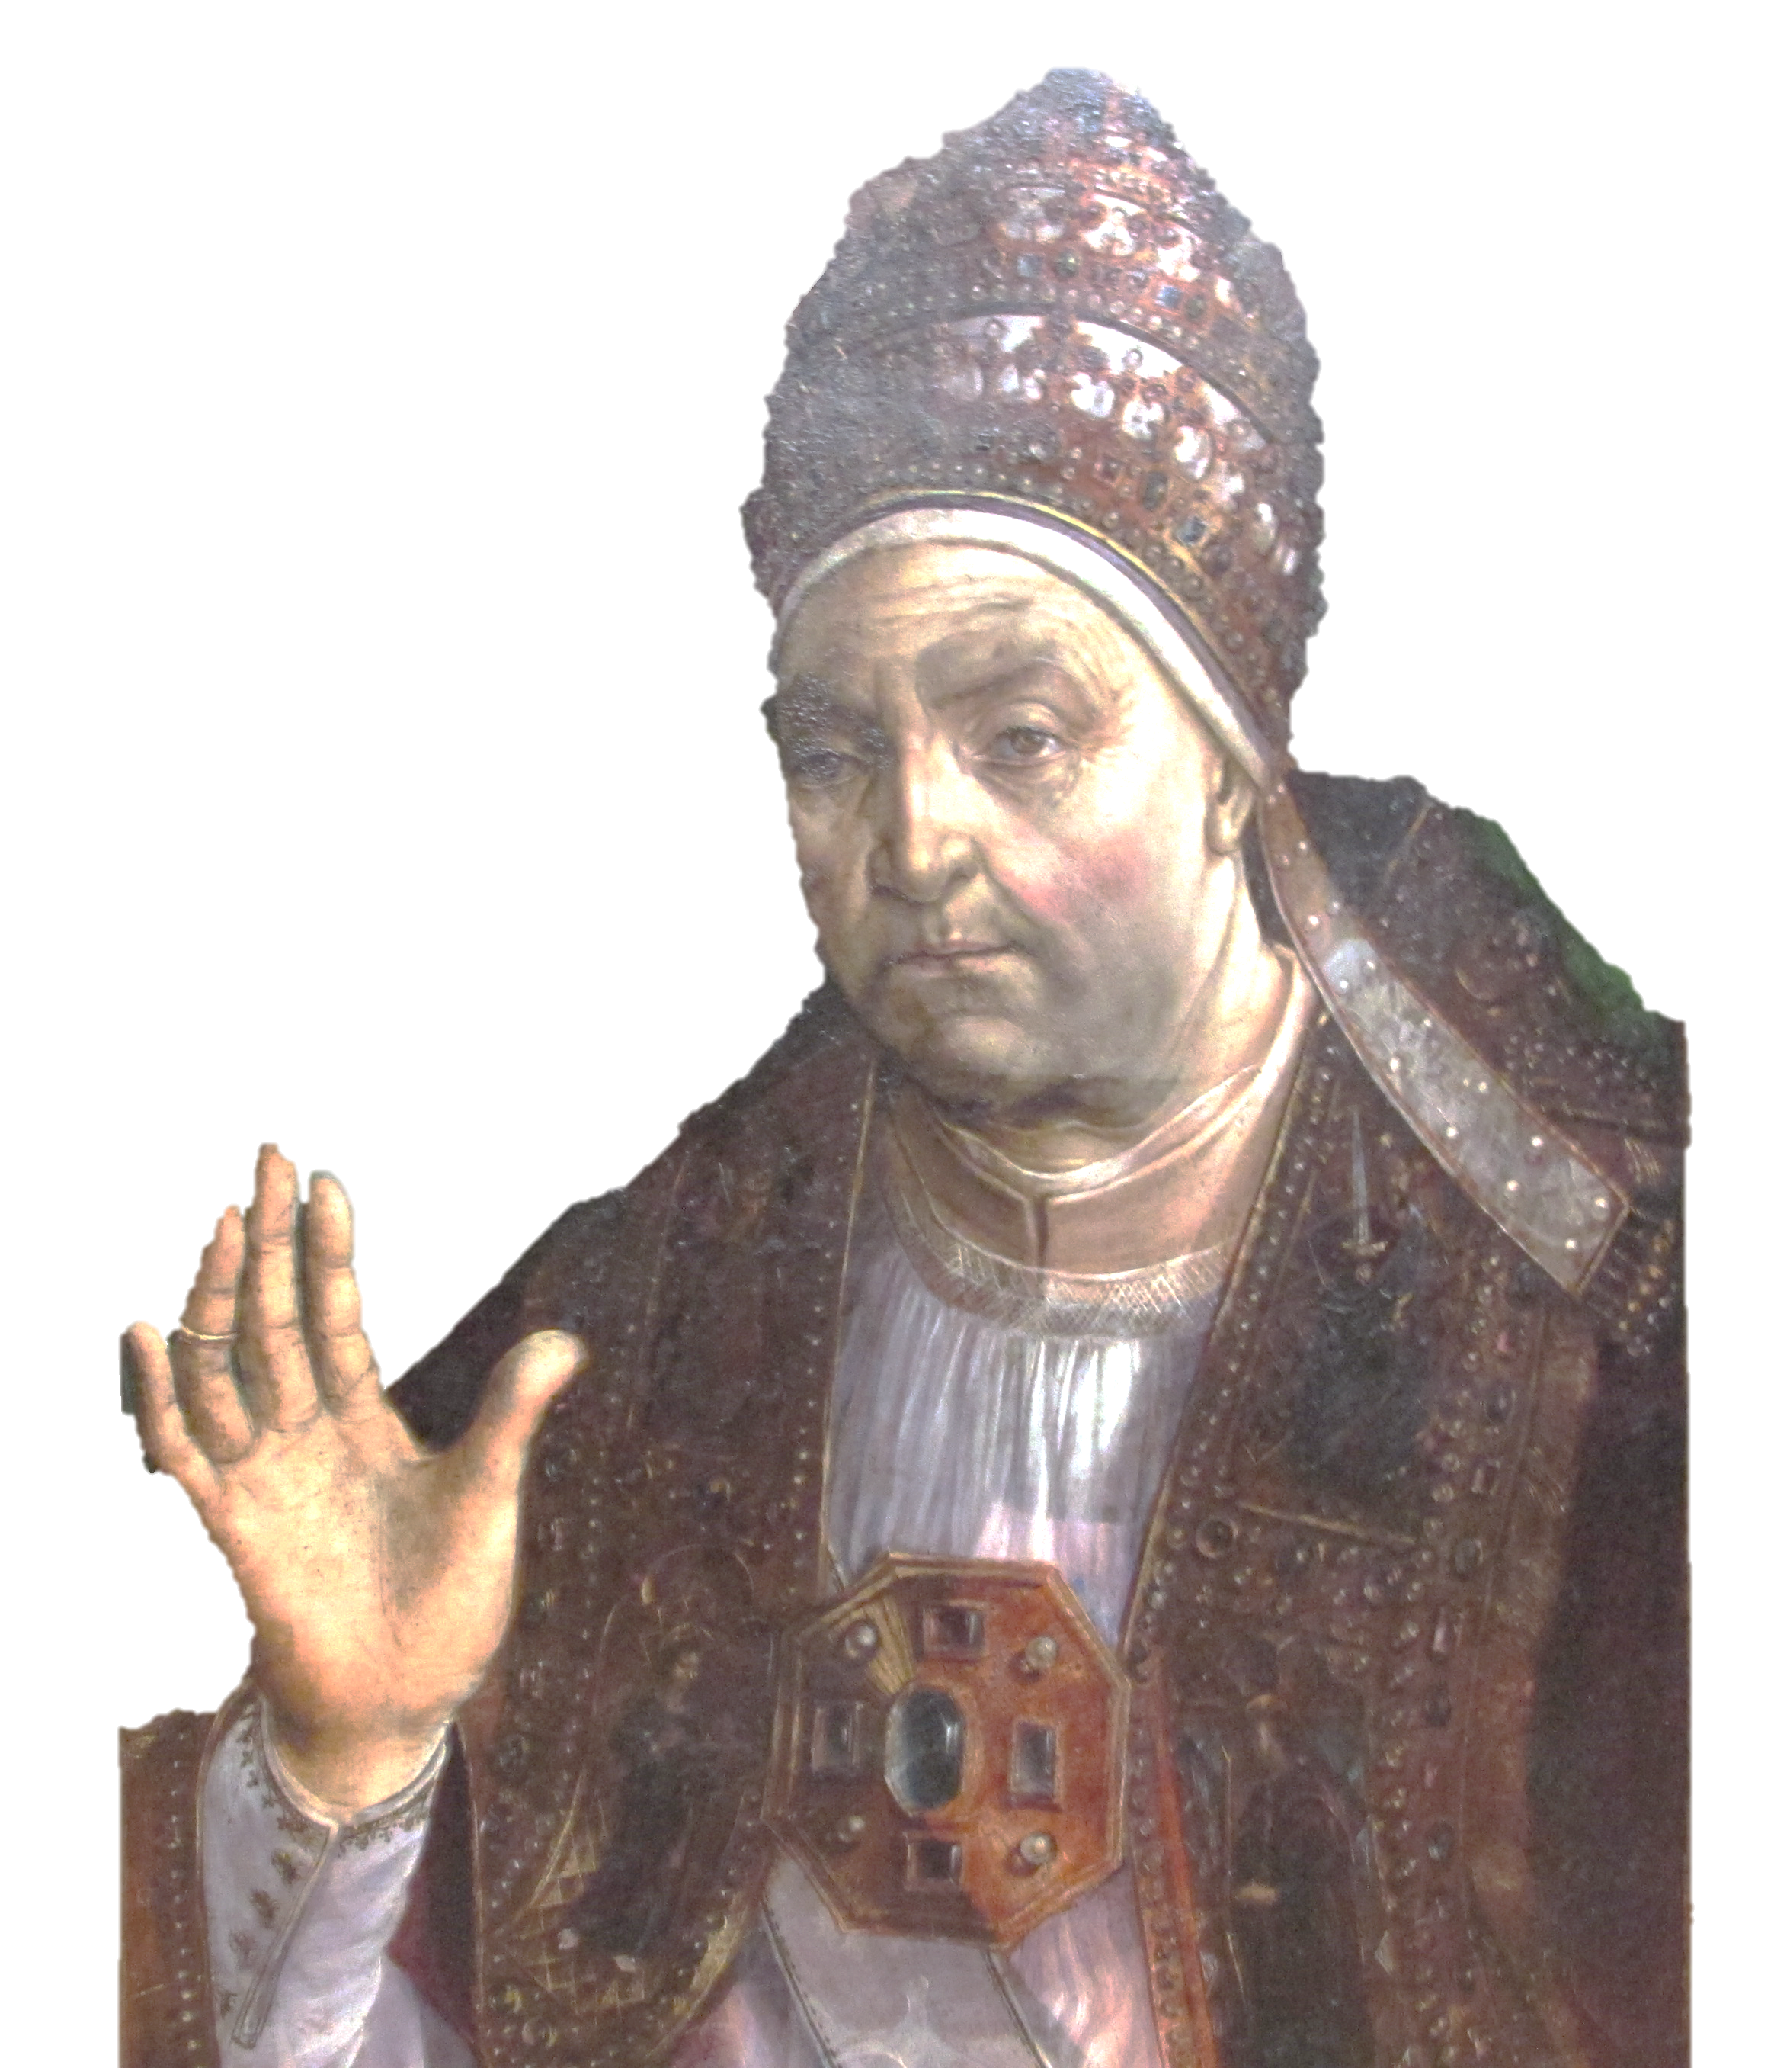
The Inquisition for some time has been moved not by zeal for the faith and the salvation of souls, but by lust for wealth. And many true and faithful Christians, on the testimony of enemies and rivals have, without any legitimate proof, been thrust into secular prisons, tortured and condemned as relapsed heretics, deprived of their goods and property, and handed over to the secular arm to be executed, causing disgust to many.
POPE SIXTUS IV

Slide 20
  ANSWER THE QUESTIONS:
  Why were Conversos resented in Spain in the 1400s?
  How were charges brought against the Conversos? What kind of evidence was required?
  What does this quote tell us about the motivations of many of the inquisitors?
  What are some of the misconceptions about torture in the Spanish Inquisition that are clarified in this lesson?

Slide 21

BISHOP WAZO
Notes:
Students summarise Wazo’s point in their own words.
Discuss how the Inquisitors could claim to be following a God of charity, forgiveness, and compassion while condemning “heretics” to death.

Slide 22

“There are certain beliefs that we do find to be generally insupportable in the modern West - a rejection of diversity, for example … These are things where certainly there’s a community interest in maintaining these and encouraging them, and so I think it’s fair to say that in different communities one might be able to identify heresy. It’s not a religious heresy - it might be a social heresy - but it is something that seems to be insupportable and something that is not to be encouraged.”
CHRISTINE CALDWELL AMES

Slide 23
  COMPARE & CONTRAST
Public Shaming | The Spanish Inquisition

Slide 25
Scripture quotations marked (CEV) are from the Contemporary English Version Copyright © 1991, 1992, 1995 by American Bible Society. Used by Permission.
Scripture quotations marked (ESV) are from the ESV® Bible (The Holy Bible, English Standard Version®), © 2001 by Crossway, a publishing ministry of Good News Publishers. Used by permission. All rights reserved.
Scripture quotations marked (MSG) are taken from The Message, copyright © 1993, 2002, 2018 by Eugene H. Peterson. Used by permission of NavPress. All rights reserved. Represented by Tyndale House Publishers.
Scripture quotations marked (NIV) are taken from the Holy Bible, New International Version®, NIV®. Copyright © 1973, 1978, 1984, 2011 by Biblica, Inc.™ Used by permission of Zondervan. All rights reserved worldwide.
Scripture quotations marked (NIVUK) are taken from the Holy Bible, New International Version® Anglicized, NIV® Copyright © 1979, 1984, 2011 by Biblica, Inc.® Used by permission of Zondervan. All rights reserved worldwide.
Scripture quotations marked (NLT) are taken from the Holy Bible, New Living Translation, copyright ©1996, 2004, 2015 by Tyndale House Foundation. Used by permission of Tyndale House Publishers, Carol Stream, Illinois 60188. All rights reserved.
Notes:
Bible Translation Copyright Credits

