Slide 1

POWER & NON-VIOLENCE
For the Love of God
‘Martin Luther King Jr.’
Notes:
Title with Subtitle

Slide 2



Slide 3
‘PROTEST’
Notes:
Statement or Discussion Question

Slide 4
  DISCUSSION QUESTIONS:
  How do you feel when you have no power?

Slide 5
  DISCUSSION QUESTIONS:
  How do you feel when you have no power?
  How do you change something that is clearly wrong?

Slide 6
  DISCUSSION QUESTIONS:
  How do you feel when you have no power?
  How do you change something that is clearly wrong?
  Is there any cause that you’d be prepared to fight for even if it cost you your life?

Slide 7
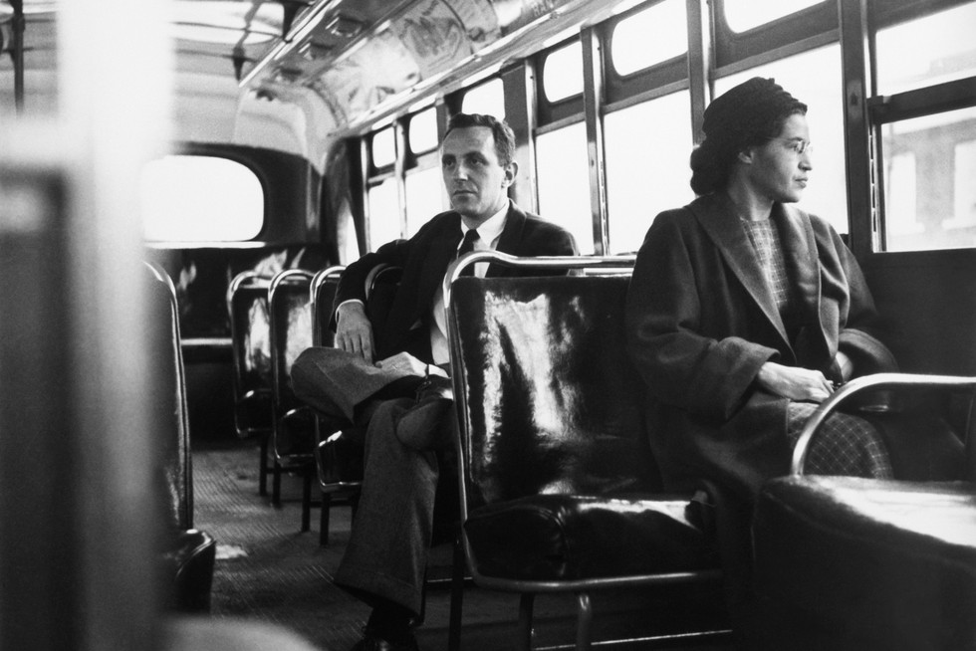

Slide 8
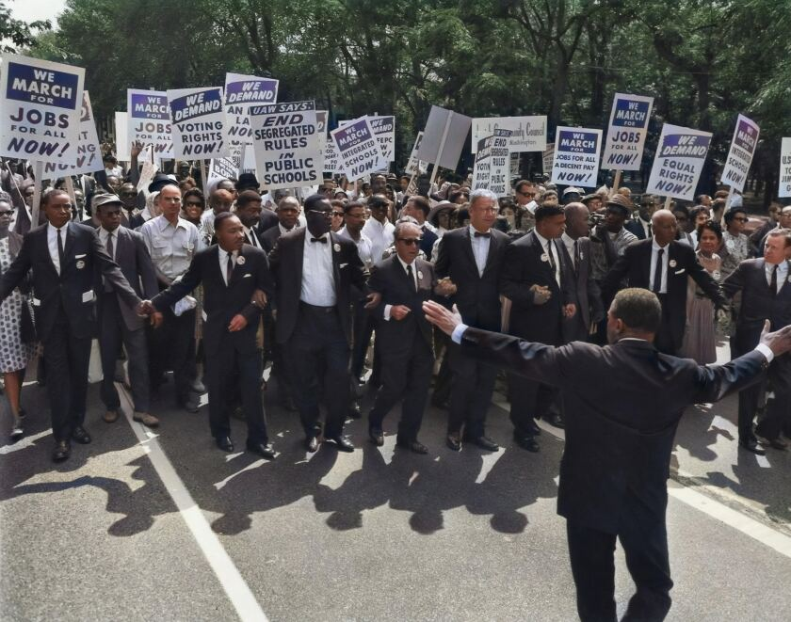

Slide 9
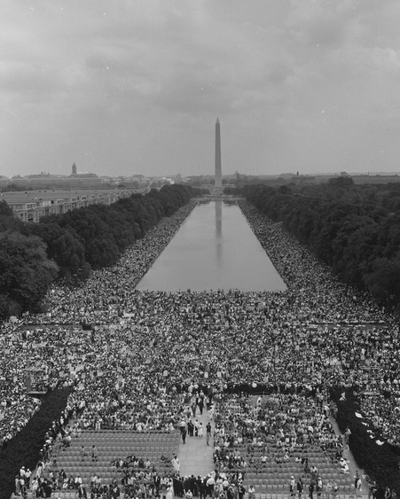

Slide 10
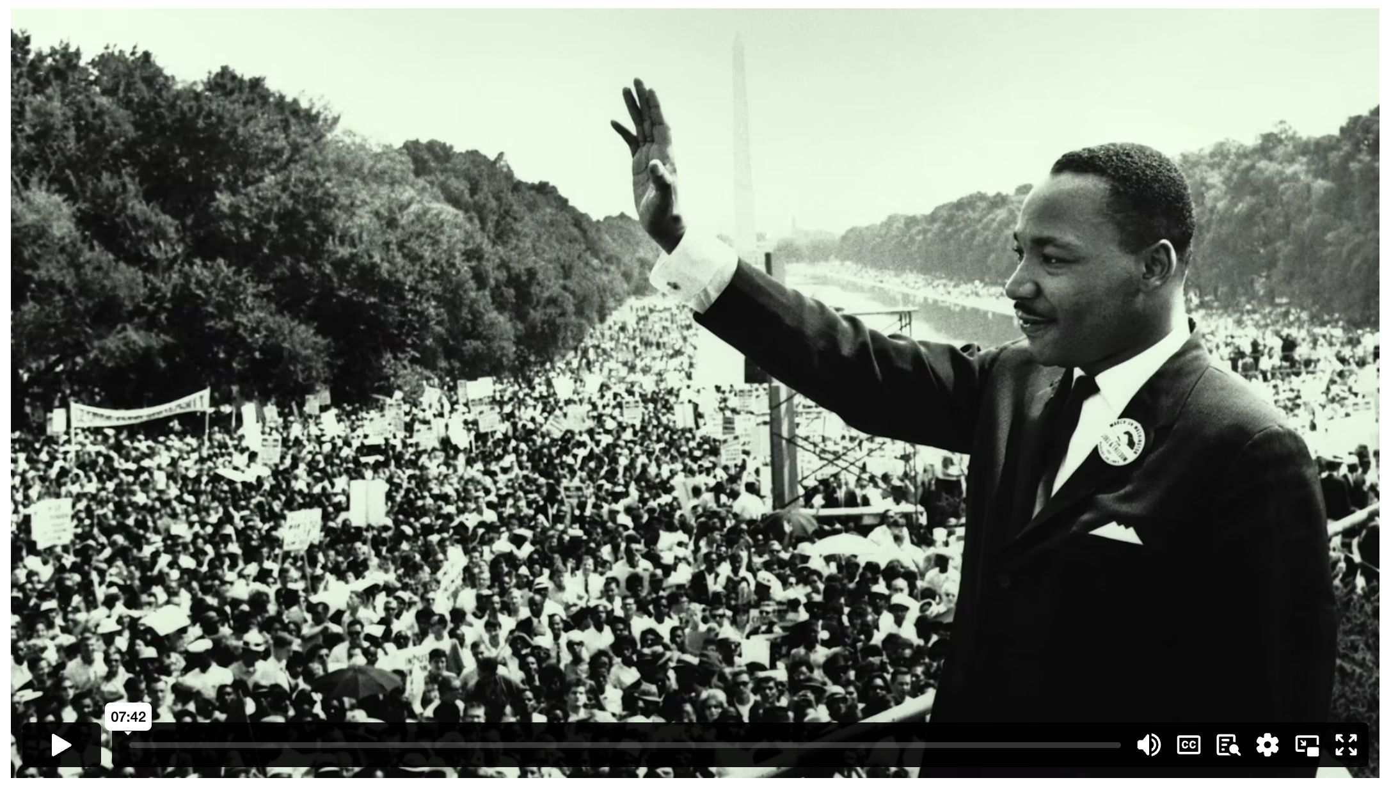
MARTIN LUTHER KING: POWER & NON-VIOLENCE
Notes:
Holding/Final slide

Slide 11

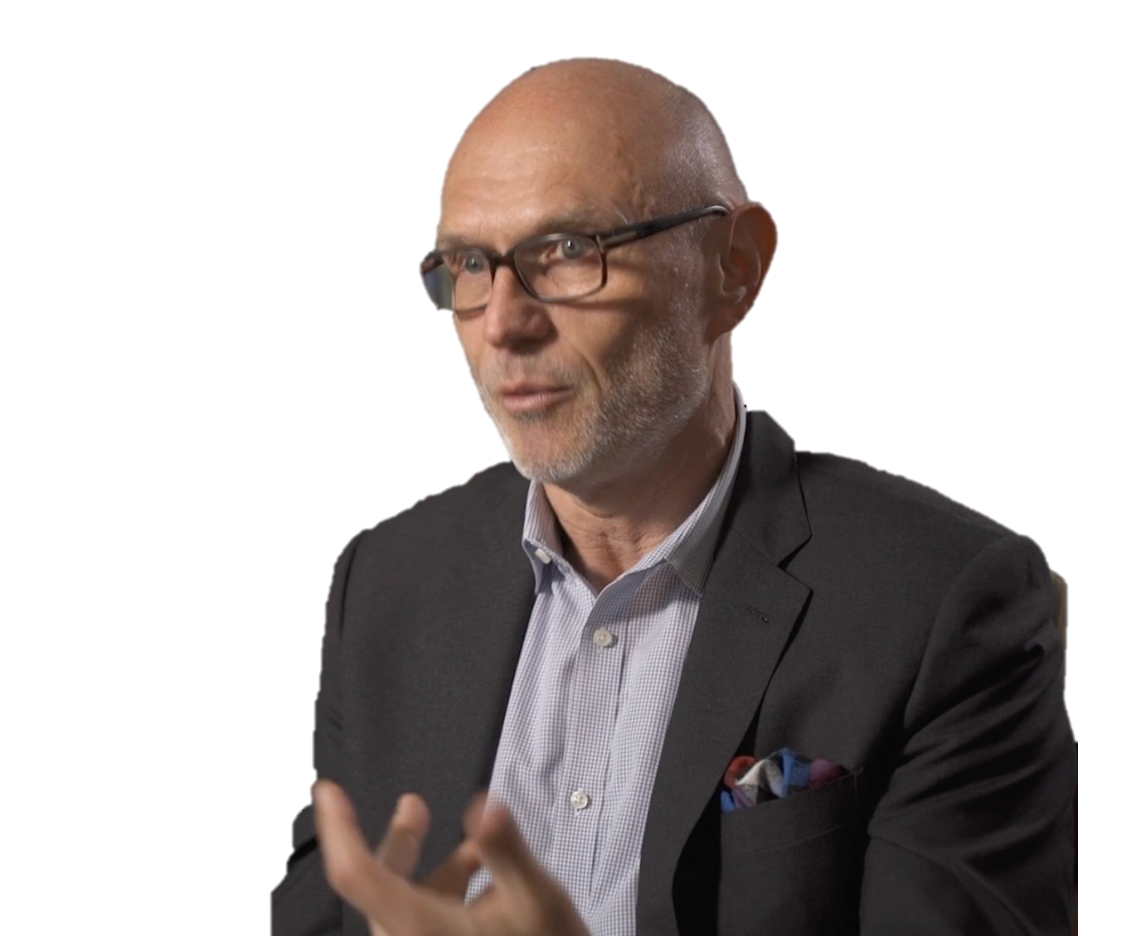
Christian faith, at its very heart, is about grace… Grace that gives without seeking in return… generosity toward the others, forgiveness of others’ injuries, reconciliation…
All of that is central to the Christian faith. Put it to be as central in practice and you’ll have a major contribution to a peaceful world.
MIROSLAV VOLF
Notes:
Quote

Slide 12
⁴ Every valley shall be raised up,
every mountain and hill made low;
the rough ground shall become level,
the rugged places a plain.
⁵ And the glory of the Lord will be revealed,
and all people will see it together.
For the mouth of the Lord has spoken.’
ISAIAH 40 (NIV)
²⁴ But let justice roll on like a river,
righteousness like a never-failing stream!
AMOS 5 (NIV)

Slide 13
¹⁷ Do not repay anyone evil for evil. Be careful to do what is right in the eyes of everyone. ¹⁸ If it is possible, as far as it depends on you, live at peace with everyone. ¹⁹ Do not take revenge, my dear friends, but leave room for God’s wrath, for it is written: ‘It is mine to avenge; I will repay,’ says the Lord. ²⁰ On the contrary:
‘If your enemy is hungry, feed him;
if he is thirsty, give him something to drink.
In doing this, you will heap burning coals on his head.’
²¹ Do not be overcome by evil, but overcome evil with good.
ROMANS 12 (NIV)
Notes:
Large Bible passage

Slide 14
  DISCUSSION QUESTIONS:
  Imagine you had the opportunity to give your own speech titled “I have a dream”. What would your speech be about?

Slide 15
  DISCUSSION QUESTIONS:
  Imagine you had the opportunity to give your own speech titled “I have a dream”. What would your speech be about?
  Do you know anyone who you think embodies the idea of “grace that gives”? How close are you to following their example?

Slide 16
Notes:
Holding/Final slide

Slide 17
Notes:
Holding/Final slide

