Slide 1

THE IMAGE OF GOD
For the Love of God
Notes:
Title with Subtitle

Slide 2
‘Do you think Christianity is more about valuing individuals, or restricting and controlling them?’

Slide 3
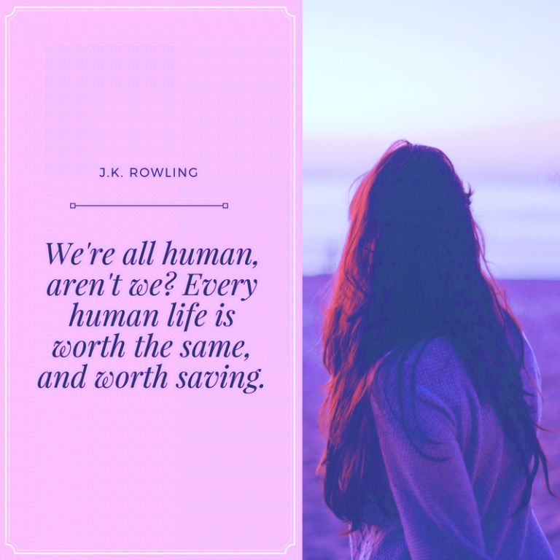


Slide 4

  DISCUSSION QUESTIONS:
  Give examples of other books or movies that demonstrate this idea.

Slide 5
  DISCUSSION QUESTIONS:
  Give examples of other books or movies that demonstrate this idea.
  Do you agree with Rowling’s quote? Why or why not?

Slide 6
  DISCUSSION QUESTIONS:
  Give examples of other books or movies that demonstrate this idea.
  Do you agree with Rowling’s quote? Why or why not?
  What do you think a single life is worth?

Slide 7
  DISCUSSION QUESTIONS:
  Give examples of other books or movies that demonstrate this idea.
  Do you agree with Rowling’s quote? Why or why not?
  What do you think a single life is worth?
  Is the value of each human life the same across all cultures and all eras?

Slide 8
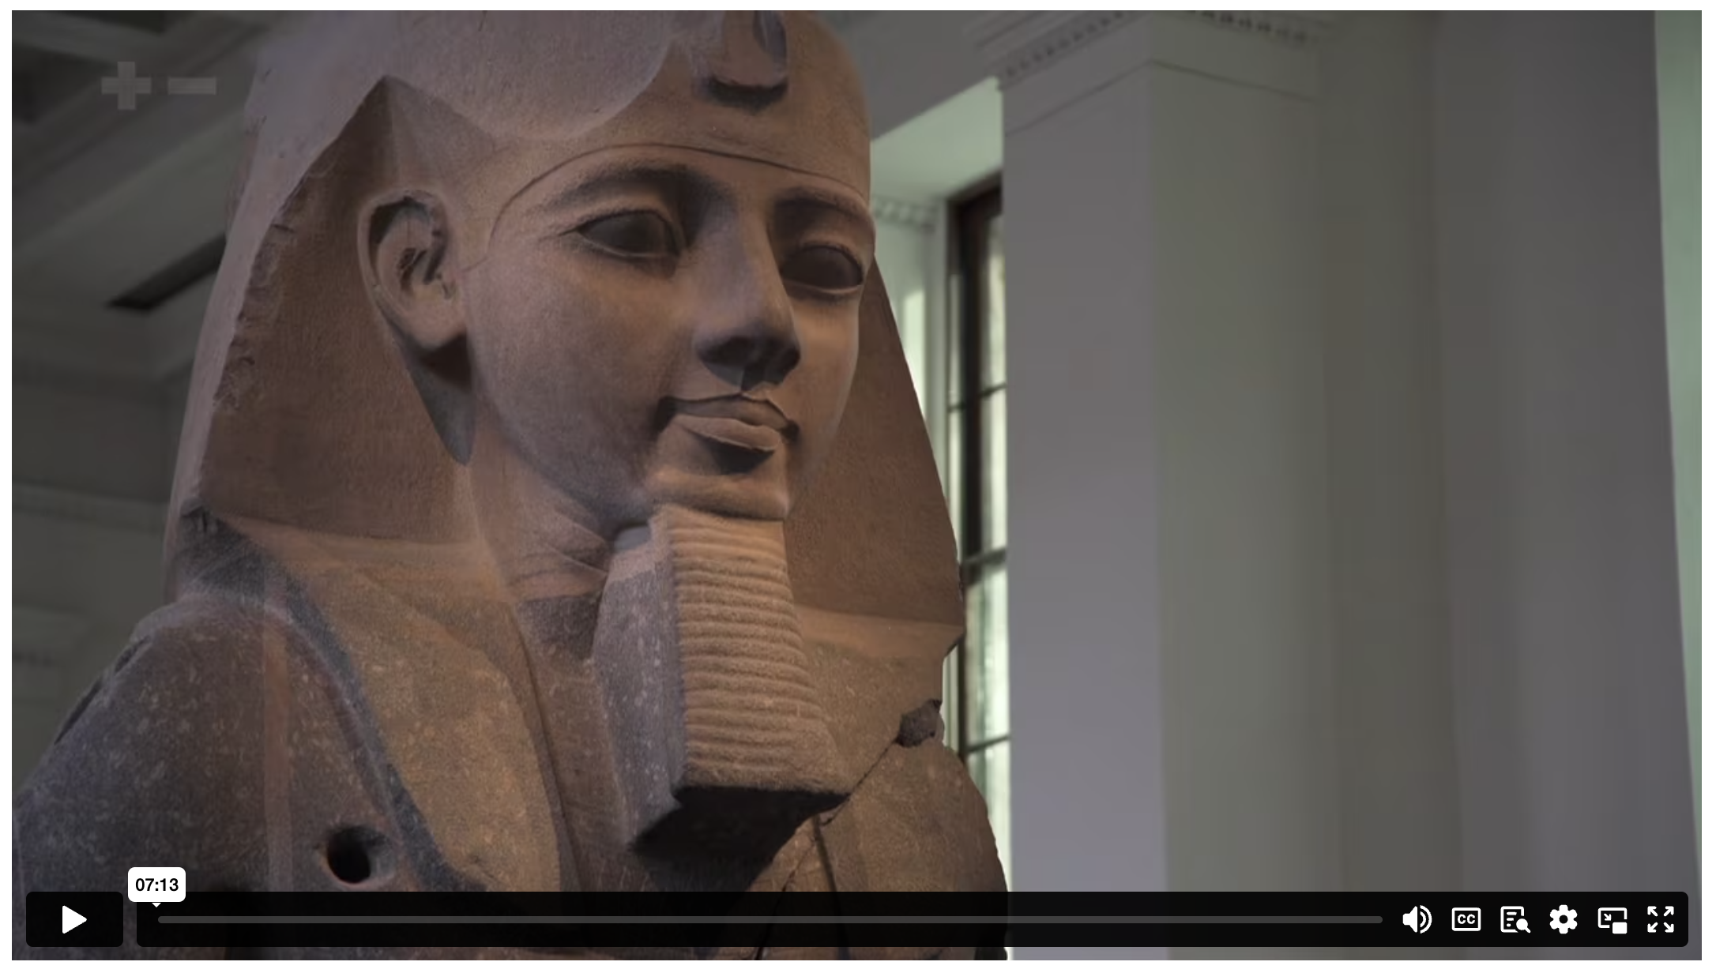
THE IMAGE OF GOD: THE CONCEPT
Notes:
Holding/Final slide

Slide 9


Slide 10
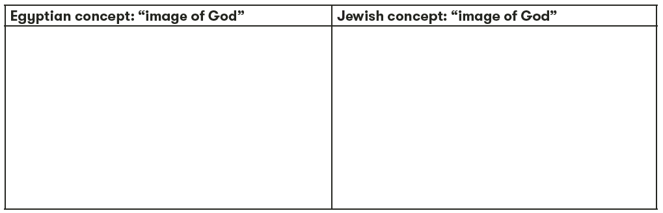

Slide 11
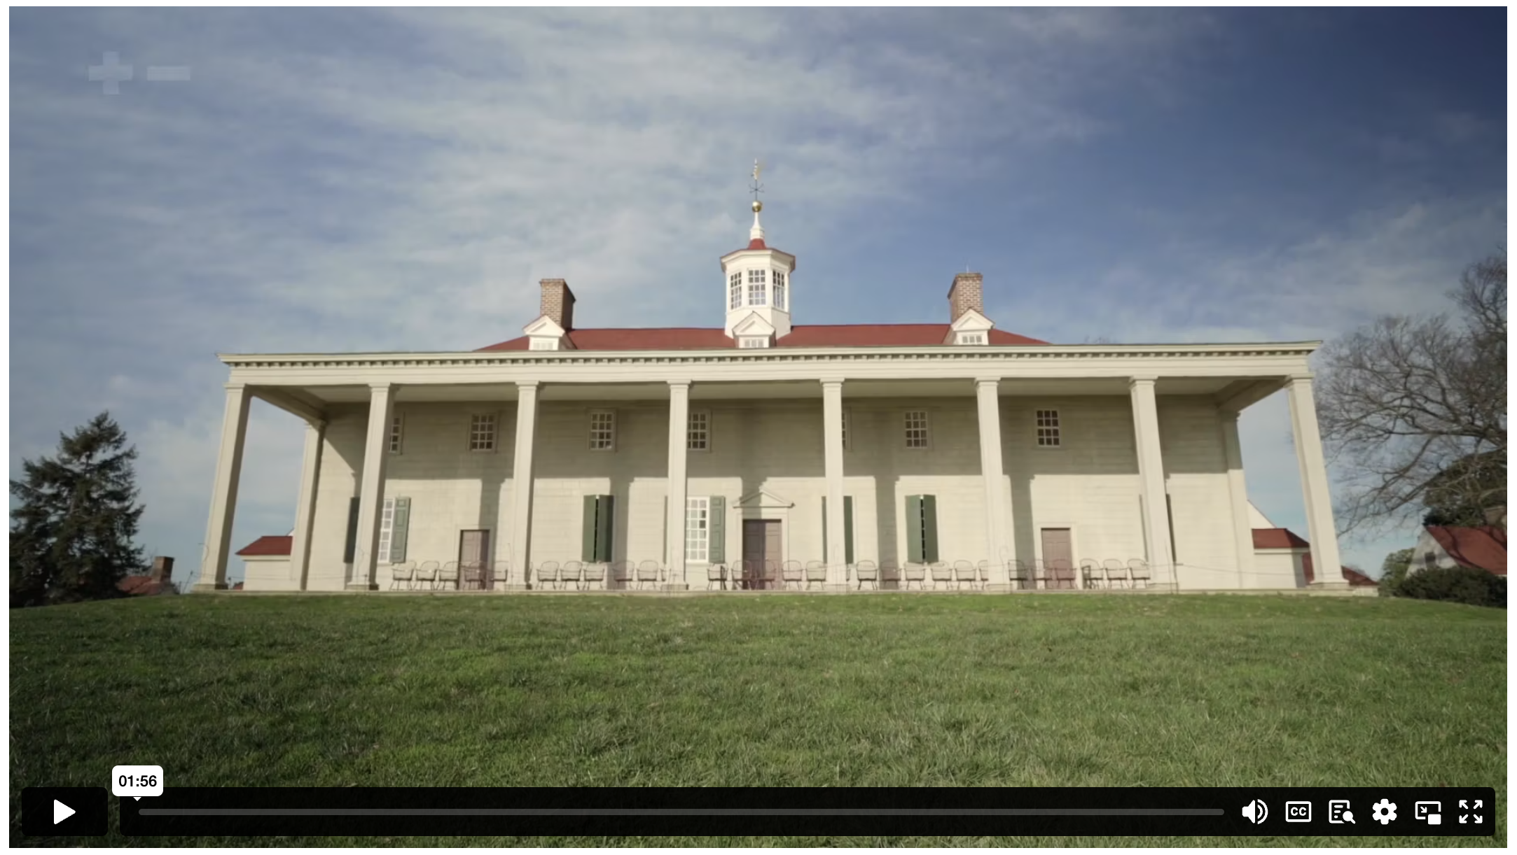
THE IMAGE OF GOD: AN ILLUSTRATION
Notes:
Holding/Final slide

Slide 12
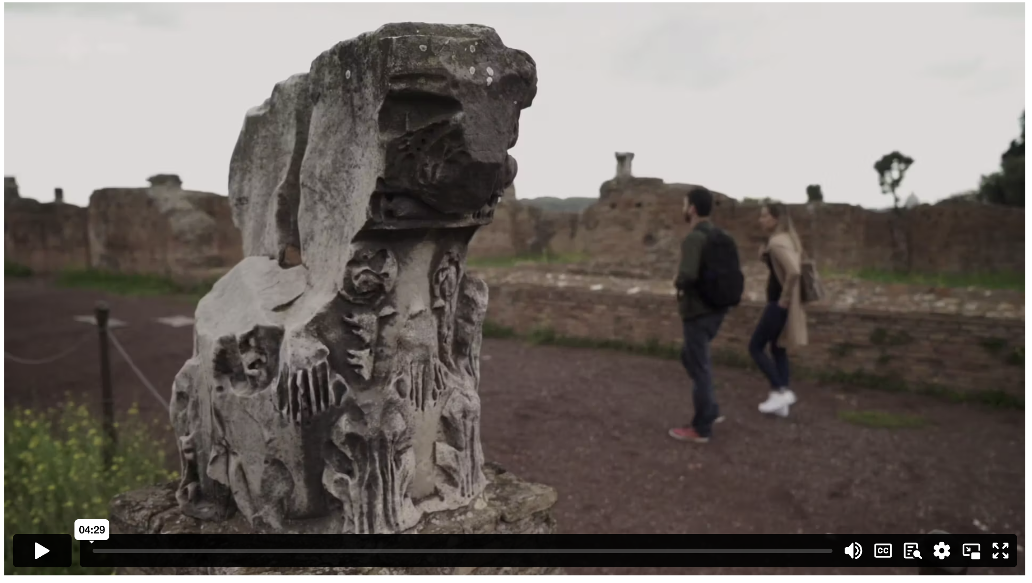
THE IMAGE OF GOD: THE IMPACT
Notes:
Holding/Final slide

Slide 13
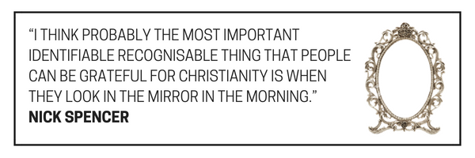

Slide 14
²⁶ Then God said, ‘Let us make mankind in our image, in our likeness, so that they may rule over the fish in the sea and the birds in the sky, over the livestock and all the wild animals, and over all the creatures that move along the ground.’
²⁷ So God created mankind in his own image,
in the image of God he created them;
male and female he created them.
²⁸ God blessed them and said to them, ‘Be fruitful and increase in number; fill the earth and subdue it. Rule over the fish in the sea and the birds in the sky and over every living creature that moves on the ground.’
GENESIS 1 (NIV)

Slide 15

If you think that every human life is infinitely valuable, regardless of capacity or usefulness, then you’ve been influenced by the Bible’s teaching about the ‘image of God’.
JOHN DICKSON

Slide 16
  DISCUSSION QUESTIONS:
  Do you think there are any ways in which our society is starting to lose the belief of the inherent dignity and worth of all people? Give examples.

Slide 17
  DISCUSSION QUESTIONS:
  Do you think there are any ways in which our society is starting to lose the belief of the inherent dignity and worth of all people? Give examples.
  If you were being marked from 1 to 10 (1 being lowest, 10 being highest) on how you treat other people, what do you think your score would be? What would raise your score?

Slide 18
Notes:
Holding/Final slide

Slide 19
Notes:
Holding/Final slide

