Slide 1

SLAVERY
For the Love of God
In “Christian” America
Notes:
Title with Subtitle

Slide 2



Slide 3
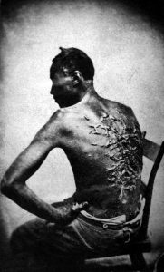

Slide 4
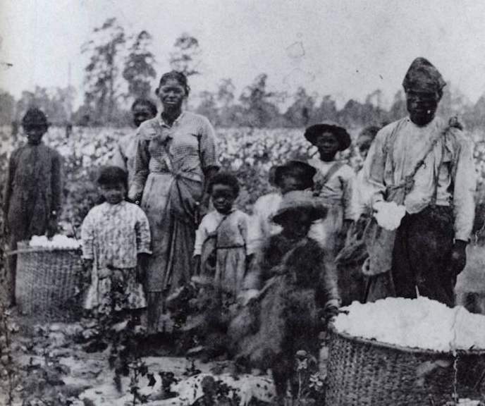

Slide 5
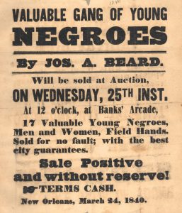

Slide 6
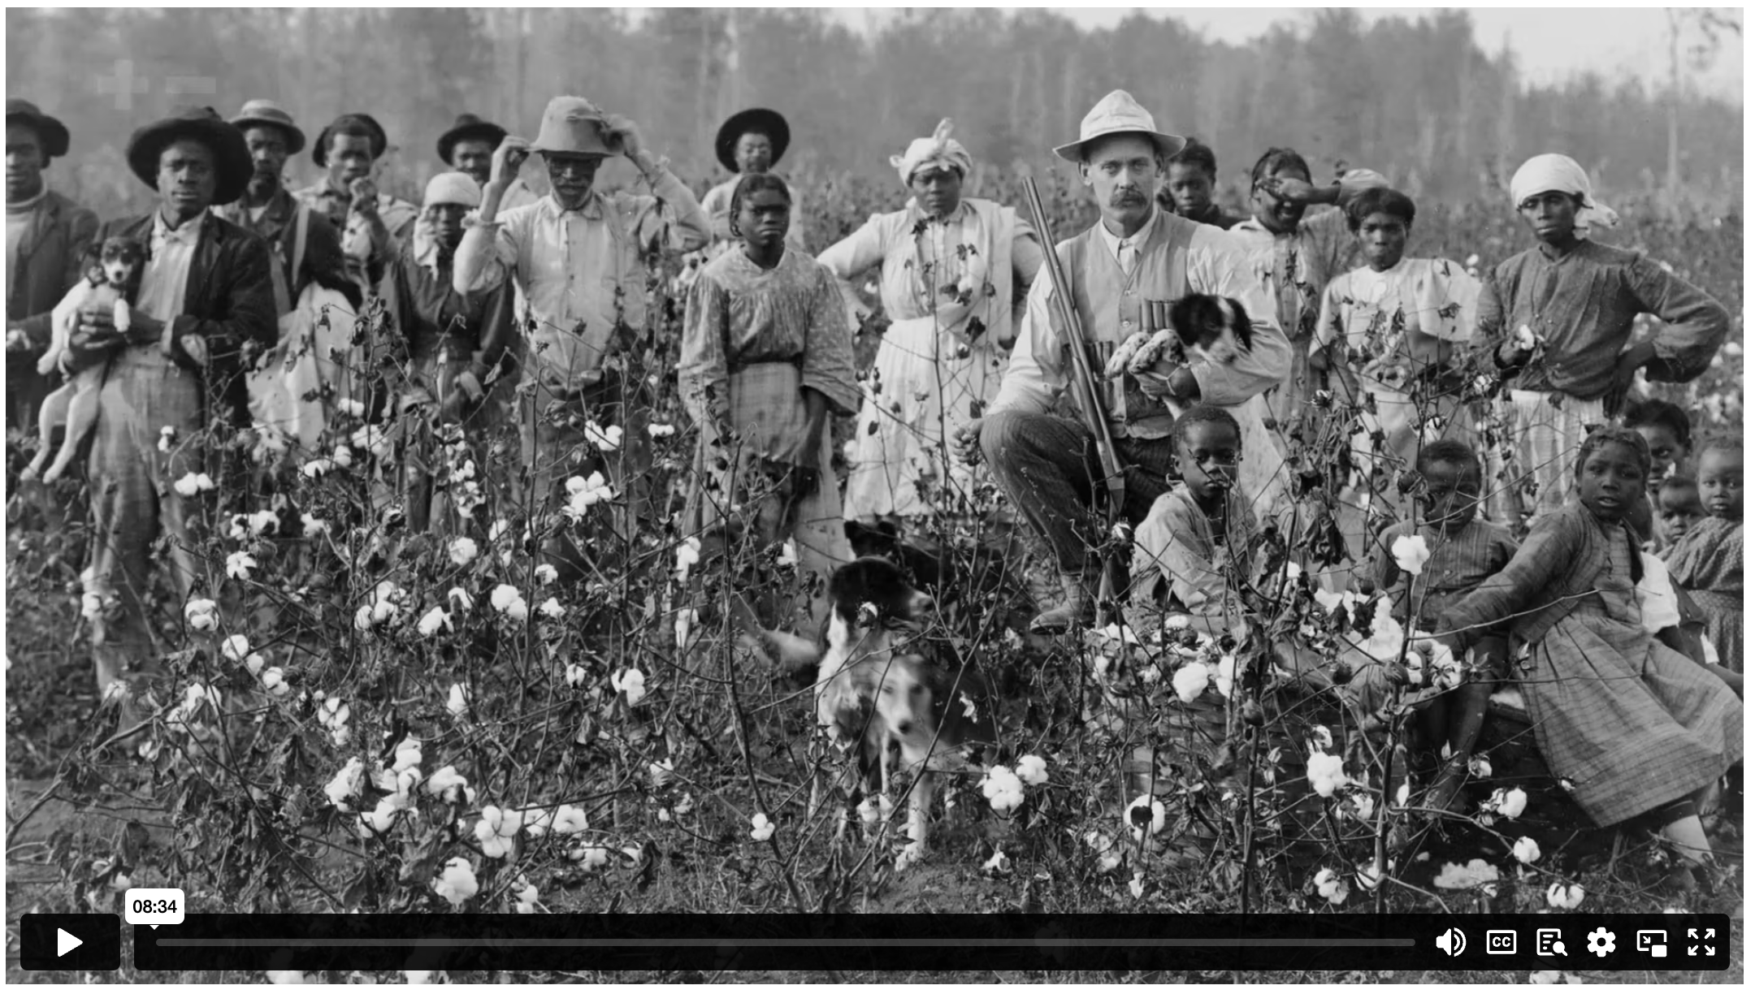
SLAVERY IN “CHRISTIAN” AMERICA
Notes:
Holding/Final slide

Slide 7

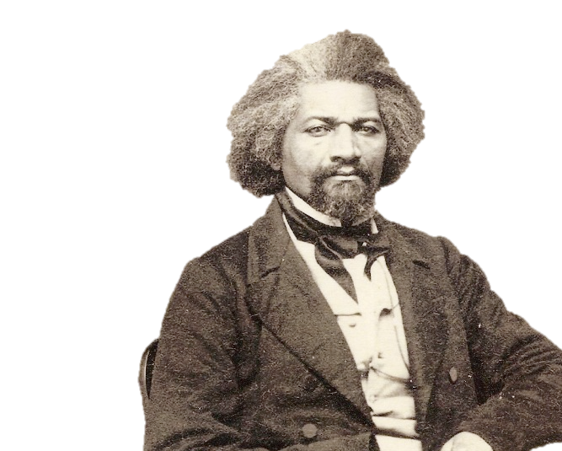
I love the pure, peaceable, and impartial Christianity of Christ: I therefore hate the corrupt, slave-holding, women-whipping, cradle-plundering, partial and hypocritical Christianity of the land. Indeed, I can see no reason but the most deceitful one, for calling the religion of the land Christianity.
FREDERICK DOUGLAS

Slide 8
¹ Look here, you rich people: Weep and groan with anguish because of all the terrible troubles ahead of you. ² Your wealth is rotting away, and your fine clothes are moth-eaten rags. ³ Your gold and silver are corroded. The very wealth you were counting on will eat away your flesh like fire. This corroded treasure you have hoarded will testify against you on the day of judgment. ⁴ For listen! Hear the cries of the field workers whom you have cheated of their pay. The cries of those who harvest your fields have reached the ears of the Lord of Heaven’s Armies.
⁵ You have spent your years on earth in luxury, satisfying your every desire. You have fattened yourselves for the day of slaughter. ⁶ You have condemned and killed innocent people, who do not resist you.
JAMES 5 (NLT)
Notes:
Large Bible passage

Slide 9
²⁶ For you are all children of God through faith in Christ Jesus. ²⁷ And all who have been united with Christ in baptism have put on Christ, like putting on new clothes. ²⁸ There is no longer Jew or Gentile, slave or free, male and female. For you are all one in Christ Jesus.
GALATIANS 3 (NLT)
Notes:
Large Bible passage

Slide 10
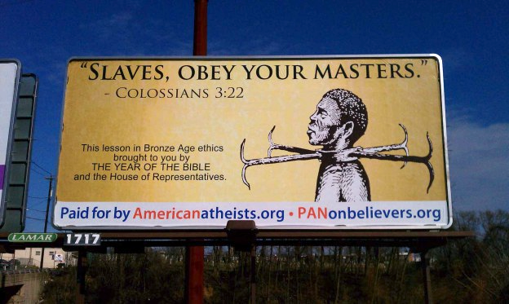
HARRISBURG, PA – MARCH 2012

Slide 11
^{3.22} Slaves, obey your earthly masters in everything you do. Try to please them all the time, not just when they are watching you. Serve them sincerely because of your reverent fear of the Lord. ²³ Work willingly at whatever you do, as though you were working for the Lord rather than for people. ²⁴ Remember that the Lord will give you an inheritance as your reward, and that the Master you are serving is Christ. ²⁵ But if you do what is wrong, you will be paid back for the wrong you have done. For God has no favourites.
^{4.1} Masters, be just and fair to your slaves. Remember that you also have a Master – in heaven.
COLOSSIANS 3 – 4 (NLT)
Notes:
Large Bible passage

Slide 12
Notes:
Holding/Final slide

Slide 13
Notes:
Holding/Final slide

