Slide 1

‘TREASURES ON EARTH’
For the Love of God
The Medieval Papacy and its Opponents
Notes:
Title with Subtitle

Slide 2
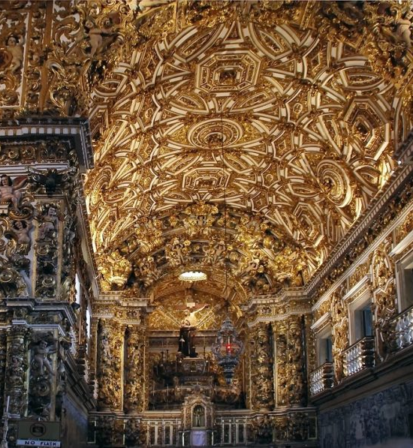
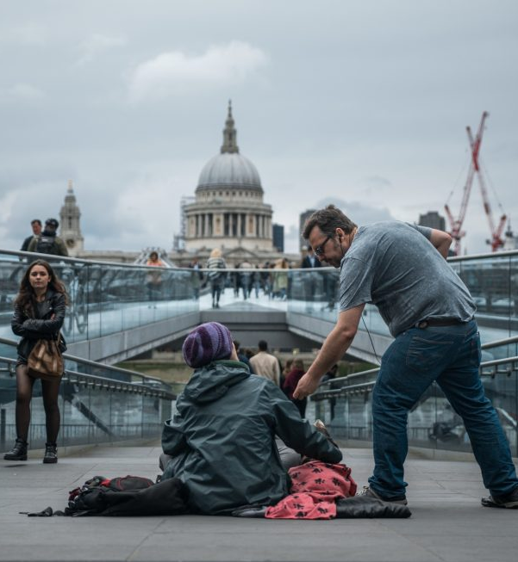
Notes:
Image for activity

Slide 3

A WISE PERSON SHOULD HAVE MONEY IN THEIR HEAD, BUT NOT IN THEIR HEART.
JONATHON SWIFT
Notes:
Existing quote images

Slide 4
A WISE PERSON SHOULD HAVE MONEY IN THEIR HEAD, BUT NOT IN THEIR HEART.
JONATHON SWIFT
MONEY NEVER MADE A MAN HAPPY YET, NOR WILL IT. THE MORE A MAN HAS, THE MORE HE WANTS. INSTEAD OF FILLING A VACCUM IT MAKES ONE.
BENJAMIN FRANKLIN
Notes:
Existing quote images

Slide 5
WHOEVER SAID MONEY CAN’T BUY HAPPINESS, SIMPLY DIDN’T KNOW WHERE TO GO SHOPPING
BO DEREK
A WISE PERSON SHOULD HAVE MONEY IN THEIR HEAD, BUT NOT IN THEIR HEART.
JONATHON SWIFT
MONEY NEVER MADE A MAN HAPPY YET, NOR WILL IT. THE MORE A MAN HAS, THE MORE HE WANTS. INSTEAD OF FILLING A VACCUM IT MAKES ONE.
BENJAMIN FRANKLIN
Notes:
Existing quote images

Slide 6


Notes:
Holding/Final slide

Slide 7
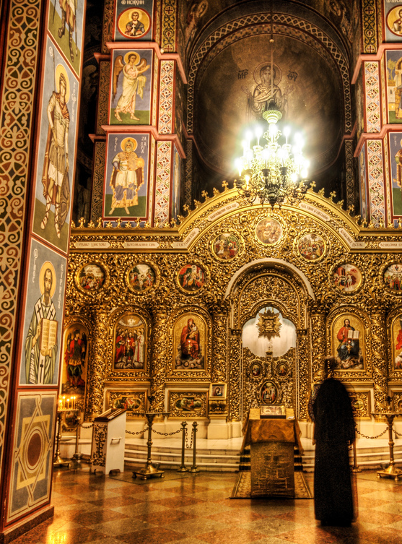
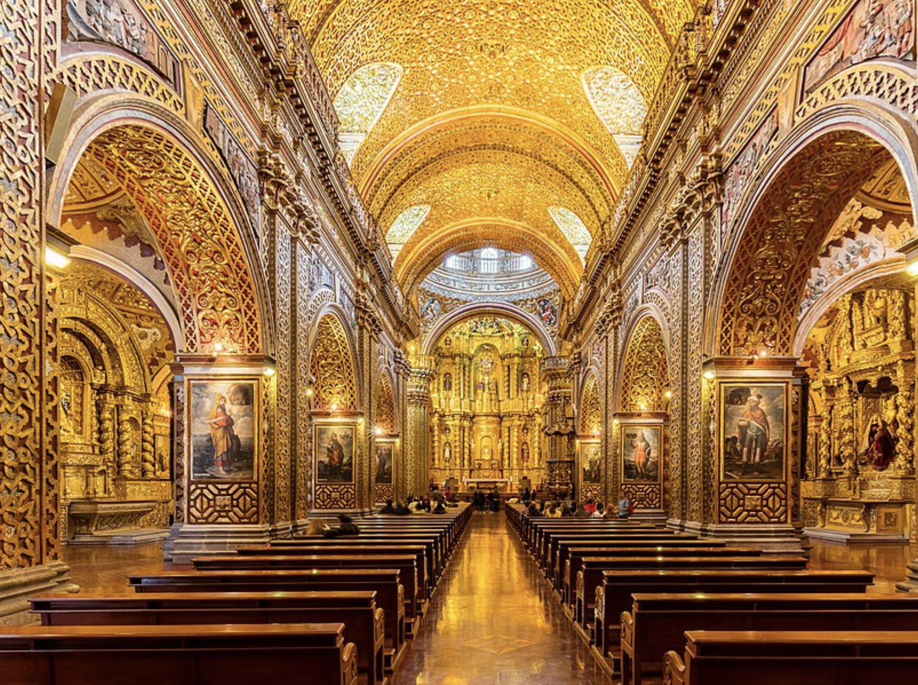
Notes:
Image for activity

Slide 8
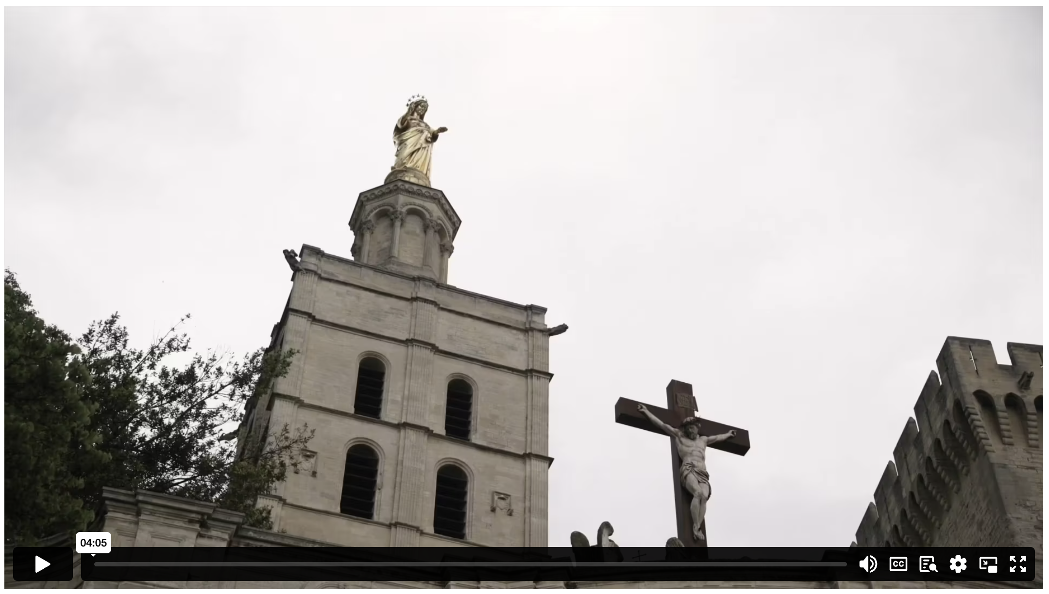
Notes:
Holding/Final slide

Slide 9
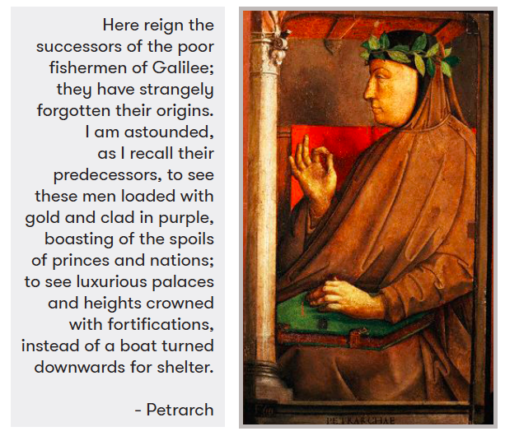
Notes:
Holding/Final slide

Slide 10
  DISCUSSION QUESTIONS:
  What do you think Jesus meant when he told his followers not to “store up treasures on earth”?
Notes:
Large discussion questions

Slide 11
  DISCUSSION QUESTIONS:
  What do you think Jesus meant when he told his followers not to “store up treasures on earth”?
  In what ways was the Medieval Church failing to reflect this ideal?
Notes:
Large discussion questions

Slide 12
  DISCUSSION QUESTIONS:
  What do you think Jesus meant when he told his followers not to “store up treasures on earth”?
  In what ways was the Medieval Church failing to reflect this ideal?
  How did Odo feel about the decadent lifestyles of church leaders? What actions did he undertake as an individual in response to his feelings?
Notes:
Large discussion questions

Slide 13
  DISCUSSION QUESTIONS:
  What do you think Jesus meant when he told his followers not to “store up treasures on earth”?
  In what ways was the Medieval Church failing to reflect this ideal?
  How did Odo feel about the decadent lifestyles of church leaders? What actions did he undertake as an individual in response to his feelings?
  What strikes you about the account of Odo and John’s journey through famine-stricken Siena?
Notes:
Large discussion questions

Slide 14
  DISCUSSION QUESTIONS:
  What do you think Jesus meant when he told his followers not to “store up treasures on earth”?
  In what ways was the Medieval Church failing to reflect this ideal?
  How did Odo feel about the decadent lifestyles of church leaders? What actions did he undertake as an individual in response to his feelings?
  What strikes you about the account of Odo and John’s journey through famine-stricken Siena?
  How was Odo’s life a strong criticism of greedy churchmen?
Notes:
Large discussion questions

Slide 15
Jesus:
“¹⁹ Don't store up treasures on earth! Moths and rust can destroy them, and thieves can break in and steal them. ²⁰ Instead, store up your treasures in heaven, where moths and rust cannot destroy them, and thieves cannot break in and steal them. ²¹ Your heart will always be where your treasure is.”
MATTHEW 6 (CEV)
Notes:
Large Bible passage

Slide 16
“You can’t live in a huge house if you are really serious about following Jesus.”
Notes:
Statement or Discussion Question

Slide 17
“Christians shouldn’t spend any money on entertainment. They should give that money to the poor instead.”
Notes:
Statement or Discussion Question

Slide 18
“On the weekend, my train went past a church that was huge! It had a brand-new building that would’ve cost at least 2 million dollars to build.
I just don’t think churches should be spending that kind of money.”
Notes:
Statement or Discussion Question

Slide 19
Notes:
Holding/Final slide

Slide 20
Notes:
Holding/Final slide

