Slide 1

‘FAITH & SOCIAL CAPITAL’
For the Love of God
Why You Need Christian Neighbours
Notes:
Title with Subtitle

Slide 2
“What makes someone a ‘good’ neighbour?
Notes:
Statement or Discussion Question

Slide 3

Pineapple should never be found on Pizza
Agree
Disagree
Notes:
Human Barometer Activity intro slide – delete the slides you don’t want

Slide 4
You can’t call chess
a sport
Agree
Disagree
Notes:
Human Barometer Activity intro slide – delete the slides you don’t want

Slide 5
The moon landing never really happened
Agree
Disagree
Notes:
Human Barometer Activity intro slide – delete the slides you don’t want

Slide 6
Marvel movies are an insult to our intelligence.
Agree
Disagree
Notes:
Human Barometer Activity intro slide – delete the slides you don’t want

Slide 7
Churches are not very involved in my local community
Bible verse goes here. Make the type smaller so it fits in this box.
Agree
Disagree
Notes:
Human Barometer Activity Slides – add any text here (statements not questions)

Slide 8
Religious people seem
to do more volunteer work
than non-religious people
Bible verse goes here. Make the type smaller so it fits in this box.
Agree
Disagree
Notes:
Human Barometer Activity Slides – add any text here (statements not questions)

Slide 9
It would be good to have a Christian neighbour
Bible verse goes here. Make the type smaller so it fits in this box.
Agree
Disagree
Notes:
Human Barometer Activity Slides – add any text here (statements not questions)

Slide 10
Notes:
Holding/Final slide

Slide 11
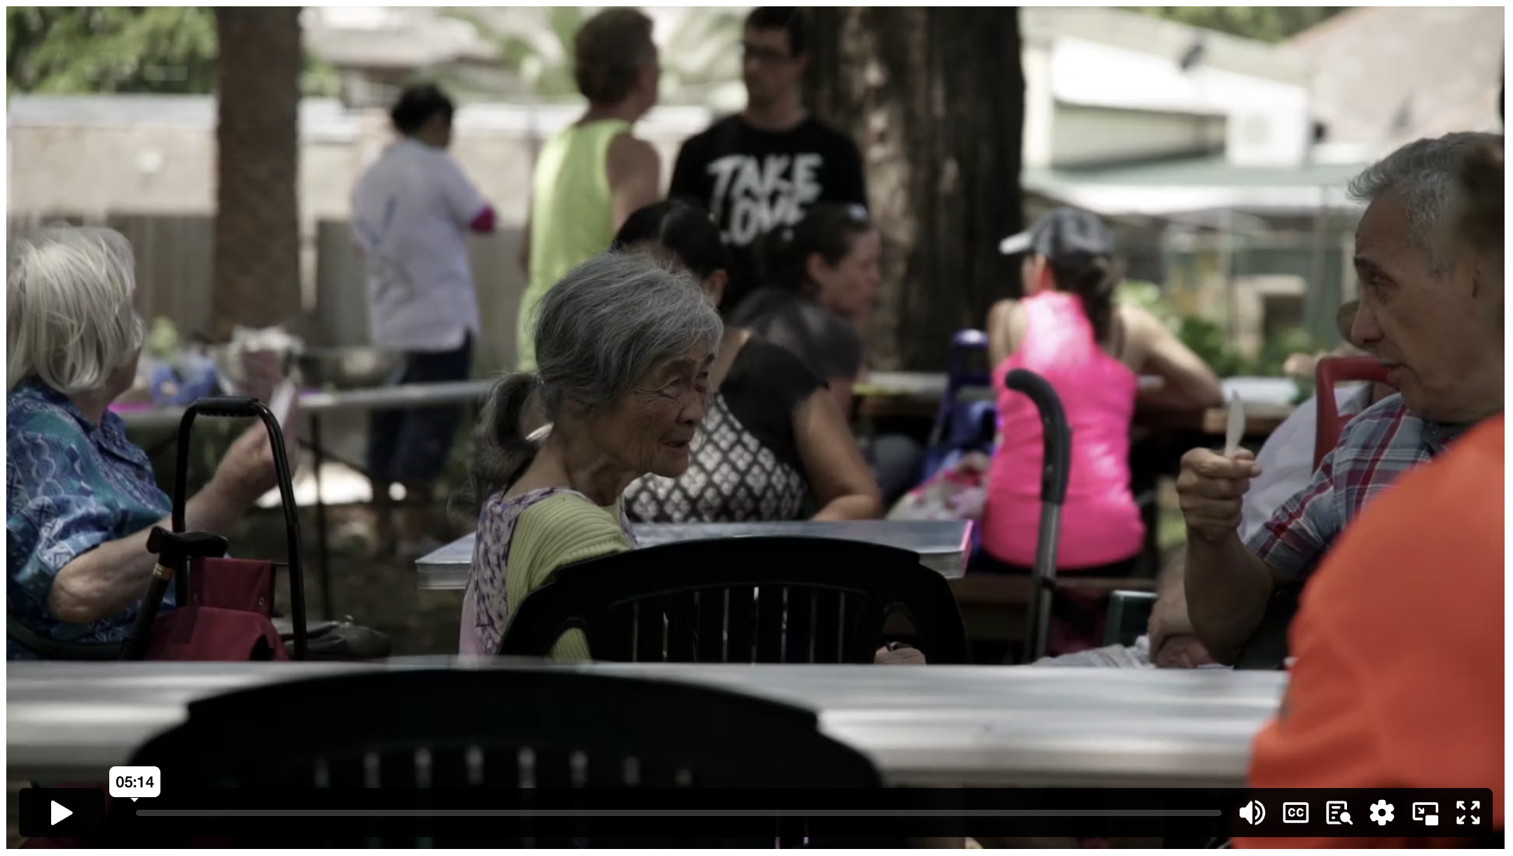
WHY YOU NEED CHRISTIAN NEIGHBOURS
Notes:
Holding/Final slide

Slide 12

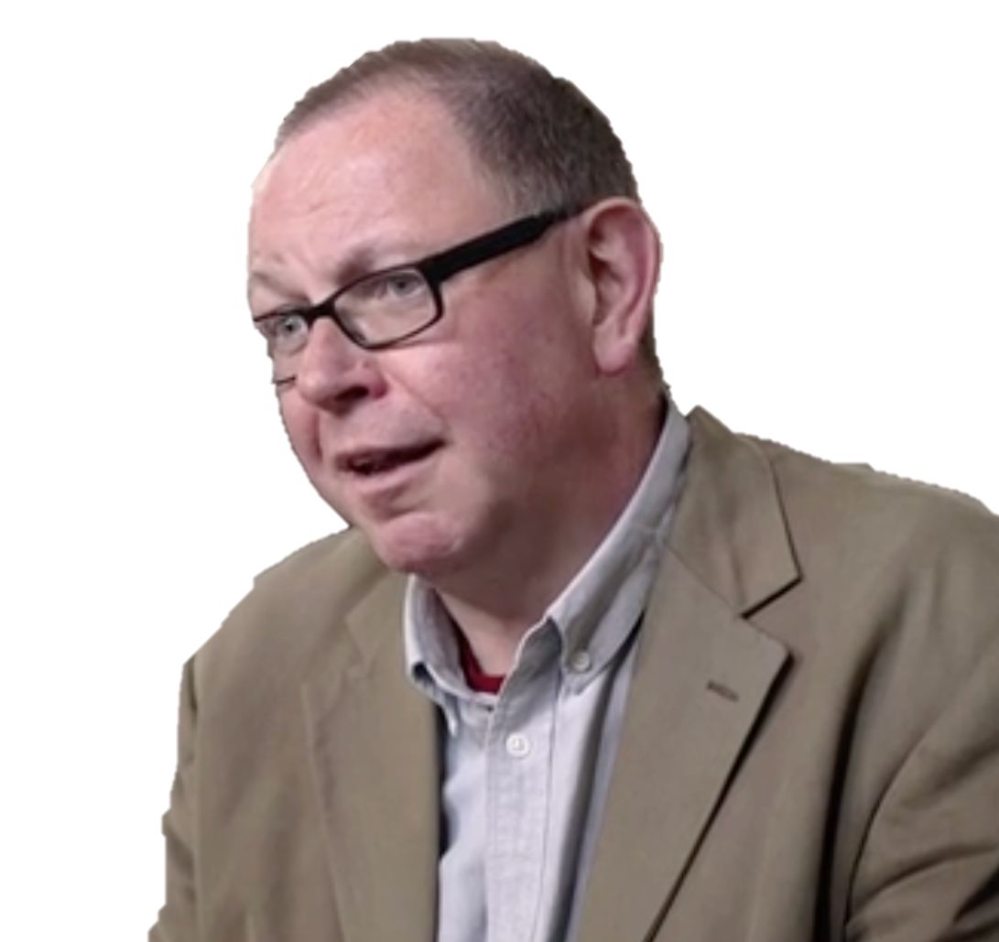
It is perfectly possible, I’m afraid, to go to a church and go “help”, and have them go, “I’m sorry, we’re busy with the flower arranging”. But it doesn’t always happen like that. It’s observable that Christians are particularly drawn towards…applying love in small, individual, practical ways.
FRANCIS SPUFFORD
Notes:
Quote

Slide 13
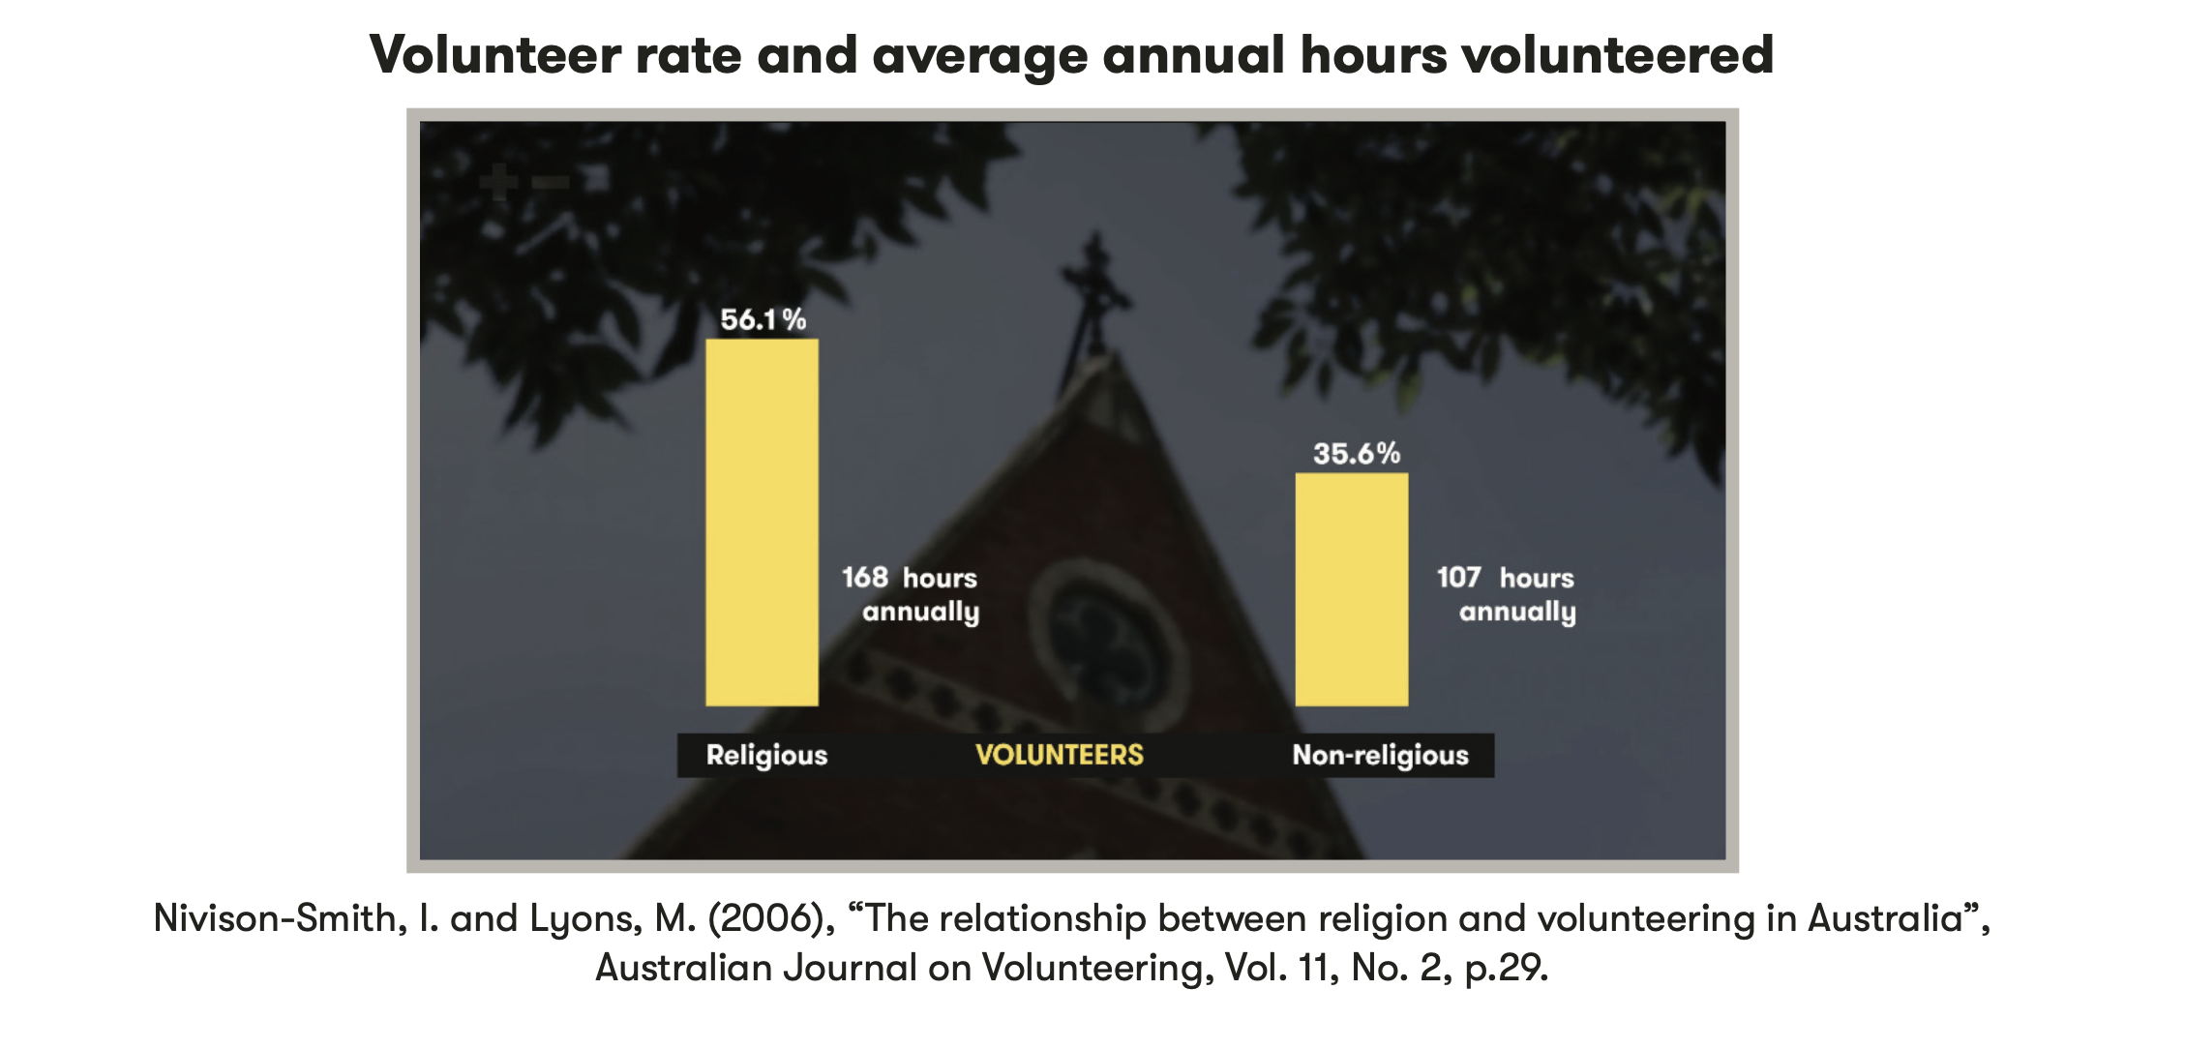
Notes:
Table Template (these are just images from existing units of work)

Slide 14
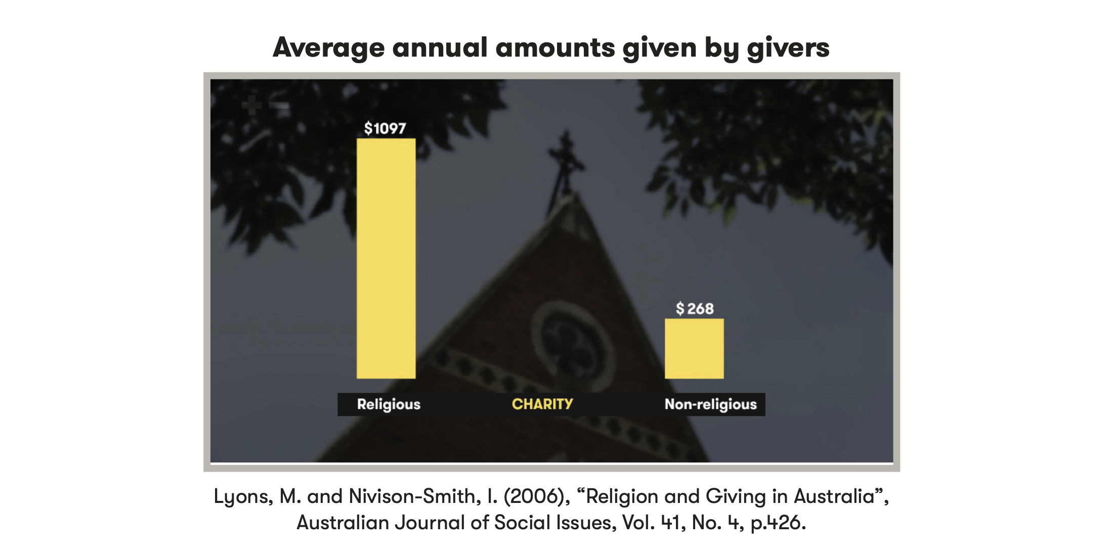
Notes:
Table Template (these are just images from existing units of work)

Slide 15
³⁷ ‘Then the righteous will answer him, “Lord, when did we see you hungry and feed you, or thirsty and give you something to drink? ³⁸ When did we see you a stranger and invite you in, or needing clothes and clothe you? ³⁹ When did we see you ill or in prison and go to visit you?”
⁴⁰ ‘The King will reply, “Truly I tell you, whatever you did for one of the least of these brothers and sisters of mine, you did for me.”
MATTHEW 25 (NIV)
Notes:
Large Bible passage

Slide 16
Dear friends, do you think you’ll get anywhere in this if you learn all the right words but never do anything? Does merely talking about faith indicate that a person really has it? For instance, you come upon an old friend dressed in rags and half-starved and say, “Good morning, friend! Be clothed in Christ! Be filled with the Holy Spirit!” and walk off without providing so much as a coat or a cup of soup – where does that get you? Isn’t it obvious that God-talk without God-acts is outrageous nonsense?
JAMES 2.14-17 (MSG)
Notes:
Large Bible passage

Slide 17
  DISCUSSION QUESTIONS:
  Why does the author say that faith without action is not enough?
Notes:
Brief discussion questions

Slide 18
  DISCUSSION QUESTIONS:
  Why does the author say that faith without action is not enough?
  How should those who take this Bible passage seriously treat people in need?
Notes:
Brief discussion questions

Slide 19
  DISCUSSION QUESTIONS:
  Why does the author say that faith without action is not enough?
  How should those who take this Bible passage seriously treat people in need?
  How could these passages, and other Christian teachings about helping those in need, contribute to the common good?
Notes:
Brief discussion questions

Slide 20
‘Social Capital’
Notes:
Statement or Discussion Question

Slide 21
Notes:
Holding/Final slide

Slide 22
Notes:
Holding/Final slide

