Slide 1

THE CHURCH UNDER
NAZI RULE
For the Love of God
Notes:
Title with Subtitle

Slide 2

  DISCUSSION QUESTIONS:
  Do you associate Jesus Christ more with power or with humility?
Notes:
Large discussion questions

Slide 3
  DISCUSSION QUESTIONS:
  Do you associate Jesus Christ more with power or with humility?
  Do you think Christians/the church are overall more concerned with gaining and maintaining power, or with humbly serving others? What reasons do you have for your answer?
Notes:
Large discussion questions

Slide 4
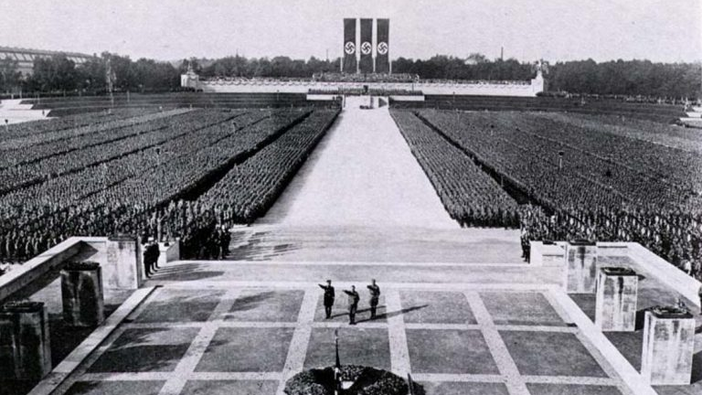
Notes:
Image for activity

Slide 5
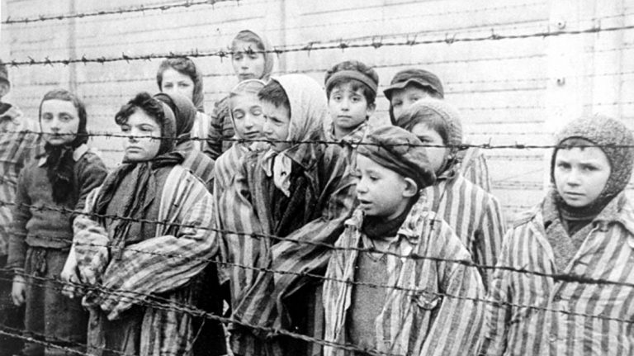
Notes:
Image for activity

Slide 6
Notes:
Holding/Final slide

Slide 7
  DISCUSSION QUESTIONS:
  Do you associate Jesus Christ more with power or with humility?
  Do you think Christians/the church are overall more concerned with gaining and maintaining power, or with humbly serving others? What reasons do you have for your answer?
  Have you ever felt that you or a group that you were a part of was being persecuted? How did you feel?
Notes:
Large discussion questions

Slide 8
  DISCUSSION QUESTIONS:
  Do you associate Jesus Christ more with power or with humility?
  Do you think Christians/the church are overall more concerned with gaining and maintaining power, or with humbly serving others? What reasons do you have for your answer?
  Have you ever felt that you or a group that you were a part of was being persecuted? How did you feel?
  What’s the bravest thing you have ever done? Why did you make the decision to do it, instead of taking the easier/safer/less scary option?
Notes:
Large discussion questions

Slide 9
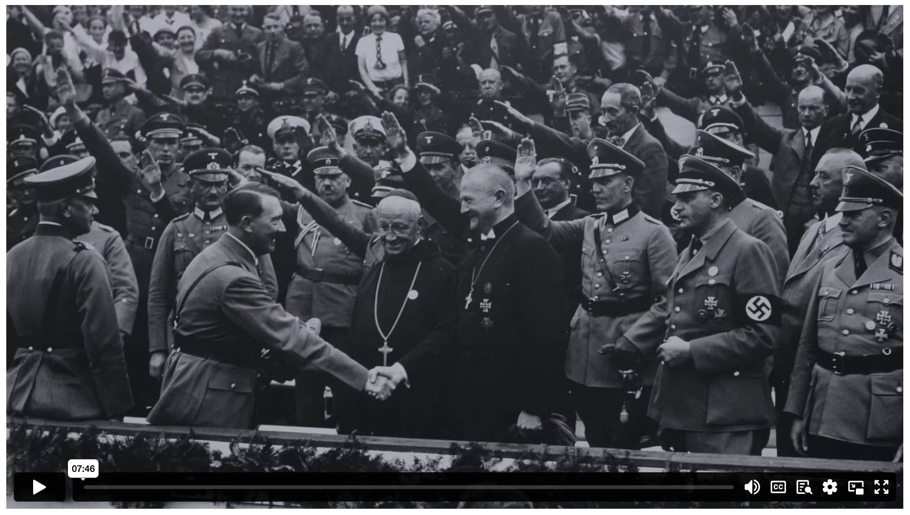
THE CHURCH UNDER NAZI RULE
Notes:
Holding/Final slide

Slide 10
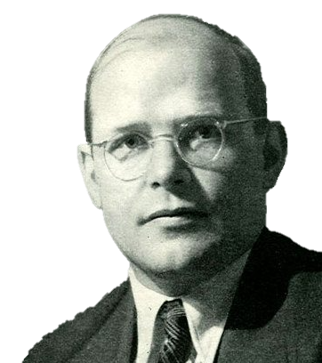
We are not simply to bandage the wounds of victims beneath the wheels of injustice, we are to drive a spoke into the wheel itself.
The church is the church only when it exists for others.
When Jesus calls us, he bids us come and die.
Mere waiting and looking is not Christian behaviour. Christians are called to sympathy and action.
This is the end. For me, the beginning of life.
DIETRICH BONHOEFFER
Notes:
Existing quote images

Slide 11
³⁵ Then James and John, the sons of Zebedee, came to him. ‘Teacher,’ they said, ‘we want you to do for us whatever we ask.’
³⁶ ‘What do you want me to do for you?’ he asked.
³⁷ They replied, ‘Let one of us sit at your right and the other at your left in your glory.’
³⁸ ‘You don’t know what you are asking,’ Jesus said. ‘Can you drink the cup I drink or be baptised with the baptism I am baptised with?’
³⁹ ‘We can,’ they answered.
Jesus said to them, ‘You will drink the cup I drink and be baptised with the baptism I am baptised with, ⁴⁰ but to sit at my right or left is not for me to grant. These places belong to those for whom they have been prepared.’
MARK 10 (NIV)
Notes:
Large Bible passage

Slide 12
⁴¹ When the ten heard about this, they became indignant with James and John. ⁴² Jesus called them together and said, ‘You know that those who are regarded as rulers of the Gentiles lord it over them, and their high officials exercise authority over them. ⁴³ Not so with you. Instead, whoever wants to become great among you must be your servant, ⁴⁴ and whoever wants to be first must be slave of all. ⁴⁵ For even the Son of Man did not come to be served, but to serve, and to give his life as a ransom for many.’
MARK 10 (NIV)
Notes:
Large Bible passage

Slide 13
Jesus:
“²³Then he said to the crowd, “If any of you wants to be my follower, you must give up your own way, take up your cross daily, and follow me. ²⁴If you try to hang on to your life, you will lose it. But if you give up your life for my sake, you will save it.”
LUKE 9 (NLT)
Notes:
Large Bible passage

Slide 14
Notes:
Holding/Final slide

Slide 15
Notes:
Holding/Final slide

