Slide 1

MISSIONARY LEGACY
For the Love of God
How Missionaries Changed the World
Notes:
Title with Subtitle

Slide 2


Notes:
Table Template (these are just images from existing units of work)

Slide 3
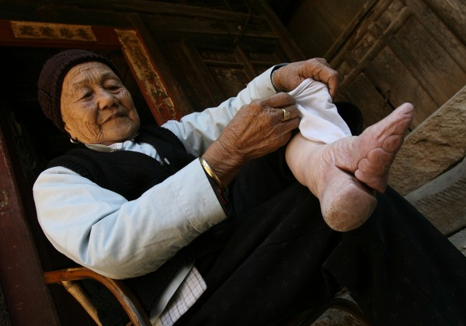
FOOT BINDING
Chinese Foot Binding(5) by John C Bullas available at https://www.flickr.com/photos/johnbullas/501815667 under a Creative Commons BY-NC-ND 2.0 Licence. Full terms at https://creativecommons.org/licenses/by-nc-nd/2.0/.
Notes:
Image for activity

Slide 4
Should we respect and preserve all cultural traditions?
Notes:
Statement or Discussion Question

Slide 5
Missionaries
Notes:
Statement or Discussion Question

Slide 6
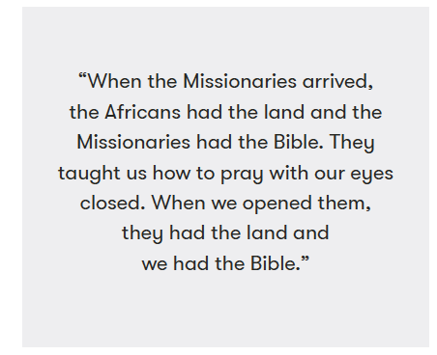
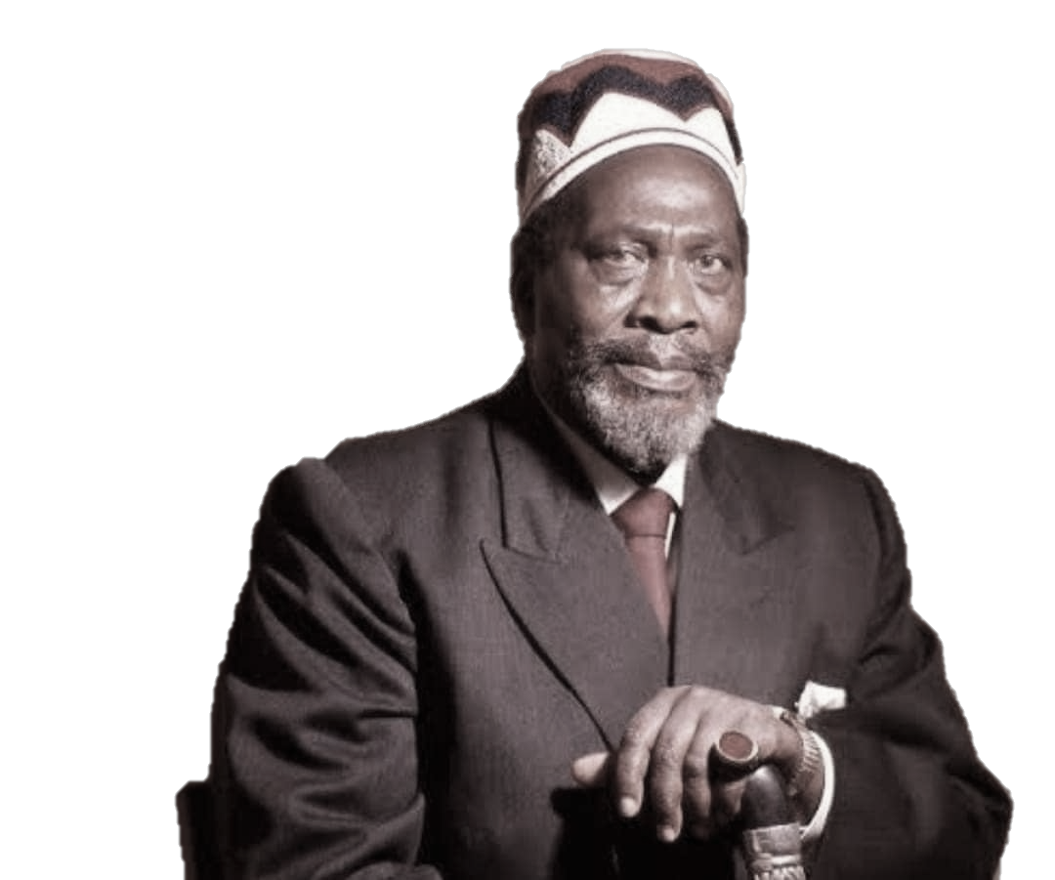
Jomo Kenyatta was a Kenyan
anti-colonial activist and politician who became the first President of Kenya. He played a key role in Kenya's struggle for independence from Britain.
Notes:
Existing quote images

Slide 7
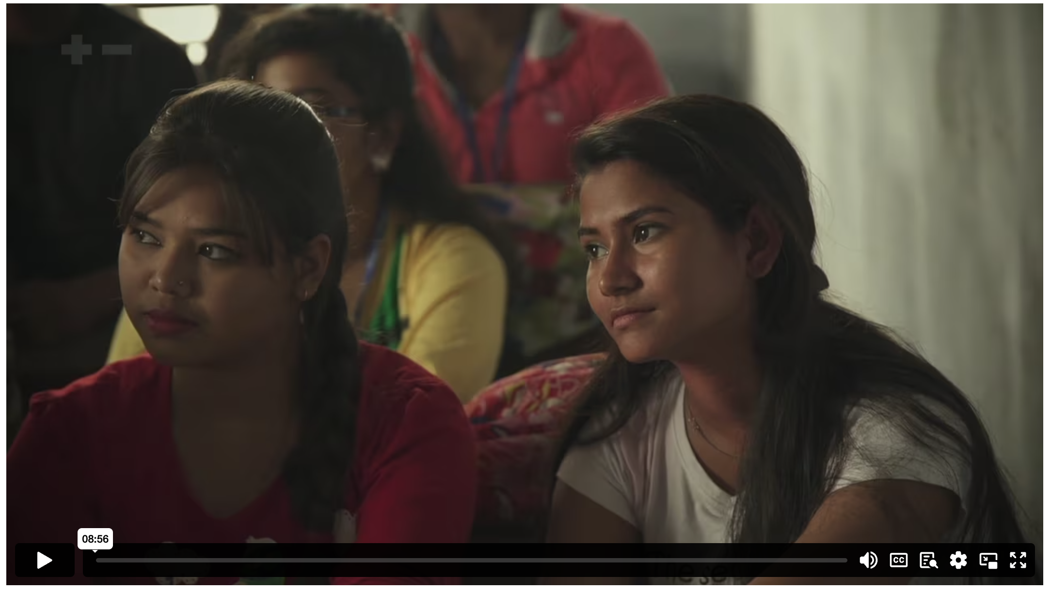
HOW MISSIONARIES CHANGED THE WORLD
Notes:
Holding/Final slide

Slide 8
Did William Carey have the right to challenge the Indian practice of ‘Sati’?
Notes:
Statement or Discussion Question

Slide 9
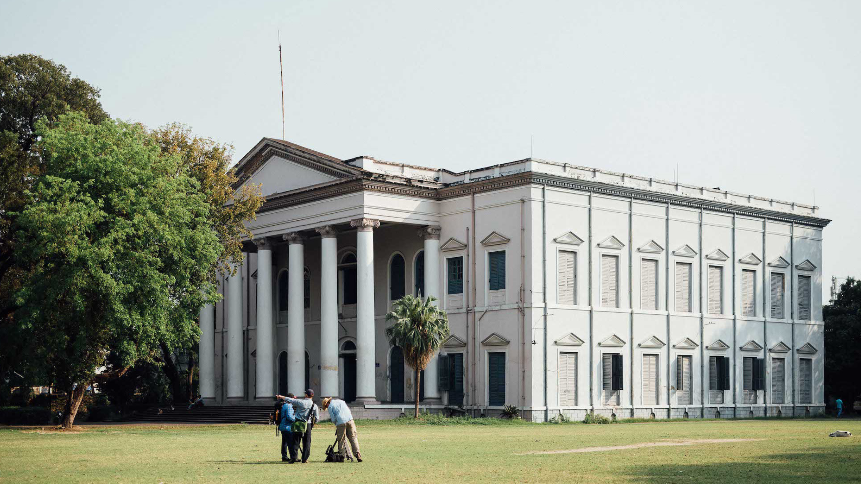
SERAMPORE COLLEGE
Notes:
Holding/Final slide

Slide 10
¹ You know, brothers and sisters, that our visit to you was not without results. ² We had previously suffered and been treated outrageously in Philippi, as you know, but with the help of our God we dared to tell you his gospel in the face of strong opposition. ³ For the appeal we make does not spring from error or impure motives, nor are we trying to trick you. ⁴ On the contrary, we speak as those approved by God to be entrusted with the gospel. We are not trying to please people but God, who tests our hearts. ⁵ You know we never used flattery, nor did we put on a mask to cover up greed – God is our witness. ⁶ We were not looking for praise from people, not from you or anyone else, even though as apostles of Christ we could have asserted our authority. ⁷ Instead, we were like young children among you.
1 THESSALONIANS 2 (NIV)
Notes:
Large Bible passage

Slide 11
Just as a nursing mother cares for her children, ⁸ so we cared for you. Because we loved you so much, we were delighted to share with you not only the gospel of God but our lives as well. ⁹ Surely you remember, brothers and sisters, our toil and hardship; we worked night and day in order not to be a burden to anyone while we preached the gospel of God to you. ¹⁰ You are witnesses, and so is God, of how holy, righteous and blameless we were among you who believed. ¹¹ For you know that we dealt with each of you as a father deals with his own children, ¹² encouraging, comforting and urging you to live lives worthy of God, who calls you into his kingdom and glory.
1 THESSALONIANS 2 (NIV)
Notes:
Large Bible passage

Slide 12
Notes:
Holding/Final slide

Slide 13
Notes:
Holding/Final slide

