Slide 1

‘HOW TO JUDGE THE CHURCH’
For the Love of God
A Musical Analogy
Notes:
Title with Subtitle

Slide 2
Is it right to judge a religion on the basis of how its adherents behave?
Notes:
Statement or Discussion Question

Slide 3
Notes:
Holding/Final slide

Slide 4
Should we judge the quality of a song based on a bad performance?
Notes:
Statement or Discussion Question

Slide 5
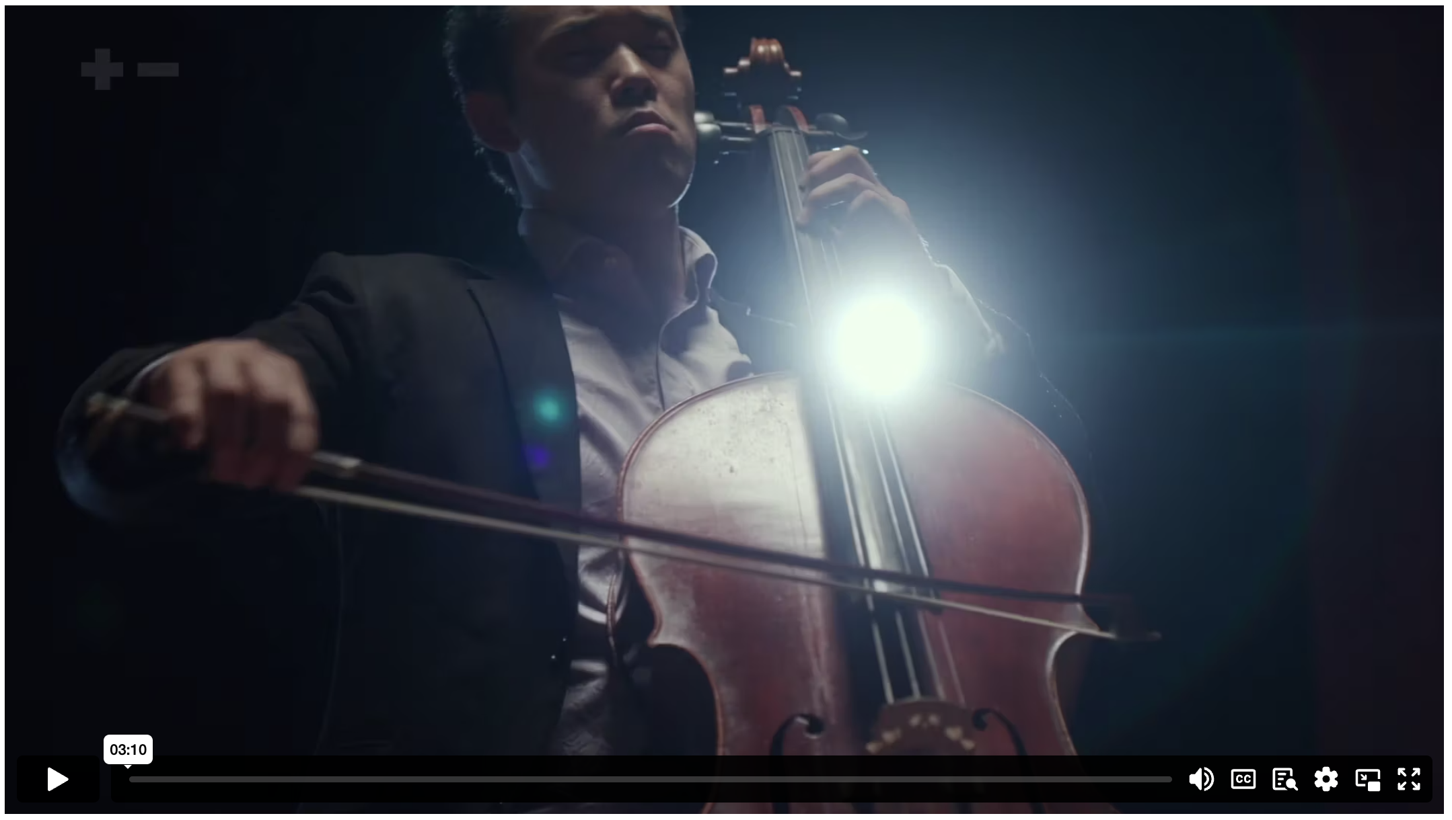
HOW TO JUDGE THE CHURCH
Notes:
Content Clip for this lesson

Slide 6
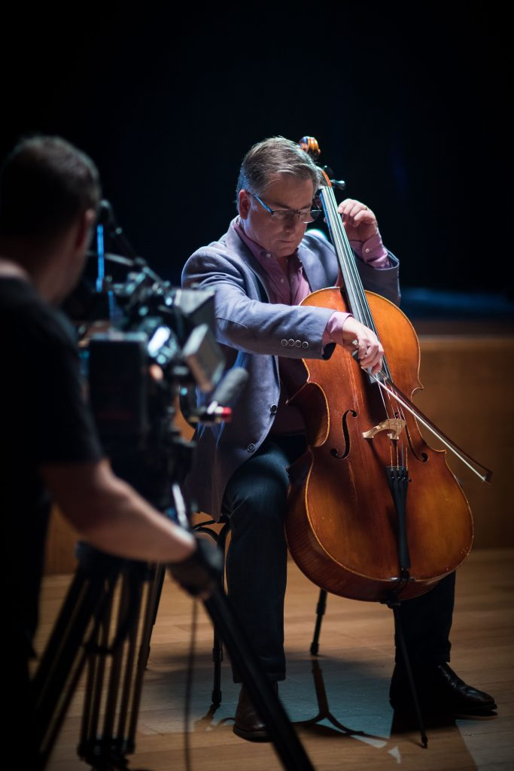
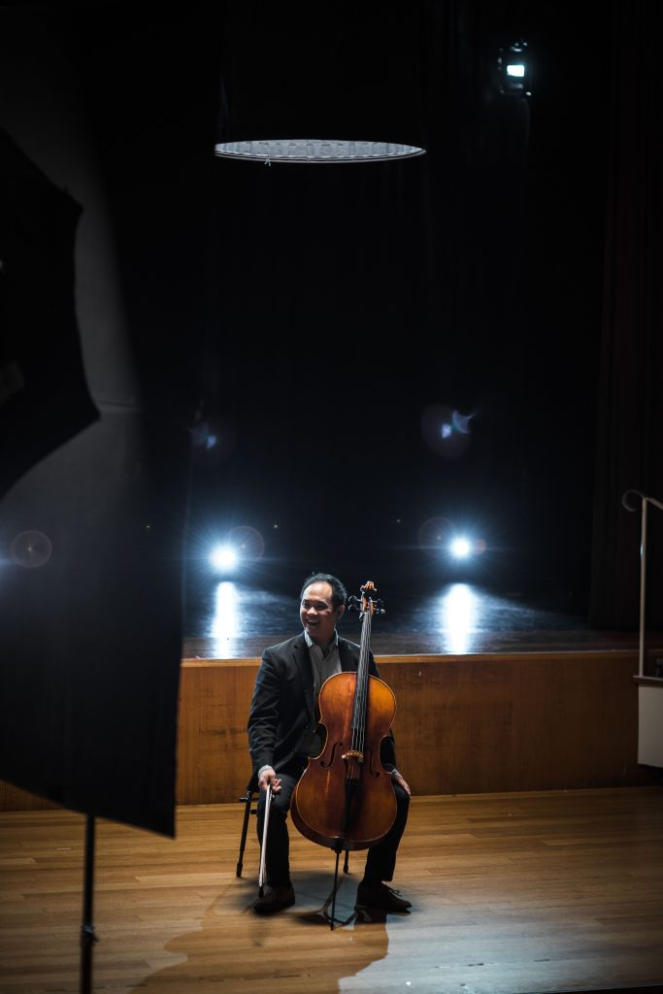
Compare & Contrast
Notes:
Content Clip for this lesson

Slide 7


Christianity’s… ethic of love has given us much of what we value most in the world today.
JOHN DICKSON
Notes:
Quote

Slide 8

Pineapple should never be found on Pizza
Agree
Disagree
Notes:
Human Barometer Activity intro slide – delete the slides you don’t want

Slide 9
You can’t call chess
a sport
Agree
Disagree
Notes:
Human Barometer Activity intro slide – delete the slides you don’t want

Slide 10
The moon landing never really happened
Agree
Disagree
Notes:
Human Barometer Activity intro slide – delete the slides you don’t want

Slide 11
Marvel movies are an insult to our intelligence.
Agree
Disagree
Notes:
Human Barometer Activity intro slide – delete the slides you don’t want

Slide 12
Jesus Christ shouldn’t be dismissed on account of his followers’ sins
Agree
Disagree
Notes:
Human Barometer Activity Slides – add any text here (statements not questions)

Slide 13
Christianity loses credibility when Jesus’ followers behave badly
Agree
Disagree
Notes:
Human Barometer Activity Slides – add any text here (statements not questions)

Slide 14
Christians should behave better than non-Christians
Agree
Disagree
Notes:
Human Barometer Activity Slides – add any text here (statements not questions)

Slide 15
Jesus:
“²⁷ ‘But to you who are listening I say: love your enemies, do good to those who hate you, ²⁸ bless those who curse you, pray for those who ill-treat you. ²⁹ If someone slaps you on one cheek, turn to them the other also. If someone takes your coat, do not withhold your shirt from them. ³⁰ Give to everyone who asks you, and if anyone takes what belongs to you, do not demand it back. ³¹ Do to others as you would have them do to you.
LUKE 6 (NIV)
Notes:
Large Bible passage

Slide 16
Jesus:
“¹⁹ Don't store up treasures on earth! Moths and rust can destroy them, and thieves can break in and steal them. ²⁰ Instead, store up your treasures in heaven, where moths and rust cannot destroy them, and thieves cannot break in and steal them. ²¹ Your heart will always be where your treasure is.”
MATTHEW 6 (CEV)
Notes:
Large Bible passage

Slide 17
Jesus:
¹ Then Jesus said to the crowds and to his disciples, ² “The teachers of religious law and the Pharisees are the official interpreters of the law of Moses. ³ So practice and obey whatever they tell you, but don’t follow their example. For they don’t practice what they teach. ⁴ They crush people with unbearable religious demands and never lift a finger to ease the burden.
⁵ “Everything they do is for show. On their arms they wear extra wide prayer boxes with Scripture verses inside, and they wear robes with extra long tassels. ⁶ And they love to sit at the head table at banquets and in the seats of honour in the synagogues. ⁷ They love to receive respectful greetings as they walk in the marketplaces, and to be called ‘Rabbi.’
MATTHEW 23 (NLT)
Notes:
Large Bible passage

Slide 18
⁸ “Don’t let anyone call you ‘Rabbi,’ for you have only one teacher, and all of you are equal as brothers and sisters. ⁹ And don’t address anyone here on earth as ‘Father,’ for only God in heaven is your Father. ¹⁰ And don’t let anyone call you ‘Teacher,’ for you have only one teacher, the Messiah. ¹¹ The greatest among you must be a servant. ¹² But those who exalt themselves will be humbled, and those who humble themselves will be exalted.
MATTHEW 23 (NLT)
Notes:
Large Bible passage

Slide 19

Comment from “Mitor the Bold” in response to one of the Centre for Public Christianity’s articles.
Notes:
Existing quote images

Slide 20
Notes:
Holding/Final slide

Slide 21
Notes:
Holding/Final slide

