Slide 1

THE GOOD SAMARITAN
For the Love of God
Notes:
Large Title

Slide 2

Pineapple should never be found on Pizza
Bible verse goes here. Make the type smaller so it fits in this box.
Agree
Disagree
Notes:
Human Barometer Activity intro slide – delete the slides you don’t want

Slide 3
You can’t call chess
a sport
Bible verse goes here. Make the type smaller so it fits in this box.
Agree
Disagree
Notes:
Human Barometer Activity intro slide – delete the slides you don’t want

Slide 4
The moon landing never really happened
Bible verse goes here. Make the type smaller so it fits in this box.
Agree
Disagree
Notes:
Human Barometer Activity intro slide – delete the slides you don’t want

Slide 5
Marvel movies are an insult to our intelligence.
Bible verse goes here. Make the type smaller so it fits in this box.
Agree
Disagree
Notes:
Human Barometer Activity intro slide – delete the slides you don’t want

Slide 6
Caring for the needy is a responsibility that comes with wealth
Bible verse goes here. Make the type smaller so it fits in this box.
Agree
Disagree
Notes:
Human Barometer Activity – delete the slides you don’t want

Slide 7
A healthy society will always offer genuine care for the poor and needy
Bible verse goes here. Make the type smaller so it fits in this box.
Agree
Disagree
Notes:
Human Barometer Activity – delete the slides you don’t want

Slide 8
Jesus’ most significant teaching was that we should love and care for the needy
Bible verse goes here. Make the type smaller so it fits in this box.
Agree
Disagree
Notes:
Human Barometer Activity – delete the slides you don’t want

Slide 9
Religious people should spend more time helping people and less time talking about their religion
Bible verse goes here. Make the type smaller so it fits in this box.
Agree
Disagree
Notes:
Human Barometer Activity – delete the slides you don’t want

Slide 10
Notes:
Holding/Final slide

Slide 11
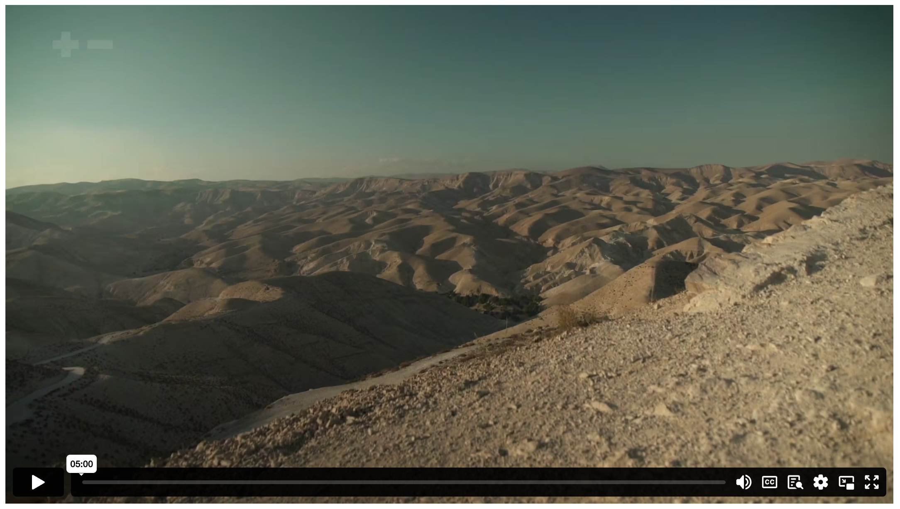
THE GOOD SAMARITAN
Notes:
Holding/Final slide

Slide 12
  DISCUSSION QUESTIONS:
  Why did Jesus make the Samaritan the hero of his story? What point was he making?
Notes:
Large discussion questions

Slide 13
  DISCUSSION QUESTIONS:
  Why did Jesus make the Samaritan the hero of his story? What point was he making?
  Describe how the parable of the Good Samaritan shaped the way the early church cared for the poor.
Notes:
Large discussion questions

Slide 14
  DISCUSSION QUESTIONS:
  Why did Jesus make the Samaritan the hero of his story? What point was he making?
  Describe how the parable of the Good Samaritan shaped the way the early church cared for the poor.
  What did Roman officials find in the basement of the church of Cirta? What might this show us about the priorities of the early church?
Notes:
Large discussion questions

Slide 15
  DISCUSSION QUESTIONS:
  Why did Jesus make the Samaritan the hero of his story? What point was he making?
  Describe how the parable of the Good Samaritan shaped the way the early church cared for the poor.
  What did Roman officials find in the basement of the church of Cirta? What might this show us about the priorities of the early church?
  Joel Edwards says that “added benefit to your neighbour” is an “essential feature of what Christian faith looks like”. Do you agree? Why or why not?
Notes:
Large discussion questions

Slide 16
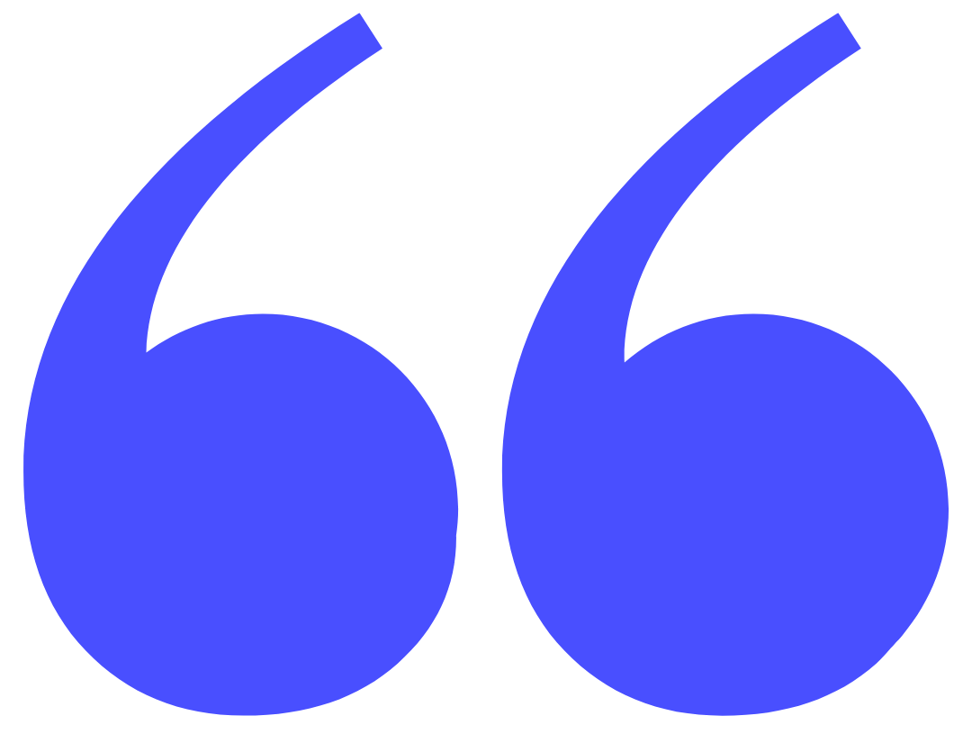
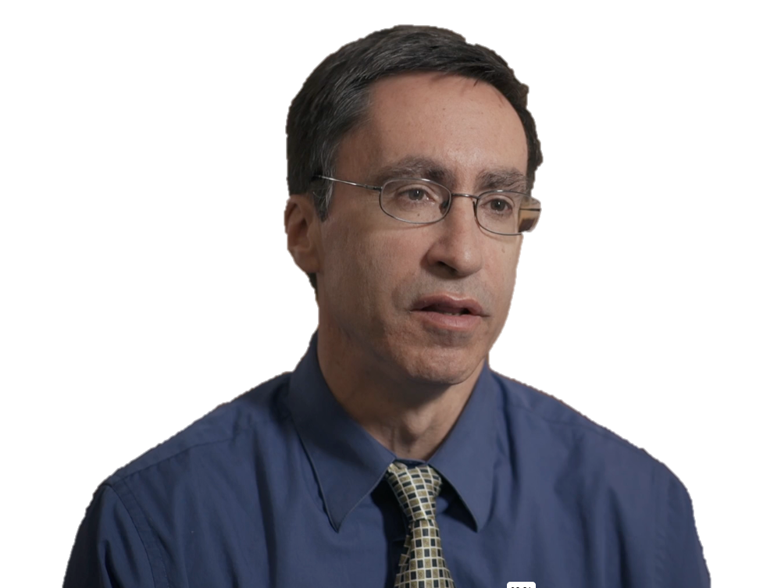
The best kind of care that the church has provided for the world is when it’s not out of power and it’s not worried about ruling, but more worried about being on the ground, taking care of the poor and vulnerable.
WILLIAM CAVANAUGH
Notes:
Quote

Slide 17
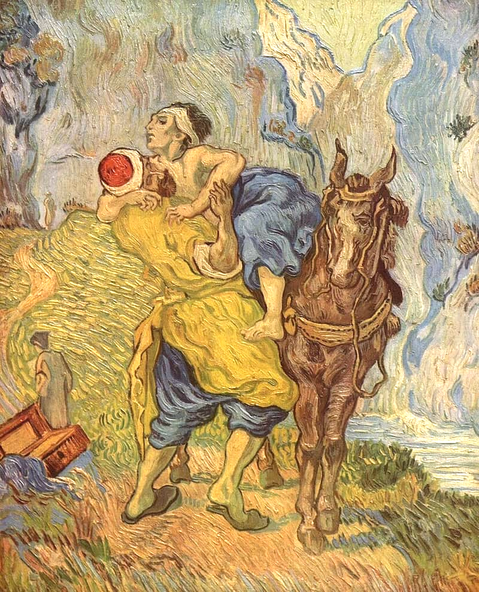
Vincent van Gogh (1890) The Good Samaritan
Notes:
Image for activity

Slide 18
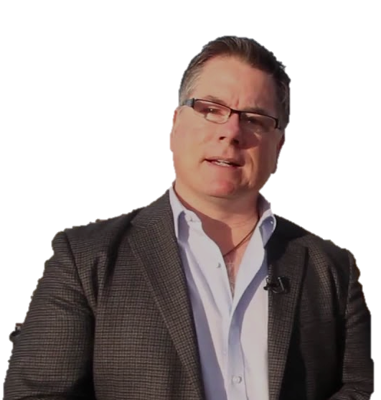
Jesus expected his followers to care for people in need, regardless of race, religion, or morality.
JOHN DICKSON
Notes:
Quote

Slide 19
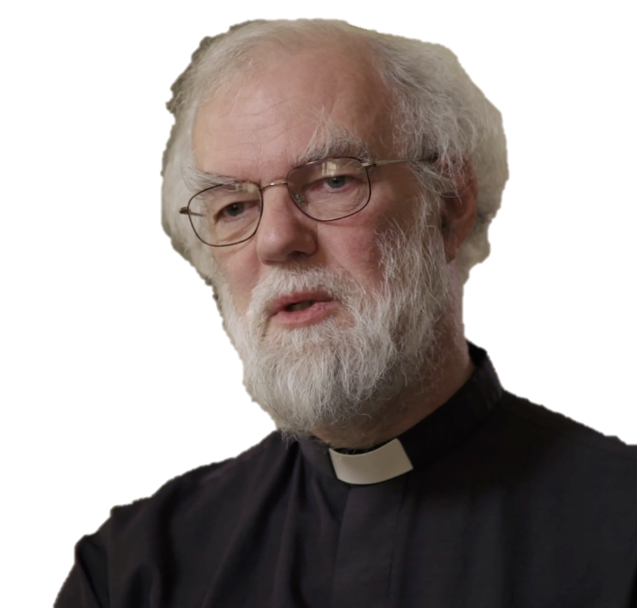
Looking out for the interests of the people who’ve been forgotten – and I think that’s actually one of the things that the church keeps coming back to one way and another. Who’s not here? Who’s not audible? Who’s not visible? They’re the people we need to be in touch with.
ROWAN WILLIAMS
Notes:
Quote

Slide 20
Notes:
Holding/Final slide

Slide 21
Notes:
Holding/Final slide

