Slide 1


THE
FREEDOM
TRAP

Slide 2

“Freedom means…”
THE FREEDOM TRAP

Slide 3
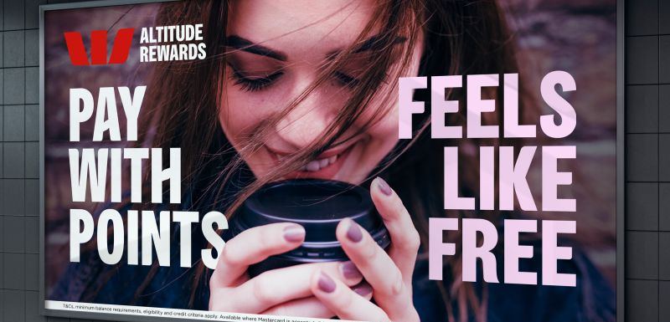
THE FREEDOM TRAP
Notes:
Westpac Billboard (Seen in Sydney – 2025)

Slide 4

INTRODUCING FREEDOM

Slide 5
  DISCUSSION QUESTIONS:
  What does freedom mean to you in your everyday life? (e.g. choices, rights, something deeper?)
  Why do you think people care so much about having freedom? (What makes it important or worth fighting for?)
  Where do you think the desire to be free comes from? (Are we born with it, or is it something we learn?)

Slide 6
What’s the best way to measure freedom?
THE FREEDOM TRAP

Slide 7
PERSONAL FREEDOM

Slide 8
  DISCUSSION QUESTIONS:
  Do you think having no limits would make life better or more stressful? (Does a life with no limits actually work in real life?)
  How good are we at knowing what will make us happy? (Can you think of a time you got it wrong?)
  Which personal freedoms matter most to you right now? (Do you have enough freedom in those areas, or do you want more?)

Slide 9
“True freedom means having no limits.”
THE FREEDOM TRAP
Notes:
In small groups students complete a Step Inside activity.
Allocate each group a character, students identify and share how each would respond to the statement.
(e.g. a teenager, a parent, a politician, an influencer, a judge, a sporting coach, a teacher, a police officer, a doctor etc.)

Slide 10
What superpower do you wish you had?
THE FREEDOM TRAP
Notes:
Discuss what students would do if they were ‘unlimited’.
Discuss which limits are good for us.

Slide 11
FREEDOM V. AUTONOMY

Slide 12
  DISCUSSION QUESTIONS:
  Why do we all want to “do things our own way”? (Where does our desire for autonomy come from?)
  What are some of the things that can go wrong when people purely focus on their own autonomy?
  Why is ‘autonomy’ a poor substitute for freedom? (How would you describe what true freedom should include?)
Notes:
Why do we all want to “do things our own way”? (Where does our desire for autonomy come from?)
What are some of the things that can go wrong when people just focus on their own autonomy?
Why is ‘autonomy’ a poor substitute for freedom?

Slide 13
THE
FREEDOM
TRAPS

Slide 14
TRAP #1

Slide 15
Have you ever felt overwhelmed by having too many options?
THE FREEDOM TRAP

Slide 16
“Decision Fatigue”
THE FREEDOM TRAP
Notes:
Definition = the mental exhaustion we feel after making too many decisions.

Slide 17
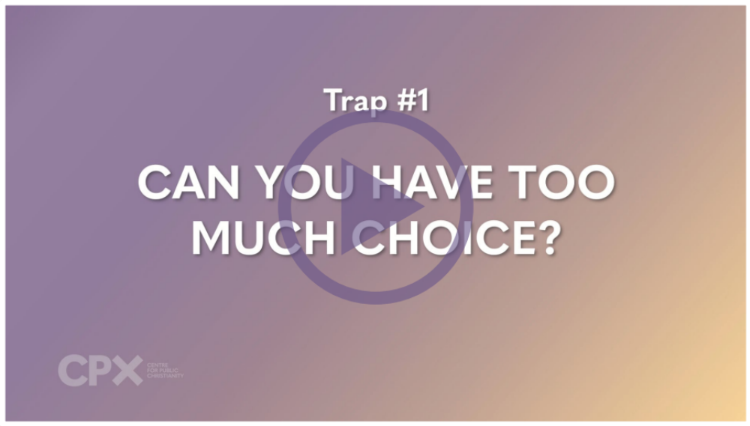
TRAP #1: TOO MUCH CHOICE

Slide 18
  DISCUSSION QUESTIONS:
  How much choice is too much?
  Why do we believe that more choices make us more free?
  What are some everyday examples of decision fatigue in your life?
  Can too much choice distract us from more meaningful decisions?

Slide 19
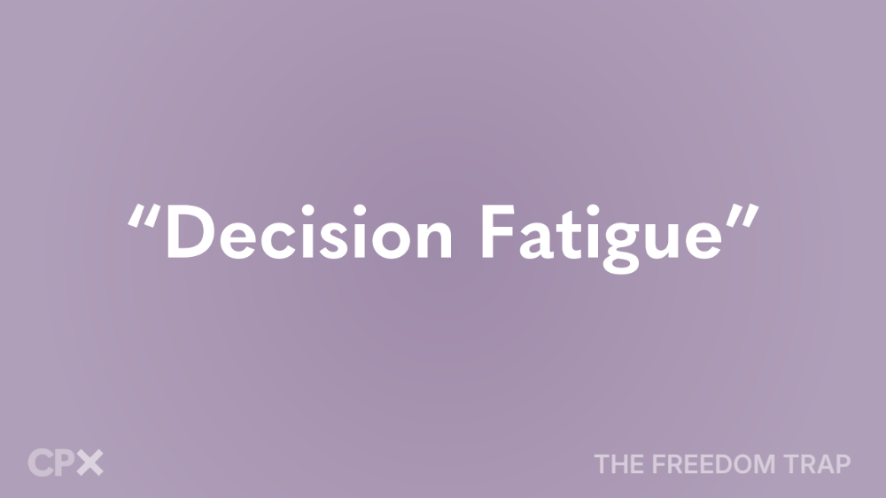

What is one area of your life where you could simplify your choices or habits to gain more clarity or peace?

Slide 20
TRAP #2

Slide 21
Have you ever said ‘yes’ to something and later regretted it because you missed out on something better?
THE FREEDOM TRAP
Notes:
Statement or Discussion Question

Slide 22
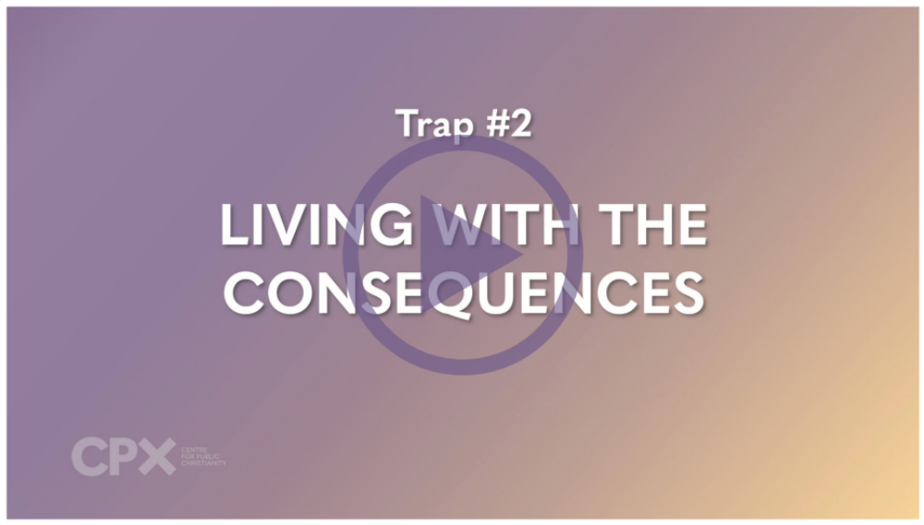
TRAP #2: LIVING WITH THE CONSEQUENCES

Slide 23
“Opportunity Cost”
THE FREEDOM TRAP
Notes:
Students write a definition in their own words.
Definition = what you give up or forego by choosing to do something.

Slide 24
  DISCUSSION QUESTIONS:
  How do we measure the true ‘cost’ of our choices? How do we evaluate the consequences?
  Why do some decisions feel “worth it” in the moment – but not later?
  Have any of your choices ended up having an unexpected impact? What happened?
  In what ways does our culture downplay or distract us from the real cost of our habits or lifestyles?

Slide 25
What is one decision
I could make more intentionally this week?
  (Journal Prompt)

Slide 26
 | COST | BENEFIT
USING SOCIAL MEDIA
GAMING
BUYING A NEW OUTFIT
STUDYING
Notes:
Students create a cost-benefit chart with a partner or in small groups around a common teen choice (e.g., social media use, gaming, overcommitment to work or sport, or buying trends etc.).
Students can choose one or more ’choices’ to evaluate.

Slide 27
TRAP #3

Slide 28
Can you think of a situation where someone’s freedom came at someone else’s expense?
  Think / Pair / Share
THE FREEDOM TRAP
Notes:
Statement or Discussion Question

Slide 29

TRAP #3: THE IMPACT ON OTHERS

Slide 30
  DISCUSSION QUESTIONS:
  In what ways should our freedom be limited for the good of others?
  Do you think humans are naturally selfish? Why or why not?
  Can you think of a time when someone’s choice affected you in a negative way?
  Have you ever made a choice that helped you, but ended up making things harder for someone else?

Slide 31
In what small way could you use your freedom this week to increase someone else’s freedom or wellbeing – not just your own?
  (Written Response)

Slide 32
“For you have been called to live in freedom, my brothers and sisters. But don’t use your freedom to satisfy your sinful nature.
Instead, use your freedom to serve one another in love.”
The Apostle Paul – Galatians 5.13 (NLT)
Notes:
Students to rewrite the verse in their own words, with a specific relationship in mind (family, friendship, work colleague or sporting team context etc.).

Slide 33
TRAP #4

Slide 34
Pineapple should never be found on Pizza
AGREE
DISAGREE
Notes:
Practice statements – use as many of these as the group needs.

Slide 35
You can’t call chess
a sport
AGREE
DISAGREE
Notes:
Practice statements – use as many of these as the group needs.

Slide 36
The moon landing never really happened
AGREE
DISAGREE
Notes:
Practice statements – use as many of these as the group needs.

Slide 37
Marvel movies are an insult to our intelligence
AGREE
DISAGREE
Notes:
Practice statements – use as many of these as the group needs.

Slide 38
Success is mainly about achieving good results, making money, or having good experiences
AGREE
DISAGREE
Notes:
Lesson Statements – use as many of these as are helpful

Slide 39
Most people my age feel pressure to “keep up” with others
AGREE
DISAGREE
Notes:
Lesson Statements – use as many of these as are helpful

Slide 40
People should be free to define success however they want
AGREE
DISAGREE
Notes:
Lesson Statements – use as many of these as are helpful

Slide 41
God offers a more meaningful
way to define success
than society does
AGREE
DISAGREE
Notes:
Lesson Statements – use as many of these as are helpful

Slide 42
Social media has made it
harder to feel successful.
AGREE
DISAGREE
Notes:
Lesson Statements – use as many of these as are helpful

Slide 43
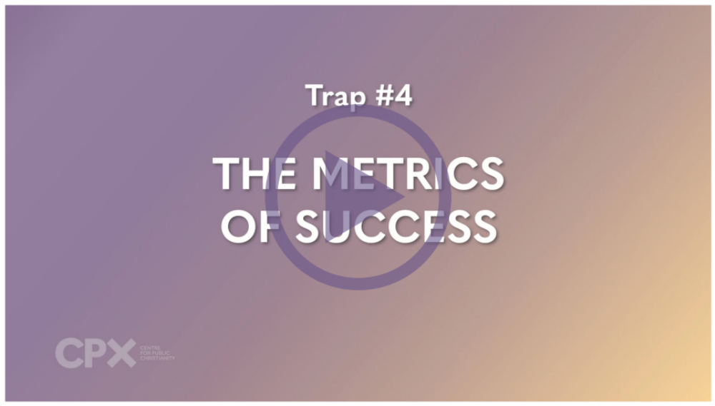
TRAP #4: THE METRICS OF SUCCESS

Slide 44
  DISCUSSION QUESTIONS:
  What are the healthiest measures of success?
  What are the most common ways success is measured in today’s world for young people?
  What do we lose when success is only measured by results or image?
  What’s the emotional or mental toll of constantly trying to “measure up”?

Slide 45

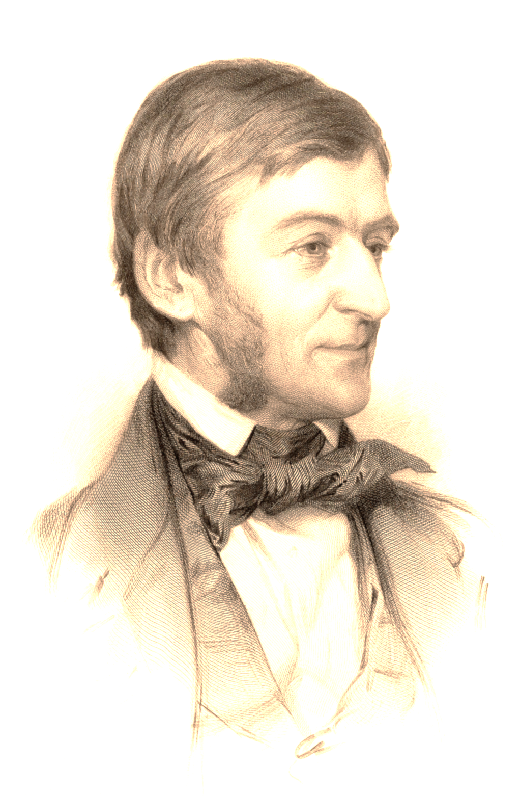
To laugh often and much:
to win the respect of intelligent people and the affection of children, to earn the appreciation of honest critics and endure the betrayal of false friends;
to appreciate beauty, to find the best in others, to leave the world a bit better whether by a healthy child, a garden patch, or a redeemed social condition;
to know even one life has breathed easier because you lived.
This is to have succeeded.
Ralph Waldo Emerson (1803–1802)
Notes:
Ralph Waldo Emerson (1803–1802)

Slide 46
I’m rethinking what success means to me because…
  (Journal Prompt)
Notes:
“I’m rethinking what success means to me because…”

Slide 47
TRAP #5

Slide 48
In what ways do technology and my devices make my life better?
In what ways do technology and my devices make my life worse?
  (Individual Reflection)
Notes:
“I’m rethinking what success means to me because…”

Slide 49
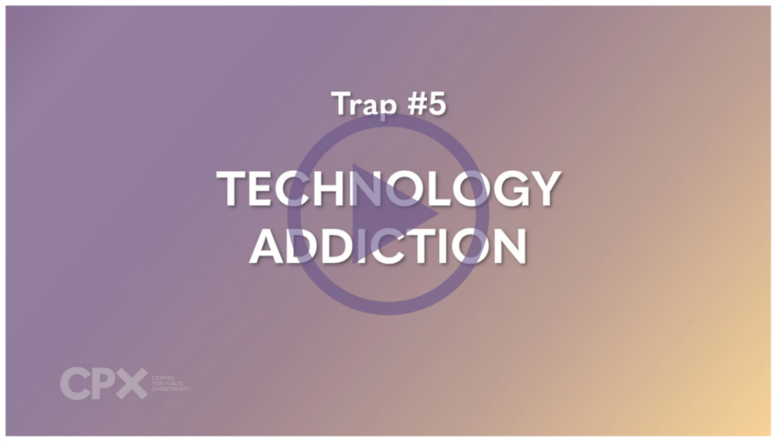
TRAP #5: TECHNOLOGY ADDICTION

Slide 50
  DISCUSSION QUESTIONS:
  How would you describe your relationship with technology?
  How do you think technology has changed the way we form and maintain relationships?
  How much of an impact has technology made on you? Your attention span, rest/sleep, creativity?
  What are your tips for “true freedom” in terms of using technology in a healthy way?

Slide 51
‘I have the right to do anything,’ you say – but not everything is beneficial. ‘I have the right to do anything’– but I will not be mastered by anything.
The Apostle Paul – 1 Corinthians 6.12 (NIVUK)
Notes:
Invite students to discuss how we are ‘mastered’ by our technology, and how we can make sure that we stay in charge of the technology in our lives.

Slide 52
THE
FREEDOM
TRAP

Slide 53
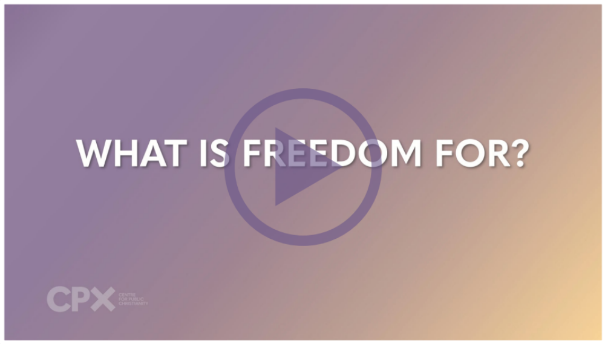
FREE OR FLOURISHING?

Slide 54
  DISCUSSION QUESTIONS:
  What does a good thriving life look like to you?
  What kinds of choices might you need to make, if you want to live a good life – not just a fun one?
  What kinds of ‘limits’ can be healthy for us? What boundaries do we need to flourish?

Slide 55
What does it mean to flourish?
  (Image Prompt Discussion)
THE FREEDOM TRAP

Slide 56
  (Reflective Journaling)
If I decided to use my freedom
to focus on truly flourishing,
what would I do differently?
THE FREEDOM TRAP

Slide 57
SO WHAT ARE WE HERE FOR?

Slide 58
  DISCUSSION QUESTIONS:
  Can you think of a time when putting others first helped you grow as a person?
  How could caring more about God or other people actually make your life feel more free or meaningful?
  Why do you think it's hard for us to focus on our relationship with God or care deeply about others sometimes? (What gets in the way?)

Slide 59

“Interestingly, however, the Christian message claims that God himself embraced limitations. He stepped into the world as a person, submitting himself to the human realities of hunger, thirst, pain, grief, loss, loneliness and, ultimately, death.
According to the Bible, whenever Jesus voluntarily embraced limits, he did so with a broader purpose in mind. He was playing the long game. It was more than mere humility. It was strategy. Strategy underpinned by purpose.” (p.83-84)
Notes:
Students reflect on why God would choose to embrace limits, and restrict his freedom, willingly.

Slide 60
³ Don’t be selfish; don’t try to impress others. Be humble, thinking of others as better than yourselves. ⁴ Don’t look out only for your own interests, but take an interest in others, too.
⁵ You must have the same attitude that Christ Jesus had.
⁶ Though he was God, he did not think of equality with God as something to cling to.
⁷ Instead, he gave up his divine privileges;
he took the humble position of a slave and was born as a human being.
When he appeared in human form, ⁸ he humbled himself in obedience to God
and died a criminal’s death on a cross.
⁹ Therefore, God elevated him to the place of highest honour
and gave him the name above all other names,
¹⁰ that at the name of Jesus every knee should bow,
in heaven and on earth and under the earth,
¹¹ and every tongue declare that Jesus Christ is Lord, to the glory of God the Father.
¹² Dear friends, you always followed my instructions when I was with you. And now that I am away, it is even more important. Work hard to show the results of your salvation, obeying God with deep reverence and fear. ¹³ For God is working in you, giving you the desire and the power to do what pleases him.
PHILIPPIANS 2 (NLT)
Notes:
Q: What does Paul identify as the motives behind an attitude of entitlement and autonomy? (v.3-4)
(Selfishness, ego validation/insecurity, pride, self-centredness)

Slide 61
³ Don’t be selfish; don’t try to impress others. Be humble, thinking of others as better than yourselves. ⁴ Don’t look out only for your own interests, but take an interest in others, too.
⁵ You must have the same attitude that Christ Jesus had.
⁶ Though he was God, he did not think of equality with God as something to cling to.
⁷ Instead, he gave up his divine privileges;
he took the humble position of a slave and was born as a human being.
When he appeared in human form, ⁸ he humbled himself in obedience to God
and died a criminal’s death on a cross.
⁹ Therefore, God elevated him to the place of highest honour
and gave him the name above all other names,
¹⁰ that at the name of Jesus every knee should bow,
in heaven and on earth and under the earth,
¹¹ and every tongue declare that Jesus Christ is Lord, to the glory of God the Father.
¹² Dear friends, you always followed my instructions when I was with you. And now that I am away, it is even more important. Work hard to show the results of your salvation, obeying God with deep reverence and fear. ¹³ For God is working in you, giving you the desire and the power to do what pleases him.
PHILIPPIANS 2 (NLT)
Notes:
Q: How would you describe Jesus’ attitude to his personal ‘freedom’ and rights? (v.6-8)

Slide 62
³ Don’t be selfish; don’t try to impress others. Be humble, thinking of others as better than yourselves. ⁴ Don’t look out only for your own interests, but take an interest in others, too.
⁵ You must have the same attitude that Christ Jesus had.
⁶ Though he was God, he did not think of equality with God as something to cling to.
⁷ Instead, he gave up his divine privileges;
he took the humble position of a slave and was born as a human being.
When he appeared in human form, ⁸ he humbled himself in obedience to God
and died a criminal’s death on a cross.
⁹ Therefore, God elevated him to the place of highest honour
and gave him the name above all other names,
¹⁰ that at the name of Jesus every knee should bow,
in heaven and on earth and under the earth,
¹¹ and every tongue declare that Jesus Christ is Lord, to the glory of God the Father.
¹² Dear friends, you always followed my instructions when I was with you. And now that I am away, it is even more important. Work hard to show the results of your salvation, obeying God with deep reverence and fear. ¹³ For God is working in you, giving you the desire and the power to do what pleases him.
PHILIPPIANS 2 (NLT)
Notes:
Q: What does v.13 say is the true source of freedom?
Q: In what ways does this passage challenge how people today usually think about freedom, success, and identity?

Slide 63

SLOW DOWN & PAY ATTENTION

Slide 64
  – Reflective Journaling –
Who do you admire for how they use their time and money?
What do they do that you respect?
THE FREEDOM TRAP

Slide 65
  – Reflective Journaling –
When was the last time you fully relaxed and took a complete break?
What did it look like?
THE FREEDOM TRAP

Slide 66
  – Reflective Journaling –
What is one small change that I could make this week, to be more present and available to my friends and family?
THE FREEDOM TRAP

Slide 67
LIMIT CHOICE FOR A SIMPLER LIFE

Slide 68
What would a simpler life look like?
  (Image Prompt Discussion)
THE FREEDOM TRAP

Slide 69
  DISCUSSION QUESTIONS:
  What choices in your life have you found to be the most overwhelming at times?
  Who inspires you with their simpler approach to life? What do they seem to value?
  Why do you think we fill up our lives with so many activities and distractions?
  If you only had capacity to do one thing this week, what would be your priority?
  What three things could you do to make your life simpler?

Slide 70
BEING KIND

Slide 71
  DISCUSSION QUESTIONS:
  What makes something kind?
  Who is the kindest person you know? What makes them stand out?
  If someone looked at your life this week, what do you think they would rate your kindness our of 10?
  What gets in the way of us being able to (or even wanting to) be kind and loving to others?

Slide 72
INVESTING IN RELATIONSHIPS

Slide 73
  DISCUSSION QUESTIONS:
  Can you think of a time when putting others first helped you grow as a person?
  How could caring more about God or other people actually make your life feel more free or meaningful?
  Why do you think it's hard for us to focus on our relationship with God or care deeply about others sometimes? (What gets in the way?)

Slide 74
THE
FREEDOM
TRAP

Slide 76
Scripture quotations marked (CEV) are from the Contemporary English Version Copyright © 1991, 1992, 1995 by American Bible Society. Used by Permission.
Scripture quotations marked (ESV) are from the ESV® Bible (The Holy Bible, English Standard Version®), © 2001 by Crossway, a publishing ministry of Good News Publishers. Used by permission. All rights reserved.
Scripture quotations marked (MSG) are taken from The Message, copyright © 1993, 2002, 2018 by Eugene H. Peterson. Used by permission of NavPress. All rights reserved. Represented by Tyndale House Publishers.
Scripture quotations marked (NIV) are taken from the Holy Bible, New International Version®, NIV®. Copyright © 1973, 1978, 1984, 2011 by Biblica, Inc.™ Used by permission of Zondervan. All rights reserved worldwide.
Scripture quotations marked (NIVUK) are taken from the Holy Bible, New International Version® Anglicized, NIV® Copyright © 1979, 1984, 2011 by Biblica, Inc.® Used by permission of Zondervan. All rights reserved worldwide.
Scripture quotations marked (NLT) are taken from the Holy Bible, New Living Translation, copyright ©1996, 2004, 2015 by Tyndale House Foundation. Used by permission of Tyndale House Publishers, Carol Stream, Illinois 60188. All rights reserved.
THE FREEDOM TRAP
Notes:
Bible Translation Copyright Credits

Slide 77


